Slide 1
Nuclear Fuel Performance
NE-533
Spring 2026

Slide 2
Last time

Slide 3
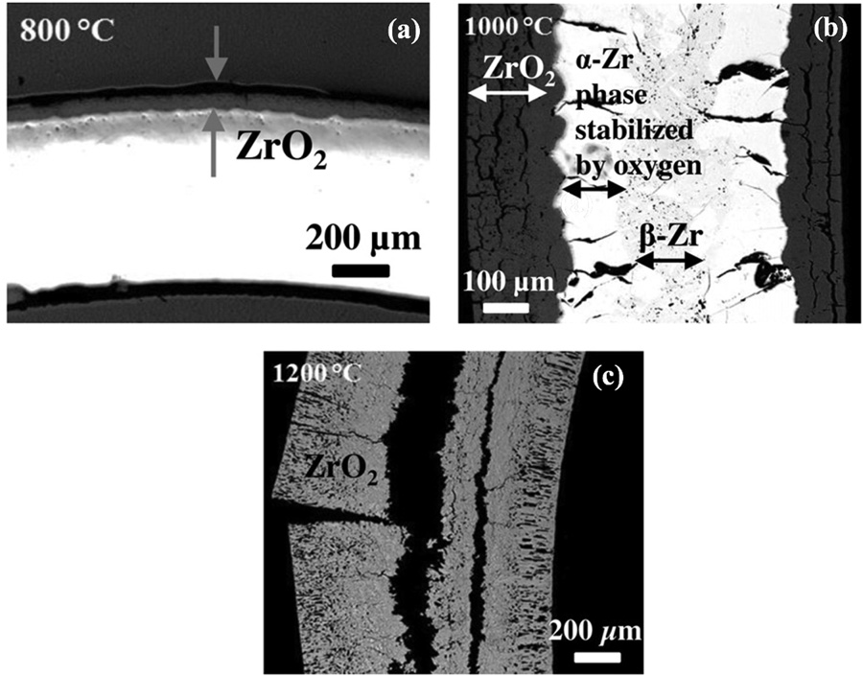
Steam Oxidation
Right is an image of Zircaloy-2 after steam oxidation for 8 hours at a) 800 C, b) 1000 C, c) 1200 C
At 800C, the oxide layer is intact and passivating
At higher temperatures, the oxide layer is thicker and cracked
At 1200C, everything has been oxidized

Slide 4
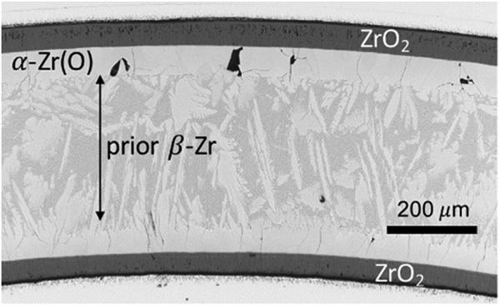
High T Phase Transition
alpha Zr can phase transform to beta Zr at 863 C
With high O content, this leads to a beta phase matrix with oxygen-stabilized alpha Zr closest to the oxide/metal interface
This stabilized alpha phase contributes to the brittle failure behavior

Slide 5
Hydride Embrittlement
We have already covered this
Hydrogen produced in oxidation and radiolysis can be picked up by the cladding, producing hydrides which can embrittle the cladding
More oxidation = more hydrogen = more embrittlement

Slide 6
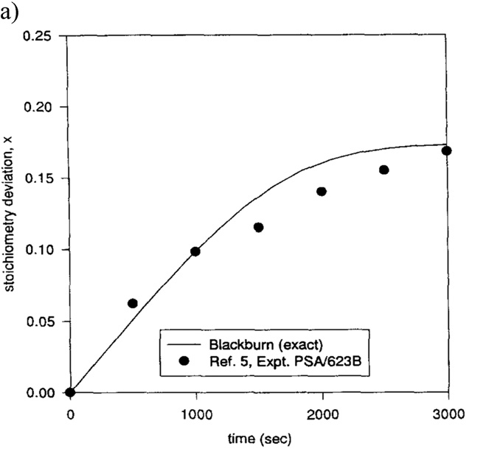
Fuel oxidation
UO2 is chemically inert in water, with a positive Gibbs free energy to form U3O8 or U4O9 compounds
The oxidation of UO2 is a dissolution reaction of water on the surface, freeing O to diffuse into UO2, making UO2+x, and producing H in the coolant

Slide 7
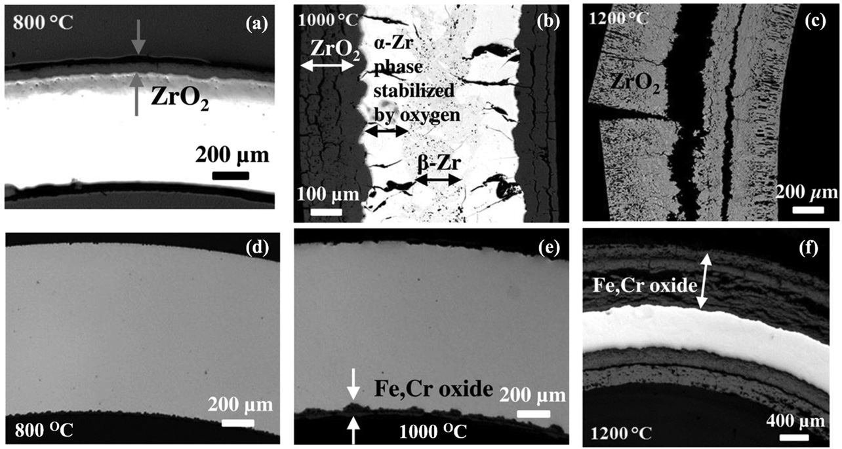
Advanced Cladding Materials
Fe-Cr or Fe-Cr-Al alloys display significantly improved oxidation resistance compared to Zr alloys
Fe-Cr can still form oxides which are not protective at 1200 C
Fe-Cr-Al alloys form an Al2O3 layer with enhanced stability compared to ZrO2, FeO2, or Cr2O3
SiC cladding can display even better oxidation resistance

Slide 8
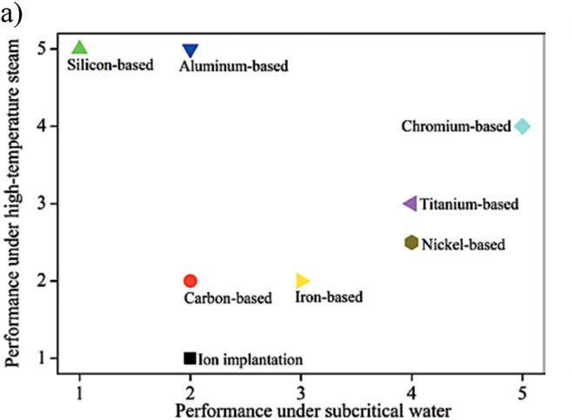
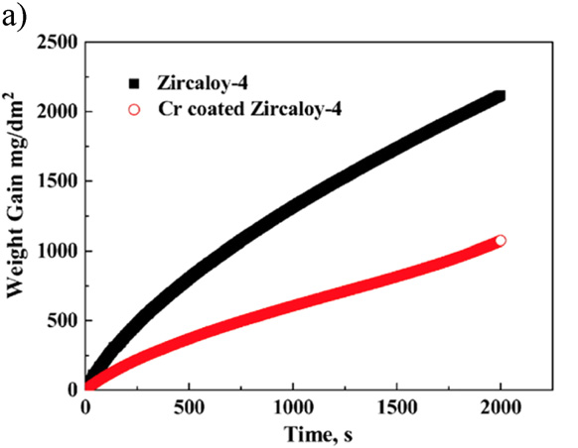
Coatings
The development of advanced coatings to enhance the accident tolerance by providing a barrier to steam attack of the underlying Zr
Different coatings with different fabrication methods have been explored
Cr coating has shown success in improving Zr cladding performance up to 1000 C
Behavior under 1200 C steam has shown little improvement

Slide 9
Summary
Steam oxidation behavior is critical for safe operation during an accident
Breakaway oxidation can occur, leading to thick, cracked oxides and high H generation
Zr phase transformations are indicative of high temperatures, and lead to further embrittlement of the cladding
Fuel oxidation of UO2 is largely not a concern, but can have deviations in stoichiometry, affecting fuel properties
Advanced cladding materials and coatings are being explored to improve accident tolerance

Slide 10
Accident tolerant fuels

Slide 11
Mitigation through design
Accident tolerant fuels aim to provide additional coping time
The time required for the water to boil away
The time required for the fuel to melt
The time required for the molten fuel to breach the primary pressure boundary
Fuels with enhanced tolerance can tolerate loss of active cooling for a considerably longer period, while maintaining or improving performance during normal operation
Can also widen the existing safety margin for nuclear plants and improve nuclear plant performance with fuel that lasts longer

Slide 12
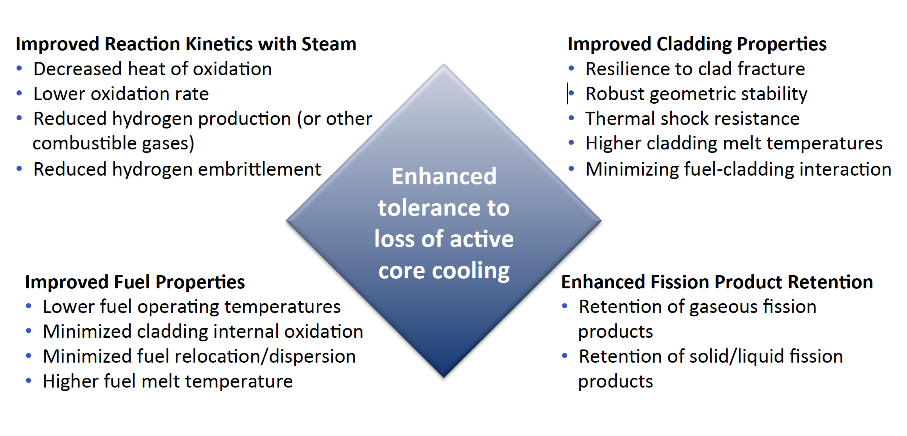
Accident Tolerance

Slide 13
Categories of ATF Concepts
ATF can be divided into three main categories
near-term ATF improvements
novel fuel and cladding materials
transformational fuel and cladding concepts
Near-term ATF improvements
Zirconium-based cladding
coatings to improve corrosion resistance, especially under high T steam
Urania-based fuel
additives to increase thermal conductivity
These changes are mean to be drop-in replacements that are compatible with existing systems

Slide 14
Categories of ATF Concepts
Novel fuel and cladding materials
U3Si2 fuels
FeCrAl alloys for cladding
Minimal changes needed for LWR designs, could be deployed in 10ish years
Transformational fuel and cladding concepts
fully ceramic micro-encapsulated (FCM) fuels
SiC/SiC composite cladding
drastically differ from traditional LWR fuel systems
may require significant modifications to reactor design and operation, but offer potentially large benefits to performance and/or safety

Slide 15
Summary
In loss of coolant accidents (LOCA), the fuel and cladding experience
increases temperature
decrease in coolant pressure
High temperatures lead to increased oxidation, producing additional hydrogen
This can lead to embrittlement, ballooning, and burst of the cladding
Fuel relocation and fission gas release in the fuel
Accident tolerant fuel includes different fuel and cladding materials to increase time before catastrophic behavior during an accident

