Slide 1
Final Project
Yuqing Huang
NE 591
Dr. Benjamin Beeler

Slide 2
Introduction
Heat is produced in the fuel, transports through the cladding and gap, and into cladding
Heat transported through the fuel, cladding by conduction
Mostly heat transported through the gap by conduction, some by convection
Heat transported through coolant by convection

Slide 3
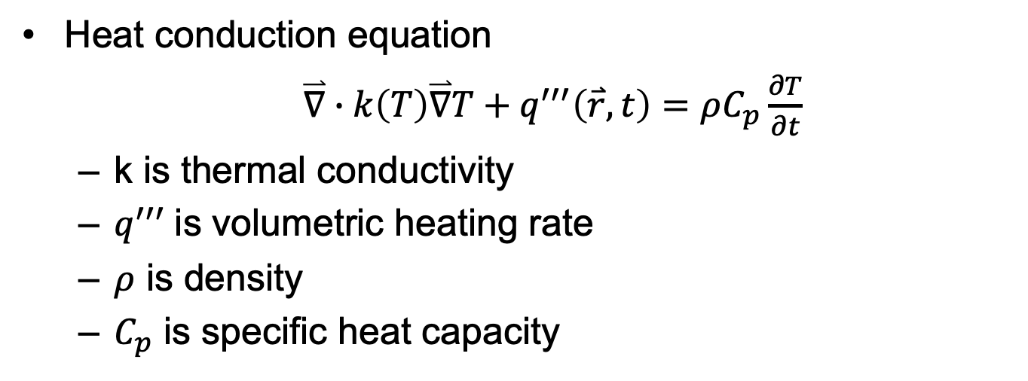
Heat conduction
Heat conduction equation
$\overset{⃑}{∇}∙k\left(T\right)\overset{⃑}{∇}T+q^{′′′}\left(\overset{⃑}{r},t\right)=ρC_{p}\frac{∂T}{∂t}$
k is thermal conductivity
$q^{′′′}$is volumetric heating rate
$ρ$ is density
$C_{p}$ is specific heat capacity

Slide 4
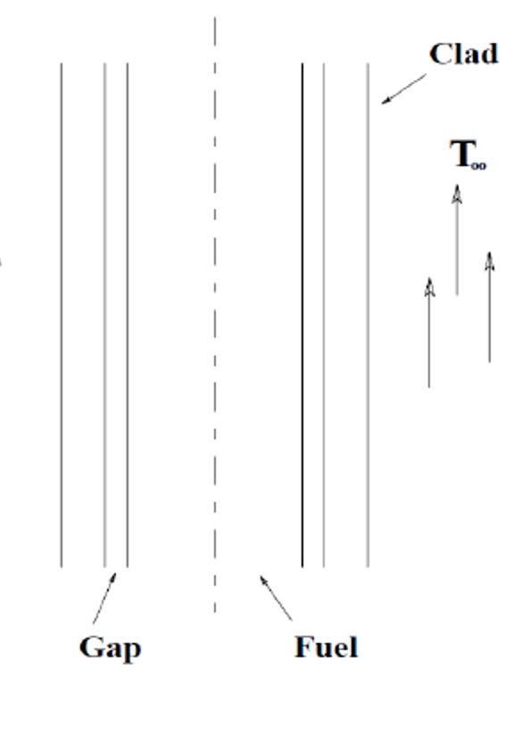
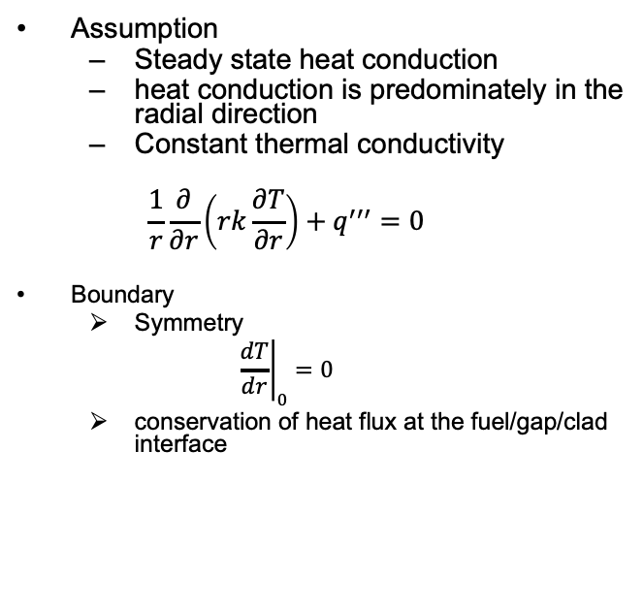
Heat Conduction in Light Water Reactor
Assumption
Steady state heat conduction
heat conduction is predominately in the radial direction
Constant thermal conductivity
$$\frac{1}{r}\frac{∂}{∂r}\left(rk\frac{∂T}{∂r}\right)+q^{′′′}=0$$
Boundary
Symmetry
$${\left.\frac{dT}{dr}\right|}_{0}=0$$
conservation of heat flux at the fuel/gap/clad interface

Slide 5

Heat Conduction in Light Water Reactor
Fuel region $rε\left[0,R_{F}\right]$
$$\frac{1}{r}\frac{∂}{∂r}\left(rk\frac{∂T}{∂r}\right)+q^{′′′}=0$$
$$T\left(r\right)−T\left(0\right)=−\frac{q^{′′′}r^{2}}{4k}$$
Gap region $rε\left[R_{F}, R_ci\right]$
$$q^{′′}\left(R_{ci}\right)=H_{G}\left(T_{s}−T_{ci}\right)$$
$H_{G}$ is gap conductance;
$T_{S}$ is fuel pellet surface temperature
$T_{ci}$is inner clad surface temperature

Slide 6
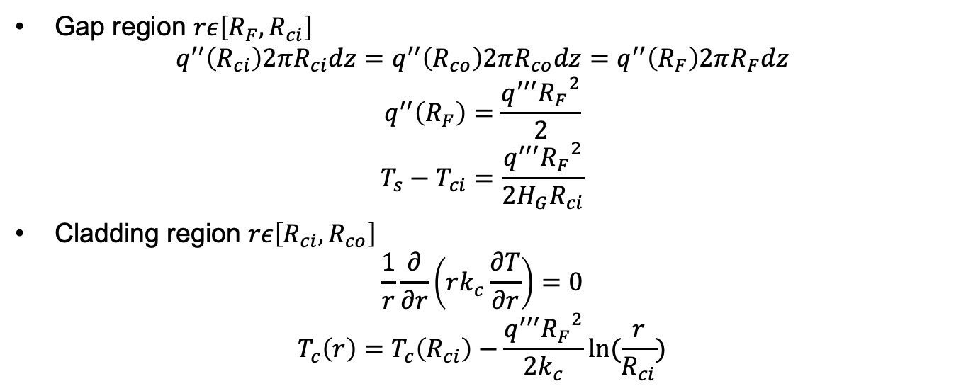
Heat Conduction in Light Water Reactor
Gap region $rε\left[R_{F},R_{ci}\right]$
$$q^{′′}\left(R_{ci}\right)2πR_{ci}dz=q^{′′}\left(R_{co}\right)2πR_{co}dz=q^{′′}\left(R_{F}\right)2πR_{F}dz$$
$$q^{′′}\left(R_{F}\right)=\frac{q^{′′′}{R_{F}}^{2}}{2}$$
$$T_{s}−T_{ci}=\frac{q^{′′′}{R_{F}}^{2}}{2H_{G}R_{ci}}$$
Cladding region $rε\left[R_{ci},R_{co}\right]$
$$\frac{1}{r}\frac{∂}{∂r}\left(rk_{c}\frac{∂T}{∂r}\right)=0$$
$$T_{c}\left(r\right)=T_{c}\left(R_{ci}\right)−\frac{q^{′′′}{R_{F}}^{2}}{2k_{c}}ln⁡(\frac{r}{R_{ci}})$$

Slide 7
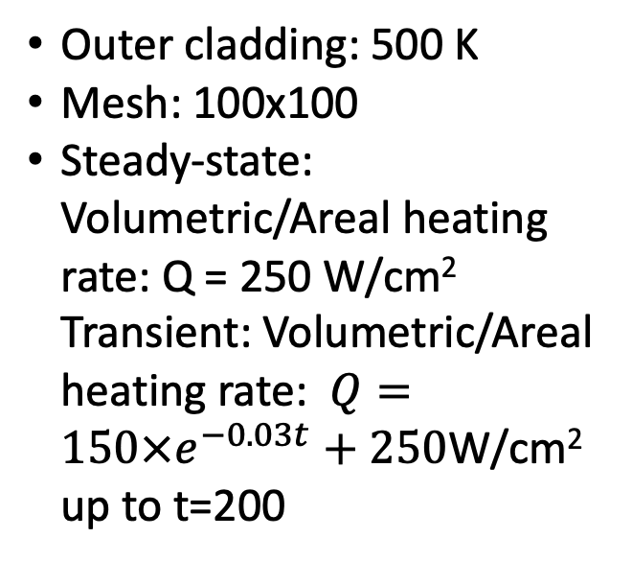
Simulation Details
0.5 cm
0.1 cm
0.1 cm
Outer cladding: 500 K
Mesh: 100x100
Steady-state: Volumetric/Areal heating rate: Q = 250 W/cm² Transient: Volumetric/Areal heating rate: $Q=150×e^{−0.03t}+250$W/cm² up to t=200
1 cm
Cladding
Fuel
Gap

Slide 8
Parameters for Materials
type | Thermal conductivity (W/cm-K) | Density(g/cm³) | Specific heat capacity(J/g-K)
Fuel | 0.3 | 10.98 | 0.33
Gap | 0.1 | 5.9 | 0.158
Cladding | 0.17 | 6.5 | 0.35

Slide 9
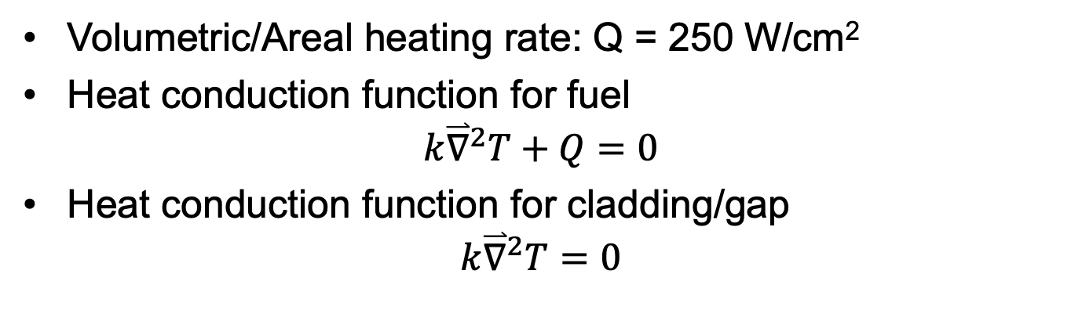
Steady State
Volumetric/Areal heating rate: Q = 250 W/cm²
Heat conduction function for fuel
$$k{\overset{⃑}{∇}}^{2}T+Q=0$$
Heat conduction function for cladding/gap
$$k{\overset{⃑}{∇}}^{2}T=0$$

Slide 10
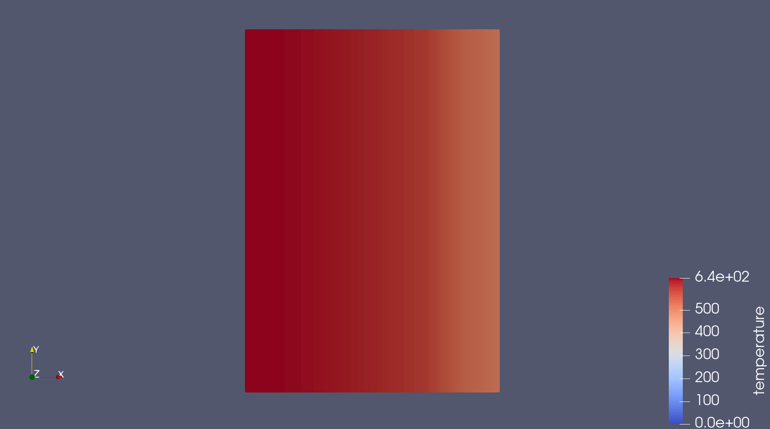
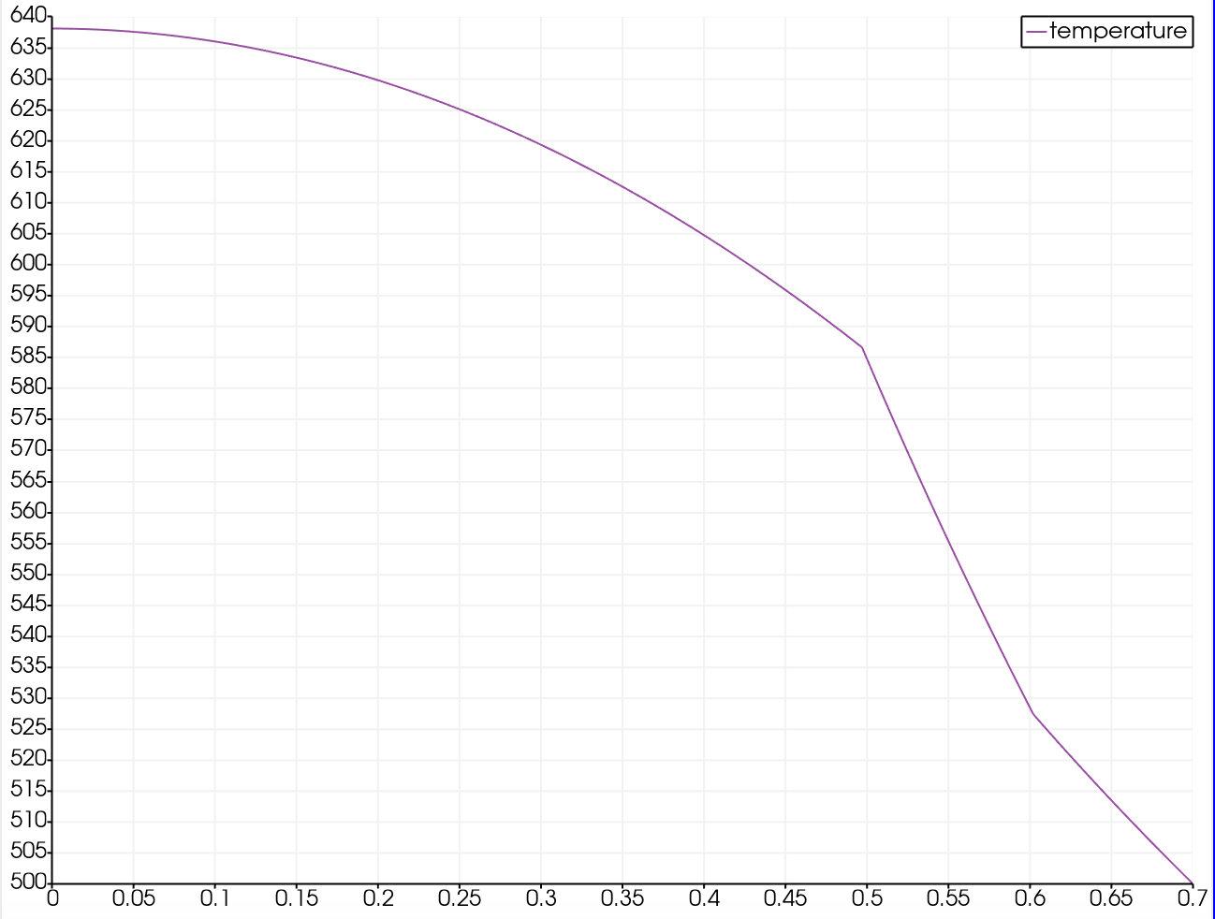
The Result for Steady State
These two figure are represented the temperature changes across the fuel, gap and cladding
There is parabolic temperature profile in fuel
Approximately Linear temperature profile in gap and clad
Lower thermal conductivity, steeper temperature drops. There is a steeper temperature drops in the gap

Slide 11
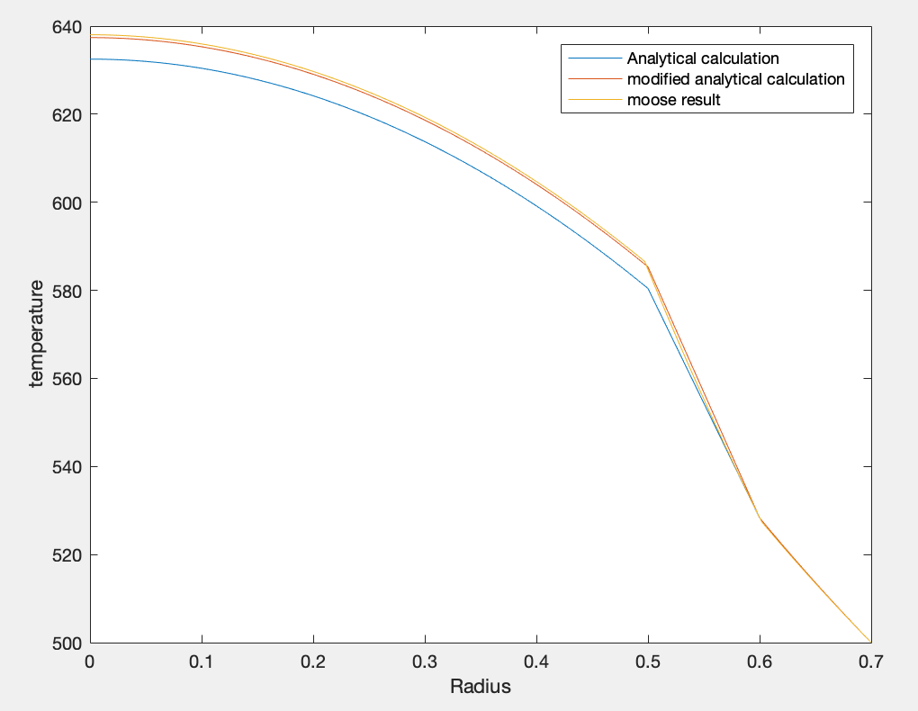
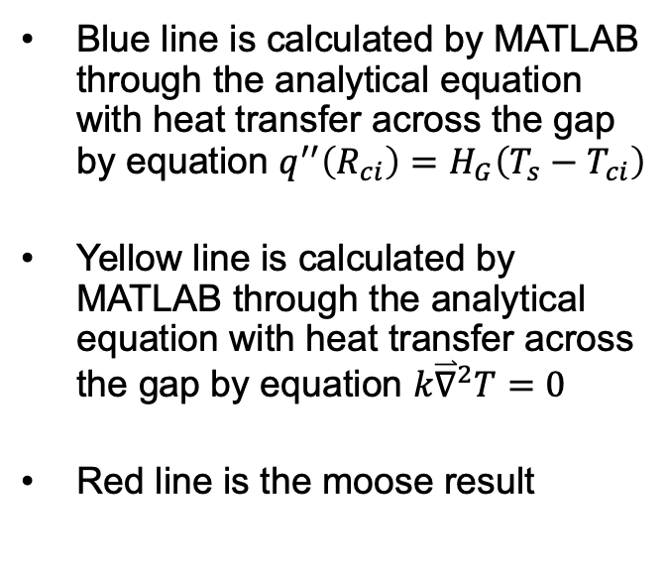
Verification
Blue line is calculated by MATLAB through the analytical equation with heat transfer across the gap by equation $q^{′′}\left(R_{ci}\right)=H_{G}\left(T_{s}−T_{ci}\right)$
Yellow line is calculated by MATLAB through the analytical equation with heat transfer across the gap by equation $k{\overset{⃑}{∇}}^{2}T=0$
Red line is the moose result

Slide 12
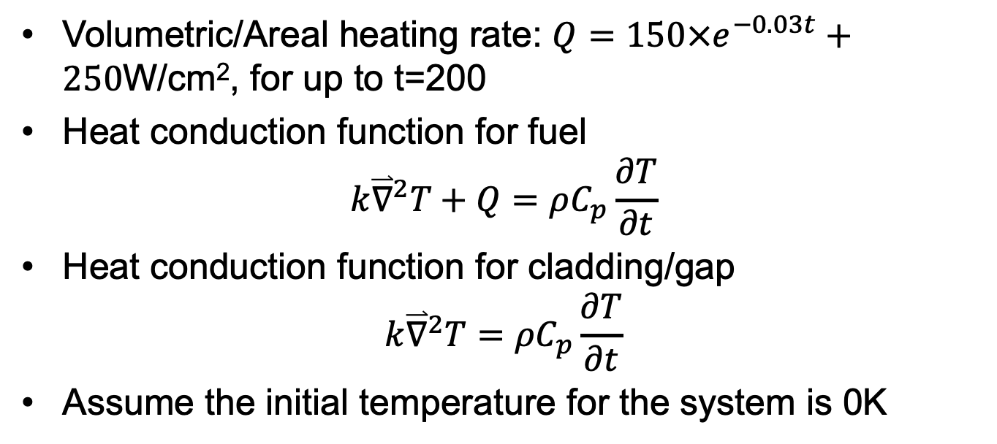
Transient
Volumetric/Areal heating rate: $Q=150×e^{−0.03t}+250$W/cm², for up to t=200
Heat conduction function for fuel
$$k{\overset{⃑}{∇}}^{2}T+Q=ρC_{p}\frac{∂T}{∂t}$$
Heat conduction function for cladding/gap
$$k{\overset{⃑}{∇}}^{2}T=ρC_{p}\frac{∂T}{∂t}$$
Assume the initial temperature for the system is 0K

Slide 13
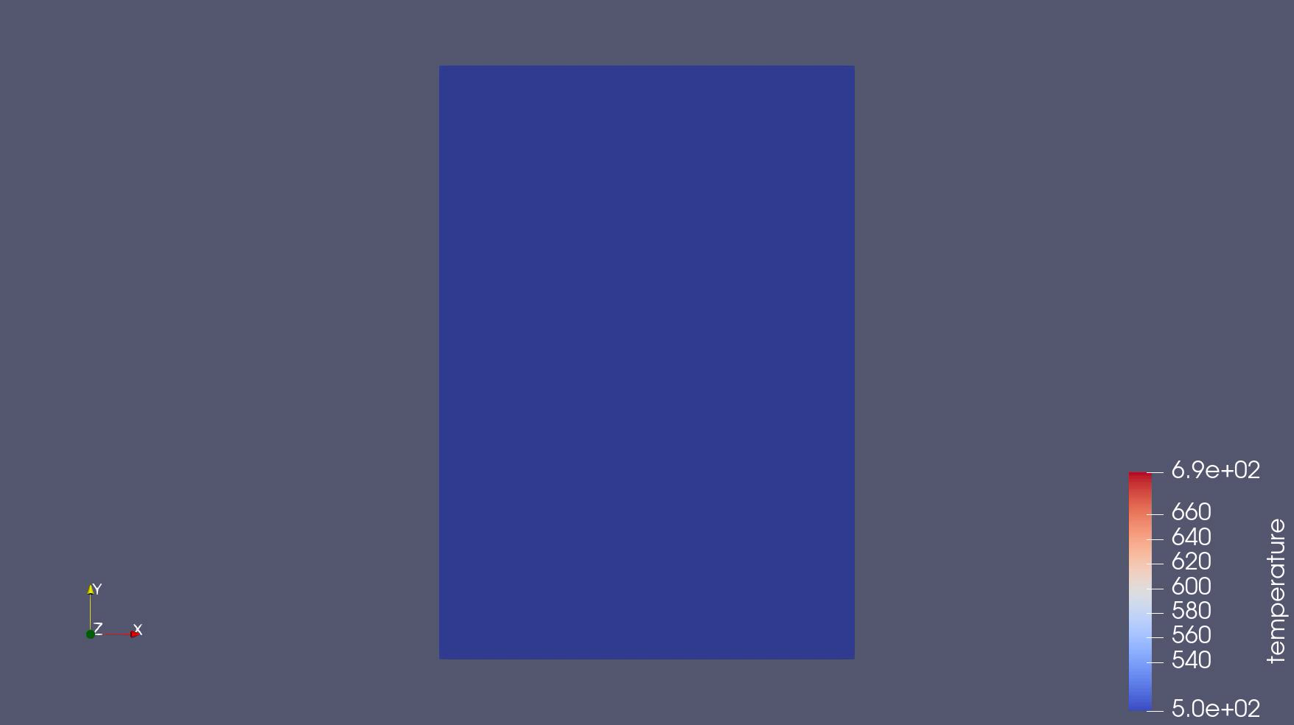
The Result for Transient
The animation for the temperature change cross the fuel, gap and cladding with time

Slide 14
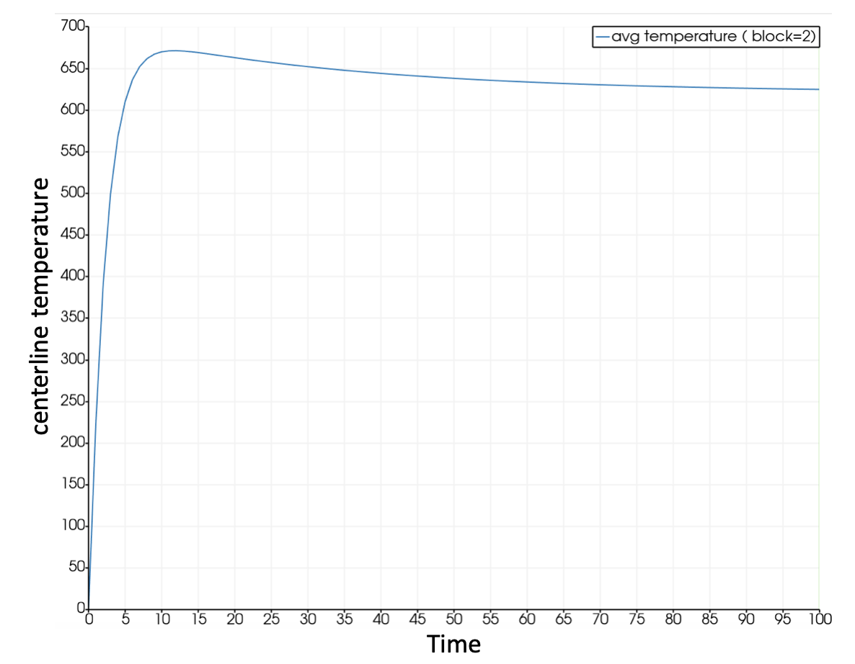
The Result for Transient
At beginning, The fuel heats up, the centerline temperature rapidly increase
As the time goes, the volumetric/areal heating rate decrease, thus the temperature will decrease.

Slide 15
Conclusion
Moose can be used to solve heat equation at 1D steady state situation
The result for 1D steady state is same compared with analytical calculation
Moose can also work well for 1D transition

