Slide 1
Nuclear Fuel Performance
NE-533
Spring 2024

Slide 2
Last Time
Empirical equations for thermal and irradiation creep of Zr
Creep down behavior of cladding on fuel pellets
Irradiation hardening of Zr + formation of dislocation channels
Pellet-Cladding Interactions
primarily leads to SCC of cladding
requires: a corrosive environment, a susceptible material, sufficient stress, and sufficient time

Slide 3
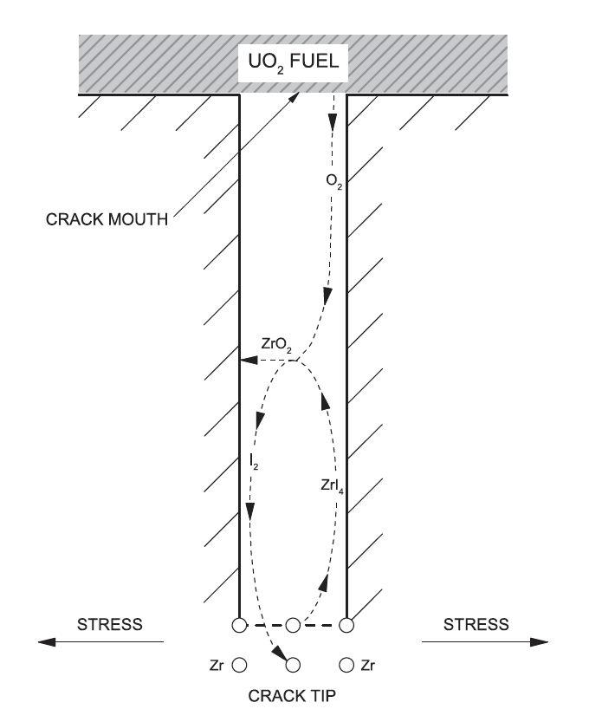
Incubation Time
The corrosive environment, represented by a sufficient inventory of chemically active fission gases in the gap, not only depends on burnup, but the ability of these gases to chemically attack the cladding
This environment requires that the normally protective oxide coating on the inner surface of the cladding is breached, thus permitting corrosive species to chemically react with the bare cladding
The incubation time reflects the time required for a flaw in the protective oxide to be developed and for sufficient ZrI4 to form in the cladding, resulting in the development of cracks

Slide 4
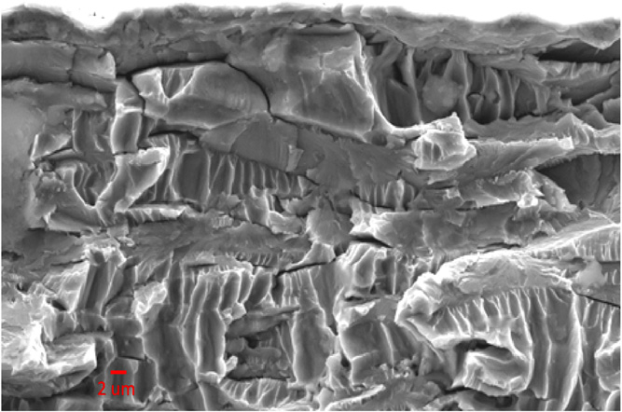
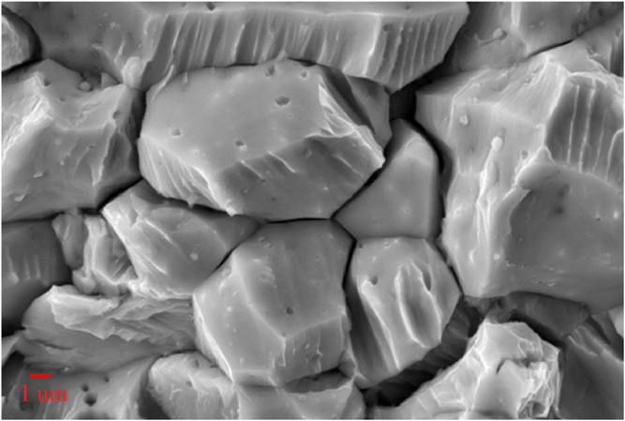
Crack Propagation
Transgranular
Once a crack has initiated, it can propagate through the cladding wall with a sufficiently high applied load
Both intergranular and transgranular propagation modes are possible
The propagation rate is a linear function of the stress intensity factor, K_{SCC}, and is independent on the propagation mode for sufficiently high K_{SCC}
The increase in iodine content generally increases the crack propagation rate
Increasing temperature results in decreasing the susceptibility to PCI failure, while neutron irradiation has been found to increase susceptibility
Intergranular

Slide 5
Through-Cracks
Following the formation of a through-wall crack and the ingress of water into the fuel-clad gap, the cracking process is arrested since the corrosive species (notably I, Cs, and Cd) have been discharged
The ingress of water in the fuel-clad gap may result in clad hydriding on the inner surface
The initial SCC crack can oxidize, and volume expansion may lead to resealing the primary failure
All PCI cracks are pin-hole defects, whereas observable cracks are secondary due to clad hydriding or ductile tearing
The time to failure depends on many parameters, but is generally determined by the local linear power, the change in linear power, and the local burnup

Slide 6
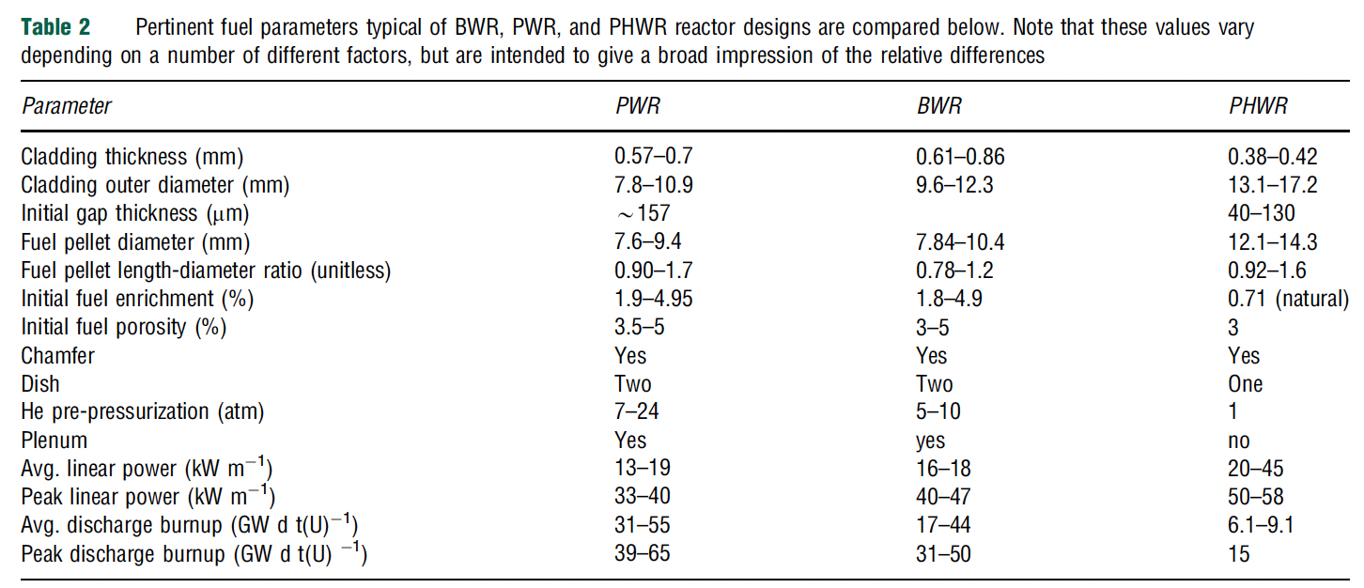
Reactor Susceptibility
All current PWR, BWR and CANDU reactors utilize UO2 fuel, zirconium alloy cladding, and are water cooled
The degree of susceptibility of each reactor and fuel design to PCI rests on numerous design specifications
PWRs have smaller fuel diameters, BWRs have the thickest cladding
The geometric design has an influence on the stresses in the fuel and cladding
Linear power affects the temperature, which impacts a variety of other phenomena
Discharge burnup influences the inventory of fission products in the fuel/cladding interface

Slide 7
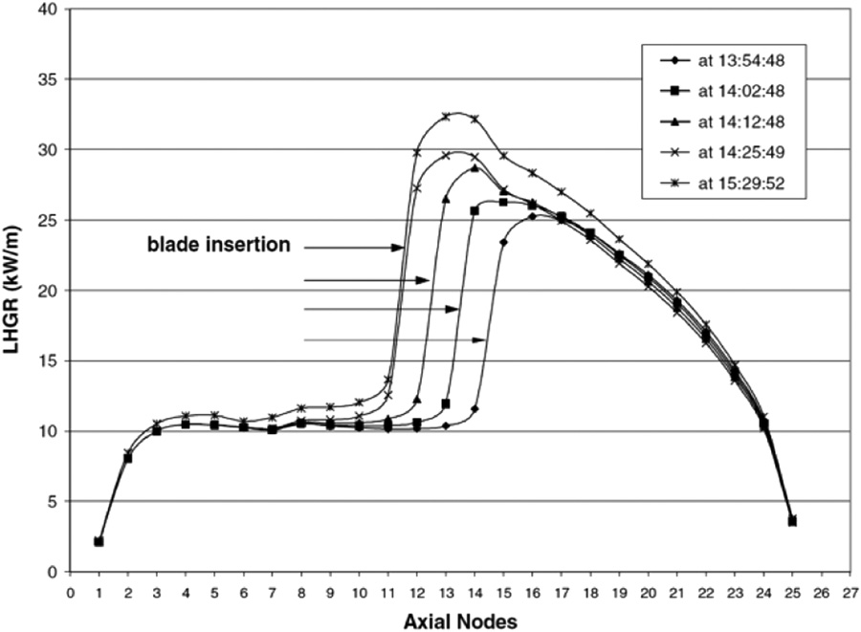
Reactor Susceptibility
In general, PCI failures are typically experienced (by any reactor) during a large change in power; thus, the manner in which power changes dictates to a large degree the likelihood of PCI failure
Unlike BWRs, the neutron flux in a PWR is not primarily controlled by the insertion and extraction of control rods during operation
Due to smoother control of reactivity and a lower linear power, PCI failures are significantly less frequent in PWRs than other major commercial power reactor designs
PCI failures are more of a concern in BWRs
Control blade maneuvers in BWRs create local power transients that often lead to PCI failures in fuel rods adjacent to these blades
The change in LHR resulting from the successive removal of three control rod blades

Slide 8
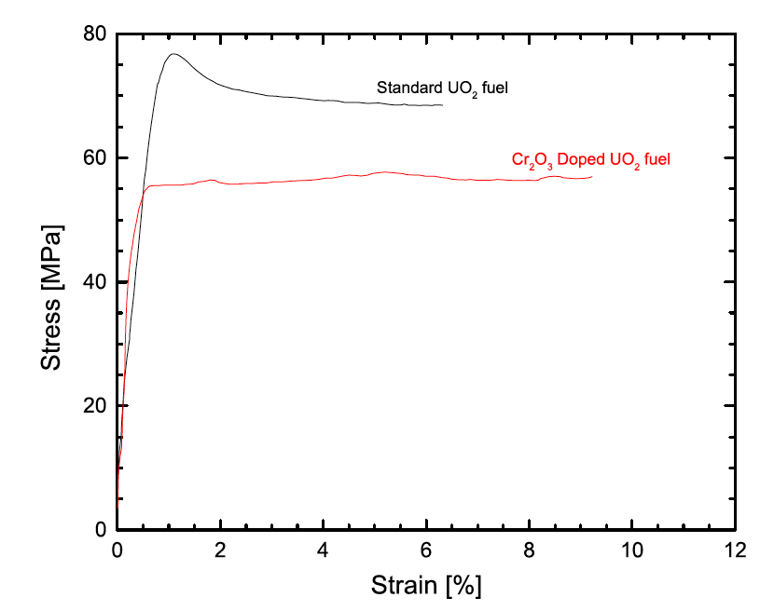
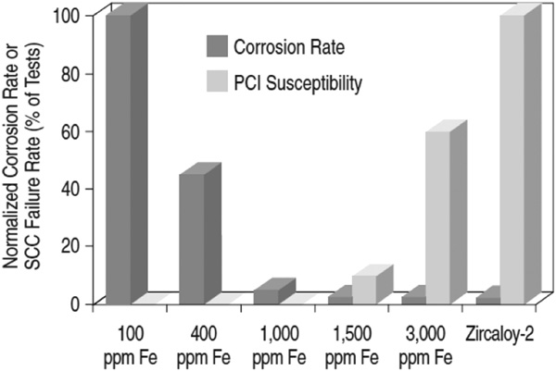
PCI Mitigation
There are two primary approaches to mitigate PCI failures: 1) changes in the design of various components – notably, the fuel pellet, fuel cladding and fuel assembly; 2) the manner in which the reactor is operated can be altered to minimize PCI failures
The design of fuel has changed to better optimize performance and reliability, including modifying the fuel pellet geometry, microstructure (i.e., grain size and porosity), and composition (i.e., initial O/M, minor additives)
Many design changes of the cladding have been investigated, including the development of small grain sizes and texture control, alloy composition, inclusion of an inner liner and the application of a pellet-clad interlayer

Slide 9
PCI Mitigation
Fuel assembly designs for all reactor types are constantly evolving as assemblies/bundles are improved to increase operational economics
A continuing trend in design evolution is sub-division of the fuel into smaller diameter elements/rods to increase the total number of elements/rods, which increases assembly/bundle power without a corresponding increase in UO2 temperature, thus mitigating thermally driven fuel failure mechanisms
Other changes in general fuel assembly/bundle design include variations on fill gas pressure, presence and design of plenums to collect fission gases, changes to appendage design to improve CHF, general optimization of rod end regions in the reactor to mitigate end-flux-peaking
The three variables that are controlled from an operational point of view are the linear power, change in linear power, ramp rate and discharge burnup

Slide 10
Summary
Pellet-clad interaction (PCI) takes two forms
Pellet-clad chemical interaction, PCCI (bonding occurs)
Pellet-clad mechanical interaction, PCMI (pellet pushes and drags cladding)
In order for SCC to initiate and propagate in any material, four conditions are simultaneously required:
A corrosive environment, a susceptible material, sufficient stress, and sufficient time
BWRs more likely to have PCI failures than PWRs
Two types of mitigation strategies to limit PCI failures
Reminder, exam on Thursday…
Problem session time

