Slide 1
Nuclear Fuel Performance
NE-533
Spring 2025

Slide 2
MOOSE Project Part 3
Same setup as part 1
Include effects of thermal expansion, densification, and FP-induced swelling
Simulate until gap closure, but do not need to handle contact
LHR is uniform, constant
T and burnup dependent kth
Make appropriate assumptions where needed
Determine the displacements and stress state in the fuel as a function of time
Perform appropriate analyses: Thermal stresses cracks in fuel? When do we have gap closure? Etc.

Slide 3
MOOSE Part 3 Writeup
Will upload input and output files to Moodle
Write up with deliverables from Part 1, 2, 3, choice of materials, mesh, details therein, etc.
Expected to have fixed any issues with Part 1/2
Part 3 writeup max of 12 pages
Due April 24 at 11:59pm

Slide 4
Last Time
Zircaloy creep equations
Zircaloy cladding creep over time
creeps down due to water pressure, reduces gap, elongates
creeps out due to fuel expansion, shortens
Zr mechanical properties sensitive to radiation
Dislocation channel cleaning leads to plasticity in highly irradiation Zr
PCMI can lead to SCC
A corrosive environment, a susceptible material, sufficient stress, and sufficient time
Talked through the basics of the corrosive environment

Slide 5
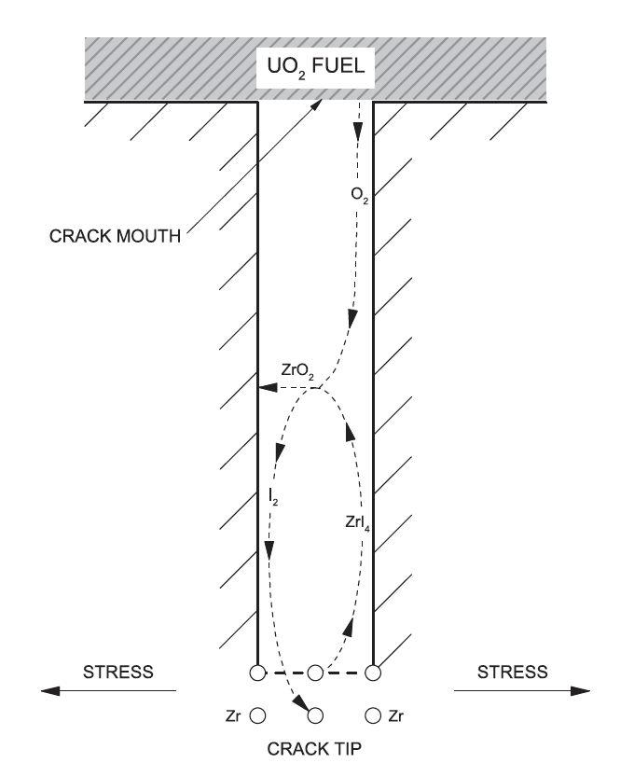
Corrosive Environment
The chemical interaction of liberated I (and possibly other elements) with the cladding is of great importance in crack initiation
A zirconium iodide gaseous species migrates up the temperature gradient towards the crack mouth, whereby the high affinity of Zr for O may result in ZrO2 formation, and decomposition may once again liberate I2 gas
The deposition of ZrO2 on the crack walls is believed to create a passivation layer, which further localizes I encroachment at the crack tip

Slide 6
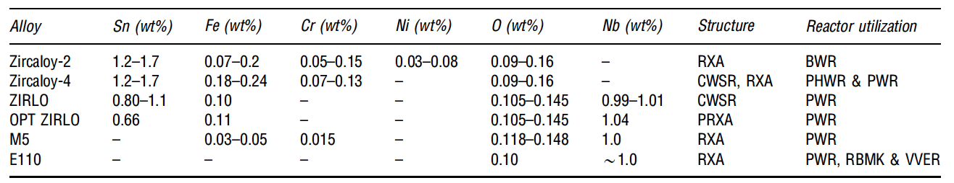
Susceptible Material
The susceptibility of the cladding to SCC can be influenced by many factors, including the composition, microstructure, texture, and irradiation damage of the cladding, and the presence of an oxide passivation layer, which protects the metal from chemical attack
All zirconium alloy cladding materials used in commercial power reactors are prone to PCI failure
Minor compositional changes have been shown to offer slightly different performance characteristics

Slide 7
Susceptible Material
The initial motivation of alloying zirconium with small amounts of tin was to offset the loss of corrosion resistance resulting from the introduction of nitrogen impurities during fabrication
The control of impurities during manufacturing have significantly improved since the introduction of these alloys, making the addition of unnecessary
The addition of niobium to these zirconium alloys increases the strength of the cladding while providing higher irradiation creep resistance and has exhibited elevated corrosion resistance, which is desirable for higher burnup fuel
All Zr alloys are somewhat equally susceptible to SCC cracking following prolonged irradiation

Slide 8
Sufficient Stress
The stress on the cladding depends on the external coolant pressure and creep, in addition to the stress imposed internally by the fuel
The fuel pellet structurally deforms as a result of the following mechanisms: thermal expansion, solid and gaseous fission product swelling, thermal and irradiation-induced creep, irradiation-induced densification and cracking
The fuel thermally expands almost immediately in response to an increase in temperature, whereas the contributions of creep and fission product swelling are longer term and depend on burnup
UO2 fuel is typically fabricated with an initial porosity of 3%–5% to accommodate fission products
The benefits of this with respect to minimizing SCC are twofold: first, the effect of swelling is diminished by solid fission products filling internal voids; second, initial pores provide sinks for fission gases, thus impeding their release to the fuel-clad gap

Slide 9
Reducing Internal Pressure
The initial grain size of the fuel, which evolves with burnup, affects fission gas release, among other factors
Since intragranular fission gas diffusion occurs at a much slower rate than intergranular diffusion, larger grain sizes impede the overall release of fission gases to the fuel surface
Reducing fission gas release with large grained fuel is less effective with increasing linear powers from 50-65 kW/m
As an undesired consequence to improved fission gas retention with large grained fuel, fission product swelling can be more pronounced

Slide 10
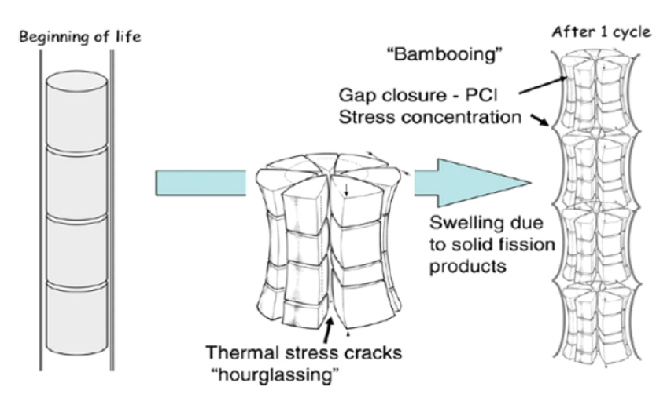
Pellet Deformation
The large thermal gradients in the radial direction, and a lesser extent in the axial direction, contribute to non-uniform thermal expansion, which results in a shape that resembles an hourglass
Pellet cracking due to thermal stresses further contributes to the hourglassing effect
The edges of cylindrical pellets induce large local stress concentrations in the cladding when the pellet-clad gap closes, leading to enhanced risk of perforation

Slide 11
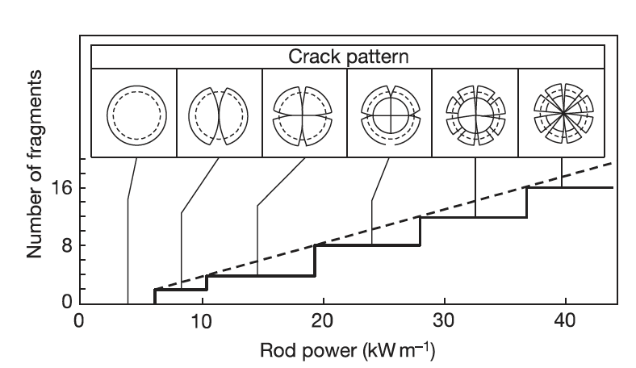
Fuel Cracking
Fuel pellets experience varying degrees of fracture due to large internal stresses induced by thermal expansion that exceed the fracture strength of UO2
The fracture strength varies from 80 to 150 MPa and is strongly influenced by pellet microstructure, such as porosity, pore size, and grain size
The number of fuel cracks generally increases with larger thermal gradients, thus the number of cracks in the fuel increases with respect to linear power

Slide 12
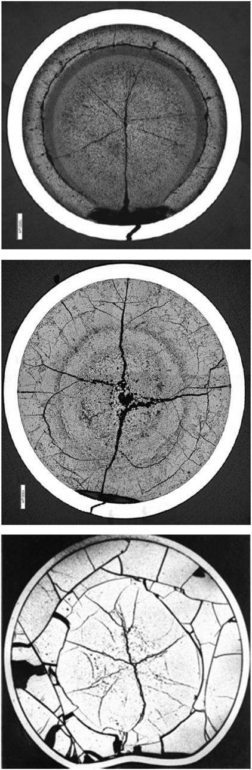
Missing Pellet Surface
PWR
Several failures have been experienced in LWRs in the early 2000s due to physical defects in the fuel, often due to chipping, which is often referred to as a Missing Pellet Surface (MPS)
The cladding eventually creeps down onto the fuel, except in the vicinity of the MPS
A local stress concentration is experienced in the cladding adjacent to the MPS as a result of the bending moment that is induced by non-uniform contact coupled with an expanding pellet
The increased local concentration of corrosive fission product species together with enhanced local stresses elevates the risk for SCC failure
BWR
PHWR

Slide 13
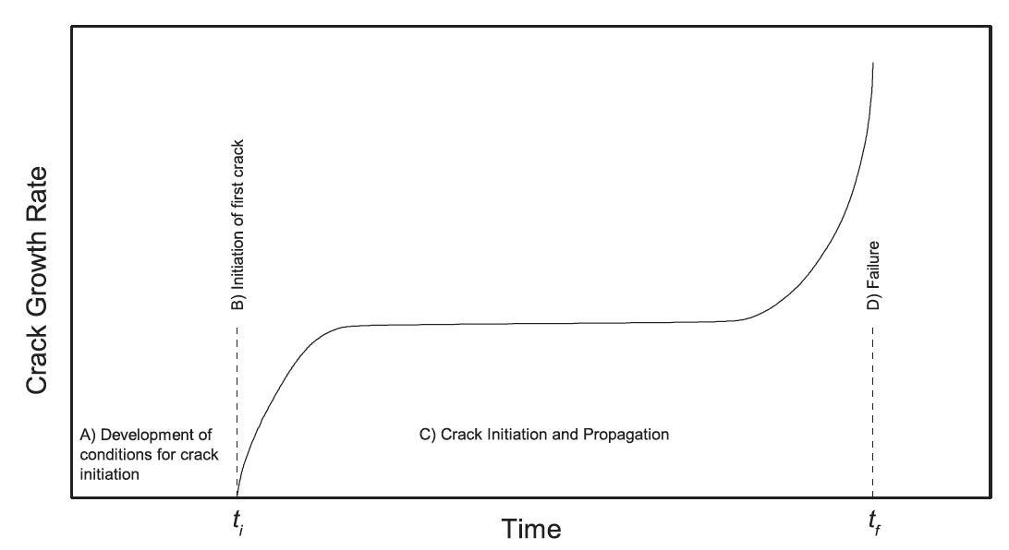
Sufficient Time
A sufficient duration of time is required for SCC to develop in the cladding
The SCC process can be divided into four stages:
Development of the corrosive environment and the surface conditions required for SCC to initiate,
Initiation of SCC,
Propagation of SCC, and
Failure
The SCC-induced crack will typically propagate through the majority of the cladding wall, and then the remaining ligament typically fails by ductile shear

Slide 14
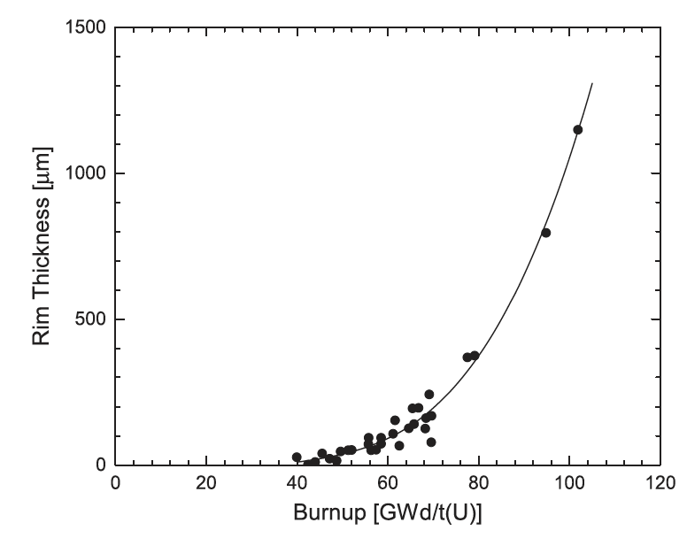
Effect of Burnup
The period of time to establish the conditions for SCC is related to burnup, and is complicated by the numerous mechanisms associated with changes in both the fuel and cladding during the course of irradiation
The mechanisms with relevance to SCC that become more pronounced with burnup include irradiation damage to the cladding, fission product swelling, fission gas release, and formation of a High Burnup Structure
The local burnup in the rim region can be 2–3 times greater than the average burnup in highly irradiated fuel, which means that the local concentrations of fission and activation products in the rim region are considerably higher, which have a direct influence on the fuel surface chemistry

Slide 15
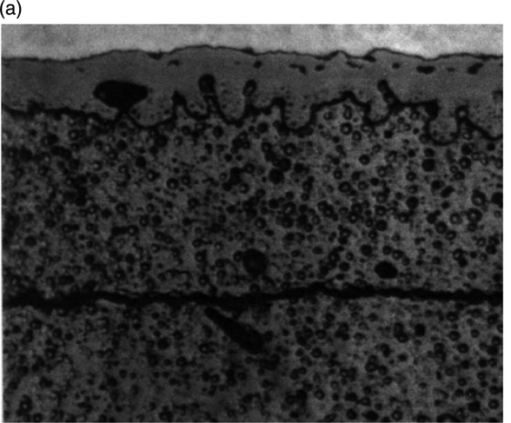
Rim/HBS Region
In medium burnup fuels, an internal zirconia layer 6–12 mm thick forms on the clad inner wall as soon as pellet-clad contact occurs
The coverage of the clad internal surface by zirconia tends to extend progressively with further irradiation and gap closing
High burnup fuel shows the development of a very effective pellet-clad bonding characterized by an intimate mixing of U and of the internal zirconia layer
Pellet-clad bonding, has been observed and seems to be controlled by the irradiation duration at closed pellet-clad gap

Slide 16
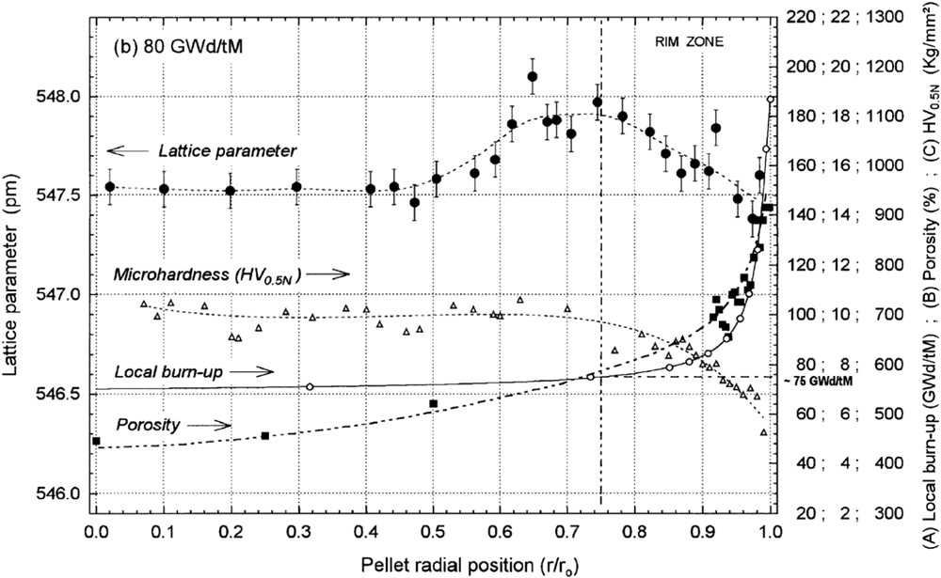
Rim/HBS Region
The HBS region has a much higher porosity (up to 30% locally) than the bulk of the fuel, which affects the mechanical properties
Microhardness measurements show an inverse trend of the strength with porosity
The softening of the fuel surface might be beneficial in reducing mechanical stresses imposed by the fuel on the cladding at the point of contact

Slide 17
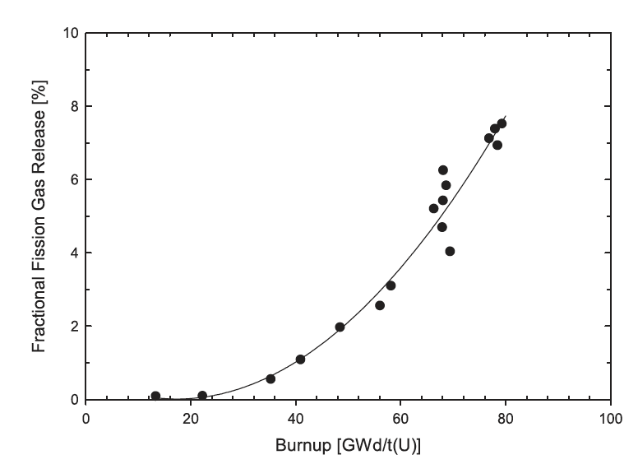
HBS and Fission Gas Release
The large increase in porosity within the HBS in high burnup fuel also affects fission gas release, providing local intergranular accommodation for retaining fission gases
Although the formation of the HBS promotes local fission gas retention, the fraction of fission gases that are released to the gap still increases with burnup

Slide 18
Incubation Time
The corrosive environment, represented by a sufficient inventory of chemically active fission gases in the gap, not only depends on burnup, but the ability of these gases to chemically attack the cladding
This environment requires that the normally protective oxide coating on the inner surface of the cladding is breached, thus permitting corrosive species to chemically react with the bare cladding
The incubation time reflects the time required for a flaw in the protective oxide to be developed and for sufficient ZrI4 to form in the cladding, resulting in the development of cracks

Slide 19
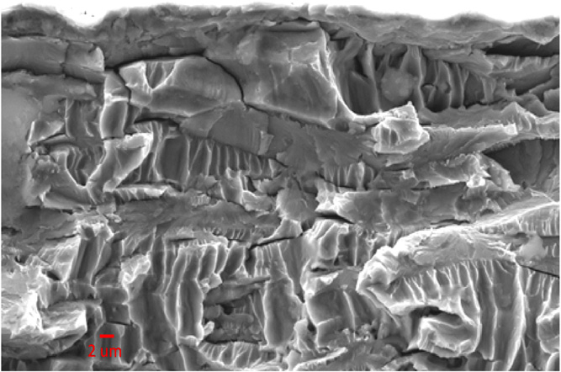
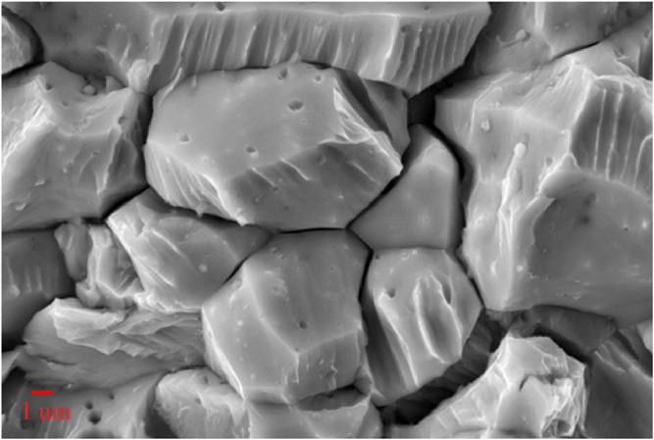
Crack Propagation
Transgranular
Once a crack has initiated, it can propagate through the cladding wall with a sufficiently high applied load
Both intergranular and transgranular propagation modes are possible
The propagation rate is a linear function of the stress intensity factor, K_{SCC}, and is independent on the propagation mode for sufficiently high K_{SCC}
The increase in iodine content generally increases the crack propagation rate
Increasing temperature results in decreasing the susceptibility to PCI failure, while neutron irradiation has been found to increase susceptibility
Intergranular

Slide 20
Through-Cracks
Following the formation of a through-wall crack and the ingress of water into the fuel-clad gap, the cracking process is arrested since the corrosive species (notably I, Cs, and Cd) have been discharged
The ingress of water in the fuel-clad gap may result in clad hydriding on the inner surface
The initial SCC crack can oxidize, and volume expansion may lead to resealing the primary failure
All PCI cracks are pin-hole defects, whereas observable cracks are secondary due to clad hydriding or ductile tearing
The time to failure depends on many parameters, but is generally determined by the local linear power, the change in linear power, and the local burnup

Slide 21
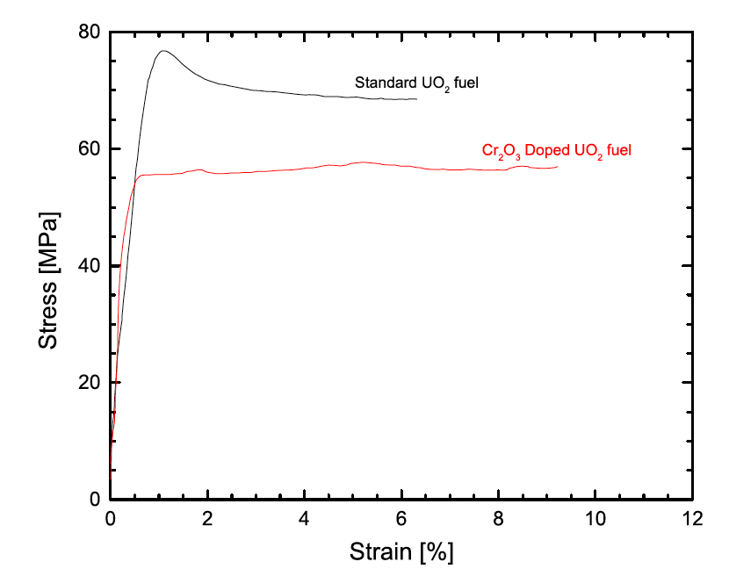
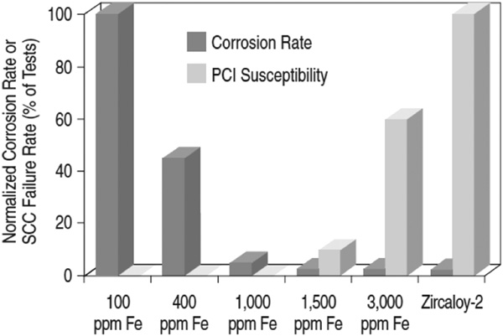
PCI Mitigation
There are two primary approaches to mitigate PCI failures: 1) changes in the design of various components – notably, the fuel pellet, fuel cladding and fuel assembly; 2) the manner in which the reactor is operated can be altered to minimize PCI failures
The design of fuel has changed to better optimize performance and reliability, including modifying the fuel pellet geometry, microstructure (i.e., grain size and porosity), and composition (i.e., initial O/M, minor additives)
Many design changes of the cladding have been investigated, including the development of small grain sizes and texture control, alloy composition, inclusion of an inner liner and the application of a pellet-clad interlayer

Slide 22
PCI Mitigation
Fuel assembly designs for all reactor types are constantly evolving as assemblies/bundles are improved to increase operational economics
A continuing trend in design evolution is sub-division of the fuel into smaller diameter elements/rods to increase the total number of elements/rods, which increases assembly/bundle power without a corresponding increase in UO2 temperature, thus mitigating thermally driven fuel failure mechanisms
Other changes in general fuel assembly/bundle design include variations on fill gas pressure, presence and design of plenums to collect fission gases, changes to appendage design to improve CHF, general optimization of rod end regions in the reactor to mitigate end-flux-peaking
The three variables that are controlled from an operational point of view are the linear power, change in linear power, ramp rate, and discharge burnup

Slide 23
Summary
In order for SCC to initiate and propagate in any material, four conditions are simultaneously required:
corrosive environment (ZrI4 -> ZrO2)
susceptible material (all Zr alloys are susceptible, minor additions make small improvements)
sufficient stress (pellet expansion, creep down, etc)
sufficient time (incubation time, steady state crack growth, ductile failure)
Two types of mitigation strategies to limit PCI failures
Reminder, exam on Thursday…
Problem session time

Slide 24
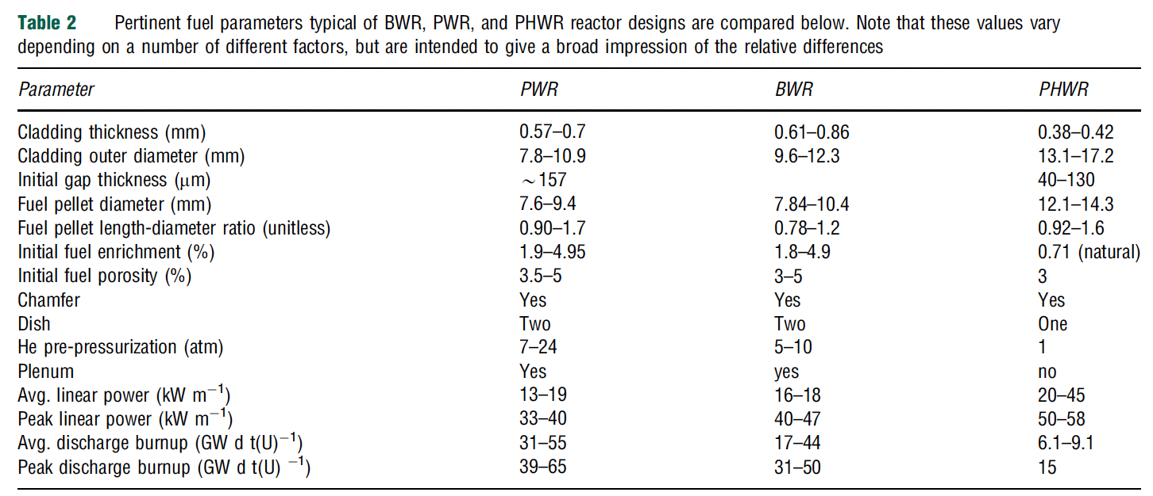
Reactor Susceptibility
All current PWR, BWR and CANDU reactors utilize UO2 fuel, zirconium alloy cladding, and are water cooled
The degree of susceptibility of each reactor and fuel design to PCI rests on numerous design specifications
PWRs have smaller fuel diameters, BWRs have the thickest cladding
The geometric design has an influence on the stresses in the fuel and cladding
Linear power affects the temperature, which impacts a variety of other phenomena
Discharge burnup influences the inventory of fission products in the fuel/cladding interface

Slide 25
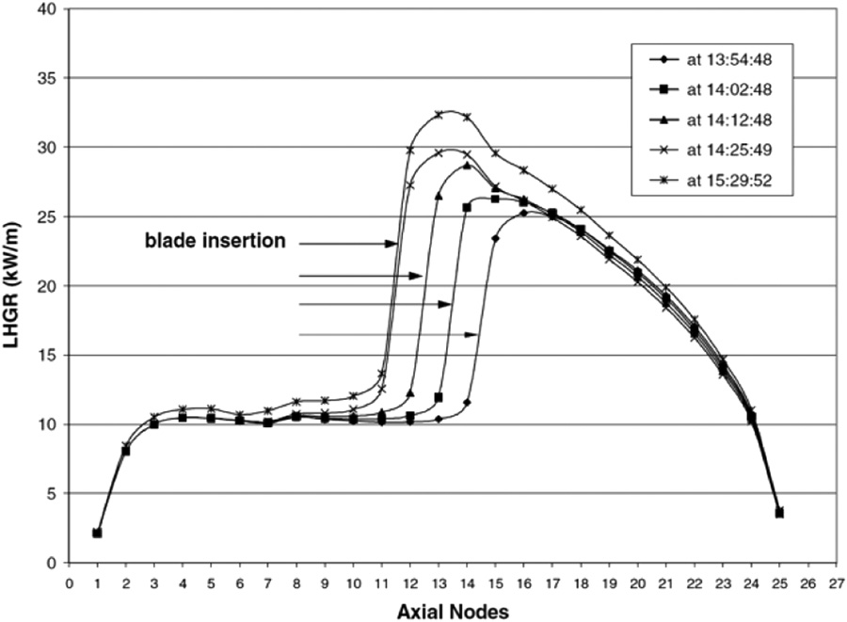
Reactor Susceptibility
In general, PCI failures are typically experienced (by any reactor) during a large change in power; thus, the manner in which power changes dictates to a large degree the likelihood of PCI failure
Unlike BWRs, the neutron flux in a PWR is not primarily controlled by the insertion and extraction of control rods during operation
Due to smoother control of reactivity and a lower linear power, PCI failures are significantly less frequent in PWRs than other major commercial power reactor designs
PCI failures are more of a concern in BWRs
Control blade maneuvers in BWRs create local power transients that often lead to PCI failures in fuel rods adjacent to these blades
The change in LHR resulting from the successive removal of three control rod blades

