Slide 1
Fuel Fabrication
NE 591

Slide 2
Fabrication Process

Slide 3
Powder Processing
Uranium arrives at a fuel manufacturing plant in one of two forms, uranium hexafluoride (UF₆) and it needs to be converted to uranium dioxide (UO₂) prior to pellet fabrication
An example conversion process injects UF₆ into water to form a UO₂F₂ particulate slurry, ammonia (NH3) is added to this mixture and the UO₂F₂ reacts to produce ammonium diuranate (ADU, (NH₃)2U₂O₇), after which the slurry is filtered, dried and heated in a reducing atmosphere to pure UO₂
A reducing atmosphere is one in which oxidation is prevented by removal of oxygen and other oxidizing gases, and which may contain actively reducing gases such as hydrogen

Slide 4
Powder/Pellet Processing
The UO₂ powder may need further processing or conditioning before it can be formed into pellets:
Homogenization: powders may need to be blended to ensure uniformity in terms of particle size distribution and specific surface area
Additives: U₃O₈ may be added to ensure satisfactory microstructure and density for the pellets and other fuel ingredients, such as lubricants, burnable absorbers (e.g. gadolinium) and pore-formers may also need to be added
UO₂ powder is fed into dies and pressed biaxially into cylindrical pellet form using a load of several hundred MPa
Pellets are then sintered in a heating furnace
Sintering is the process of compacting and forming a solid mass of material by heat or pressure

Slide 5
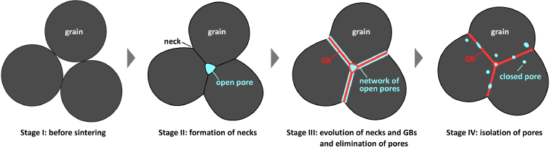
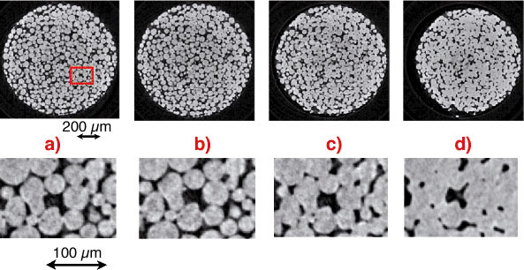
Sintering Process
During sintering, atoms in the materials diffuse across the boundaries of the particles, fusing the particles together and creating one solid piece
The final fuel pellets are nearly fully dense with a uniform microstructure: grain size ~ 10 μm; pore size ~ 3 μm; density ~ 95 - 99%
A single pellet in a typical reactor yields about the same amount of energy as one ton of coal

Slide 6
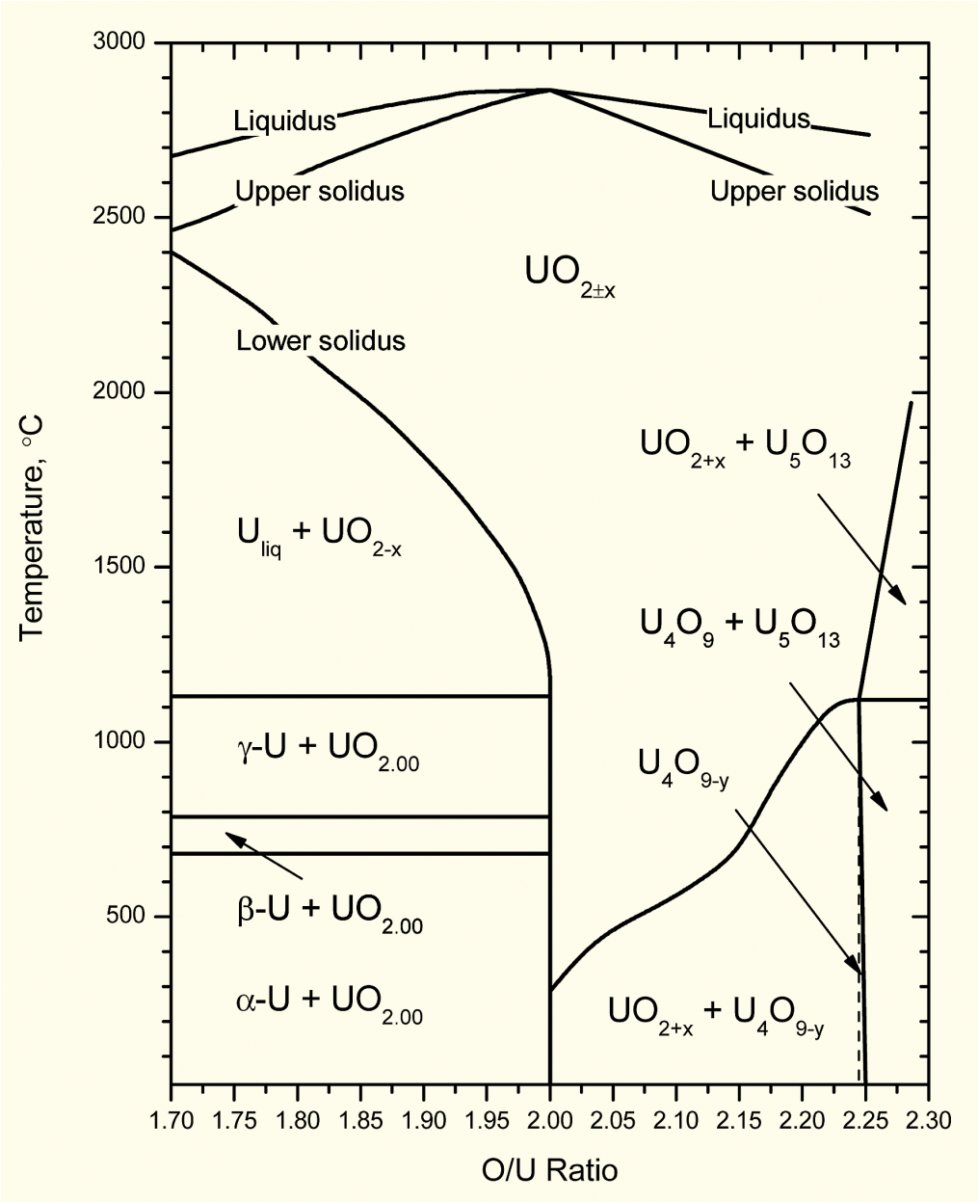
Fuel strictly manufactured to be UO₂
Fuel fabricated to be nearly stoichiometric; i.e., UO_{2.00±}
Structure stable to T_{melt}
Maximum T_{melt}
O/M ratio varies slightly during irradiation
Large deviations from stoichiometry relevant to
Fabrication
Defected fuel behavior
Reprocessing
Accident conditions during dry storage or shipment of used nuclear fuel

Slide 7
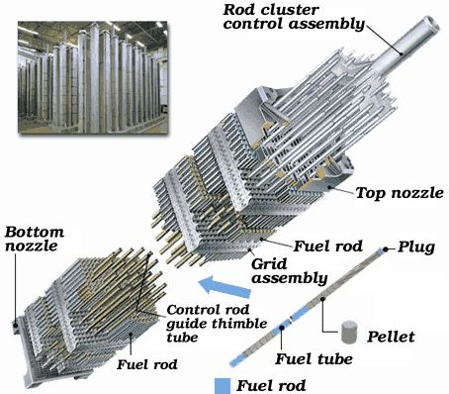
Rods and Assemblies
The fuel pellets are assembled in fuel rods and then put together in fuel assemblies
Designs dictate that the pellet-filled rods have a precise physical arrangement in terms of their lattice pitch (spacing), and their relation to other features such as water (moderator) channels and control-rod channels
Physical structures for holding the fuel rods are therefore engineered with extremely tight tolerances and are largely constructed of steel and zirconium alloys

Slide 8
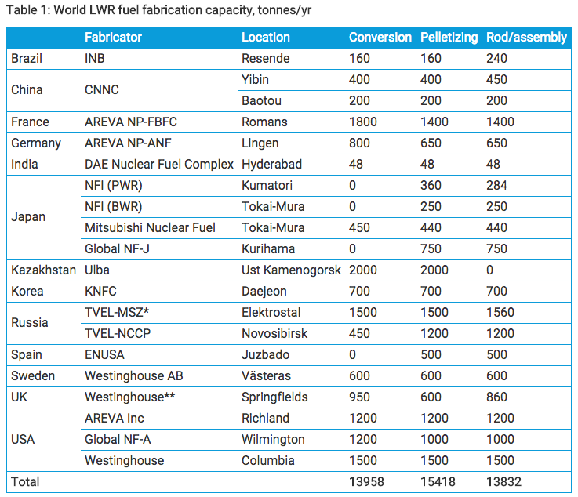
Global Fuel Fabrication
Uranium is mined and converted into fuel in a number of countries
USA, Russia, Kazakhstan and France are leaders
Is a growing need for HALEU
High assay low enriched uranium
Uranium with 19.7% enrichment

Slide 9
Fuel Fabrication Summary
Mining -> Processing -> Conversion -> Enrichment -> Powder -> Compaction/Sintering -> Rod/Assembly
U₃O₈ must be converted to UF₆ for enrichment, which is then converted to UO₂ powder for pellet manufacture

