Slide 1
Nuclear Fuels
Benjamin Beeler
Associate Professor
Department of Nuclear Engineering
North Carolina State University
bwbeeler@ncsu.edu

Slide 2
Who am I?
From rural western Kentucky
PhD in Nuclear Engineering from Georgia Tech
Worked at Idaho National Laboratory before joining NCSU in 2019
I am a computational nuclear materials scientist
  Computational tools
  Geared for material science research
  Applied to nuclear materials (especially advanced fuels)
  Spans physics, chemistry, and engineering

Slide 3
Ask Questions!
I don’t want to stand up here and talk for an hour…
I will talk about things you won’t understand
Stop me and ask me about whatever
The purpose of this is for you to be exposed to new information and to learn
Other notes:
  I’ve got two speech impediments, so if anything I say is unclear, ask me to repeat it or restate it

Slide 4
Background: Key Terms for Today
Fast vs. thermal neutrons: born fast (~2 MeV); slowed by collisions to thermal (~0.025 eV)
Moderator: light nuclei (H in water, C in graphite) that slow neutrons down
Enrichment: raising U-235 above its natural 0.7% (LWR fuel: ~3–5%)
Burnup: how much of the fuel has fissioned (% of heavy atoms, or energy per mass)
Breeder / burner: makes more fissile material than it uses / destroys Pu and actinides
Minor actinides: Np, Am, Cm: long-lived waste made by neutron capture
Negative reactivity feedback: reactor heats up → fission rate drops on its own
Source term: radioactive material that could escape in an accident
Phase / crystal structure: how atoms are arranged (e.g., BCC, fluorite); one material can have several phases
Phase diagram: map of which phase is stable vs. temperature and composition
Anisotropic: properties differ by direction
Grain / grain boundary: a solid is many tiny crystals (grains); their interfaces are fast paths for atoms and gas
Diffusion: atoms migrating through a solid; much faster when hot
Stoichiometry: atom ratio, e.g., O/U = 2 in UO₂; small deviations (UO₂±ₓ) change properties
Sintering: pressing powder, then heating below melting to form a dense solid
Thermal conductivity (k): how easily heat flows; low k → very hot pellet center
Linear heat rate: power per length of fuel rod (kW/m)
Transient: rapid, off-normal change in power or temperature
FCCI: fuel–cladding chemical interaction; reactions that thin the cladding

Slide 5
What is the purpose of fuel?

Slide 6
Fuel is the Heat Source
Fuel functions as a heat source, generating heat that is transferred to a coolant, which transfers heat through external loops, heat exchangers, etc., to run a generator
While the fuel must meet neutronic requirements, limiting possible options of materials choice, the lifetime of the fuel is governed by material constraints
What I care about is how the fuel material evolves/behaves as a function of time

Slide 7
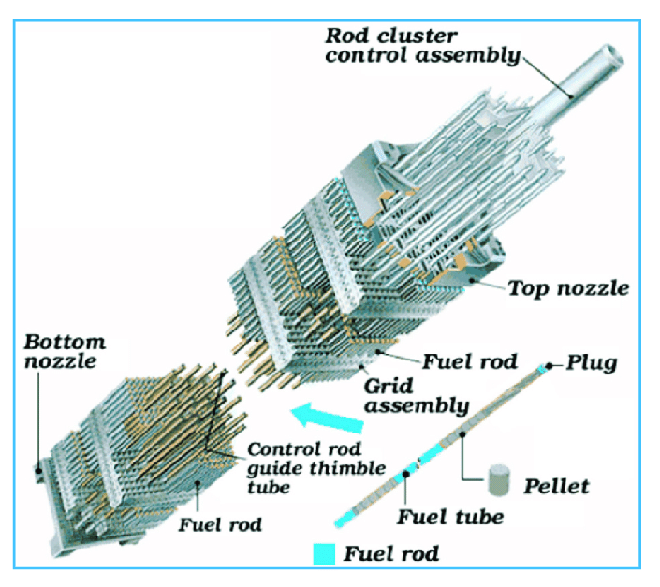
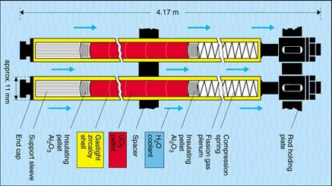
Fuel System
Fissile material compound (fuel), surrounded by a cladding, surrounded by coolant
Fuel generates your neutrons and heat, while cladding keeps the nasty stuff in the fuel from getting to the coolant
Coolant transports the heat away to secondary systems
Coolant can also reduce energy of (moderate) neutrons
I focus on the fuel here, but this concept of a fuel system is more complete

Slide 8
Fuel is limited to select elements
A fissionable nuclide is capable of undergoing fission (even with a low probability) after capturing a high energy neutron
A fissile nuclide is capable of sustaining a nuclear fission chain reaction with neutrons of any energy
A fertile material is a material that, although not itself fissile, can be converted into a fissile nuclide by neutron absorption and subsequent nuclei conversions.
U-235 is a fissile isotope that naturally occurs in uranium in small amounts (0.7%). Can be enriched.
Neutron + Target Nucleus -> Two fission products, 2-3 neutrons; Fission releases around 210 MeV of energy

Slide 9
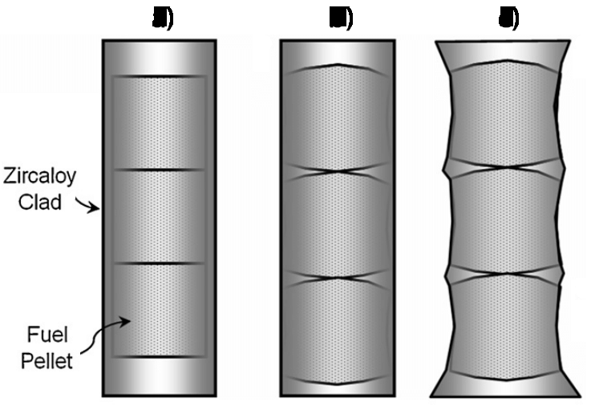
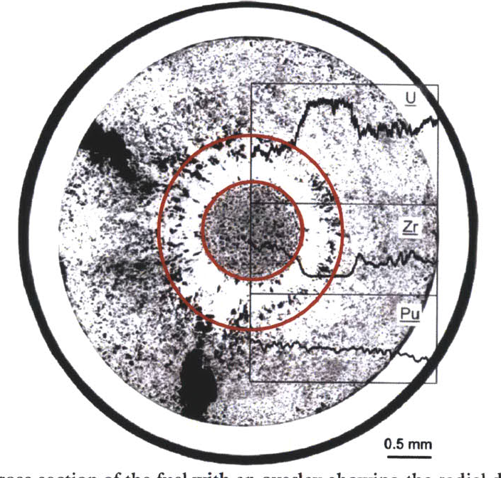
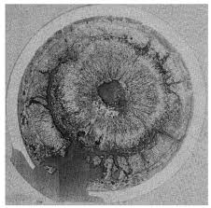
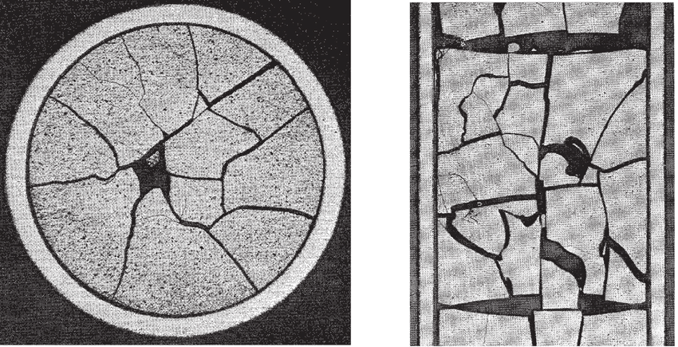
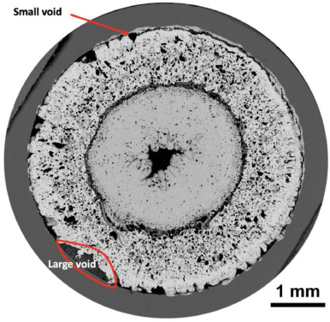
Fuel Considerations
Safety:
  Stable and predictable behavior
  No melting, no phase changes under transients that lead to deleterious behavior
Uranium density
Mechanical integrity
Cladding interactions
Swelling and fission gas release
Operating temperatures

Slide 10
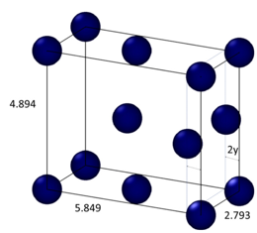
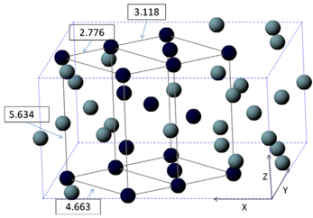
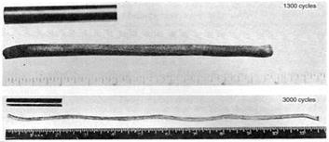
Why not use pure uranium metal?
Pure uranium has three solid phases
  α-phase is orthorhombic
  β-phase is tetragonal
  γ-phase is body-centered cubic
  During thermal cycling, pure uranium
  dramatically swells
  α-U has both anisotropic thermal expansion and anisotropic irradiation growth
Alloy U with transition metals or form U compounds with O, C, N, etc.

Slide 11
What is the reference fuel for commercial reactors?

Slide 12
Uranium Dioxide (UO2)
Reference fuel for nuclear power industry
Single phase, fluorite structure
Fabrication via sintering UO2 powder into pellets
Water coolant
Pellets are stacked inside Zircaloy cladding tubes (zirconium alloy)
Good behaviors
  Very high melting point, about 2800 C
  Maintains a stable fluorite phase up to melting
  Very compatible with Zircaloy clad
  Relative stability in water
  Reasonably radiation resistant

Slide 13
Uranium Dioxide (UO2)
Bad behaviors
  Brittle (thermal stress fractures, fragmentation)
  Poor thermal conductivity
  Properties very sensitive to stoichiometry
  Limited linear heating rates
  Non-negligible thermal expansion/swelling
  Higher stored thermal energy than other fuel material

Slide 14
Uranium Dioxide (UO2)
Critical Phenomena
  Thermal conductivity (and degradation)
  Fission gas release, leading to pressure increase inside the cladding
  Fuel fragmentation and relocation under transients
  Bambooing creating stress concentrations
All 94 operational reactors in US utilize UO2
  we sufficiently understand its limitations, and don’t push it beyond

Slide 15
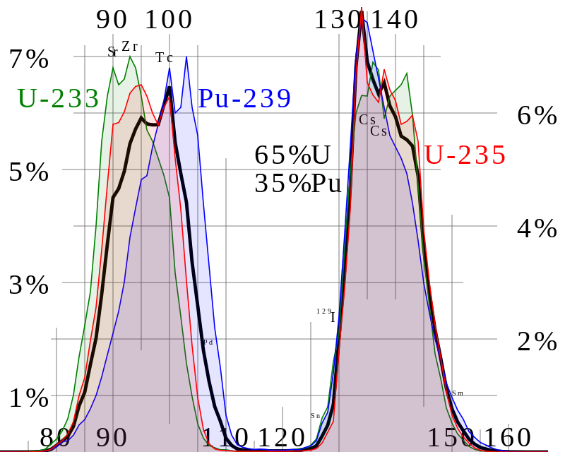
Fission Product Generation
Fission releases around 200 MeV
  The fission fragments have 169 MeV of kinetic energy
  2 to 3 neutrons with an average energy of 2 MeV
  7 MeV of prompt gamma ray photons
  The remaining energy is released by beta decay
Every fission product that is produced is now in the crystal lattice of the fuel, changing the microstructure

Slide 16
What are some common fission products?

Slide 17
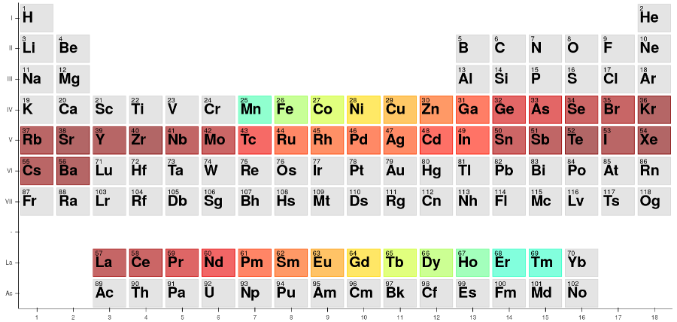
A big chunk of the periodic table

Slide 18
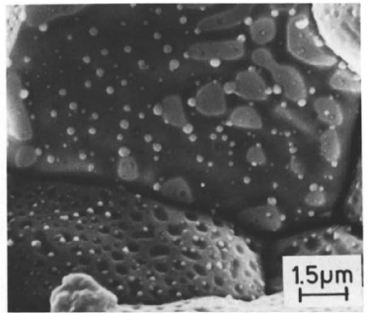
Various types of fission products in the fuel
Soluble oxides (Y, La and the rare earths)
Dissolved in the cation sublattice
Insoluble oxides (Zr, Ba and Sr)
Form insoluble oxides in the fluorite lattice
Metals (Mo, Ru, Pd, and Tc)
Form metallic precipitates
Volatiles (Br, Rb, Te, I and Cs)
Exist as gases at high temperatures of the pellet interior
Also exist as solids at the cooler pellet exterior
Noble gases (Xe, Kr)
Essentially insoluble in the fuel matrix
Form either intragranular (within grain) voids or bubbles or intergranular (grain boundary) bubbles

Slide 19
Fission products impact the behavior of the fuel

Slide 20
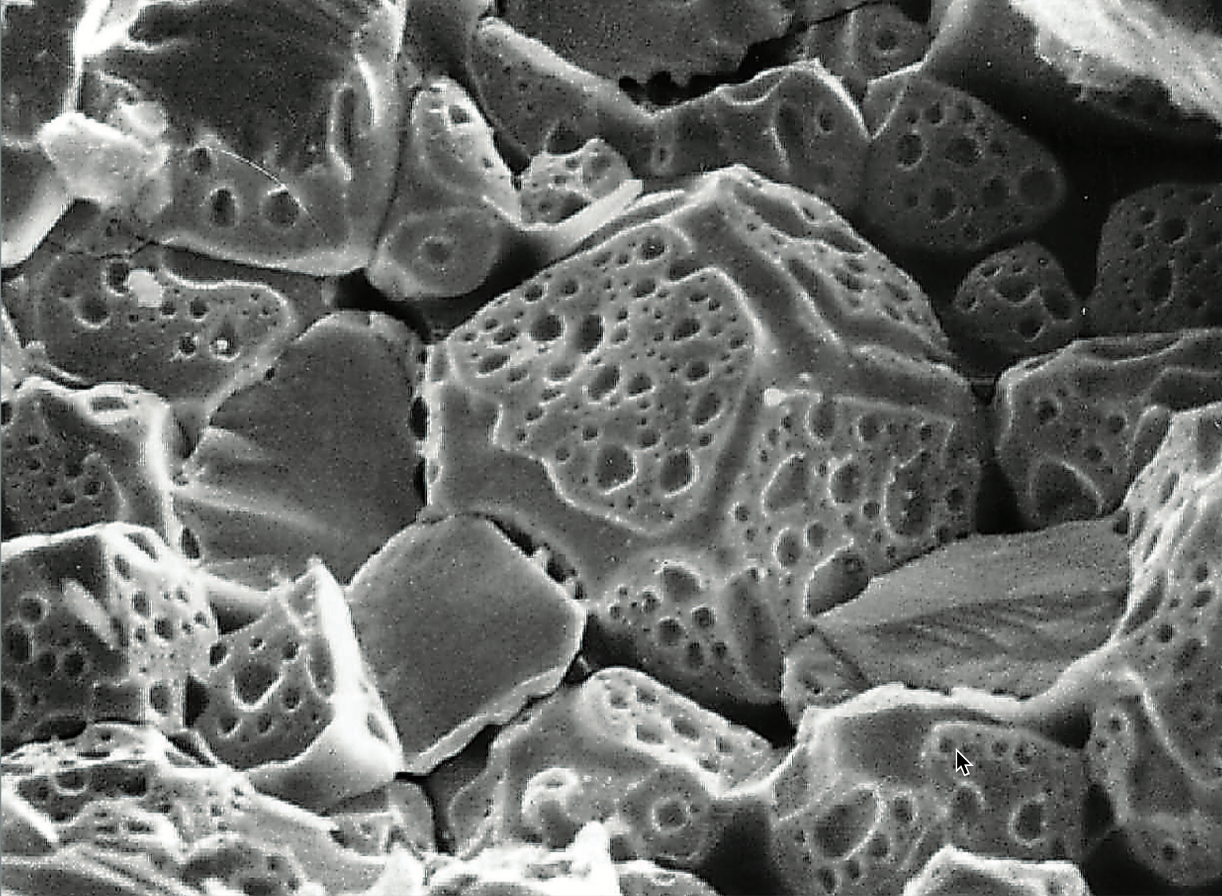
Fission Gas Release
Fission gases (Xe, Kr) are released in a process composed of three stages in UO2
Stage 1: Gas atoms are produced throughout the fuel due to fission and diffuse towards grain boundaries
Stage 2: Gas bubbles nucleate on grain boundaries, growing and interconnecting
Stage 3: Gas travels through interconnected bubbles to a free surface

Slide 21
UO2 Wrap-up
Reference fuel
Good behaviors
  Very high melting point, about 2800 C, Maintains a stable fluorite phase up to melting, Very compatible with Zircaloy clad, Relative stability in water, Reasonably radiation resistant
Bad behaviors
  Brittle, Poor thermal conductivity, Properties very sensitive to stoichiometry, Limited linear heating rates, Non-negligible thermal expansion/swelling
Fuel evolution is governed by fission products and their impacts
  change thermal conductivity, change chemistry, cause swelling, etc.

Slide 22
Advanced Fuel Types and Associated Reactor Types
Mixed Oxide (MOX) and U-Zr – Sodium Cooled Fast Reactors
UC/UCO – High Temperature Gas Reactors
UF4/UCl3 – Molten Salt Reactors

Slide 23
Mixed Oxides
UO2 can be combined with PuO2 for a mixed oxide (MOX) fuel for use in fast reactors
  fast reactor uses higher energy neutrons
  MOX also used in (thermal) light water reactors
Allows to burn excess weapons grade plutonium, or breed additional fuel isotopes
Less common is inclusion of minor actinides in MOX to burn waste
~30 reactors in Europe currently utilize a partial MOX core
Similar behavior to UO2, but different neutronics, fission gas release, thermal conductivity, etc.

Slide 24
Uranium-Zirconium (UZr)
Utilized in sodium cooled fast reactors (SFRs) - EBR I, EBR II
Varied crystal structure and compositional environment
Easily alloyed with Pu, minor actinides (MA)
Can function as a breeder/burner fuel
Sodium coolant
Fe-based cladding
Alloy with Zr to increase the melting point and to stabilize the high temperature body-centered cubic phase
Terrapower building Natrium reactor with UZr fuel

Slide 25
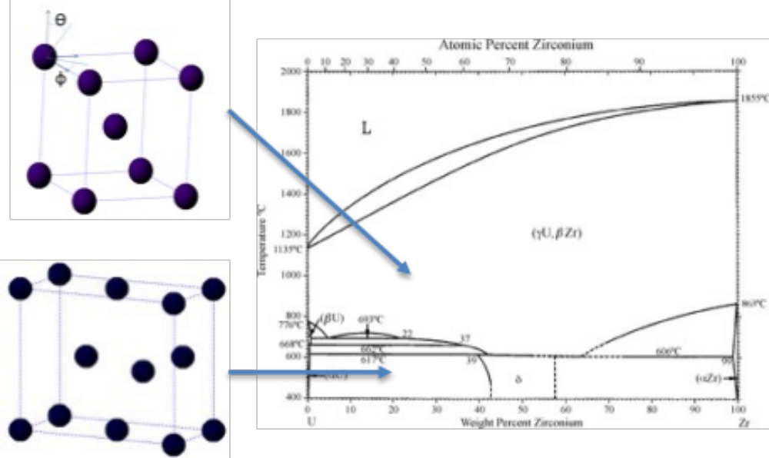
Uranium-Zirconium (UZr)
Phenomena of interest
  30-50% swelling
  Constituent redistribution
  Alpha tearing
  Fuel-cladding chemical interaction (FCCI)
Good: High thermal conductivity; Stability to high burnups (> 20%); Flexible composition; Inherent safety- negative reactivity feedback, etc.
Bad: Low melting point; Dramatic fuel swelling that must be accounted for; Incredibly complex microstructures; FCCI, Easily oxidized, etc.

Slide 26
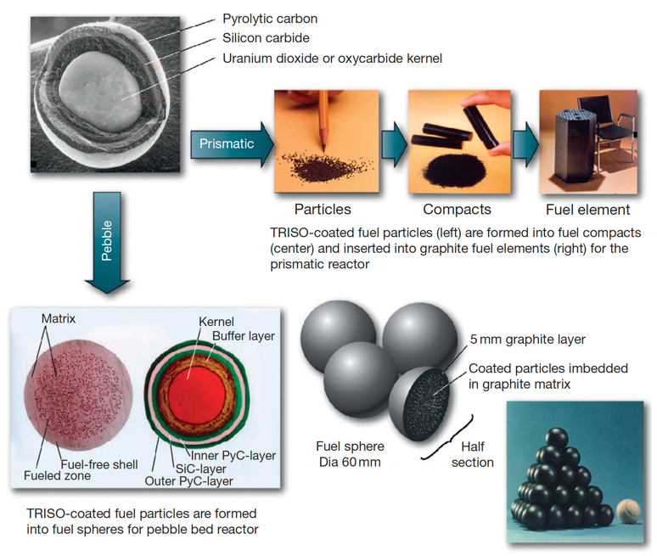
TRISO Particle Reactors
High temperature gas reactors (HTGRs) or molten salt reactors (MSRs) can utilize TRISO particles as the fuel source
Pebble bed and prismatic types of HTGRs
Particles are agglomerated with graphite into a larger pebble, or into a cylindrical block
Current designs utilize UCO (in the US), which is a heterogeneous mixture of UO2 and UC fuel
Helium cooled gas or molten salt cooled
X-energy and Kairos pursuing TRISO-fueled reactors

Slide 27
UC/UCO TRISO Fuels
TRISO: TRistructural ISOtropic particle fuel
Layered fuel in mm-sized particles
Layers:
  Fuel Kernel
  Buffer
  Inner Pyrolytic Carbon (IPyC)
  SiC
  Outer Pyrolytic Carbon (OPyC)
Advantages
  excellent safety: breach leads to minimal source term, low rates of failure, stable to very high temperatures
Disadvantages
  very sensitive to manufacturing processes, somewhat limited fuel loading

Slide 28
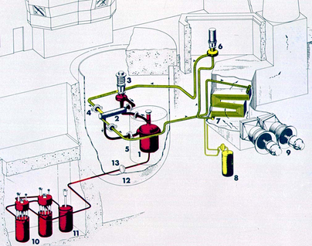
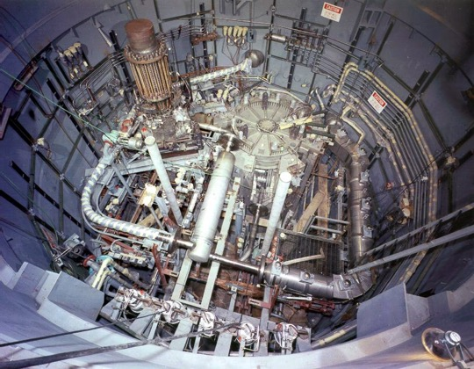
Molten Salt Reactors
Utilize molten salt (alkali/alkaline-halides), e.g., NaCl, as a heat transfer medium, functioning as coolant, fuel, or both
The molten salt reactor experiment (MSRE) operated at Oak Ridge in the 1960s and utilized flowing fuel molten salt: LiF-BeF2-ZrF4-UF4
MSRs can operate at ambient pressures and high temperatures
MSRs have a very large margin to boiling, and combined with a negative reactivity feedback coefficient, have inherent safety

Slide 29
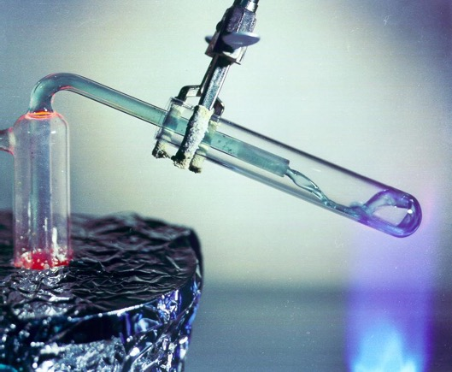
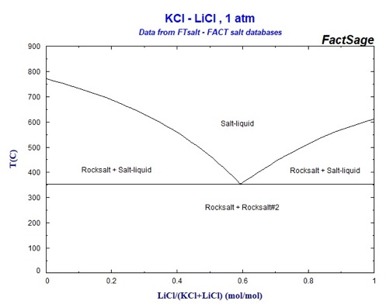
Molten Salt Reactors
Molten salts have high heat capacity, high boiling point, and high thermal conductivity, and can easily absorb fission products
The changing chemical composition of the salt as it is transmuted by reactor radiation leads to changing properties
The corrosivity of hot salts can break down cladding components and leech alloying elements
LWR-type reactor structural materials cannot be used, but some Ni alloys and graphite are sufficiently compatible with molten salts
MCRE, Kairos (salt coolant), ThorCon, Copenhagen atomics, and others

Slide 30
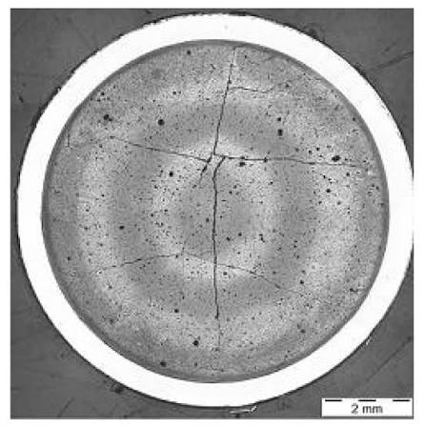
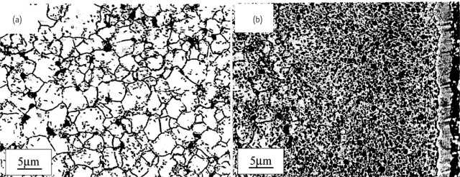
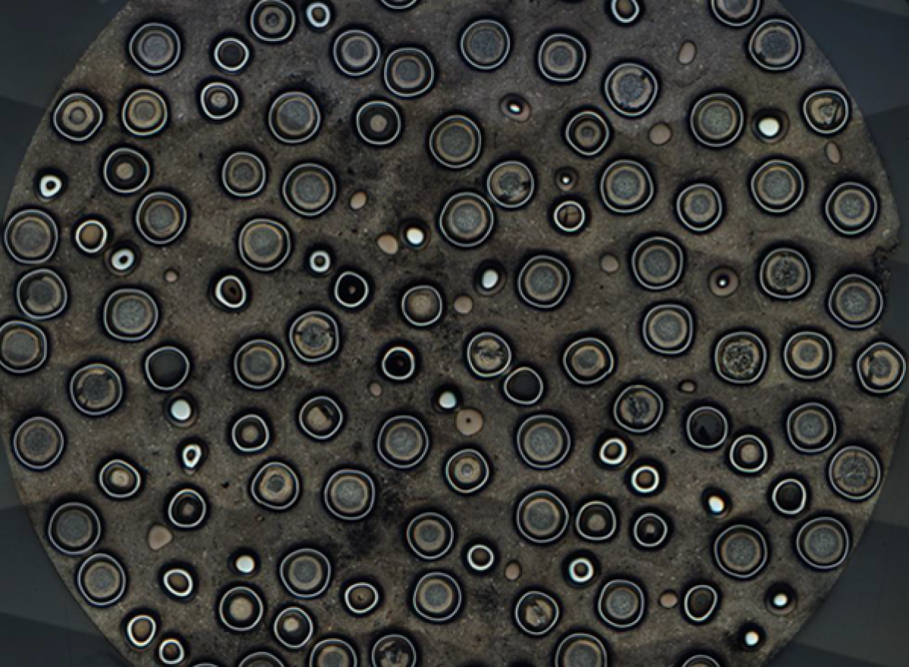
Summary
There exist a number of nuclear fuels in different stages of utilization and development
The more established ones are the less interesting ones… but still have a lot to understand
Active research on existing, underutilized, and developmental fuel designs
Each reactor design or application has individual needs, and no one fuel is one size fits all
Need to balance safety, performance (normal, off-normal, extended), manufacture, processing, waste, etc.
UO2
TRISO

Slide 31
How do we model advanced fuels?

Slide 32
My viewpoint/approach
Scientifically informed engineering is a multiscale problem
Critical phenomena need to be identified from the macroscale, and informed from the lower length scales
Perform good science, sometimes for science’s sake, but often to address a key engineering problem or need

Slide 33
Atomistic Modeler’s Toolkit
Density Functional Theory (DFT)
  is a computational quantum mechanical modelling method used to investigate the electronic structure of many-body systems, in particular atoms, molecules, and the condensed phases
Molecular Dynamics (MD)
  is a computer simulation method for analyzing the physical movements of atoms and molecules, determined by numerically solving Newton's equations of motion for a system of interacting particles
Yashima, https://doi.org/10.1039/C0CC00573H
Sand, https://doi.org/10.1016/j.jnucmat.2018.08.049

Slide 34
Atomistic Modeler’s Toolkit
ab initio Molecular Dynamics (AIMD)
  is a computer simulation method in which finite temperature molecular dynamics (MD) trajectories are generated with forces obtained from accurate 'on the fly' electronic structure calculations
  hybrid mixing between the accuracy of electronic structure calculations, while allowing for real temperature effects to be considered
Schnappinger, https://doi.org/10.1039/C7CP05061E
Yazyev, https://doi.org/10.1007/s00214-005-0052-6

Slide 35
DFT applied to Nuclear Fuels
Since we are dealing with the electronic structure, these calculations are very computationally expensive and limited to a few hundred atoms
Typically employed to calculate lattice constants, elastic constants, point defects, electronic densities, phonon DOS, etc.
DFT on advanced nuclear fuels has really only existed for about 15 years

Slide 36
DFT applied to Nuclear Fuels

Slide 37
MD applied to Nuclear Fuels
MD can span longer time scales and larger length scales, up to millions of atoms and nanoseconds
These simulations require interatomic potentials capable of accurately predicting a number of properties
No interatomic potentials for advanced nuclear fuels existed prior to about 15 years ago
Potential development is still a major area for research

Slide 38

MD applied to Nuclear Fuels

Slide 39
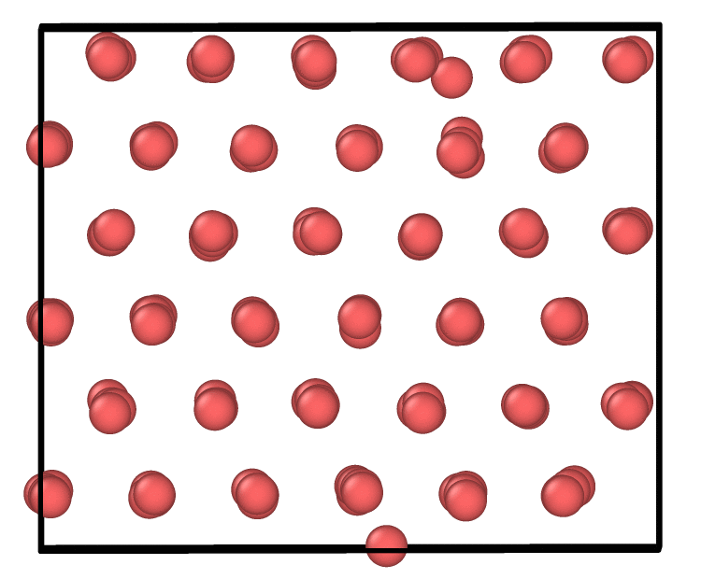
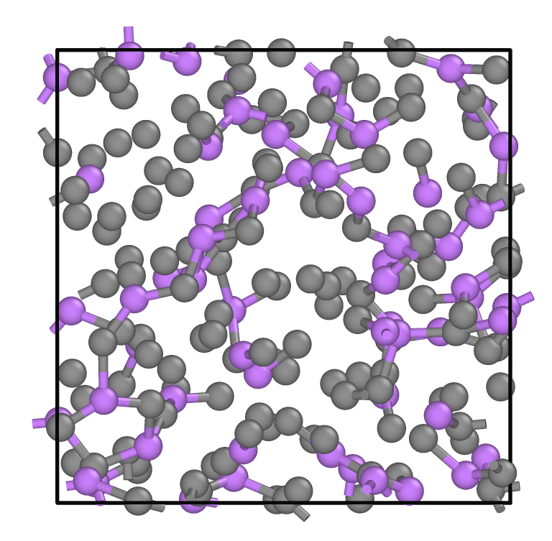
AIMD applied to Nuclear Fuels
Alpha U with int
Use highly accurate DFT, but add temperature/motion
Especially useful for unstable phases at 0 K and liquids to predict thermophysical properties, defects, free energies, etc.
Can be incorporated with machine learning models to generate interatomic potentials for classical MD
Being used extensively for molten salts
Eutectic LiCl-KCl

Slide 40
Integration into Fuel Performance Models
BISON is the multiphysics MOOSE-based fuel performance code developed under NEAMS and includes thermal transport, stress, and underlying material evolution, etc.
BISON requires models for material properties and how they evolve during operation
A lot of these fundamental properties are unknown, and too difficult to obtain experimentally
Lower Length Scale Modeling!

Slide 41
Summary
Scientifically informed engineering is a multiscale problem
There exist a number of scientific knowledge gaps for advanced nuclear fuels
Atomistic methods (DFT, MD, AIMD) are a rapidly growing area that can fill in a number of these gaps
Atomistic data can be implemented into higher length scale methodologies to increase fidelity of fuel performance simulations

