Slide 1
Nuclear Fuel Performance
NE-533
Spring 2023

Slide 2
Last Time
Pellet-clad interaction (PCI) takes two forms
Pellet-clad chemical interaction, PCCI (bonding occurs)
Pellet-clad mechanical interaction, PCMI (pellet pushes and drags cladding)
In order for SCC to initiate and propagate in any material, four conditions are simultaneously required:
A corrosive environment, a susceptible material, sufficient stress, and sufficient time
Two types of mitigation strategies to limit PCI failures

Slide 3
cladding oxidation

Slide 4
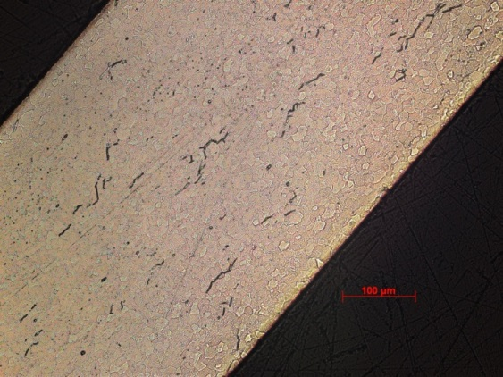
Zirconium Oxidation
Corrosion of zirconium due to the water coolant is one of the largest concerns for LWR fuel operation
Corrosion of zirconium alloys in an aqueous environment is principally related to the oxidation of the zirconium by the oxygen in the coolant, dissolved or produced by radiolysis of water
Zirconium interacts with water to make zirconia and hydrogen
Both the oxide layer and the hydrogen adversely impact cladding performance
ZrO₂
Zr metal

Slide 5
Corrosion
Corrosion is the degradation of a material and its properties under the action of the surrounding environment by chemical and/or electrochemical reaction
Corrosion reactions require the following:
Oxidant
Electric current
A corrosion reaction is composed of an oxidation reaction and a reduction reaction
During corrosion at a particular spot on the surface of the object, oxidation takes place, and that spot behaves as an anode
The electrons released at this anodic spot move through the metal and go to another spot and reduce H, which behaves as a cathode

Slide 6
Corrosion
Corrosion reaction rates are determined by thermodynamics and kinetics
Thermodynamics tell us whether a material may corrode
Measure voltage difference between anodic and cathodic sites
Kinetics tell us how quickly a material will corrode
Measure net current between anodic and cathodic sites

Slide 7
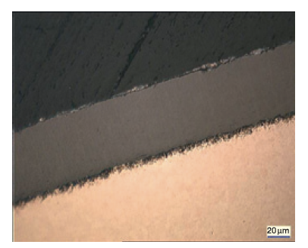
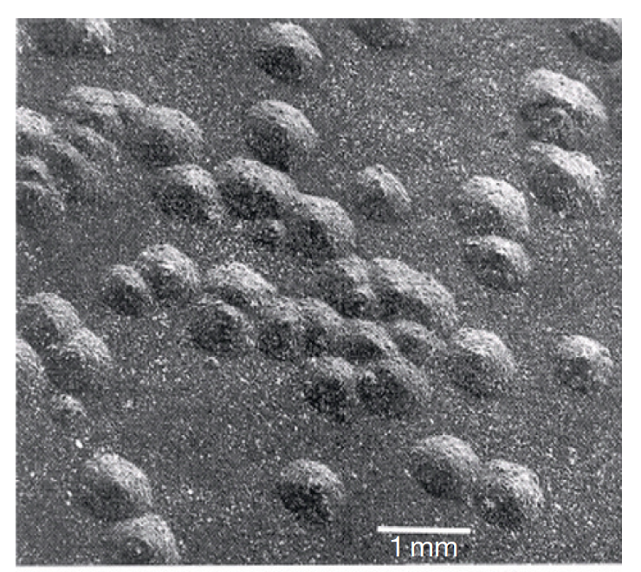
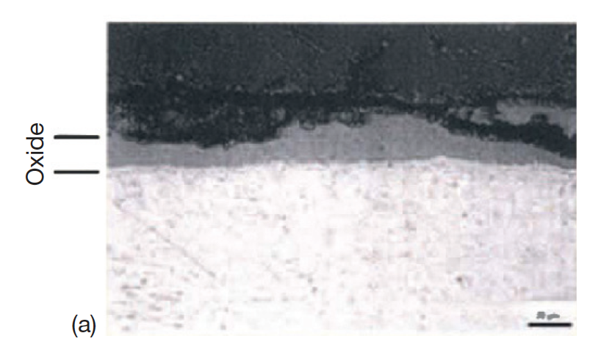
Corrosion Types in LWRs
Several types of corrosion morphologies have been observed in nuclear reactors and in autoclave experiments, of which the most important are: 1) uniform, 2) nodular, and 3) shadow
Uniform: The formation of a thin uniform layer of zirconium dioxide on the surface of a zirconium alloy component
Nodular : The formation of local, small, circular zirconium oxide blisters
Shadow: The formation of local corrosion regions that mirror the shape (suggestive of a shadow) of other nearby noble reactor core components

Slide 8

Formation of Oxide Layer After Oxide Formation
H₂0
Zr
H₂0
ZrO₂
Zr
O⁻²
e⁻
Oxidation reaction:
Dissociation of water at oxide/water interface
Absorption of oxygen into oxide layer
Diffusion of oxygen through oxide layer
Reaction of oxygen with zirconium
Diffusion of electrons through oxide layer
Reduction of hydrogen
Reduction reaction:

Slide 9
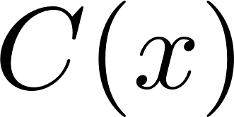
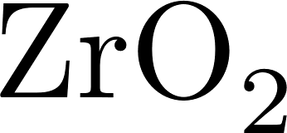

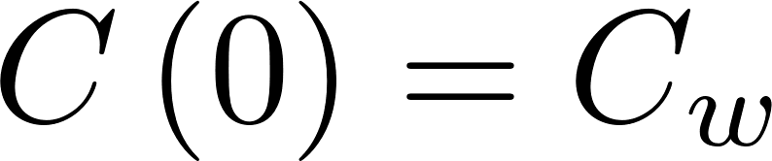
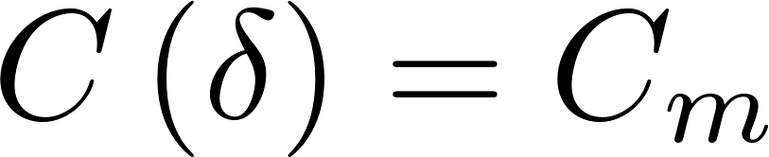

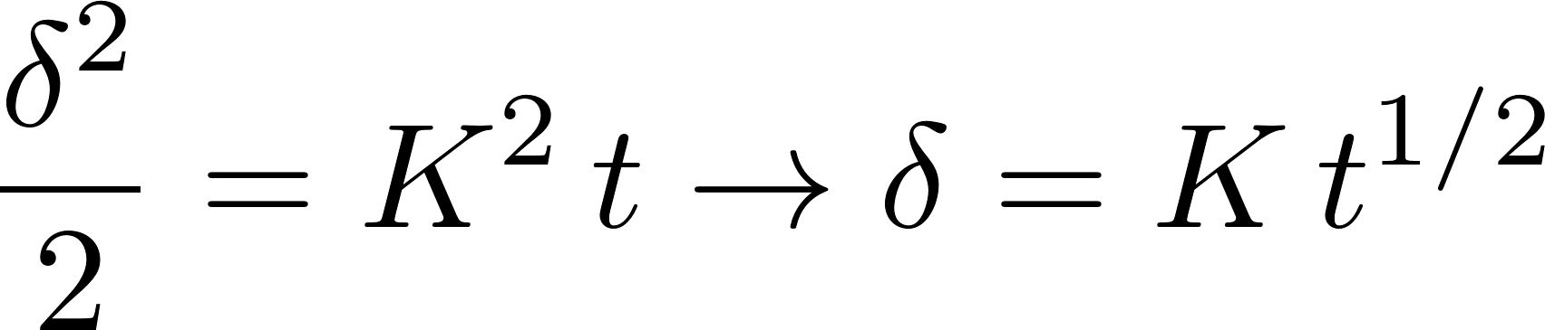

Corrosion rate limited by diffusion
Because the rate limiting steps are diffusion, we can model the oxidation rate using diffusion
Assumptions:
Transport of O species is rate-limiting
Transport of charged species by diffusion only
Homogeneous oxide layer
No sources/sinks of ions in oxide
All oxygen is used to create oxide
No loss of oxide

Slide 10
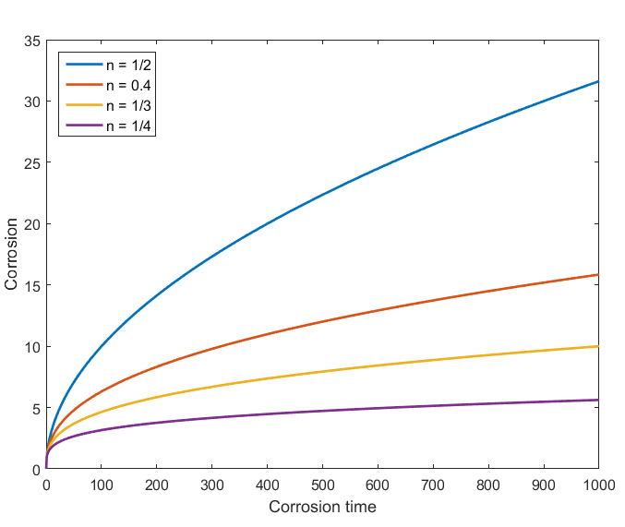
Observed kinetics are slower than parabolic
Parabolic kinetics
Diffusion of species across the oxide
Sub-parabolic kinetics
Additional ions in oxide
Non-uniform electric field in oxide layer
Once a nonhomogeneous electric field arises, the corrosion rate decreases to the sub-parabolic rate due to inhibition of transport of charged species

Slide 11
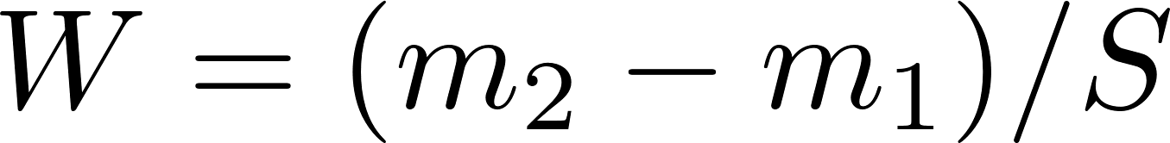
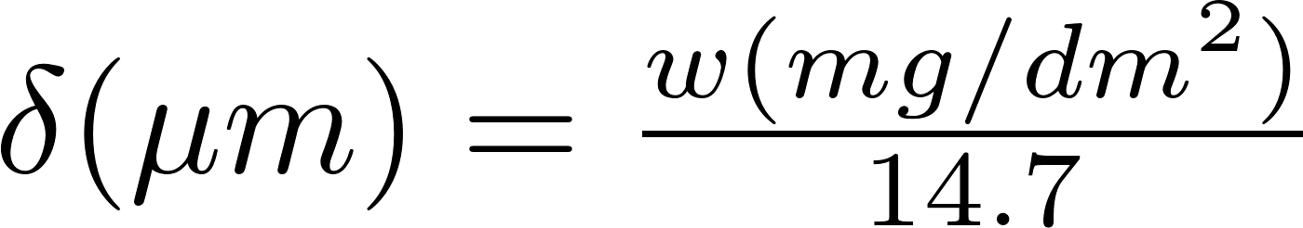
Corrosion Quantified
Corrosion is measured by sample weight gain
Oxidation of alloys is measured experimentally using the weight gain in mg/dm²
Oxide forms by incorporating oxygen in the metal structure causing an increase in weight
14.7 comes from density of O in ZrO2
Approximation weight gain – oxide thickness for Zr:
Dividing by the surface enables comparison between samples

Slide 12
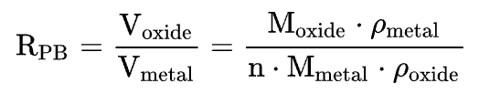
Pilling-Bedworth ratio : PBR
The ratio of the volume per unit of the metal oxide to the volume per unit of the corresponding metal is called the Pilling-Bedworth ratio (PBR)
PBR < 1: the oxide coating layer is thin, likely broken and provides no protective effect (for example magnesium)
PBR > 2: the oxide coating chips off and provides no protective effect (example iron)
1 < PBR < 2: the oxide coating is passivating and provides a protecting effect against further surface oxidation
Passivation refers to a material becoming "passive," that is, less affected or corroded by the environment
ZrO₂
Zr metal

Slide 13
Example
A corrosion coupon of ZIRLO measures 2.8 cm x 2.8 cm x 600 µm and has an initial mass of 3 g. After corrosion for 200 days, its final mass is 3.0721 g. What is the estimated oxide thickness?
First, we need to convert the units (10 cm = 1 dm)
Find area
S = 0.28*0.28 = 0.0784 dm²
Find mass change
dM = 307.21 - 300 mg = 7.21 mg
Then we calculate the weight gain per area
W = dM/S = (7.21)/0.0784= 91.96 mg/dm²
Last estimate the thickness
d = W/14.7 = 91.96/14.7 = 6.3 microns thick after 200 days

Slide 14
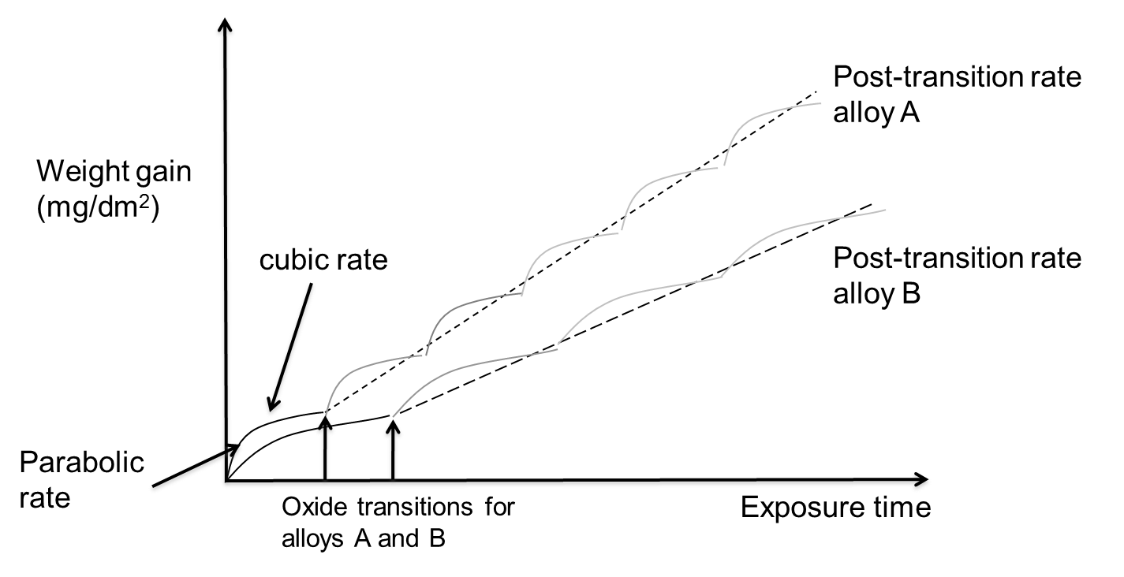
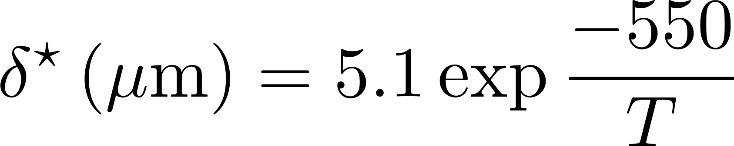
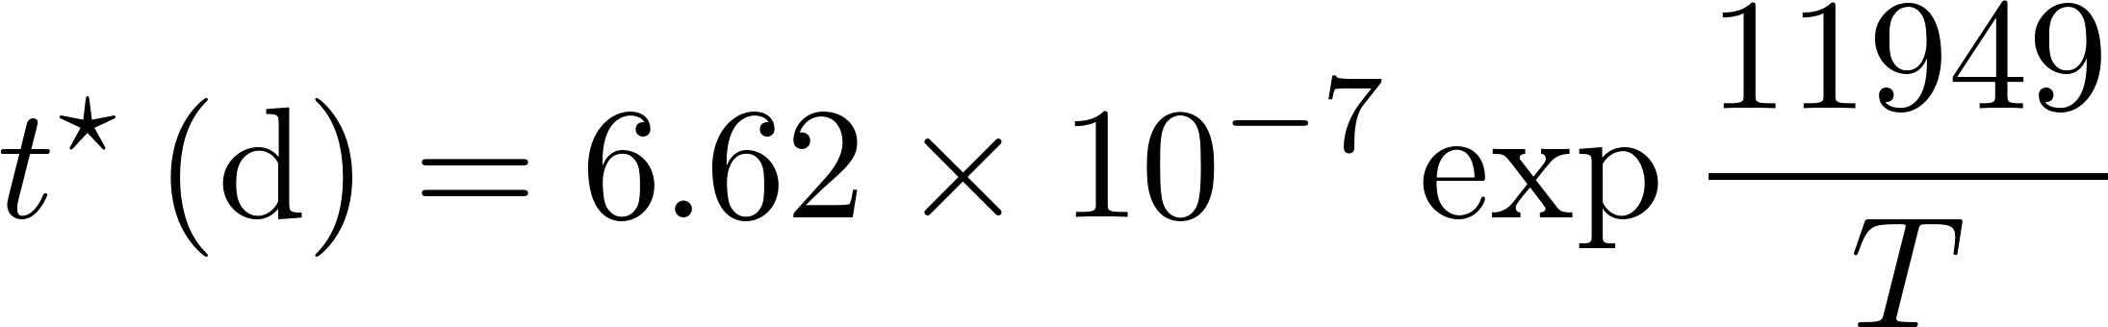
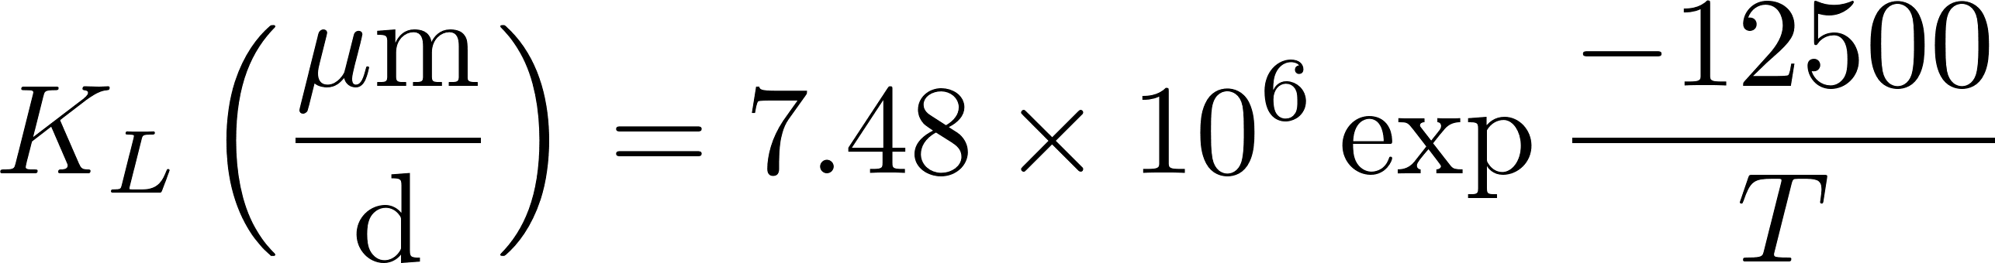
Corrosion Rate
Average weight gain of a sample follows linear kinetics
The oxide reaches transition at different times in different points, but the average is linear
Critical oxide thickness for transition is defined as
Critical time for transition is defined as
After transition, oxide thickness is

Slide 15
Example
Estimate the oxide thickness on a ZIRLO sample at 650 K after 200 days exposed to water.
First, we have to determine if the oxide has gone through transition
t* = 6.62e-7*exp(11949/650 k) = 63.76 days
So, the sample is past transition, so we need to use the linear fit
Next, we calculate the oxide thickness at transition
δ* = 5.1*exp(-550/650) = 2.19 microns
Now, we can compute the final oxide thickness
K_{L} = 7.48e6*exp(-12500/650) = 0.0333
δ = 2.19 + 0.0333*(200 – 63.76) = 6.73 microns

