Slide 1
Nuclear Fuel Performance
NE-533
Spring 2022

Slide 2
Notes
Had some pushback on additional project
This additional presentation project will be optional
Default grading scheme is in the syllabus
Opt-in grading scheme is outlined in last class
You must contact me to opt-in to the additional presentation
Distance students, please schedule your exam with me, even if it will take place during the class period
On campus students, please let me know if you will take the test virtually

Slide 3
Last Time
The average grain size in UO₂ impacts fuel behavior and performance
The material wants to reduce its energy by having large grains grow at the expense of small grains
Fuel densification is driven by reduction in surface area of pores – continuation of sintering process
Five families of fission products which uniquely change the fuel behavior
Fission gas is released in three stages
Fission gas production and diffusion to grain boundaries
Grain boundary bubble nucleation, growth, and interconnection
Gas transport through interconnected bubbles to free surfaces
Fission gas release is measured using post-irradiation annealing and/or in pile experiments

Slide 4
Fission Gas Release
Fission gas release models attempt to predict the rate at which gas is released from the fuel
To model fission gas release, ideally, we must model all three stages of gas release
Diffusion of gas atoms to grain boundaries
Growth and interconnection of grain boundary bubbles
Transport of gas atoms through interconnected bubbles to free surfaces
The earliest models only considered Stage 1
Most models now consider stage 1 and 2
There are no models that consider all three stages, but some are under development

Slide 5
Booth Model
The Booth model is the earliest model of fission gas release and only considers stage 1
A grain is considered as a simple sphere
Gas atoms are released at the grain boundary
The model solves the diffusion equation in 1D spherical coordinates
Assumptions
c_{g}(r, t)
All grains are spheres of radius a
D is constant throughout the grain
Gas is produced uniformly throughout the grain
Gas is released once it reaches the grain boundary
Release
Gas atoms
Grain boundary
ICs and BCs
c_{g}(r, 0) = 0
c_{g,r}(0, t) = 0
c_{g}(a, t) = 0 (release)

Slide 6
Modeling post-irradiation annealing
The initial gas concentration is c_{g}⁰
No gas is produced
Solving this equation tells us the value of c_{g} at any radius or time
However, we want to know the fraction of gas atoms that have made it to the grain boundary
We use the flux at the grain boundary
Release
Gas atoms
Grain boundary
ICs and BCs
c_{g}(r, 0) = c_{g}⁰
c_{g,r}(0, t) = 0
c_{g}(a, t) = 0 (release)

Slide 7
Solving the Booth Model
This equation is solved using a Laplace transform after nondimensionalization
Will not go through the derivation (shown in Olander)
τ = D x t / a²
Release
Gas atoms
Grain boundary
τ < π⁻²
τ ≥ π⁻²

Slide 8
Booth Example
For a diffusion coefficient for Xe of D = 8e-15 cm²/s, what fraction of the fission gas trapped in an post-irradiation annealed fuel pellet has escaped after one hour? It has an average grain size of 10 microns
D = 8e-15 cm²/s
a = 10e-4 cm
t = 3600 s
Which f? τ = D x t/a² = 2.88E-4 < π⁻² = 0.101
f = 6*sqrt(8e-15*3600/(pi*(10e-4)^2)) – 3*8e-15*3600/(10e-4)^2 = 0.0181

Slide 9
Different expressions for fission gas release
Given the data from the previous example, can plot both
τ < π⁻²
τ > π⁻²

Slide 10
Modeling in-pile release
The initial gas concentration is 0
Gas is produced due to fission, where y is the chain yield (y = 0.3017 for Xe and Kr) and the fission rate
Gas can also decay, where λ is the decay constant
If we only consider stable stable products, λ = 0
For in pile release, the fraction is equal to
After solving with with a Laplace transform
The total gas production is gas atoms/cm³
Release
Gas atoms
Grain boundary
ICs and BCs
c_{g}(r, 0) = 0
c_{g,r}(0, t) = 0
c_{g}(a, t) = 0 (release)

Slide 11
Example
For a diffusion coefficient for Xe of D = 8e-15 cm²/s, what fraction of the fission gas trapped in an in-pile fuel pellet has escaped after one hour? It has an average grain size of 10 microns.
D = 8e-15 cm²/s
a = 10e-4 cm
We have a short time (t=3600 s), so we can use:
f = 4*sqrt(8e-15*3600/(pi*(10e-4)^2)) – 3/2*8e-15*3600/(10e-4)^2 = 0.0121

Slide 12
As time progresses, both the fraction released and the produced gas increase

Slide 13
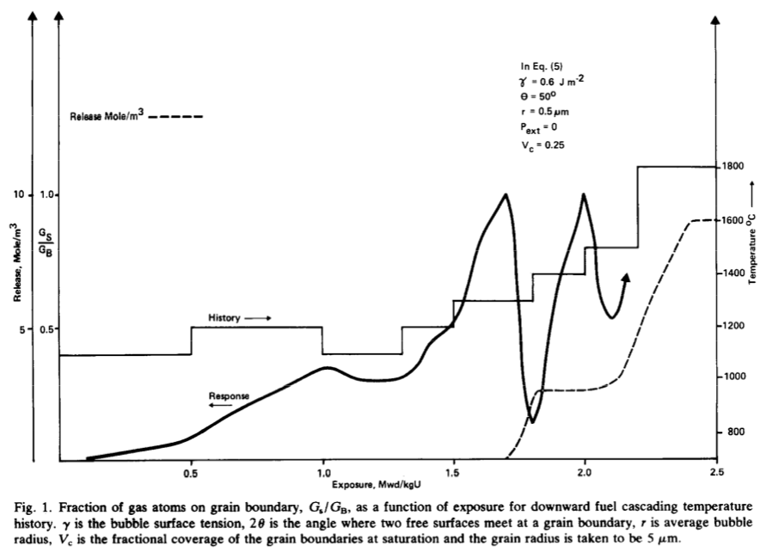
Forsberg-Massih model
The Booth model ONLY considers stage one of fission gas release
Two stage Forsberg-Massih mechanistic model
Considers intragranular diffusion diffusion to grain boundaries (stage 1)
Also, grain boundary gas accumulation, resolution back into grain, saturation (stage 2)
Assumes that once the bubbles on the grain face are interconnected, it is released (no stage 3)

Slide 14
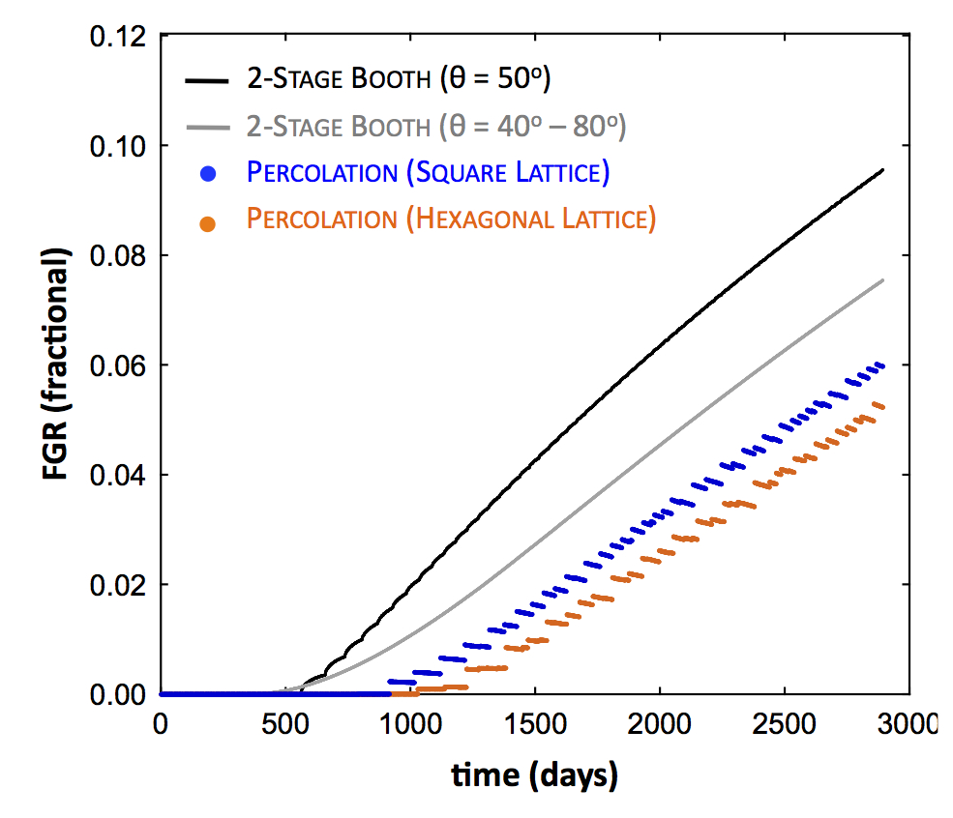
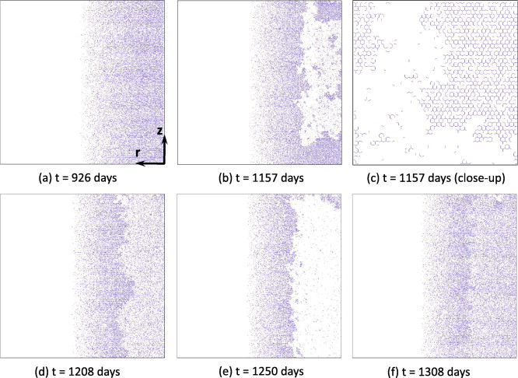
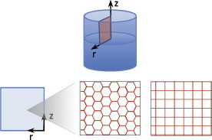
Forsberg-Massih model
2-stage F-M model over-predicts gas release because it neglects grain boundary bubble percolation (Stage 3)
Millett, Tonks, and Biner. JNM, 424.1 (2012): 176-182.

Slide 15
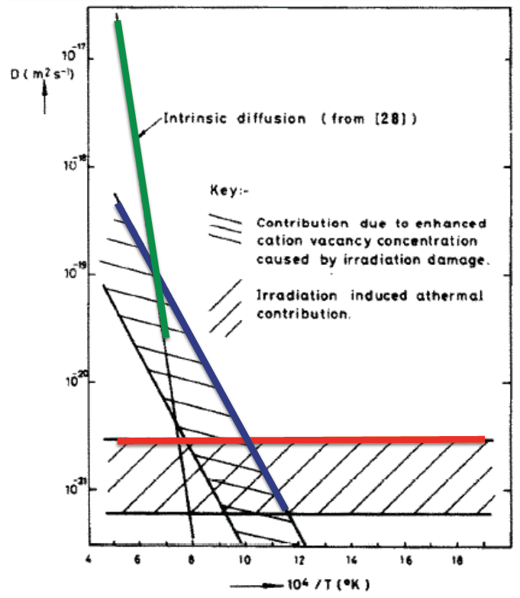
Gas diffusion
The diffusivity of the fission gas depends on temperature and on irradiation
Experimental data shows three different regimes for the diffusivity
D = D₁ + D₂ + D₃ cm²/s

Slide 16
Gas diffusion
The effective fission gas diffusivity is slower due to trapping by intragranular bubbles
As the gas atoms diffuse towards the grain boundary, some are trapped by the small intragranular bubbles
Some are later knocked out by energized particles (called resolution)
The effective diffusion constant depends on the trapping rate r_{t} and the resolution rate r_{r}

Slide 17
Summary
Fission gas release models are used to understand fission gas experiments and to predict gas release for fuel performance codes
Spherical grain models predict a fraction of gas release for post-irradiation annealing or for in-pile gas release
Fission gas diffusivity behavior changes with temperature and fission rate

Slide 18
Notes
Exam next Thursday
Open book
Exams are testing your conceptual knowledge and ability to implement the equations derived/provided
Conceptual knowledge questions should be able to be answered without consulting notes
Tests can be completed in the allotted time

