Slide 1
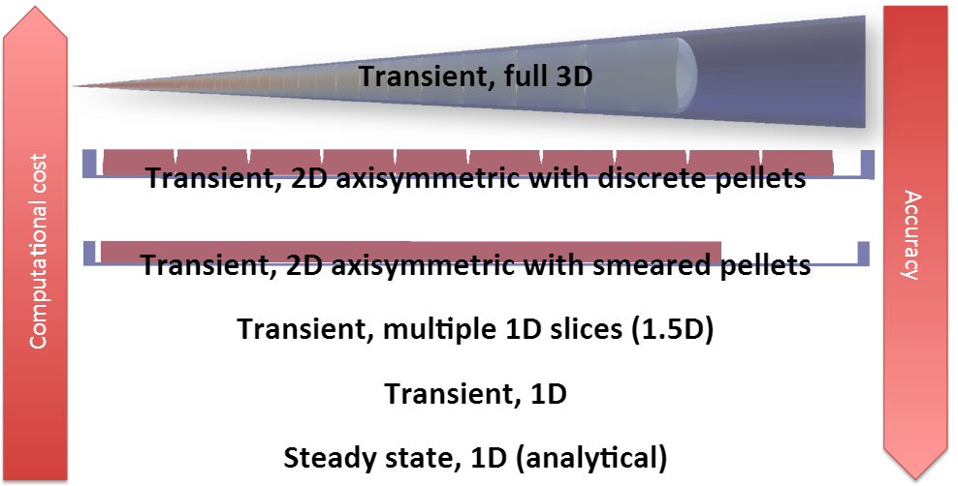
General Description of the Project
The goal of this project is to create a simple fuel performance code and use it to investigate different cases:
Case 1: Fuel, clad and gap properties are burnup independent
Case 2: Fuel, clad and gap properties are burnup dependent
Case 3: Simulation of loss of coolant accident
1-
MOOSE
2-
MATLAB
3-

Slide 2
Case 1: Fuel, clad and gap properties are burnup independent

Slide 3
1.5-D multiple slice approach
2-D smeared pellet approach (0-20×10³ s)
MOOSE
2-D smeared pellet approach (0-25 s)

Slide 4
Model comparison for Case-1

Slide 5
Case 2: Fuel, clad and gap properties are burnup dependent

Slide 6
1.5-D multiple slice approach
2D Smeared
MOOSE
T_{max}
T_{min}
2D Smeared

Slide 7
Model comparison for Case-2

Slide 8
Case 3: Simulation of loss of coolant accident

Slide 9
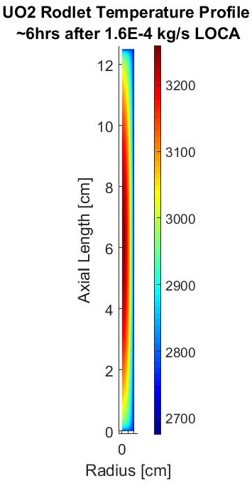
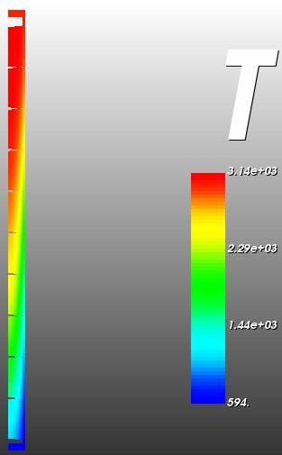
2D Smeared
MOOSE

