Slide 1
Fuel Fabrication
NE 591

Slide 2
Last Time
Mining -> Processing -> Conversion -> Enrichment -> Powder -> Compaction/Sintering -> Rod/Assembly
U₃O₈ must be converted to UF₆ for enrichment, which is then converted to UO₂ powder for pellet manufacture
For different fuel types, enriched UF₆ follows a different path

Slide 3
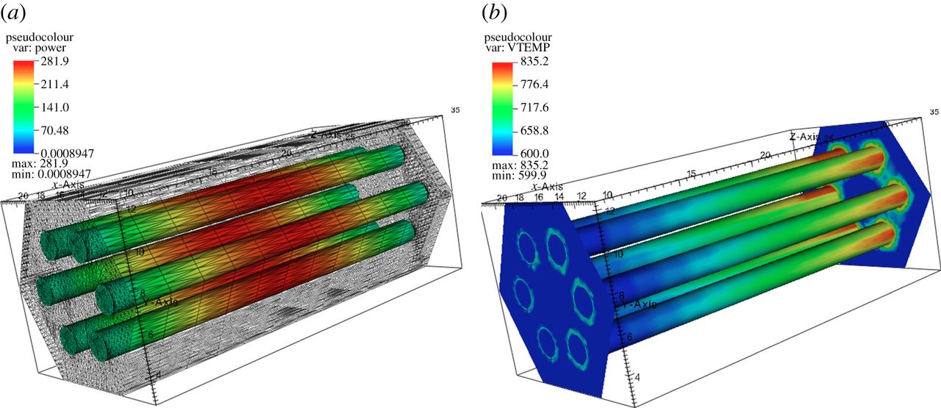
The heat generation rate is a function of the thermal neutron flux, which varies in time and space
Q = E_{f} N_{f} σ_{f} ϕ_{th}

