Slide 1
“Multiscale Simulations of Thermal Transport in W-UO2
Cermet Fuel for Nuclear Thermal Propulsion”, Sessim & Tonks – A Critical Review
Daniel Falkenbach
2/15/2022

Slide 2
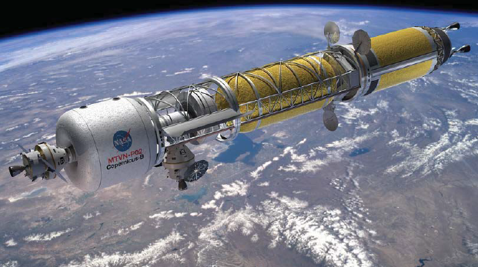
Scope
Critical review of the title paper, with discussion on what NTP/NTRs are, overview of some typical NTP FEs, what Cermet is, why the paper was written, and specific details as to the topics covered in the paper.
Details are also provided on what could have been done in paper and future considerations.

Slide 3
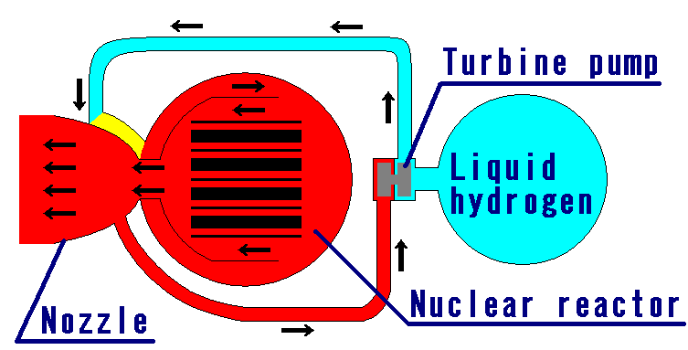

Introduction - NTR
What is a Nuclear Thermal Rocket (NTR) or Nuclear Thermal Propulsion system (NTP)?
  NTR = is a thermal propulsion system that uses nuclear fission to create heat
    Liquid hydrogen used as fuel/moderator (cryogenic)
    Turbopumps used to condition hydrogen (reach a certain required nozzle/reactor inlet pressure)
    Hydrogen flowing through the reactor moderates neutrons and starts nuclear fission chain reaction
    A product of the nuclear fission process is neutrons, fission products (such as Sr-90 or Cs-137), and energy (often in form of heat).
    Hot hydrogen flowing through CD-nozzle generates thrust
NTRs are beneficial as they provide high $I_{sp}$ (~850-950 s) and high thrust (25-75 klbf) for in space propulsion systems ($I_{sp}$ can be thought of as rocket efficiency).
  Provides more abort capabilities
  Increase Initial Mass in Low Earth Orbit (IMLEO)
  Faster transit times to Mars and interplanetary destinations given higher $I_{sp}$ & thrust
However significant technical challenges due to very hot reactor (around ~3000K FE temperature for 900 seconds $I_{sp}$), and hot hydrogen corrosion/embrittlement.

Slide 4
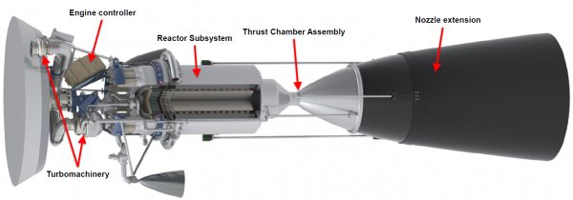
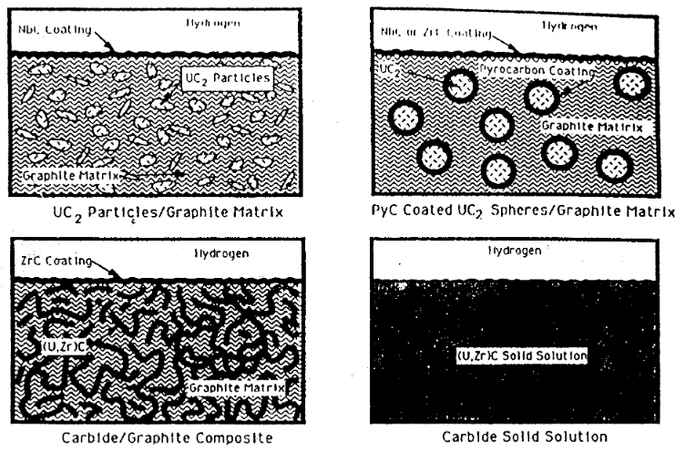
Introduction – NTR Fuel Forms (Cermet & others)
What fuels have historically been considered?
  U.S. Heritage fuel forms from 1960s NASA program “ROVER/NERVA”
  Originally started as a Joint Air Force/AEC program, called “Rover”
  NASA took the program over in 1959 and the program lasted until 1973
  Utilized graphite composite UC2 initially and ended with (U, Zr)C solid solution – Zr
  HEU design (highly enriched uranium) only
  Never flew and was only ground tested
HALEU now being considered due to non-proliferation concerns with HEU
Cermet or “ceramic-metallic” fuel forms originally developed in 1940s – related to paper
  UO2 and UN both considered in W matrix, however latter more recently considered in NASA programs up until 2021 (with Mo30W matrix) due to higher Uranium loading
Cercer or “ceramic-ceramic” fuel forms also being considered in addition to UC2 graphite coated forms (NERVA-like) in latest NASA/DARPA programs
Some Russian programs were considering tertiary carbides (U, Zr, Nb)C in twisted ribbon FE designs which provided higher temp operation

Slide 5
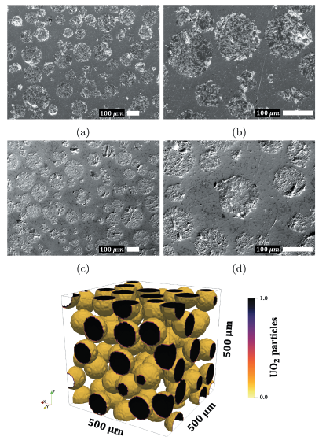
Paper Summary – Overview
General:
Analysis of steady-state (SS) thermal transport for UO2-W cermet fuel form as it applies to a NTR design.
Given UO2-W high temperature material data is severely lacking at the extreme reactor temperatures, an Effective Thermal Conductivity (ETC) for UO2-W was derived thru use of multiscale models (MARMOT & BISON), which are portion of MOOSE SW suite.
  MARMOT – Used to develop material models and determine ETC at mesoscale, derived from microscale SEM 2-D micrographs and extrapolated to 3-D
  BISON – Used the MARMOT derived ETC to predict SS heat transfer results in 61, 19, & 7 channel FEs – macroscale
2-D micrographs
3-D extrapolation

Slide 6
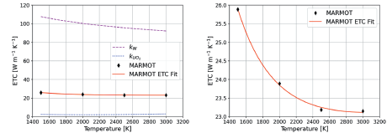
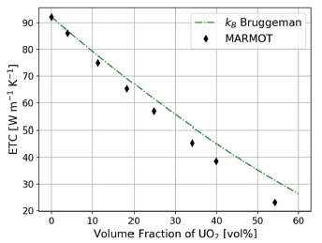

Paper Summary – Multiscale Models
Literature review and use of an empirical Fink model for $k_{UO2}$ & Tolias model for $k_{W}$ used as comparison:
$k_{UO2}=\frac{100}{7.5408+17.692t+3.6142t^{2}}+\frac{6400}{t^{\frac{5}{2}}}\exp\left(−\frac{16.35}{t}\right)$
  Where $t=\frac{T [kelvin]}{1000}$
$k_{W}=149.441−45.466E−3 T+13.193E−6 T^{2}−1.484E−9 T^{3}+\frac{3.866E6}{T^{2}}$
Bruggeman derived ETC (60% volume fraction applicable):
$k_{ETC}=k_{UO2}+\left(1−f_{V}\right)\left(k_{W}−k_{UO2}\right){\left(\frac{k}{k_{W}}\right)}^{\frac{1}{3}}$
  Where $f_{V}=vol fraction of UO2$
Bruggeman most applicable model given prototypic vol fraction 54.2% in this analysis:
  Final comparisons of MARMOT results to Bruggeman analytical model and results in delta of ~40%
  Discrepancy potentially due to Bruggeman model having uniform particle distribution (not assumed in MARMOT model)
~40%

Slide 7
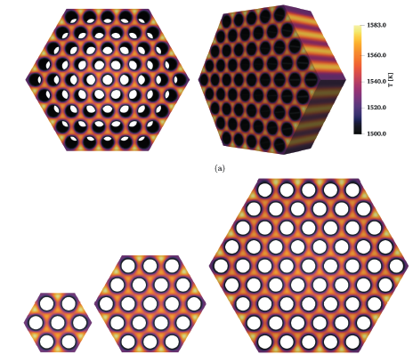
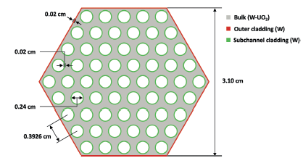
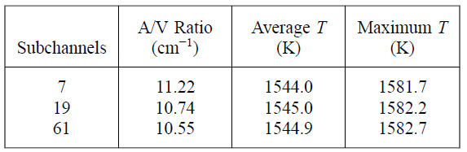

Paper Summary – BISON & Conclusion
The MARMOT material model and ETC was then used in BISON to analyze thermal transport of 3 different FE configurations:
  61 (prototypic), 19 and 7 (test) channel configurations analyzed with 1 cm thickness.
  BISON utilizes the following SS heat conduction equation:
    $∇k\left(\overset{⃑}{r},T\right)∗∇T\left(\overset{⃑}{r},T\right)+\dot{q}\overset{⃑}{r}=0$
      $$where k\left(\overset{⃑}{r},T\right)=k at a given position \overset{⃑}{r} and temp T$$
      $\dot{q}=bulk heat generation due to fission$
All 3 analyzed FEs assumed 0 flux at BCs
61 - channel
19
7

Slide 8
Paper Summary – The 3 main “whys”
Due to the very hot temperature (3000K) of an NTP reactor, many material data gaps exist in the planned materials and is considered a high technical risk for current NTP programs. Given this, an analytical “guess” was required to provide a better starting point for larger scale models and inform prototypic FE/reactor testing.
  While it only provides a guess for thermal transport of this fuel form, it provides an answer where no alternative data existed – can be used to begin correlation of higher fidelity models and reduces risk for any prototypic reactor or fuel testing.
Demonstrates that MARMOT & BISON can be used for UO2 NTP fuel forms and provides confidence that similar assessments for other NTP fuel forms (e.g. Cercer, graphite composites, etc.) could be completed successfully.

Slide 9
Critique - What should have been done?
The Cermet microstructure utilized was derived from SEM micrographs of depleted Uranium. This should be reassessed utilizing a HALEU-level U enrichment as the micrographs were used to model MARMOT.
Due to current US non-proliferation considerations, W-UO2 analyzed (HEU >20% U-235 applicable); however, the study should be repeated utilizing more modern fuel forms that are applicable to HALEU (5-19.75% U-235) & higher Uranium loading NTP designs – e.g., UN, UC2, (U,Zr)C (NERVA-like) FEs.
ETC <1500K via MARMOT should have been considered. NTP reactors have much lower reactor inlet temperature possible (as low as 20K).
The analysis waws ignoring the heat transfer between W & UO2, however this should not be ignored as it could result in significant thermal transport impacts.
In plane thickness of BISON FEs should be extended from 1 cm to full FE length (1 meter), and ETC as a function of axial position should be derived.

Slide 10
Critique - What should have been done? (cont.)
Heat soak of liquid hydrogen and its impact on reactor temps not considered as contributor, however impact to FEs and heat sink likely non-negligible.
  Additionally, large thermal gradient across FE would result in significant thermal stresses
Zero flux boundary assumed in BISON; however, neutron radial reflectors exist and its effect on neutron economy as well as impact of edge heating/hot spots should be assessed as likely critical to overall performance of FE
  Additionally, it’s expected that more channels would provide a much larger surface cooling area-to-volume ratio and thus a much larger maximum T is expected than what was concluded – the BCs should be assessed and each subchannel configuration FE should have its own initial/boundary conditions.

Slide 11
Considerations - What could be done next?
FE burnup, microstructure evolution, and void growth/irradiation effects not considered – however those and other transient effects should be considered in future analyses.
Variation in W feedstock and UO2 purity possible, and sensitivity analyses should be performed.
Varying volume fractions of UO2 (or other fuel) could be considered
3-D scans of UO2 (or FE of interest) should be used to develop more accurate MARMOT models materials (as opposed to 2-D micrographs and running scripts).
Multiphysics analysis including neutronics simulations, fluid, thermal, and structural coupled together should be considered with MOOSE SW suite.

Slide 12
Thank you
Feel free to reach out to me with any questions you might have:
Email: djfalken@ncsu.edu

Slide 13
References
[1] – Slide 2 image “AIAA-2014-3623”, Borowski, Nuclear Thermal Rocket Propulsion for Future Human Exploration Missions.pptx
[2] – Slide 3 Image “Generic NTR”, https://commons.wikimedia.org/wiki/File:Nuclear_thermal_rocket_en.png
[3] – Slide 3 Image “NERVA Engine”, https://www1.grc.nasa.gov/historic-facilities/rockets-systems-area/7911-2/#b1-test-of-an-axialflow-pump
[4] - Marina Sessim & Michael R. Tonks (2021) “Multiscale Simulations of Thermal Transport in W-UO2 CERMET Fuel for Nuclear Thermal Propulsion”, Nuclear Technology, 207:7,1004-1014, DOI: 10.1080/00295450.2021.1910005[5] – “SNPO-NPRD-1 - NERVA Program Requirements Document”, https://fas.org/nuke/space/nerva-req.pdf
[5] – “An Assessment of Fuels for Nuclear - Thermal Propulsion”, S. K. Bhattacharyya
[6] – Slide 4 image “Figure 1: CAD Model of a Nuclear Thermal Propulsion (NTP) Engine Assembly”, https://www1.grc.nasa.gov/research-and-engineering/nuclear-thermal-propulsion-systems/

