Slide 1
Modeling Reactivity Insertion Experiments of TRISO Particles in NSRR using BISON
Presentation by Robert Gentile

Slide 2
Introduction
TRISO fuels being considered for wide range of advanced reactors
Under RIA, kernel may experience rapid expansion & melting
Work focuses on modeling TRISO behavior using BISON
Two failure mechanisms considered

Slide 3
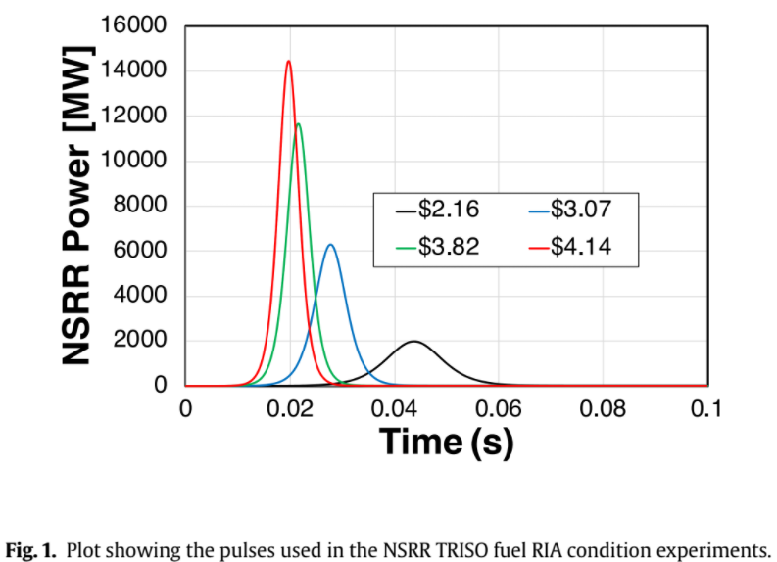
Experimental Data
Data and calculations published by Umeda et. al.
Validation calculation falls in correct range

Slide 4
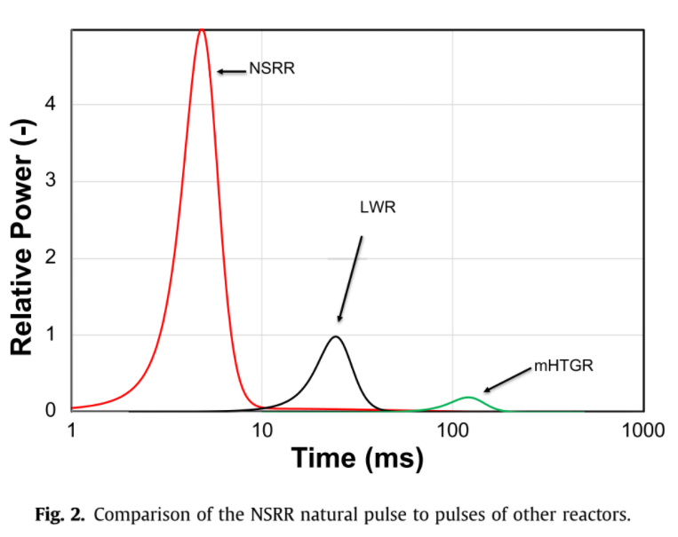
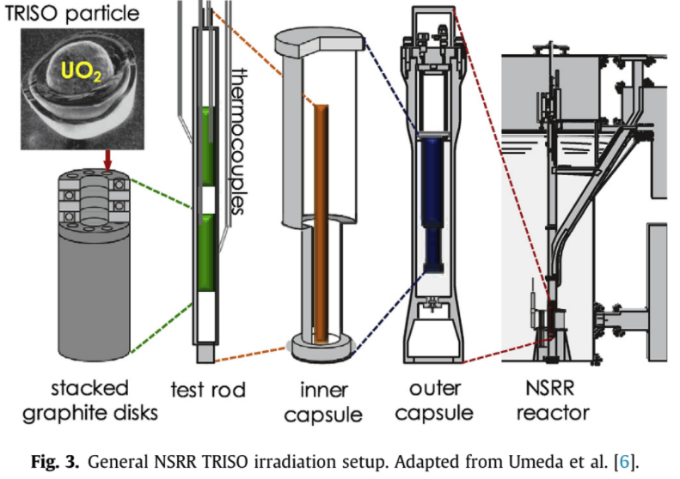
Experimental Data

Slide 5
BISON and Material Models
Finite element code based on MOOSE
Some irradiation models not included in simulations
Primary material properties
Specific heat
Thermal expansion
Thermal conductivity
Density
Elastic modulus
Thermal Conductivity
UO₂ capped at 2670 K
Specific Heat
UO₂ capped at 2670 K
Coefficient of Thermal Expansion
UO₂ set to correlation form MATPRO

Slide 6
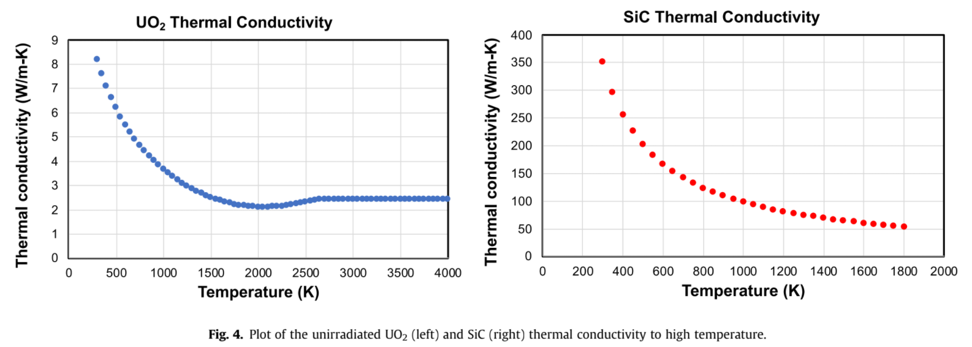
BISON and Material Models

Slide 7
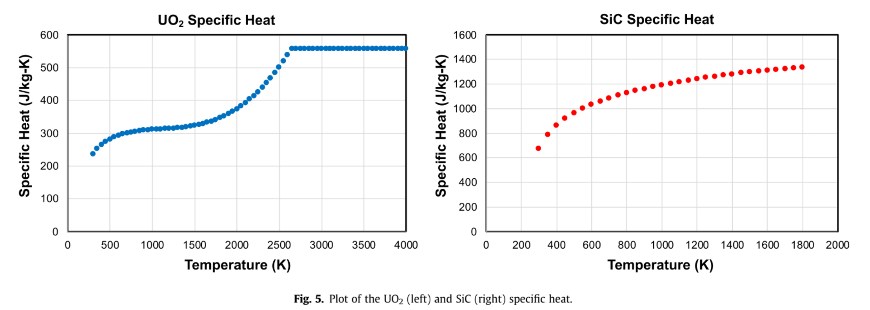
BISON and Material Models

Slide 8
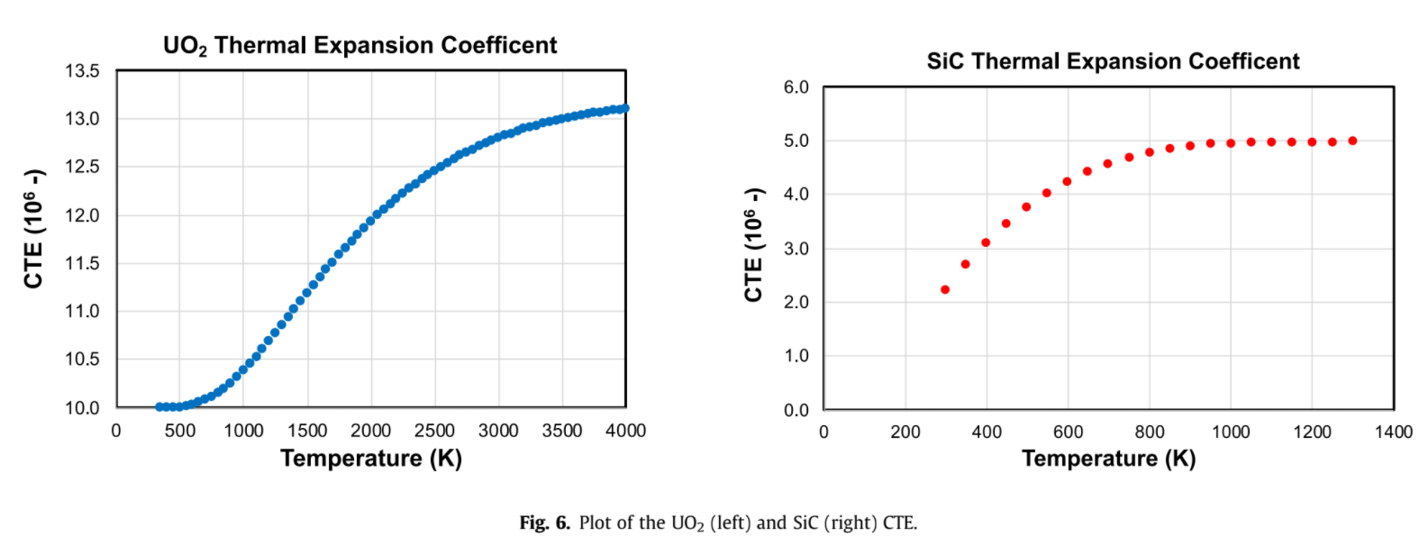
BISON and Material Models

Slide 9
Model Description
Single TRISO particle surrounded by graphite shell
Interface debonding not permitted
3D mesh used
Simulation run at 10s initial condition, stopped 1s after initiation
0.5ms timesteps used during transient

Slide 10
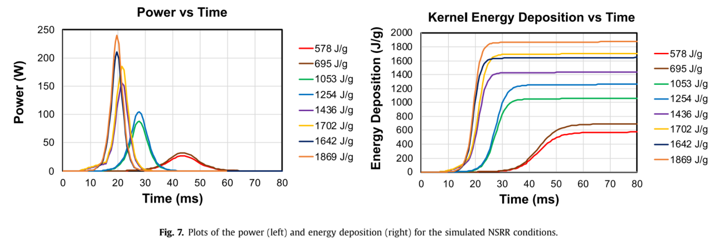
Results

Slide 11
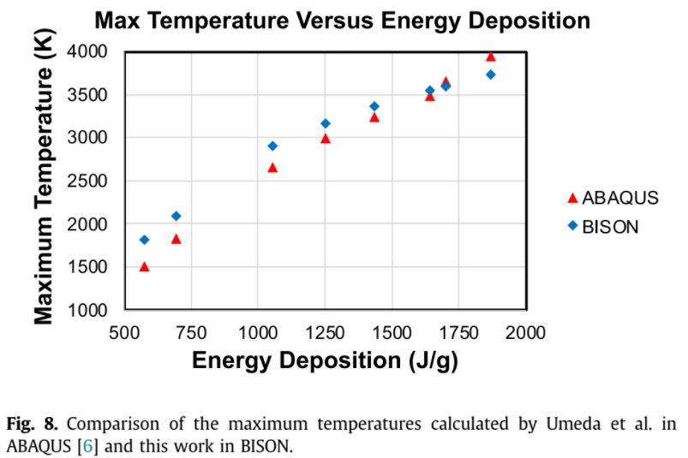
Results

Slide 12
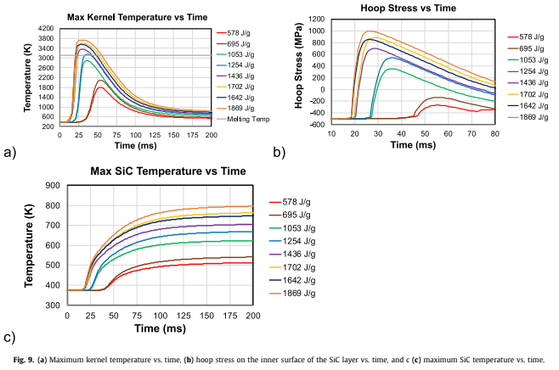
Results

Slide 13
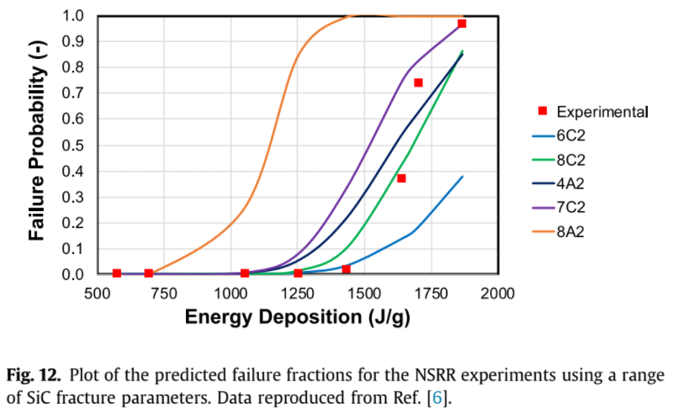
Results

Slide 14
Summary and Future Work
Simulated set of TRISO particle transient irradiation experiments from NSRR
Obtained reasonable agreement in max temperature calculations and experimental SiC fracture probability
Fuel melting predicted at same energy deposition as onset of SiC fracture
Future Work and Improvements:
Simulating longer pulses and determining stresses in other relevant matrix materials
Capturing effects of burnup and fast neutron flux on kernel & layers
Acquiring material property selections from ABAQUS simulations

