Slide 1
Multiscale modeling of fission gas behavior in U3Si2 under LWR conditions
T. Barani, G. Pastore, D. Pizzocri, D.A. Andersson, C. Matthews, A. Alfonsi, K.A. Gamble, P. Van Uffelen, L. Luzzi, J.D. Hales
NE 533 Paper Critique Project
Patrick Hartwell
North Carolina State University
Nuclear Engineering Department

Slide 2
Why Triuranium Disilicide instead of Uranium Dioxide?
Higher Uranium density and better thermal conductivity.
Under wet, high temperature conditions, such as are created in a fuel cladding rupture, UO2 reacts with water and produces several compounds which degrades the cohesion of the UO2 and results in the release of the fission products. U3Si2 Under the same conditions forms a protective coating of the uranium mineral Coffinite which insulates the remaining fuel and fission products from being dispersed in the coolant after a rupture.

Slide 3
Multiscale Modeling of Fission Gases
Lower-length scale modeling-
Density functional theory
Intra-granular re-solution
Engineering scale modeling-
Intra-granular fission gas behavior
Inter-granular model

Slide 4
Lower-length scale modeling
Density functional theory
Quantum mechanistic modeling method.
Used to calculate formation energies, diffusivity coefficients etc.
Diffusivity coefficients for Xe atoms and U 2a Vacancies.
Mostly imported values from Density functional theory calculations of self- and Xe diffusion in U3Si2. By D. A. Anderson, X. -Y, Liu, B. Beeler, S. Middleburgh, A. Claisse, C. Stanek.
Greatly approximated for order of magnitude results.

Slide 5

Lower-length scale modeling
Intra-granular re-solution
R Rate of atomic re-solution
F Fission rate
a0 re-solution probability function
n number of atoms in a bubble
rho bubble concentration distribution function
Rb radius of spheres

Slide 6
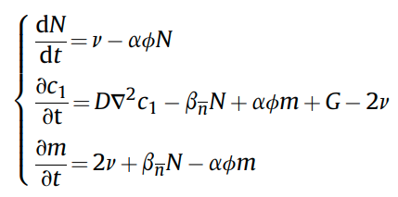
Engineering scale modeling
Intra-granular fission gas behavior
N total number of bubbles.
v nucleation rate of fission gas dimers
a re-solution rate
aΦ probability per second of bubble destruction
Bn trapping rate of gas atoms into intra-granular bubbles
c1 concentration of atoms in the matrix
G production rate of gas atoms
M total concentration of gas in bubbles
D diffusion coefficient of single gas atoms in the fuel matrix

Slide 7


Engineering scale modeling
Inter-granular model
Ngf variation rate of the bubble number density
Vgf grain face bubble volume
Rgf grain face bubble radius
rgr the grain radius
Φ(Θ) geometric factor relating the volume of a lenticular bubble to that of a sphere
Θ Semi-dihedral angle of the grain boundary bubbles

Slide 8
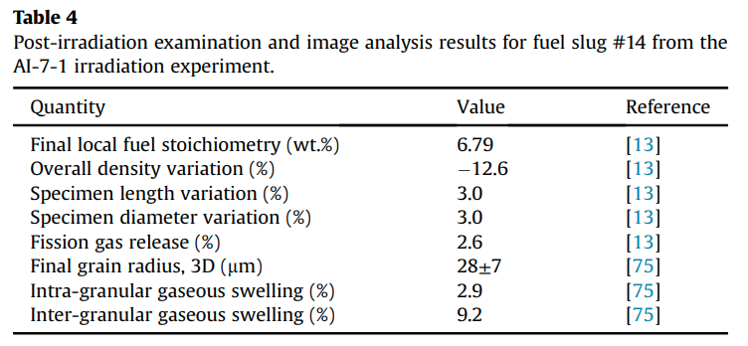
Irradiation Experiment Data

Slide 9
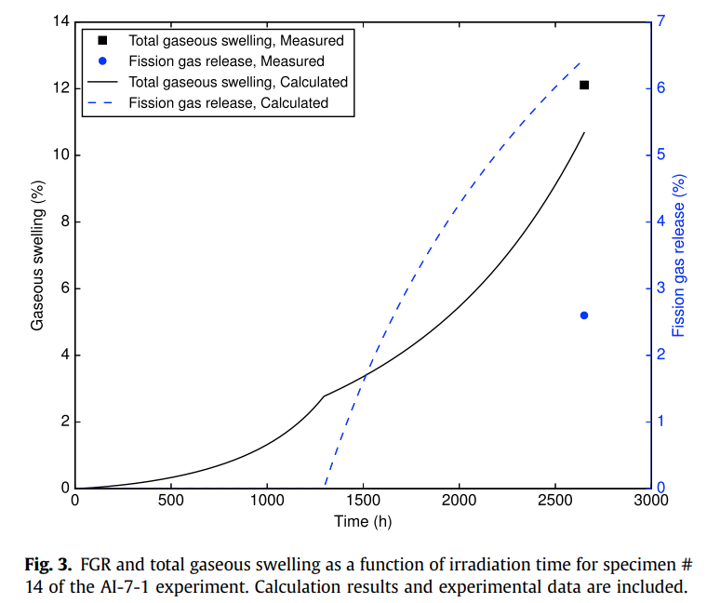
Calculated vs Measured Data

Slide 10
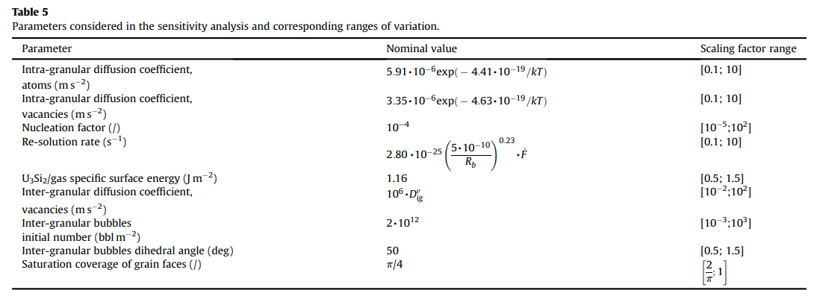
Sensitivity Analysis

Slide 11
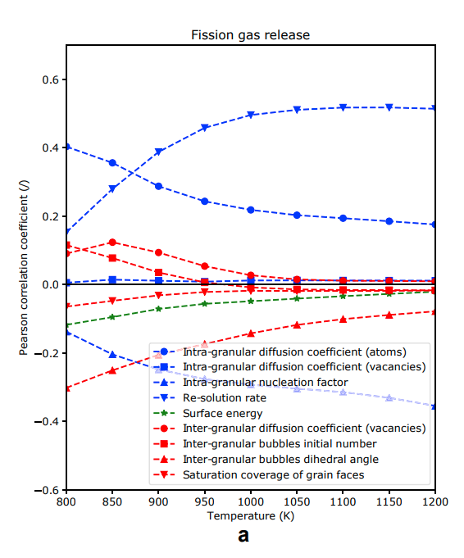
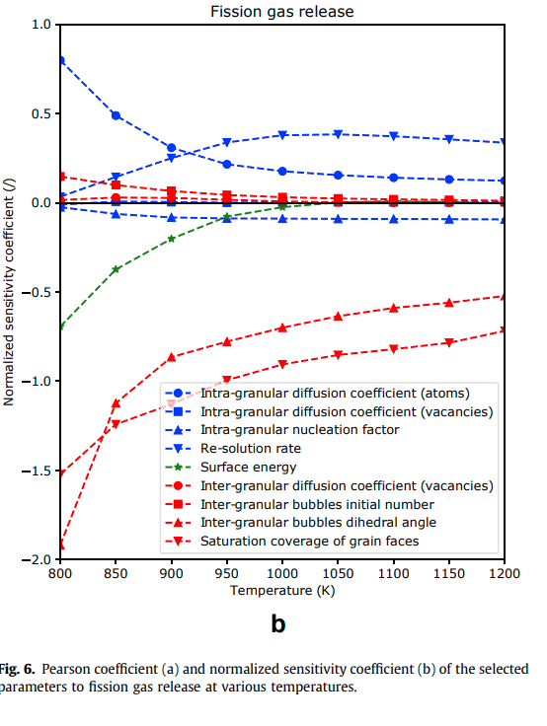
Sensitivity Analysis

Slide 12
Validation
Order of magnitude accurate according to limited data
Sensitivity analysis provides basis for future improvement prioritization.

Slide 13
Critiques/Future improvements and work
General neglect of irradiation components of every stage of modeling.
Low exposure of sole experimental data providing favorable bias.
Lack of material specific coefficients.

