Slide 1
Paper Review
“Modeling and simulation of oxygen transport in high burnup LWR Fuel”
Authored by Srdjan Simunovic, et al.
Reviewed by: Jess Williams
NE 533
15 February 2022

Slide 2
Introduction
Methods
Results
Discussion
Conclusions
Suggestions

Slide 3
Introduction
Objective: The objective of the study detailed in this paper is development of a modeling and simulation approach for oxygen transport in LWR fuel that incorporates the effects of irradiation.
The evolving oxidation state and composition of nuclear fuel strongly influences the performance and safety of reactor operations.
Such a model could enable future engineering applications such as predicting fuel failures under normal operating conditions or assessing fuel integrity under disposal conditions.

Slide 4
Methods
Formulate a computational model for oxygen transport in LWR fuel by applying irreversible thermodynamics within a FEM framework.
Calculate temporally and spatially varying elemental composition as a function of burnup using ORIGEN-S.
Incorporate computed compositions into oxygen transport model and implement in BISON fuel performance code.
Perform thermochemical calculations with Thermochimica and couple to BISON.

Slide 5
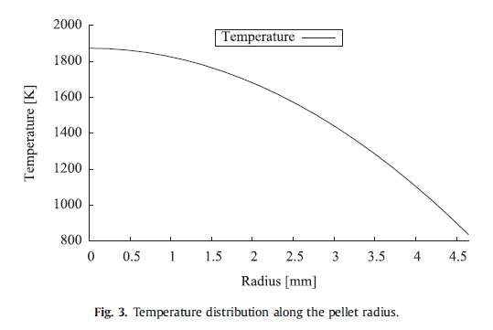
Testing the Modeling Approach
A simple fuel pellet problem with a parabolic temperature profile applied for one year was used to test the modeling approach developed in this study.
Two cases examined:
Case 1: Only considers the effects of time and the temperature gradient on oxygen transport. Fission products not considered.
Case 2: Considers the effects of irradiation in addition to the effects of time and the temperature gradient on oxygen transport using the developed modeling approach.
Notes:
Centerline temperature: 1873K ; Pellet surface: 835K
Pellet diameter: 9.3 mm
Chose parabolic temperature profile to simulate effects of volumetric heat source with low thermal conductivity
Fuel composition UO2.005

Slide 6
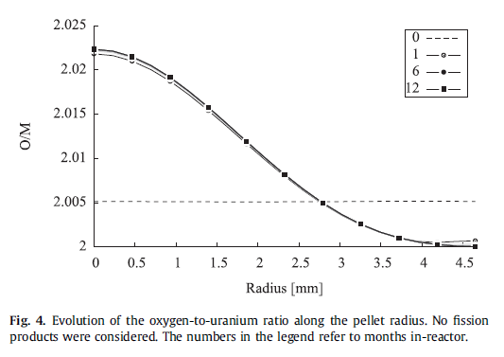
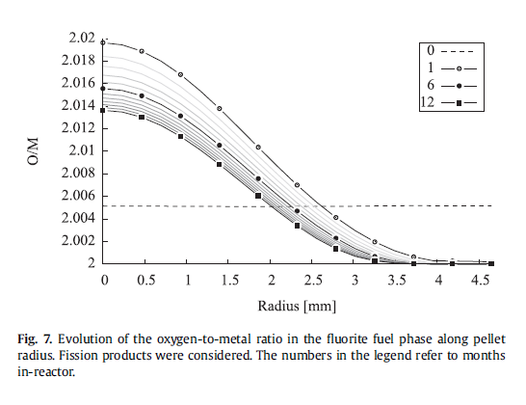
Results
The evolution of the O/M ratio and the chemical potential were examined for each case.
O/M Ratio: For the first case, there was not a significant difference between the different irradiation lengths. However, for the second case, the ratio flattened as irradiation time increased.

Slide 7
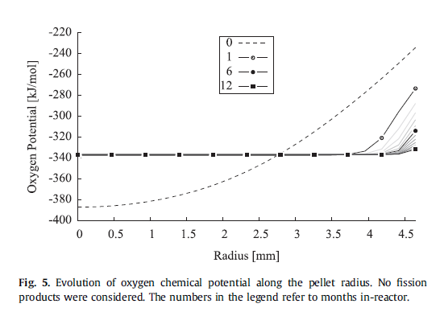
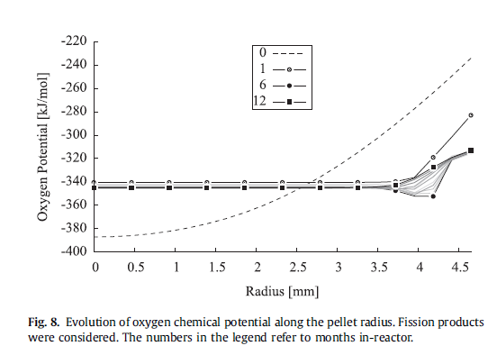
Results Continued
Oxygen Potential: For both cases, the oxygen potential after a year is approximately constant across the pellet except at the periphery of the pellet where oxygen mobility is low due to the relatively low temperature.

Slide 8
Discussion
The first case was consistent with other similar simulations reported in open literature where the oxygen potential was only affected by temperature, driving the oxygen to diffuse up the temperature gradient.
In the second case, some of the fission products have different oxidation states than uranium and there is a loss of uranium to fission, neutron absorption, and decay. The net effect is that the O/M ratio is generally lower than in a simulation without burnup. The ratio continues to decrease as burnup increases.

Slide 9
Conclusions
The authors of this paper developed a formulation for oxygen transport in nuclear fuel that incorporates the effects of irradiation on the fuel composition and oxygen transport.
The significant difference in oxygen diffusion between the case that only considers the effects of temperature versus the case that incorporates burnup demonstrate the importance of considering the effects of burnup on oxygen transport.

Slide 10
Suggestions & Potential Future Work
A clear next step is to adapt the models for more complex and realistic temperature profiles and reactor operations.
It would be particularly useful to apply this method to temperature profiles and operations for which there is experimental data to which the model can be compared.
Further optimization of strategies for defining material composition and optimization of thermodynamics calculations to reduce computational cost.

Slide 11
Questions?

