Slide 1
Three Dimensional Coupled Simulation of Thermomechanics, Heat, and Oxygen Diffusion in UO₂ Nuclear Fuel Rods
Chris Newman, Glen Hansen, Derek Gaston Idaho National laboratory
NE 533 (Paper Project 1) Rubyea Yeasmin
North Carolina State University
2/14/2022

Slide 2
Outlines
Introduction
Background
Objective
Methodology
Results
My Observation and Conclusion

Slide 3
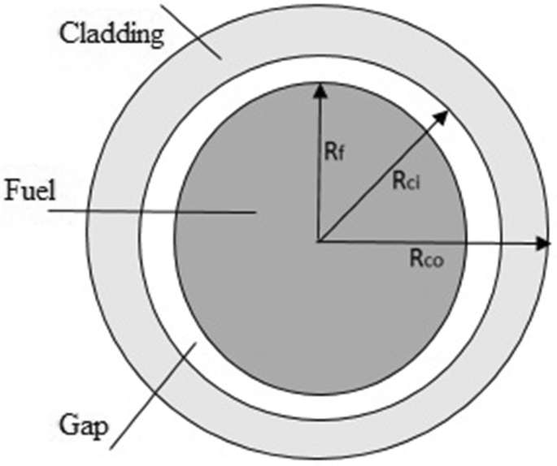
Introduction
One of the key analysis of nuclear fuel performance involves the thermodynamics and diffusion within the fuel pallet (UO₂).
This study focuses on developing a 3D fully coupled model to simulate thermal conductivity, specific heat, and oxygen diffusion in UO₂ fuel.
The authors develop a conceptual model and system of equations for pellet heat conduction, oxygen diffusion, solid mechanics and material property of the fuel.
Finally, using Jacobian-free Newton Krylov (JFNK) method, the equations are solved and simulated using BISON fuel performance code.

Slide 4
Background
Pellet Cladding Interaction (PCI), besides corrosion and mechanical wear, is one of the major reason for fuel failure.
It is very important to have a proper model to simulate PCI to estimate the lifetime of the fuel.
Many prior works including Ramirez et al.[3], Trillions[4], modelled Pellet Cladding Interaction (PCI).
Ramirez et al.[3] provides a numerical model to study coupled heat and Oxygen diffusion and shows that hyper stoichiometry significantly impacts the thermal conductivity of UO₂ , which affects the maximum temperature of the fuel rod.

Slide 5
Objective
Present proper model for thermodynamic and diffusion models in pellet cladding interaction.
Use appropriate method, such as JFNK to solve the equations.
Examine the interaction between pallet and cladding by performing a three dimensional simulation in multiprocessor system.

Slide 6
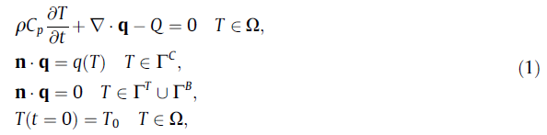

Methodology
Pellet heat conduction model:

Slide 7

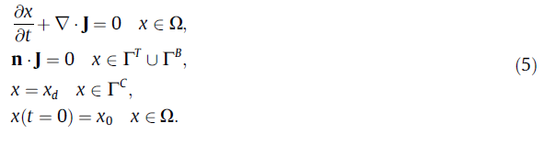
Methodology
Oxygen diffusion model:

Slide 8
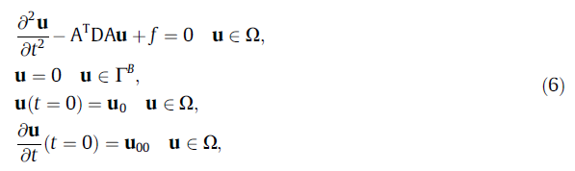
Methodology
Solid mechanics model:
The paper also uses material property model similar to Ramirez [3].
Finally, non-linear Jacobian-free Newton Krylov solver is employed to solve the system of equations.

Slide 9
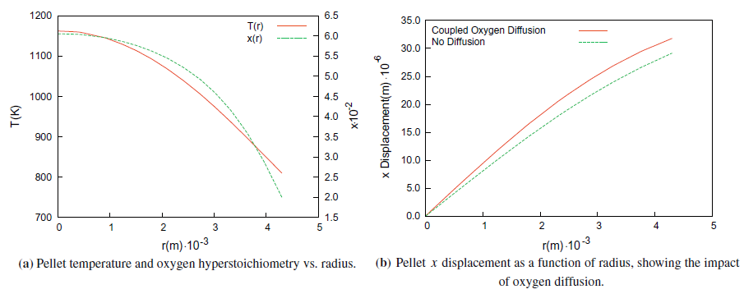
Results (steady state)

Slide 10
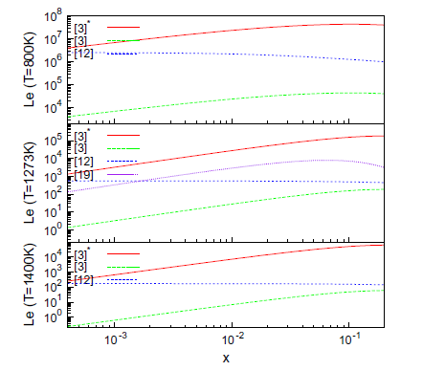
Results (steady state)

Slide 11
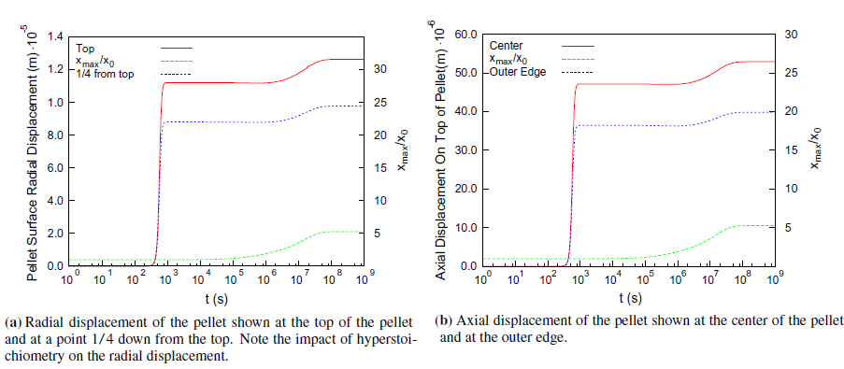
Results (transient)

Slide 12
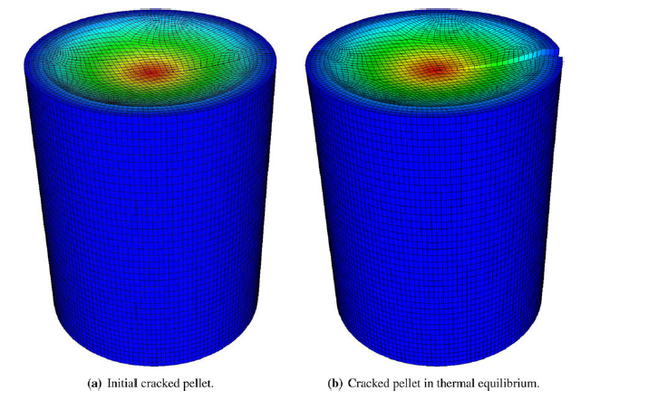
Results (3D)

Slide 13
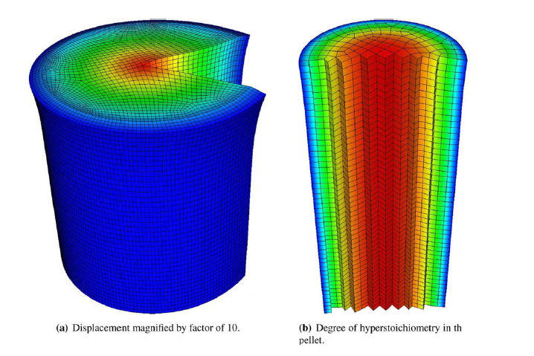
Results (3D)

Slide 14
My observation and conclusion
This paper presents informative facts regarding fuel performance simulation and I have learned how to develop a model and simulate it to analyze the fuel performance from this paper.
This paper only considers two significant parts of the Higgs[12] model, heat conduction of the pellet and oxygen diffusion.
The gas phase transport in the pallet cladding gap can be analyzed in the similar manner. Additionally, gas phase transport in the fuel cracks can also be analyzed by developing a proper model and applying proper simulation techniques.

Slide 15
Thanks!

