Slide 1
Paper Review
Development of a grain growth model for U3Si2 using experimental
data, phase field simulation and molecular dynamics
By Cheniour et al

Slide 2
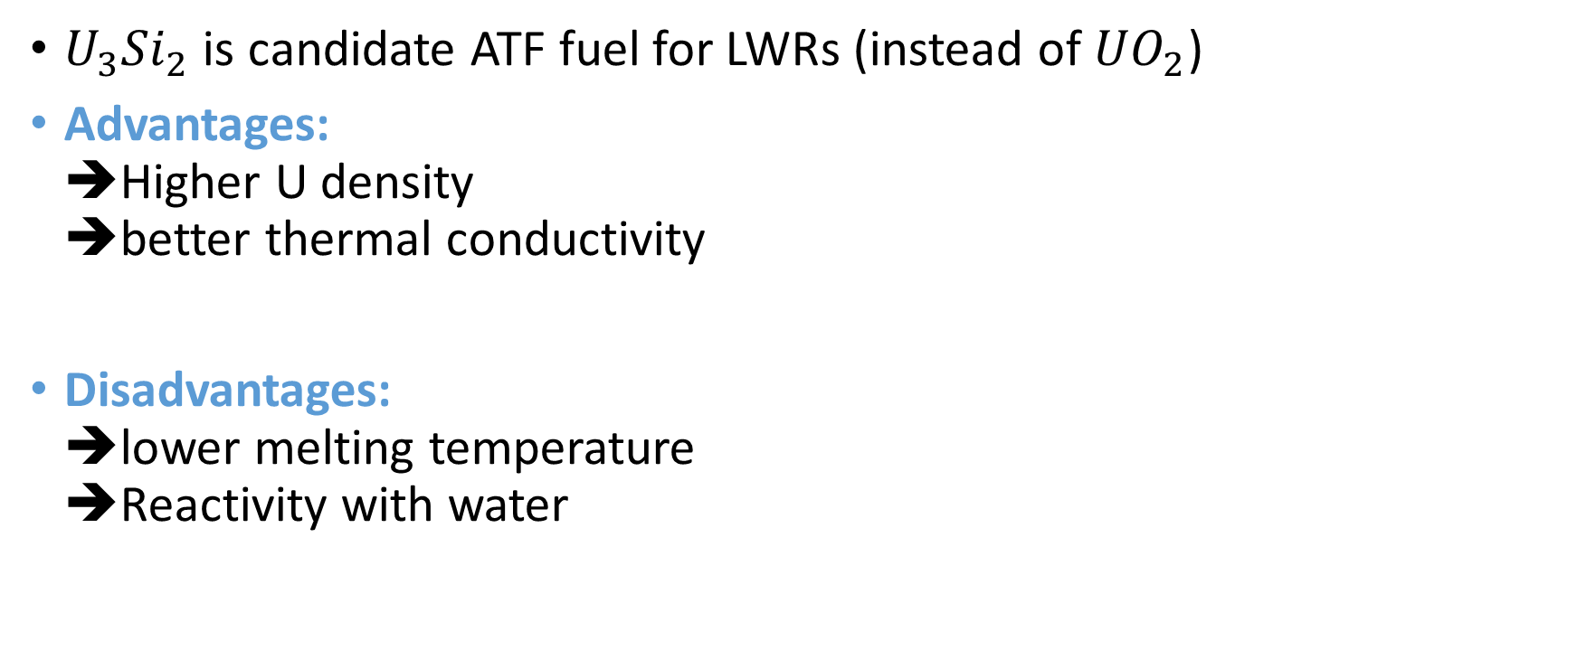
Introduction: Background and Motivation
$U_{3}{Si}_{2}$ is candidate ATF fuel for LWRs (instead of ${UO}_{2}$)
Advantages: ➔Higher U density ➔better thermal conductivity
Disadvantages: ➔lower melting temperature ➔Reactivity with water

Slide 3
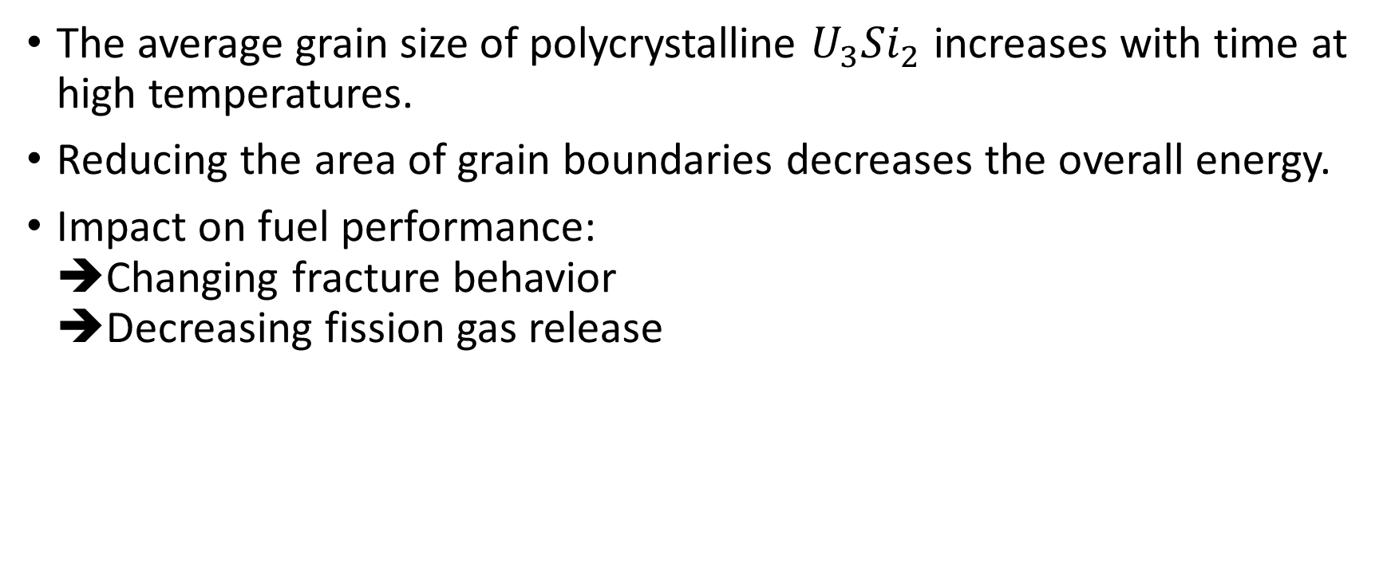
Introduction: Grain Growth
The average grain size of polycrystalline $U_{3}{Si}_{2}$ increases with time at high temperatures.
Reducing the area of grain boundaries decreases the overall energy.
Impact on fuel performance: ➔Changing fracture behavior ➔Decreasing fission gas release

Slide 4
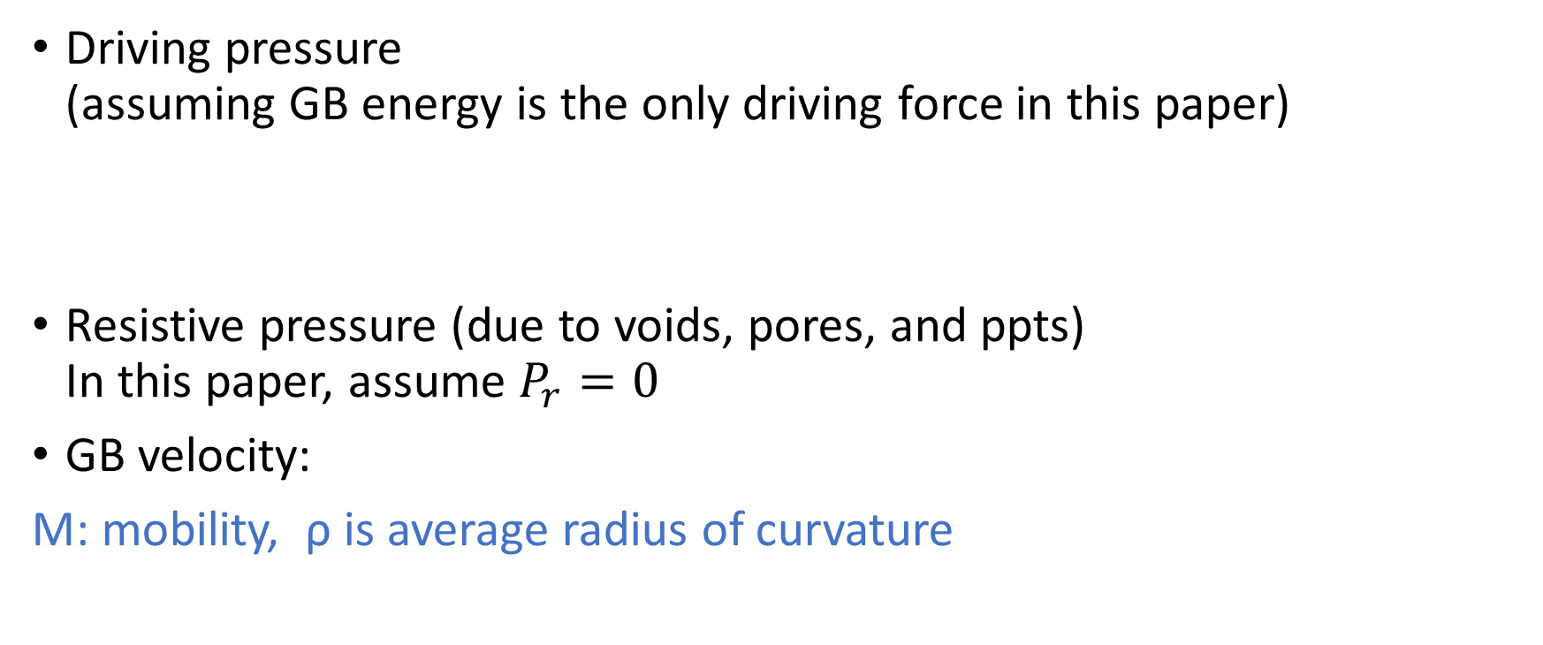
Introduction: Grain Growth Kinetics
Driving pressure (assuming GB energy is the only driving force in this paper)
Resistive pressure (due to voids, pores, and ppts) In this paper, assume $P_{r}=0$
GB velocity:
M: mobility, ρ is average radius of curvature

Slide 5
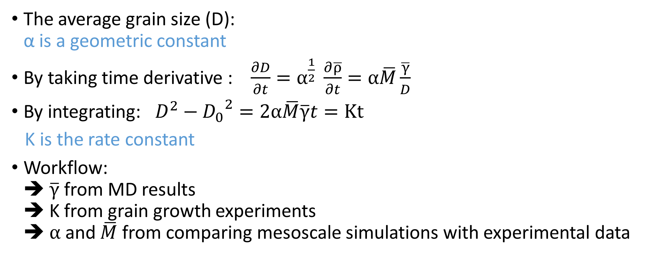
Introduction: Grain Growth Kinetics
The average grain size (D): α is a geometric constant
By taking time derivative : $\frac{∂D}{∂t}=α^{\frac{1}{2}} \frac{∂\overline{ρ}}{∂t}=α\overline{M}\frac{\overline{γ}}{D}$
By integrating: $D^{2}−{D_{0}}^{2}=2α\overline{M}\overline{γ}t=Kt$
K is the rate constant
Workflow: ➔ $\overline{γ}$ from MD results ➔ K from grain growth experiments ➔ $α$ and $\overline{M}$ from comparing mesoscale simulations with experimental data

Slide 6
Determination of GB energy

Slide 7
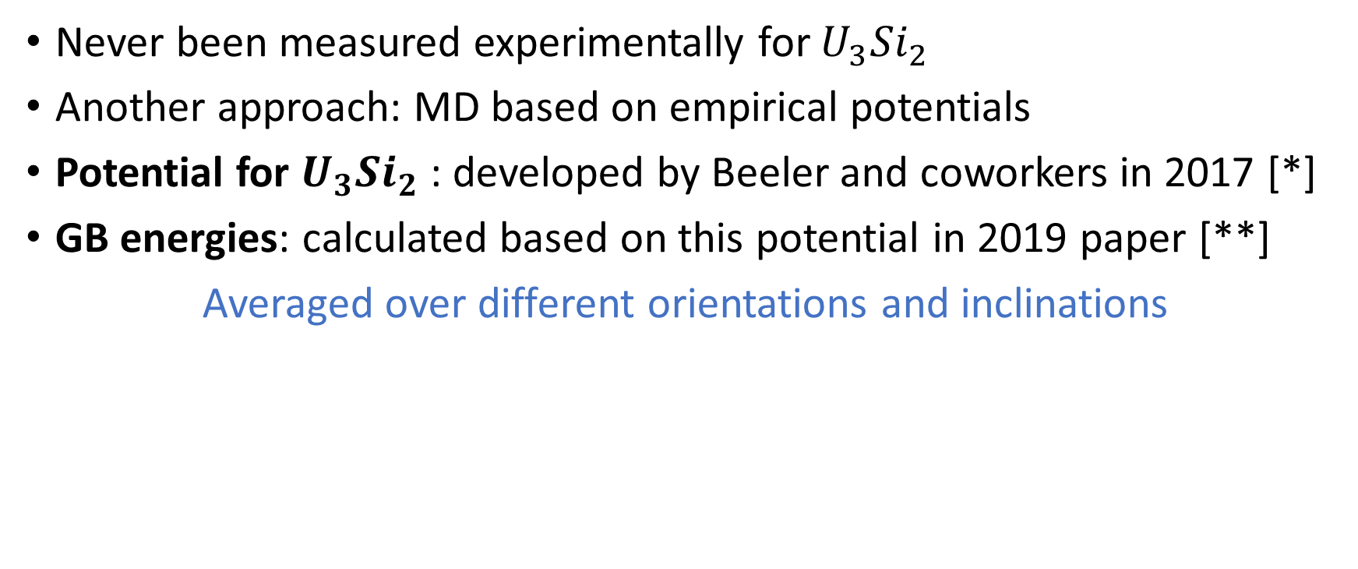
Determination of GB energy
Never been measured experimentally for $U_{3}{Si}_{2}$
Another approach: MD based on empirical potentials
Potential for $U_{3}{Si}_{2}$ : developed by Beeler and coworkers in 2017 [*]
GB energies: calculated based on this potential in 2019 paper [**]
Averaged over different orientations and inclinations

Slide 8
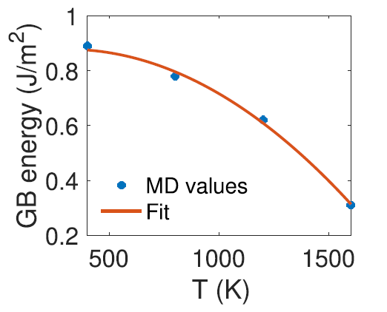
Determination of GB energy
GB energy results from sum of enthalpy of formation & entropy of formation
Polynomial fit for enthalpy and entropy from MD data yields:

Slide 9
Determination of kinetic parameter

Slide 10
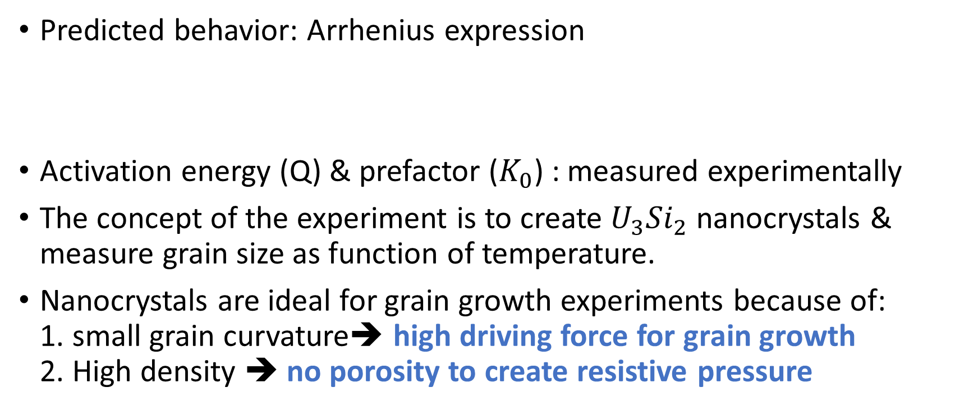
Determination of kinetic parameter (K)
Predicted behavior: Arrhenius expression
Activation energy (Q) & prefactor ($K_{0}$) : measured experimentally
The concept of the experiment is to create $U_{3}{Si}_{2}$ nanocrystals & measure grain size as function of temperature.
Nanocrystals are ideal for grain growth experiments because of: 1. small grain curvature➔ high driving force for grain growth 2. High density ➔ no porosity to create resistive pressure

Slide 11
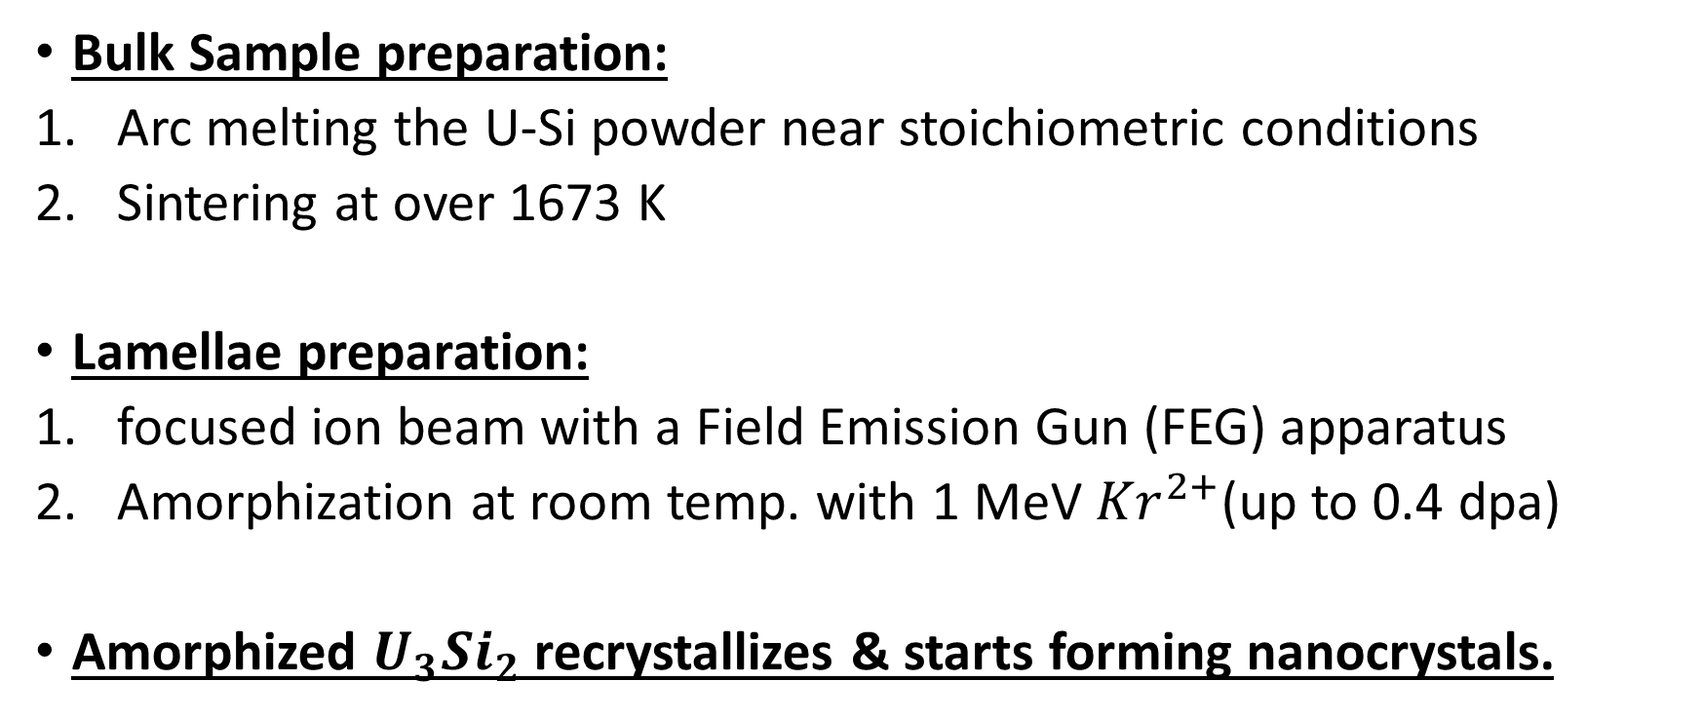
Determination of kinetic parameter (K)
Bulk Sample preparation:
Arc melting the U-Si powder near stoichiometric conditions
Sintering at over 1673 K
Lamellae preparation:
focused ion beam with a Field Emission Gun (FEG) apparatus
Amorphization at room temp. with 1 MeV ${Kr}^{2+}$(up to 0.4 dpa)
Amorphized $U_{3}{Si}_{2}$ recrystallizes & starts forming nanocrystals.

Slide 12
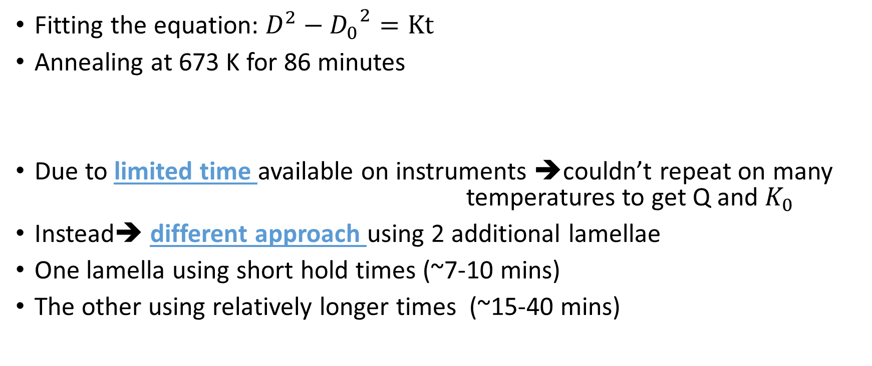
Determination of kinetic parameter (K)
Fitting the equation: $D^{2}−{D_{0}}^{2}=Kt$
Annealing at 673 K for 86 minutes
Due to limited time available on instruments ➔couldn’t repeat on many temperatures to get Q and $K_{0}$
Instead➔ different approach using 2 additional lamellae
One lamella using short hold times (~7-10 mins)
The other using relatively longer times (~15-40 mins)

Slide 13
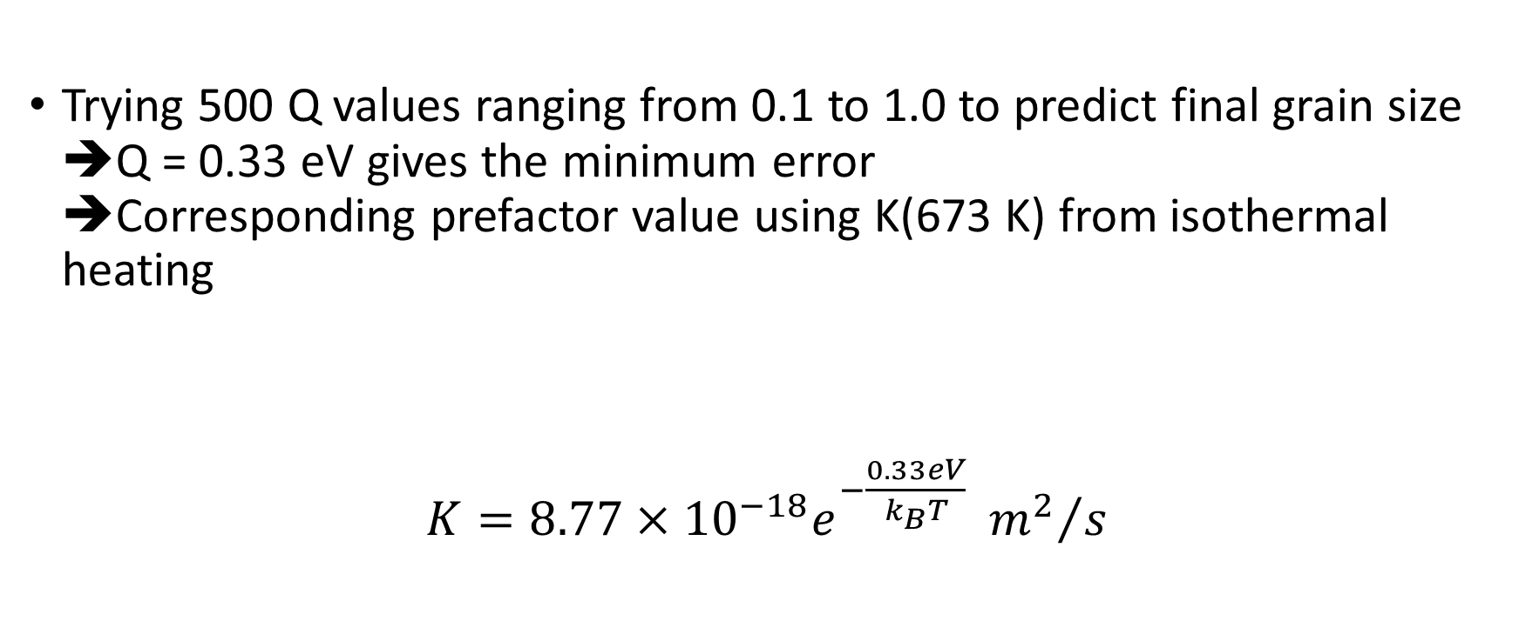
Determination of kinetic parameter (K)
Trying 500 Q values ranging from 0.1 to 1.0 to predict final grain size ➔Q = 0.33 eV gives the minimum error ➔Corresponding prefactor value using K(673 K) from isothermal heating
$K=8.77×{10}^{−18}e^{−\frac{0.33eV}{k_{B}T}} {m^{2}}/s$

Slide 14
Determination of GB mobility

Slide 15
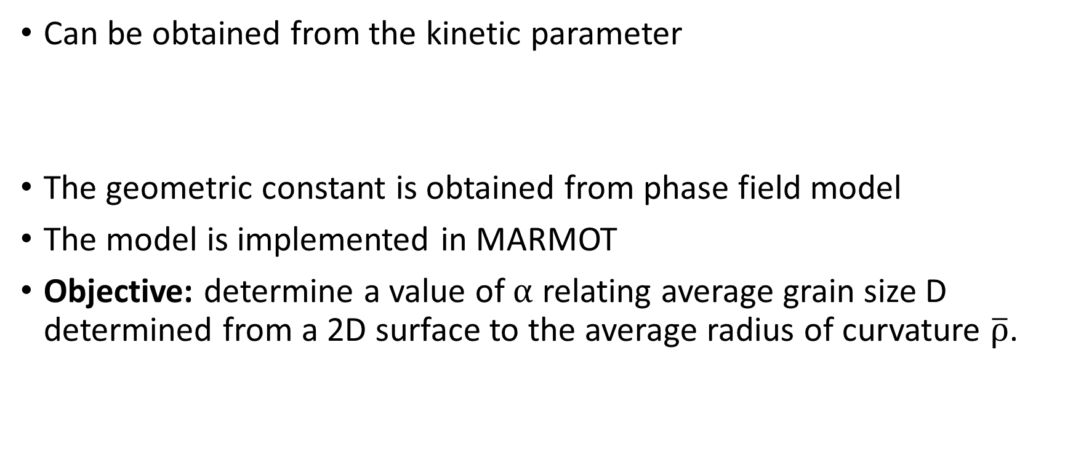
Determination of GB mobility (M)
Can be obtained from the kinetic parameter
The geometric constant is obtained from phase field model
The model is implemented in MARMOT
Objective: determine a value of $α$ relating average grain size D determined from a 2D surface to the average radius of curvature $\overline{ρ}$.

Slide 16
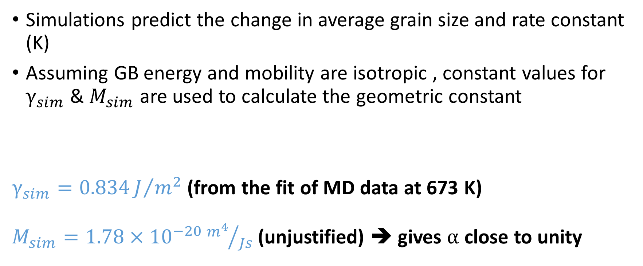
Determination of GB mobility (M)
Simulations predict the change in average grain size and rate constant (K)
Assuming GB energy and mobility are isotropic , constant values for $γ_{sim}$ & $M_{sim}$ are used to calculate the geometric constant
$γ_{sim}=0.834J/{m^{2}}$ (from the fit of MD data at 673 K) $M_{sim}=1.78×{10}^{−20}{m^{4}}/{Js}$(unjustified) ➔ gives $α$ close to unity

Slide 17
Determination of GB mobility (M)
K was obtained in 2 different ways: 1. from grain size estimated from a surface (as in the experiment) 2. from grain sizes estimated from the entire volume
5 simulations were carried out with different grain structures

Slide 18
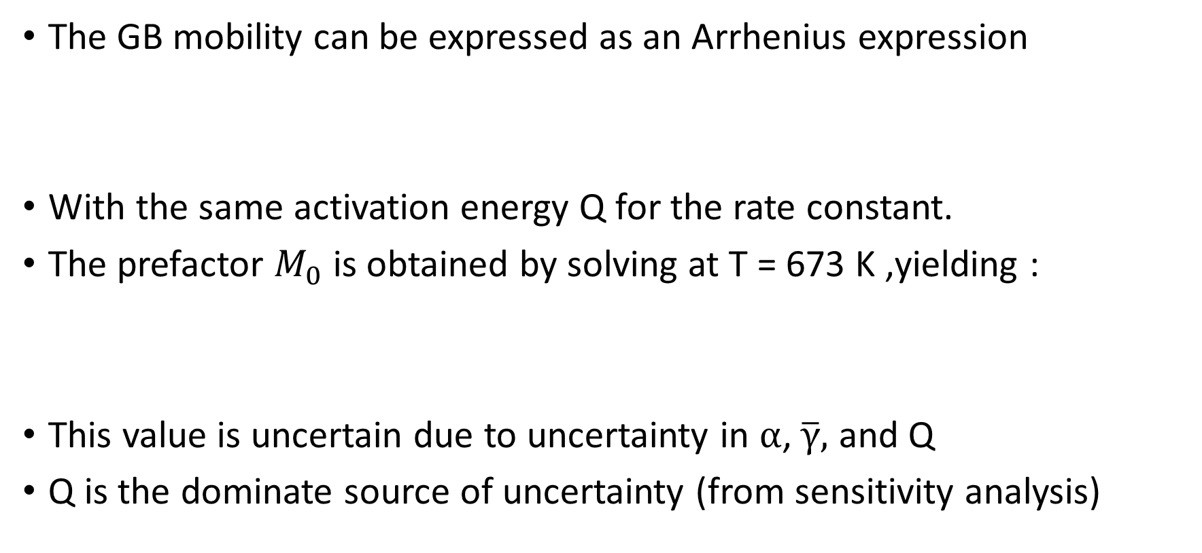
Determination of GB mobility (M)
The GB mobility can be expressed as an Arrhenius expression
With the same activation energy Q for the rate constant.
The prefactor $M_{0}$ is obtained by solving at T = 673 K ,yielding :
This value is uncertain due to uncertainty in $α$, $\overline{γ},$ and Q
Q is the dominate source of uncertainty (from sensitivity analysis)

Slide 19
Comparison with UO2

Slide 20
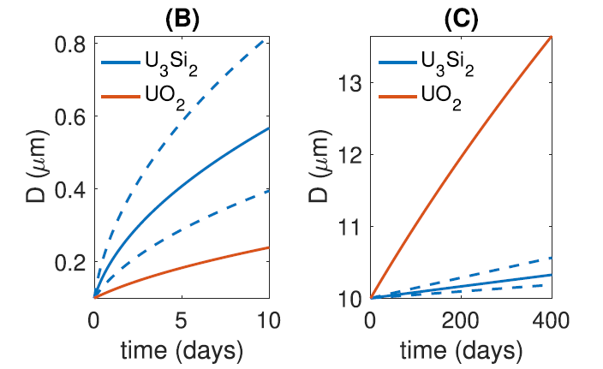
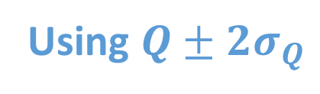
Comparison with UO2
T = 1000 K for U3Si2
T = 1400 for UO2
T = 1200 K
Using $Q±2σ_{Q}$

Slide 21
Comments

Slide 22
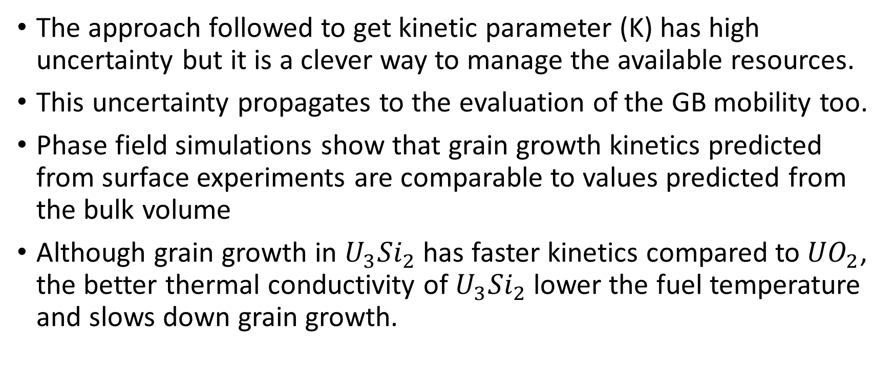
Comments
The approach followed to get kinetic parameter (K) has high uncertainty but it is a clever way to manage the available resources.
This uncertainty propagates to the evaluation of the GB mobility too.
Phase field simulations show that grain growth kinetics predicted from surface experiments are comparable to values predicted from the bulk volume
Although grain growth in $U_{3}{Si}_{2}$ has faster kinetics compared to${UO}_{2}$, the better thermal conductivity of $U_{3}{Si}_{2}$ lower the fuel temperature and slows down grain growth.

