Slide 1
Nuclear Fuel Performance
NE-533
Spring 2022

Slide 2
Last time
Fission gas release models are used to understand fission gas experiments and to predict gas release for fuel performance codes
Spherical grain models predict a fraction of gas release for post-irradiation annealing or for in-pile gas release
Fission gas diffusivity behavior changes with temperature and fission rate

Slide 3
MOOSE Project
Three-part project
Will upload input and output files to Moodle
Will upload a final written report, 5-10 pages (including figures), times new roman, 12pt, 1.5 space, pdf
Due April 26
This is an individual project, but some collaboration is encouraged

Slide 4
MOOSE Project Part 1
0.5 cm
0.002 cm
0.1 cm
Fuel pin dimensions listed
This is a 1-D problem, but I want your geometry to be set up in 2-D RZ
Assume reasonable values for thermal conductivities, can assume constant k
Outer cladding temperature: 500 K
Mesh: 100x100; or something sufficiently converged
Solve temperature profile for:
Steady-state: LHR = 150 W/cm²
Compare against analytical solution
Solve for centerline temperature vs time
Transient: LHR = 150*(1-EXP(-0.05*time))+150 for up to t=100
1 cm
Fuel
Cladding
Gap

Slide 5
Fuel Swelling/Dimensional Change

Slide 6
Fuel changes size and shape under reactor operation

Slide 7
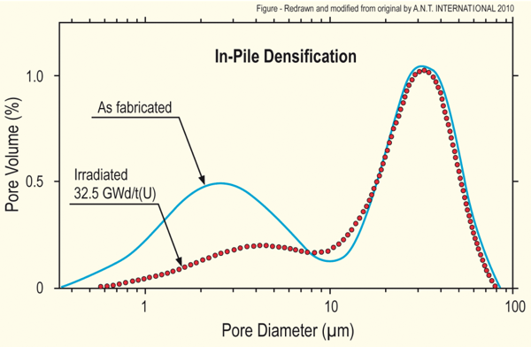
Densification
Densification takes place during initial 5 - 10 MWd/kgU
Small, as-built pores close due to effects of fission spikes and vacancy diffusion
Large pores stable (in absence of large hydrostatic stress)
Empirical correlation for densification is a function of
β - Burnup (in FIMA)
Δρ₀ – Total densification that can occur (a common value is 0.01)
β_{D} – Burnup at which densification stops ( a common value is 5 MWD/kgU)
C_{D} = 7.235 − 0.0086 (T(°C) − 25) for T < 750°C and CD = 1 for T ≥ 750 °C
[Maier et al, 1988]

Slide 8
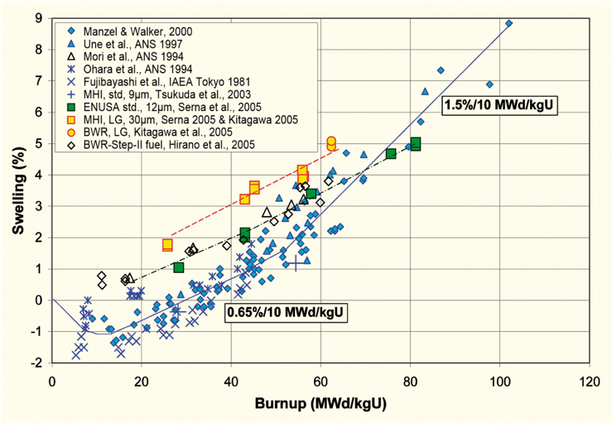
Fission product induced swelling
Fission product swelling results from three changes in the fuel microstructure
Solid swelling: Accumulation of soluble and insoluble fission products in fuel matrix
Gaseous swelling: Accumulation of gaseous and volatile fission products in intragranular and intergranular pores
High burnup swelling: Restructuring of pellet rim with the accumulation of fission gas in a large number of small pores
after Garzarolli in [Rudling et al, 2007]

Slide 9
Solid fission product swelling
The solid fission product swelling model is a function of:
Β – Burnup (in FIMA)
ρ – Initial UO₂ density (g/cm³)

Slide 10
Gaseous fission product swelling
Gaseous swelling varies strongly with temperature, fission rate and stress
T < 1000K
Fission gas atoms remain in fuel matrix or collect in small, isolated, intragranular pores (<1 nm)
Intragranular pore size limited by fission spikes that drive gas back into fuel matrix
Gaseous swelling constrained by fission gas release
T = 1000 to 1700 K
Swelling takes place at hot interior of pellet
Gas atoms in fuel matrix diffuse to grain boundaries and collect in pores
Gas pressure causes bubbles to increase in size and to coalesce into larger pores
Gaseous swelling opposed by applied stress
Gaseous swelling also constrained by fission gas release

Slide 11
Total change in volume
The total change in volume is found by adding all components of dimensional change
ε_{tot} = ε_{th} + ε_{D} + ε_{sfp} + ε_{gfp}
Example:
fission rate = 2.5e13 f/(cm³ s)
T(fuel) = 1400 K
T_{ref} = 300 K
For densification: Δρ₀ = 0.01 and β_{D} = 5 MWD/kgU
Total time: 2 weeks

Slide 12
Change in Volume Example
First, we need to calculate the burnup, enrich 5%,
M_{UO2}=16*2+238*0.95+235*0.05=269.9 g/mol
N_{U} = N_{a} ρ_{U}/M_{U} = 6.022e23*10.97/269.9 = 2.45e22 atoms of U/cm³
β = 2.5e13*3600*24*7*2/2.45e22 = 0.0012 FIMA
Next, we need to determine the strain from thermal expansion
ε_{th} = αΔT = 11e-6*(1400 – 300) = 0.0121
Then, we consider densification,
We need to calculate C_{D}, but because we are higher than 750C, C_{D} = 1
We need to convert the burnup to FIMA, β_{D} = 5 MWD/kgU/950 = 0.0053 FIMA
ε_{D} = 0.01*(exp(0.0012*log(0.01)/(1*0.0053)) – 1) = -0.0065

Slide 13
Change in Volume Example
For solid fission product swelling,
For the density of UO₂, ρ = 10.97 g/cm³
ε_{sfp} = 5.577e-2*10.97*0.0012 = 7.34e-4
Finally, gaseous fission product swelling
ε_{gfp} = 1.96e-28*10.97*0.0012*(2800 – 1400)^11.73* exp(-0.0162*(2800 – 1400))*exp(-17.8*10.97*0.0012) = 0.0023
Total:
ε_{tot} = ε_{th} + ε_{D} + ε_{sfp} + ε_{gfp} = 0.0121 – 0.0065 + 7.34e-4 + 0.0023 = 0.0086

Slide 14
The overall swelling behavior depends on temperature

Slide 15
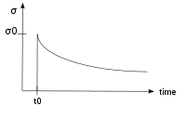
Creep
Creep is a general mechanism for plastic deformation that occurs over time when σ < σ_{y}
Consider a heated metal beam so it expands some distance dx
We then fix it between two walls and let it cool down
Because σ < σ_{y}, that stress remains constant
In creep, defect diffusion is induced by the stress to cause permanent deformation and reduce the stress
Therefore, creep
Occurs over time
Increases with increasing number of diffusing defects
High temperature (thermal creep)
Irradiation (irradiation creep)
x
x+dx
σ = E ε

Slide 16
Creep
General creep equation:
Creep can be caused by various microstructural mechanisms
Bulk Diffusion (Nabarro-Herring creep)
Atoms diffuse (high T), causing grains to elongate along the stress axis
Q = Q(self diffusion), m = 1, and b = 2
Grain boundary diffusion (Coble creep)
Atoms diffuse along grain boundaries to elongate the grains along the stress axis
Q = Q(grain boundary diffusion), m = 1, and b = 3
Dislocation creep
Dislocations glide under a high stress
Dislocations climb due to defects to avoid obstacles
Q = Q(self diffusion), m = 4–6, and b = 0

Slide 17
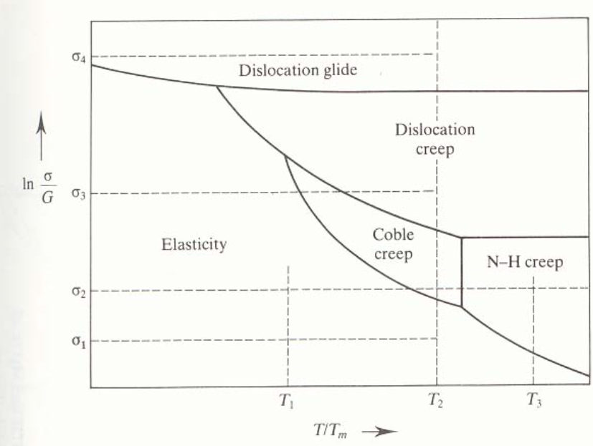
Different creep mechanisms are active for different combinations of stress and temperature

Slide 18
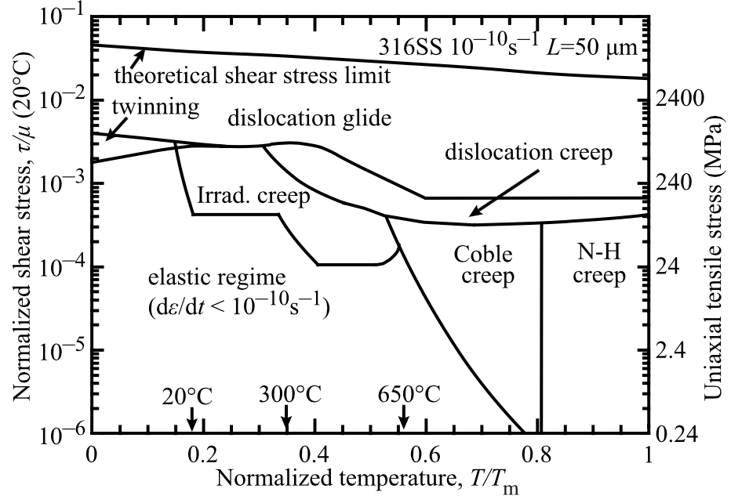
The behavior of creep changes in irradiated materials

Slide 19

Irradiation and Creep
Irradiation accelerates creep, causing it to be significant at lower temperatures
Irradiation has little effect on diffusional creep, but it accelerates dislocation creep in cubic materials
The dislocation creep rate can be written as
ρ_{d}^{m} is the density of mobile dislocations
b is the burgers vector
v_{d} is the dislocation velocity
Gliding dislocations quickly get pinned by obstacles
As the dislocations absorb defects created by irradiation, they climb to different slip planes to avoid the obstacles
More interstitials are absorbed than vacancies due to the higher sink strength for interstitials

Slide 20
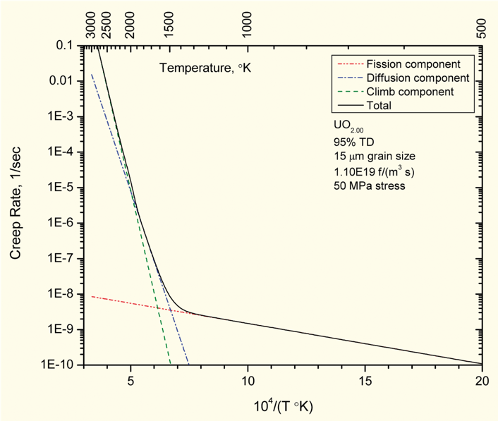
Fuel Creep
Like other materials, the fuel also undergoes creep
The fuel creep (In UO2) is a combination of diffusion creep and irradiation creep
It is expected that fuel creep plays a major role in dimensional change in metallic fuels, largely via N-H and Coble creep, but still unproven experimentally and no good creep models exist for metallic fuels

Slide 21
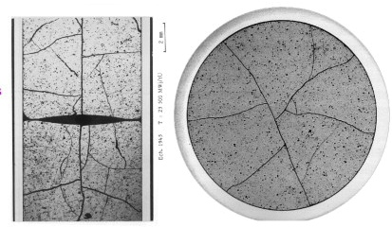
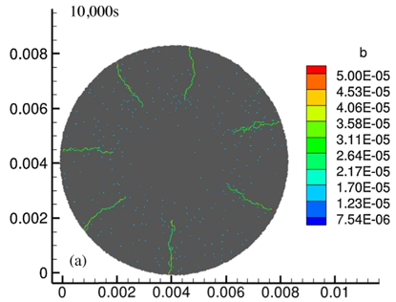
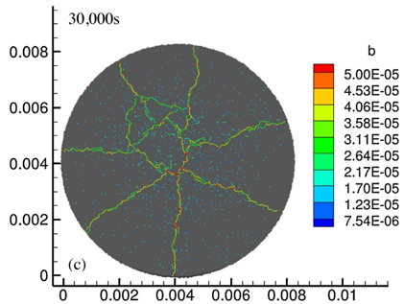
Fracture
UO₂ pellets fracture during changes in temperature due to large thermal stresses
Fracture results in:
Increased gap reduction
Reduced thermal conductivity
Increased avenues for fission gas release
Fracture has been typically modeled in two ways:
Empirical relocation model that is a function of burnup
Semi-empirical smeared cracking model
Modern methods provide means of modeling discrete cracks
Radial cracks partially penetrate the pellet during temperature increase
Full cracking occurs when the temperature decreases

Slide 22
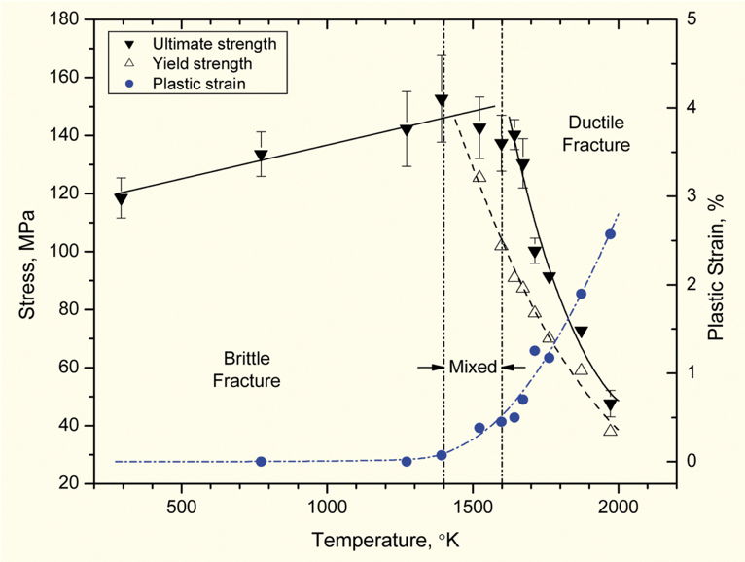
Fracture
The fracture behavior of the fuel is fairly complicated
Fracture strength varies with grain size (G)
σ_{frac} = G^{-m}σ_{frac, ref}, m = 0.04 – 0.05 (vs. m ~ 0.5 for metal)
Increasing grain size from 10 μm to 100 μm reduces σ_{frac} by ~10%
Ductility transition temperature is lower in-reactor than in thermal tests
Fracture strength is ~10× higher in compression than in tension
Load-deformation behavior strongly affected by creep under in-reactor conditions

Slide 23
Summary
Many materials models for fuel are empirical and correlated to burnup
Fuel pellets change shape due to
Thermal expansion (increase in volume)
Densification (decrease in volume)
Swelling (increase in volume)
Creep (volume stays the same)
Fracture also decreases the gap, as fractures pieces shift outward

Slide 24
Summary
The fuel thermal conductivity decreases with burnup
Empirical models take into account both phonon and electron based thermal transport
BISON primarily utilizes the NFIR model to describe thermal conductivity
The NFIR model is a fairly accurate empirical model of the fuel thermal conductivity

