Slide 1
Nuclear Fuel Performance
NE-533
Spring 2022

Slide 2
Fission products

Slide 3
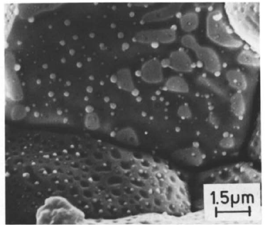
There are various types of fission products that form in the fuel
Soluble oxides (Y, La and the rare earths)
Dissolved in the cation sublattice
Insoluble oxides (Zr, Ba and Sr)
Form insoluble oxides in the fluorite lattice
Metals (Mo, Ru, Pd, and Tc)
Form metallic precipitates
Volatiles (Br, Rb, Te, I and Cs)
Exist as gases at high temperatures of the pellet interior
Also exist as solids at the cooler pellet exterior
Noble gases (Xe, Kr)
Essentially insoluble in the fuel matrix
Form either intragranular (within grain) voids or bubbles or intergranular (grain boundary) bubbles

Slide 4
Volatile Fission Products
Volatile FPs are released from the fuel matrix similar to that of the noble gases
Volatile fission products in the gap can react among themselves, resulting in a changing chemical speciation
The kinetics of formation/decomposition of CsI and Zr iodides are possible factors in the mechanism of SCC

Slide 5
Fission Product Segregation
Fission products can be segregated because of their migration to specific locations such as intragranular segregations, grain boundaries, or pellet surfaces
Metallic inclusions are commonly observed in ceramographs from irradiated samples
They are formed by isotopes of Mo, Tc, Ru, Rh, Pd, Ag, Cd, In, Sn, Sb, and Te
These inclusions are found at the surface of the grain boundaries and are associated, in general, with grain boundary and intragranular bubbles
Some of the components of these precipitates can be oxidized or reduced forming other compounds of higher volatility that can be released from the fuel matrix
Cs, Ru, Te, and Ba have been consistently found at the cracks in the pellet and on the clad inner surface

Slide 6
FP Interaction with Zr Cladding

Slide 7
Solutes in UO2

