Slide 1
Nuclear Fuel Performance
NE-533
Spring 2023

Slide 2
Last Time
Growth and creep are the major mechanisms for dimensional instability in zirconium alloy cladding
Growth results from the clustering of interstitials on prismatic planes
Creep occurs in three stages: (1) creep down from water pressure; (2) creep out from fuel column; (3) fuel column axial stress
Under irradiation, zirconium experiences irradiation induced hardening due to interstitial loops
Dislocation channels form that don’t have loops, resulting in localized deformation
Other phenomena:
Fatigue; SCC; PCI

Slide 3
Pellet Cladding Interaction (PCI)
PCI includes both mechanical (PCMI) and chemical interaction (PCCI), often seen in a more general sense FCMI and FCCI
The process of PCI involves the combination of high internal mechanical stress in the cladding and a corrosive environment resulting from the accumulation of volatile fission products in the fuel-clad gap
These conditions may lead to the initiation and propagation of radial cracks, which can penetrate through the cladding
Frequent PCI failures were observed in the 1960s and 1970s, leading to extensive research efforts
Altering operational procedures, modifying the manufacturing process of the cladding, adding a composite layer and/or applying a protective coating to the inner cladding surface can help mitigate these failures

Slide 4
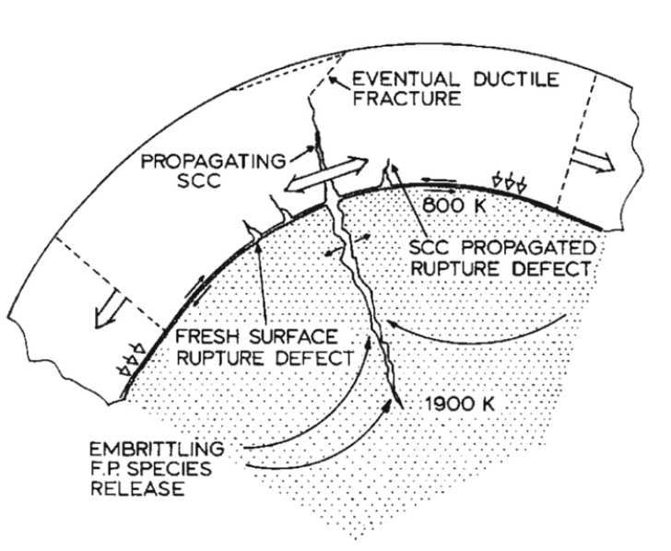
Physical Phenomena in PCI
The fuel thermally expands and swells
The cladding undergoes thermal and irradiation-induced creep
Mechanical interaction between the fuel pellet and cladding generates radial compressive stresses in addition to tensile hoop stresses
Volatile fission product gases are released into the gap
The cracking of the fuel pellet together with non-uniform thermal expansion resulting in preferential contact at the pellet interfaces increases local mechanical stresses in the cladding

Slide 5
Stress Corrosion Cracking (SCC)
Alloys that are in a corrosive environment may develop cracks that would not otherwise develop in the absence of either stress or the corrosive environment – stress corrosion cracking (SCC)
Stress corrosion cracks may propagate along intergranular (IG) and/or transgranular (TG) paths
The propagation modes of these cracks may depend on the localized mechanical and chemical conditions that lead to SCC
In order for SCC to initiate and propagate in any material, four conditions are simultaneously required:
A corrosive environment, a susceptible material, sufficient stress, and sufficient time

Slide 6
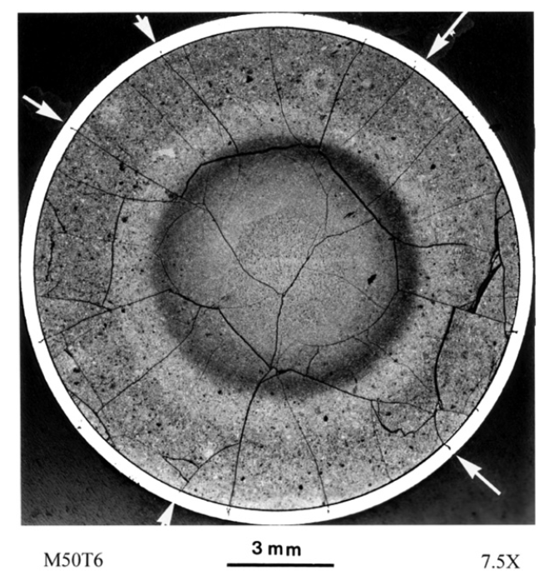
Corrosive Environment
Chemically aggressive fission products accumulating in the fuel-clad gap form an important component of the corrosive environment
Primary corrosive species are the volatile fission products, such as iodine (I), cadmium (Cd) and cesium (Cs)
Corrosive species can diffuse down the temperature gradient through fuel cracks
A higher local concentration of fission gases exists near the fuel crack and SCC is more likely to occur in the adjacent cladding region

Slide 7
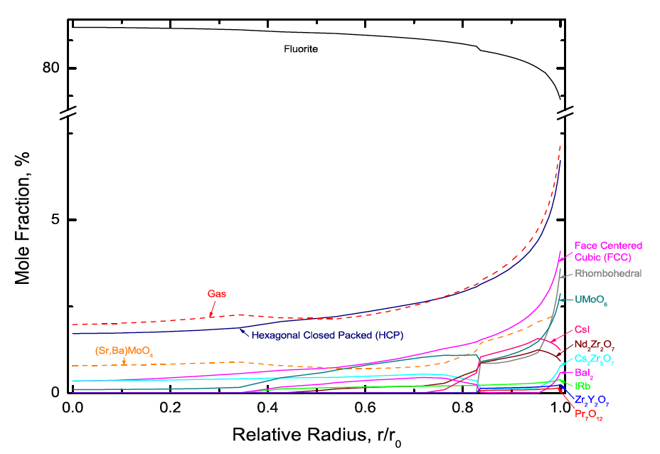
Corrosive Environment
The ability of fission product atoms to be transported through the fuel to the fuel-clad gap depends on several factors, including its physical state
The mobility of fission gases is markedly different than solid state diffusion
The relative amounts of I and other chemical elements in the gaseous phase depend on the local fuel chemistry, which varies spatially
The figure illustrates the predicted effects of fuel chemistry, in particular the predicted spatial distribution of phases in highly irradiated PWR UO2 fuel, whereby the chemical behavior on the fuel surface is of particular interest

Slide 8
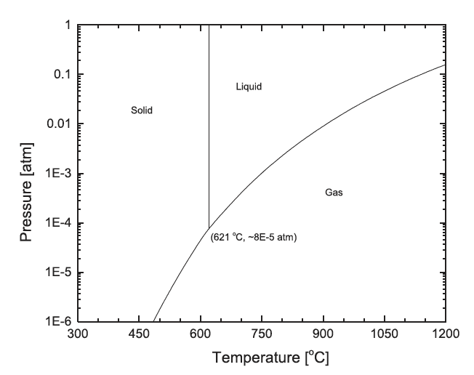
Corrosive Environment
CsI
The dominant I containing solid phase that is predicted to be thermodynamically stable on the fuel surface is CsI
Since typical fuel surface temperatures during normal operating conditions are of the order of 350–450 C and the hydrostatic pressure is greater than 1 atm, one would expect that solid CsI would be stable in the fuel-clad gap
The radiolytic decomposition of CsI increases the iodine partial pressure in the gap by many orders of magnitude

Slide 9
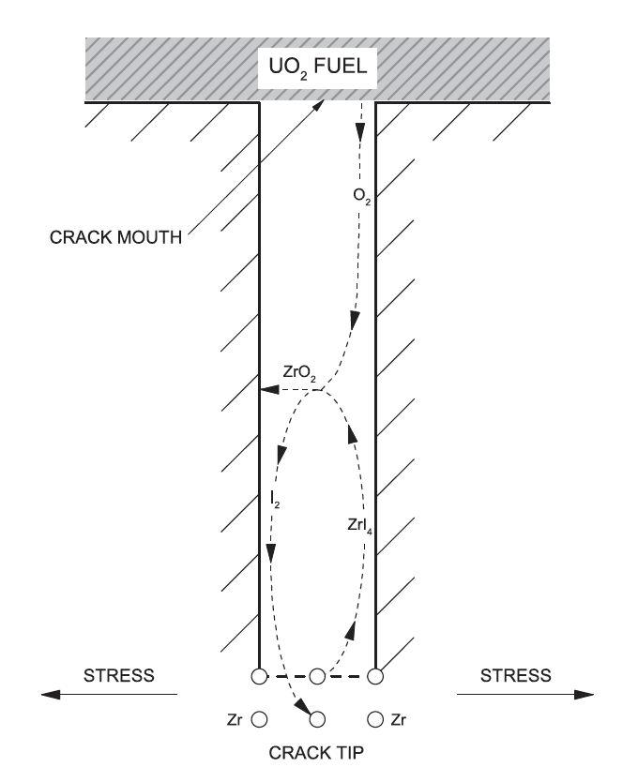
Corrosive Environment
The chemical interaction of liberated I (and possibly other elements) with the cladding is of great importance in crack initiation
A zirconium iodide gaseous species migrates up the temperature gradient towards the crack mouth, whereby the high affinity of Zr for O may result in ZrO2 formation, and decomposition may once again liberate I2 gas
The deposition of ZrO2 on the crack walls is believed to create a passivation layer, which further localizes I encroachment at the crack tip

Slide 10
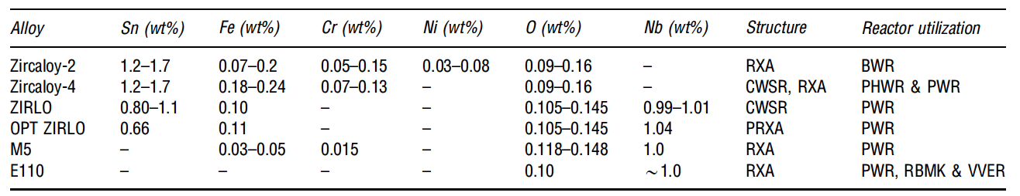
Susceptible Material
The susceptibility of the cladding to SCC can be influenced by many factors, including the composition, microstructure, texture, and irradiation damage of the cladding, and the presence of an oxide passivation layer, which protects the metal from chemical attack
All zirconium alloy cladding materials used in commercial power reactors are prone to PCI failure
Minor compositional changes have been shown to offer slightly different performance characteristics

Slide 11
Susceptible Material
The initial motivation of alloying zirconium with small amounts of tin was to offset the loss of corrosion resistance resulting from the introduction of nitrogen impurities during fabrication
The control of impurities during manufacturing have significantly improved since the introduction of these alloys, making the addition of unnecessary
The addition of niobium to these zirconium alloys increases the strength of the cladding while providing higher irradiation creep resistance and has exhibited elevated corrosion resistance, which is desirable for higher burnup fuel
All Zr alloys are somewhat equally susceptible to SCC cracking following prolonged irradiation

Slide 12
Sufficient Stress
The stress on the cladding depends on the external coolant pressure and creep, in addition to the stress imposed internally by the fuel
The fuel pellet structurally deforms as a result of the following mechanisms: thermal expansion, solid and gaseous fission product swelling, thermal and irradiation-induced creep, irradiation-induced densification and cracking
The fuel thermally expands almost immediately in response to an increase in temperature, whereas the contributions of creep and fission product swelling are longer term and depend on burnup
UO2 fuel is typically fabricated with an initial porosity of 3%–5% to accommodate fission products
The benefits of this with respect to minimizing SCC are twofold: first, the effect of swelling is diminished by solid fission products filling internal voids; second, initial pores provide sinks for fission gases, thus impeding their release to the fuel-clad gap

Slide 13
Reducing Internal Pressure
The initial grain size of the fuel, which evolves with burnup, affects fission gas release, among other factors
Since intragranular fission gas diffusion occurs at a much slower rate than intergranular diffusion, larger grain sizes impede the overall release of fission gases to the fuel surface
Reducing fission gas release with large grained fuel is less effective with increasing linear powers from 50-65 kW/m
As an undesired consequence to improved fission gas retention with large grained fuel, fission product swelling can be more pronounced

Slide 14
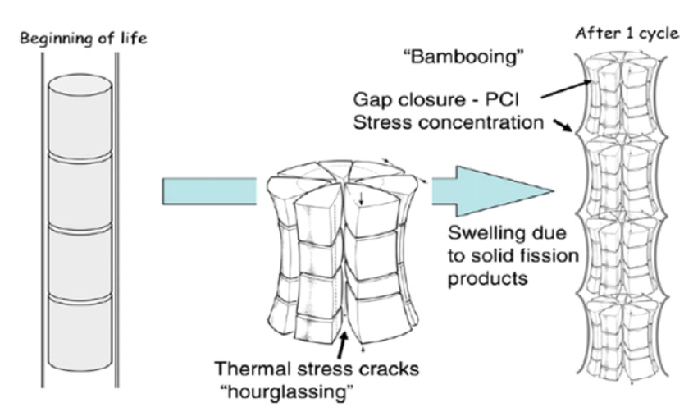
Pellet Deformation
The large thermal gradients in the radial direction, and a lesser extent in the axial direction, contribute to non-uniform thermal expansion, which results in a shape that resembles an hourglass
Pellet cracking due to thermal stresses further contributes to the hourglassing effect
The edges of cylindrical pellets induce large local stress concentrations in the cladding when the pellet-clad gap closes with the enhanced risk of perforation

Slide 15
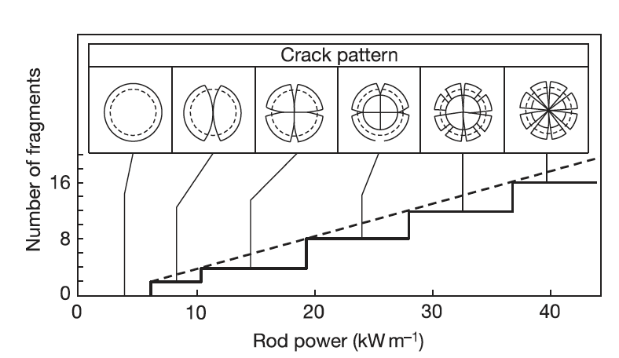
Fuel Cracking
Fuel pellets experience varying degrees of fracture due to large internal stresses induced by thermal expansion that exceed the fracture strength of UO2
The fracture strength varies from 80 to 150 MPa and is strongly influenced by pellet microstructure, which decreases with respect to porosity, pore size, and grain size
The number of fuel cracks generally increases with larger thermal gradients, thus the number of cracks in the fuel increases with respect to linear power

Slide 16
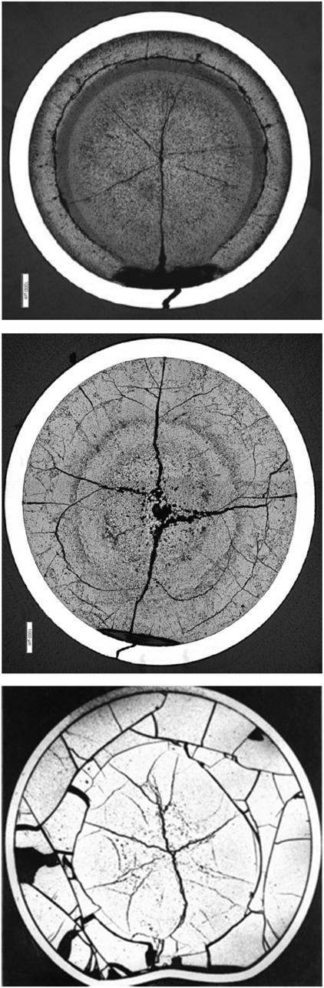
Missing Pellet Surface
PWR
Several failures have been experienced in LWRs in the early 2000s due to physical defects in the fuel, often due to chipping, which is often referred to as a Missing Pellet Surface (MPS)
The cladding eventually creeps down onto the fuel, except in the vicinity of the MPS
A local stress concentration is experienced in the cladding adjacent to the MPS as a result of the bending moment that is induced by non-uniform contact coupled with an expanding pellet
The increased local concentration of corrosive fission product species together with enhanced local stresses elevates the risk for SCC failure
BWR
PHWR

Slide 17
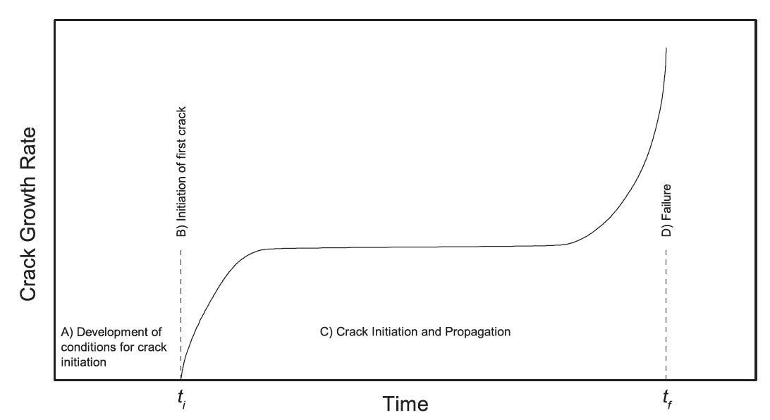
Sufficient Time
A sufficient duration of time is required for SCC to develop in the cladding
The SCC process can be divided into four stages:
Development of the corrosive environment and the surface conditions required for SCC to initiate,
Initiation of SCC,
Propagation of SCC, and
Failure
The SCC-induced crack will typically propagate through the majority of the cladding wall, and then the remaining ligament typically fails by ductile shear

Slide 18
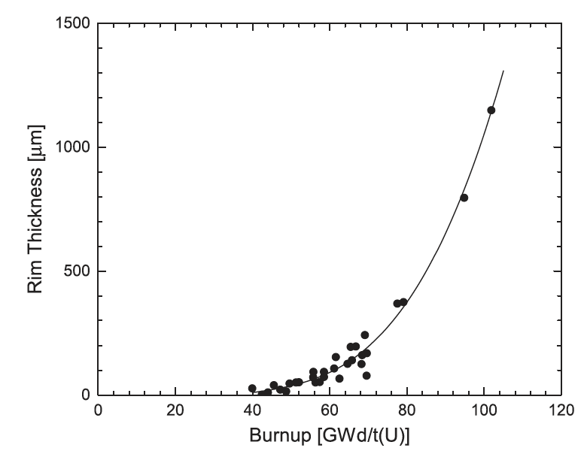
Effect of Burnup
The period of time to establish the conditions for SCC is related to burnup, and is complicated by the numerous mechanisms associated with changes in both the fuel and cladding during the course of irradiation
The mechanisms with relevance to SCC that become more pronounced with burnup include irradiation damage to the cladding, fission product swelling, fission gas release, and formation of a High Burnup Structure
The local burnup in the rim region can be 2–3 times greater than the integral burnup in highly irradiated fuel, which means that the local concentrations of fission and activation products in the rim region are considerably higher, which have a direct influence on the fuel surface chemistry

Slide 19
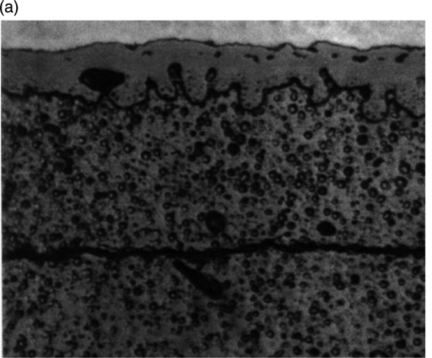
Rim/HBS Region
In medium burnup fuels, an internal zirconia layer 6–12 mm thick forms on the clad inner wall as soon as pellet-clad contact occurs
The coverage of the clad internal surface by zirconia tends to extend progressively with further irradiation and gap closing
High burnup fuel shows the development of a very effective pellet-clad bonding characterized by an intimate mixing of U and of the internal zirconia layer
Pellet-clad bonding, has been observed and seems to be controlled by the irradiation duration at closed pellet-clad gap

Slide 20
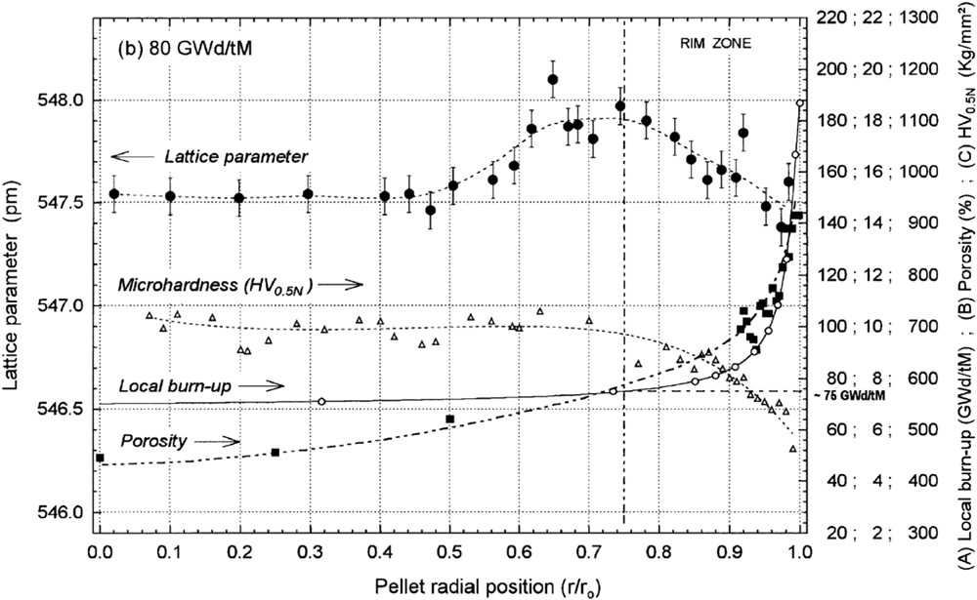
Rim/HBS Region
The HBS region has a much higher porosity (up to 30% locally) than the bulk of the fuel, which affects the mechanical properties
Microhardness measurements show a reciprocal trend of the strength with porosity
The softening of the fuel surface might be beneficial in reducing mechanical stresses imposed by the fuel on the cladding at the point of contact

Slide 21
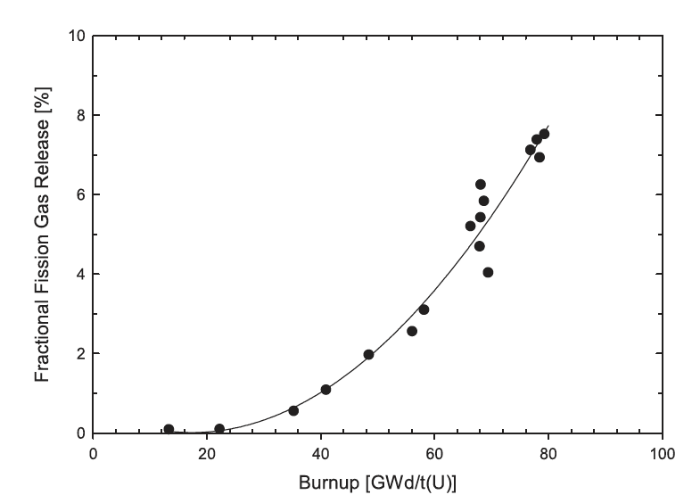
HBS and Fission Gas Release
The large increase in porosity within the HBS in high burnup fuel also affects fission gas release, providing local intergranular accommodation for retaining fission gases
Although the formation of the HBS promotes local fission gas retention, the absolute amount of fission gases that are released to the gap increases with burnup

Slide 22
Incubation Time
The corrosive environment, represented by a sufficient inventory of chemically active fission gases in the gap, not only depends on burnup, but the ability of these gases to chemically attack the cladding
This environment requires that the normally protective oxide coating on the inner surface of the cladding is breached, thus permitting corrosive species to chemically react with the bare cladding
The incubation time reflects the time required for a flaw in the protective oxide to be developed and for sufficient ZrI4 to form in the cladding, resulting in the development of cracks

Slide 23
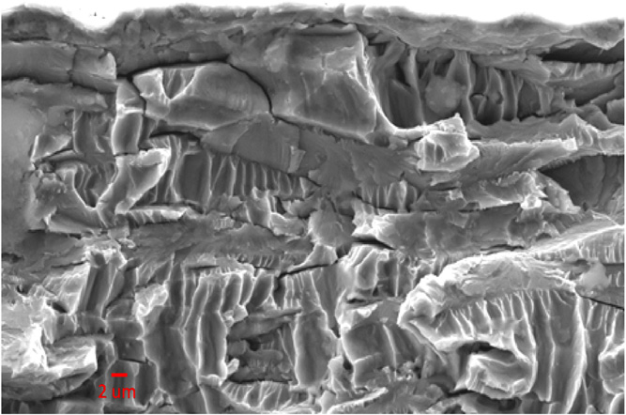
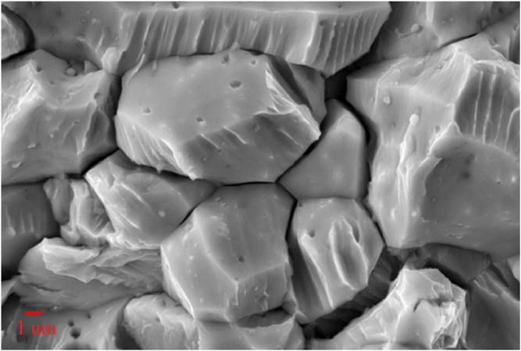
Crack Propagation
Transgranular
Once a crack has initiated, it can propagate through the cladding wall with a sufficiently high applied load
Both intergranular and transgranular propagation modes are possible
The propagation rate is a linear function of the stress intensity factor, K_{SCC}, and is independent on the propagation mode for sufficiently high K_{SCC}
The increase in iodine content generally increases the crack propagation rate
Increasing temperature results in decreasing the susceptibility to PCI failure, while neutron irradiation has been found to increase susceptibility
Intergranular

Slide 24
Through-Cracks
Following the formation of a through-wall crack and the ingress of water into the fuel-clad gap, the cracking process is arrested since the corrosive species (notably I, Cs, and Cd) have been discharged
The ingress of water in the fuel-clad gap may result in clad hydriding on the inner surface
The initial SCC crack can oxidize, and volume expansion may lead to resealing the primary failure
All PCI cracks are pin-hole defects, whereas observable cracks are secondary due to clad hydriding or ductile tearing
The time to failure depends on many parameters, but is generally determined by the local linear power, the change in linear power, and the local burnup

Slide 25
Mitigation
There are two primary approaches to mitigate PCI failures
1) changes in the design of various components – notably, the fuel pellet, fuel cladding and fuel assembly
2) the manner in which the reactor is operated can be altered to minimize PCI failures
An early and continuing trend in design evolution is sub-division of the fuel into smaller diameter elements/rods to increase the total number of elements/rods, which increases assembly/bundle power without a corresponding increase in UO2 temperature, thus mitigating thermally driven fuel failure mechanisms

Slide 26
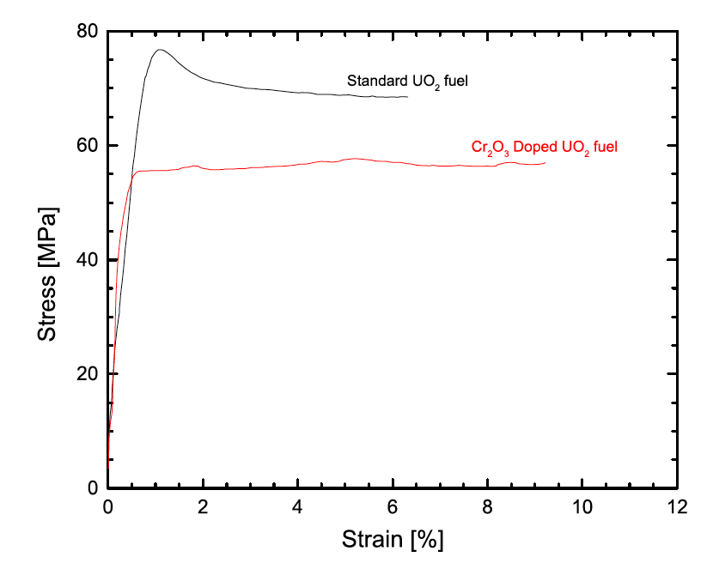
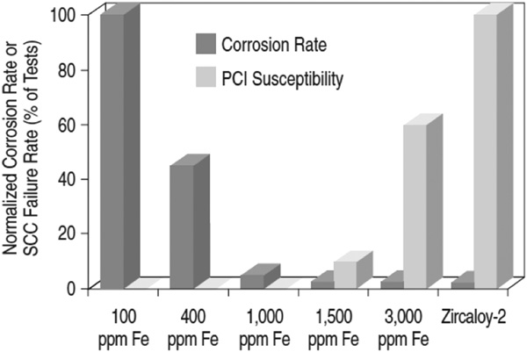
Mitigation
The design of fuel has changed to better optimize performance and reliability, including modifying the fuel pellet geometry, microstructure (i.e., grain size and porosity), and composition (i.e., initial O/M, minor additives)
Many design changes of the cladding have been investigated, including the development of small grain sizes and texture control, alloy composition, inclusion of an inner “barrier” liner and the application of a pellet-clad interlayer
The three variables that are controlled from an operational point of view are the linear power, change in linear power, ramp rate and discharge burnup

Slide 27
Summary
Pellet-clad interaction (PCI) takes two forms
Pellet-clad chemical interaction, PCCI (bonding occurs)
Pellet-clad mechanical interaction, PCMI (pellet pushes and drags cladding)
In order for SCC to initiate and propagate in any material, four conditions are simultaneously required:
A corrosive environment, a susceptible material, sufficient stress, and sufficient time
Two types of mitigation strategies to limit PCI failures

Slide 28
Stress Corrosion Cracking (SCC)
In order for SCC to initiate and propagate in any material, four conditions are simultaneously required:
A corrosive environment, a susceptible material, sufficient stress, and sufficient time

