Slide 1
Nuclear Fuel Performance
NE 533: Spring 2026

Slide 2
Last Time
Volumetric heat generation: Q = E_{f} x N_{f} x σ_{f} x φ
Talked through ‘real’ scenarios to solve heat conduction equation
Derived temperature profile across fuel, cladding gap
Assumptions:
Steady-state solution
Temperature is axisymmetric
T is constant in Z
Thermal conductivity is independent of temperature
Temperature profile in the fuel is parabolic, linear profiles in gap, cladding, and coolant

Slide 3
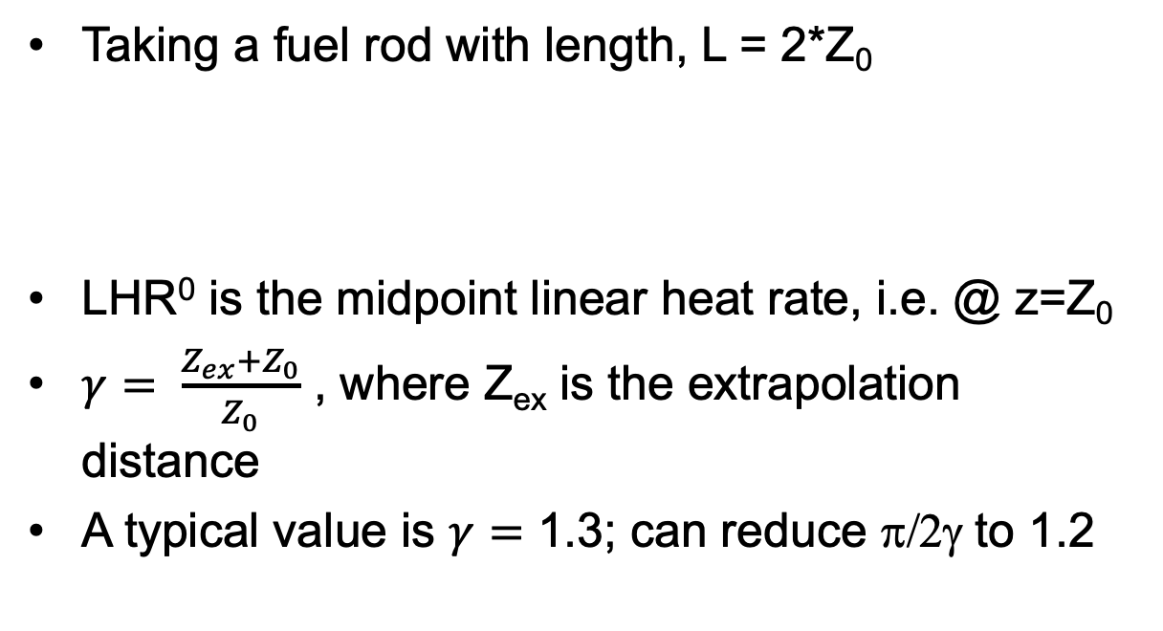
Neutron flux varies axially, so does LHR
Taking a fuel rod with length, L = 2*Z₀
LHR⁰ is the midpoint linear heat rate, i.e. @ z=Z₀
$γ= \frac{Z_{ex}+Z_{0}}{Z_{0}}$ , where Z_{ex} is the extrapolation distance
A typical value is $γ=$ 1.3; can reduce π/2γ to 1.2

Slide 4
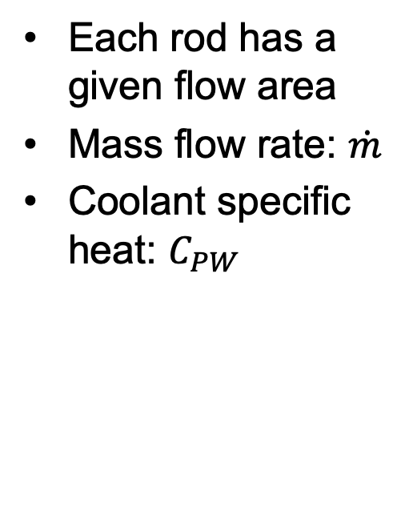
Coolant temperature varies with Z
Each rod has a given flow area
Mass flow rate: $\dot{m}$
Coolant specific heat: $C_{PW}$

Slide 5
Calculate LHR and T_{cool} with axial variation
mdot = 0.25 kg/s-rod; Z₀ = 150 cm; LHR⁰ = 150 W/cm; C_{PW} = 4200 J/kg-K; T_{in}= 570 K

Slide 6
Thermal Operational Limits

Slide 7
Thermal Operational Limits
Thermal limits are prescribed for normal operation and accident conditions, with the goal of avoiding fuel damage
Operational limits provide an envelope under which fuel failure will not occur
LHR limits
Centerline temperature limits
Critical Heat Flux (CHF)
The CHF is the heat flux at which boiling ceases to be an effective form of transferring heat from a solid surface to a liquid
As the coolant temperature increases, the mode of heat transfer changes
A boiling curve can be determined experimentally by increasing the temperature and measuring heat flux to the liquid
Nucleate boiling is a type of boiling that takes place when the surface temperature is hotter than the saturated fluid temperature

Slide 8
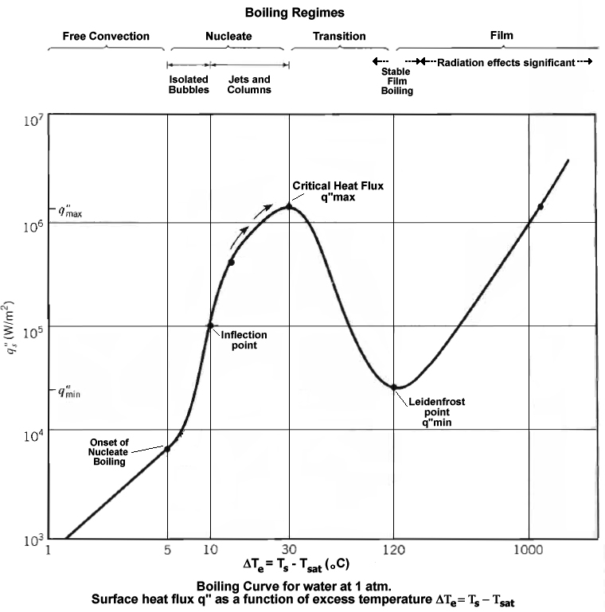
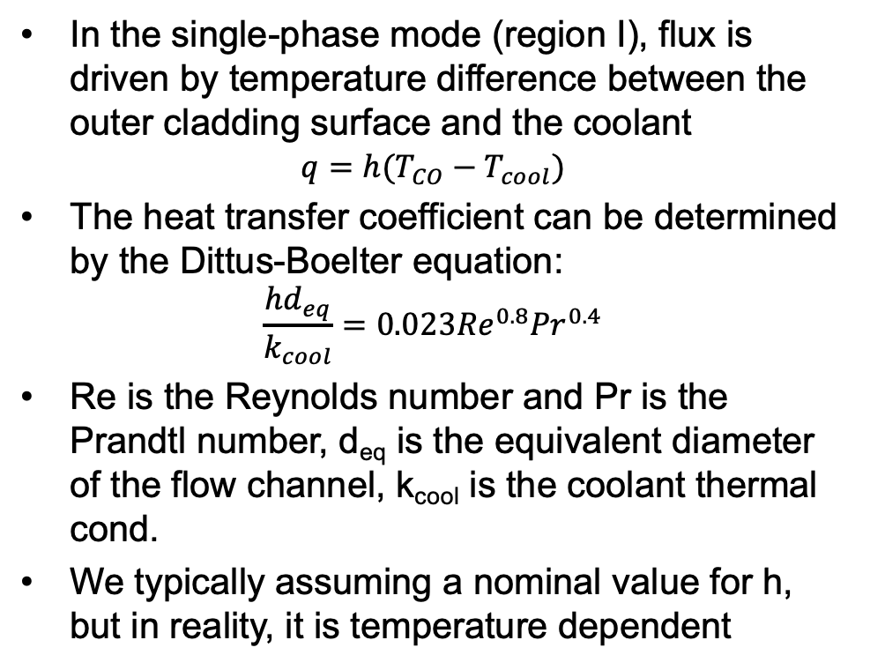
Critical Heat Flux
In the single-phase mode (region I), flux is driven by temperature difference between the outer cladding surface and the coolant
$$q=h(T_{CO}−T_{cool})$$
The heat transfer coefficient can be determined by the Dittus-Boelter equation:
$$\frac{hd_{eq}}{k_{cool}}=0.023{Re}^{0.8}{Pr}^{0.4}$$
Re is the Reynolds number and Pr is the Prandtl number, d_{eq} is the equivalent diameter of the flow channel, k_{cool} is the coolant thermal cond.
We typically assuming a nominal value for h, but in reality, it is temperature dependent

Slide 9
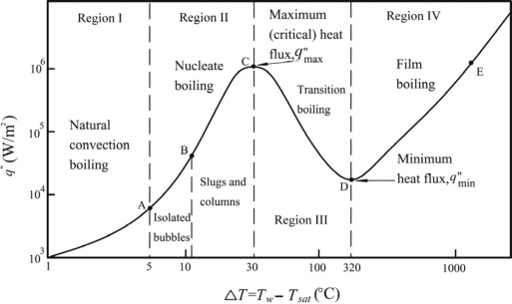
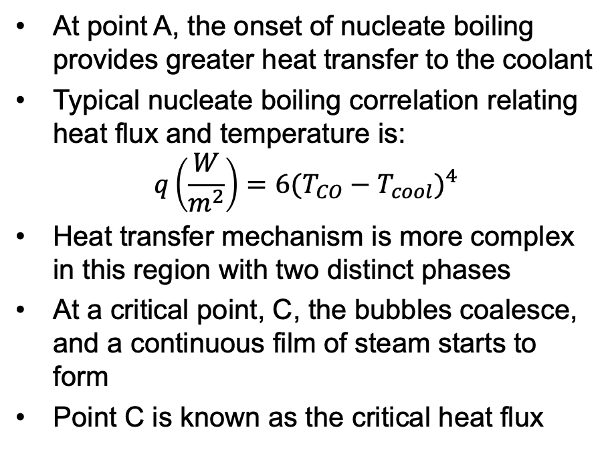
Critical Heat Flux
At point A, the onset of nucleate boiling provides greater heat transfer to the coolant
Typical nucleate boiling correlation relating heat flux and temperature is:
$$q\left(\frac{W}{m^{2}}\right)=6{(T_{CO}−T_{cool})}^{4}$$
Heat transfer mechanism is more complex in this region with two distinct phases
At a critical point, C, the bubbles coalesce, and a continuous film of steam starts to form
Point C is known as the critical heat flux

Slide 10
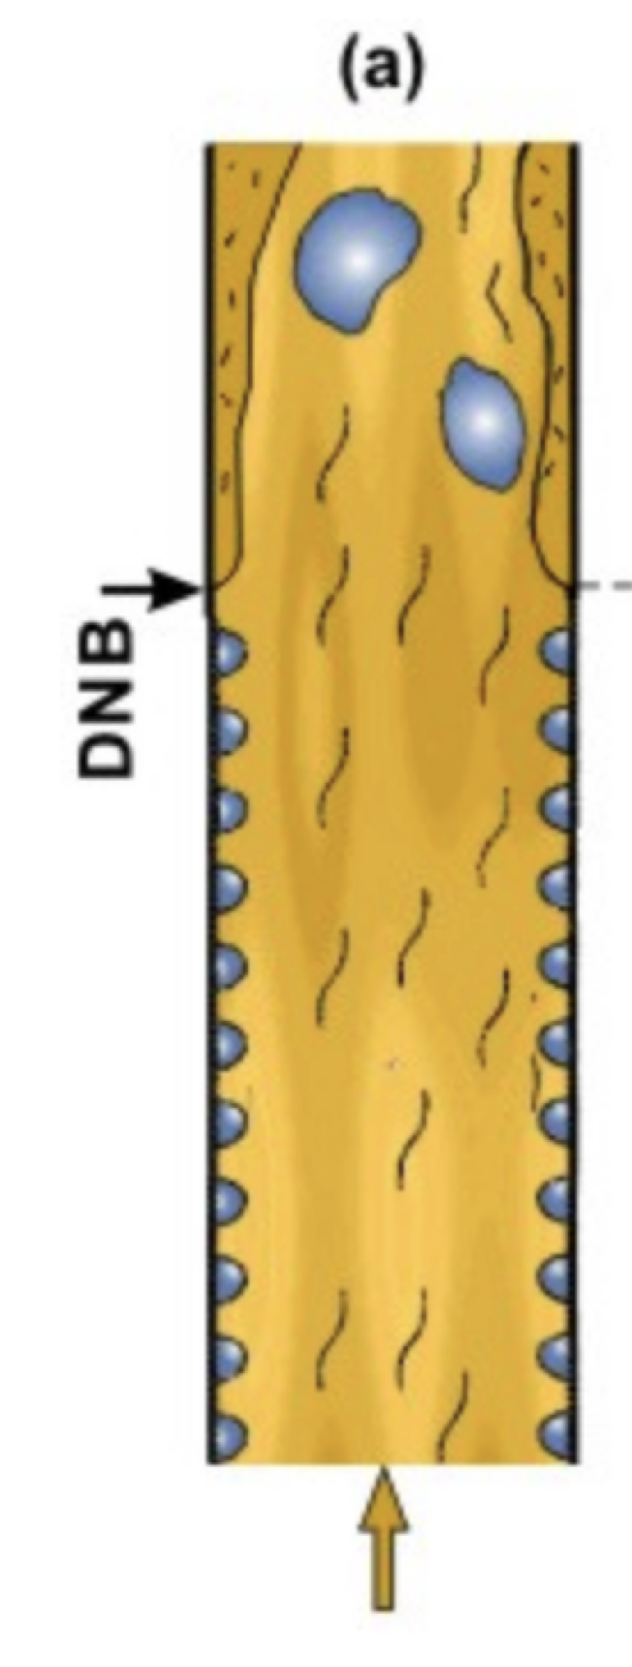
Departure from Nucleate Boiling
If the heat flux of a boiling system is higher than the critical heat flux (CHF) of the system, the bulk fluid may boil, or in some cases, regions of the bulk fluid may boil where the fluid travels in small channels
Large bubbles form, sometimes blocking the passage of the fluid
This results in a departure from nucleate boiling (DNB) in which steam bubbles no longer break away from the solid surface of the channel, bubbles dominate the channel or surface, and the heat flux dramatically decreases
Vapor essentially insulates the bulk liquid from the hot surface, increasing surface temperatures

Slide 11
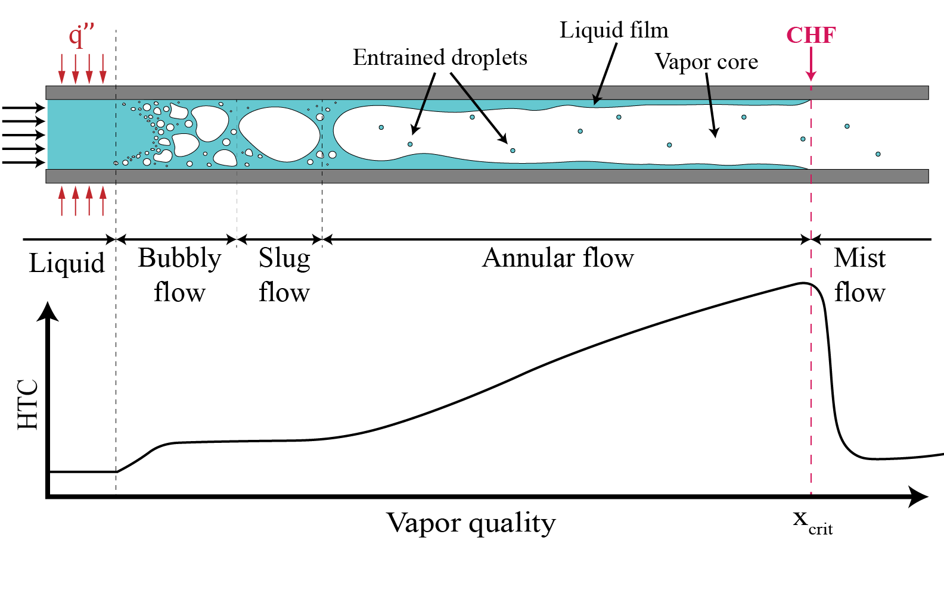
Visualization of Stages of Flow

Slide 12
Critical Heat Flux
Transition boiling is an oscillating mixture of nucleate and film boiling
Beyond point D the rod is ”coated” in steam and the heat flux is dramatically reduced
The heat transfer coefficient from cladding to steam is much lower than from cladding to water
T_{sat} is the saturation temperature, which is fixed for a given pressure, whereas the coolant temperature (T_{cool}) increases
Beyond point D, film boiling can occur

Slide 13
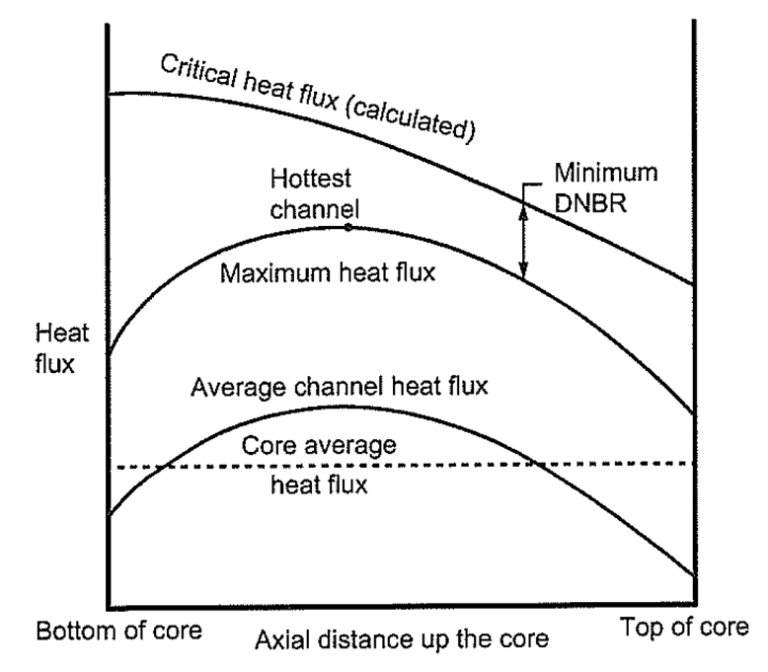
DNBR
The departure from nucleate boiling ratio (DNBR) is the ratio of the heat flux that causes dryout (the critical heat flux) to the actual heat flux
The limits on the DNBR in the hottest channel is 1.15 to 1.3, or a margin of 15-30 percent
The DNBR is determined by identifying the hottest channel, and the location where the heat flux most closely approaches the CHF
When CHF is surpassed, cladding temperature can increase to above 1100 K

Slide 14
Thermal conductivity

Slide 15
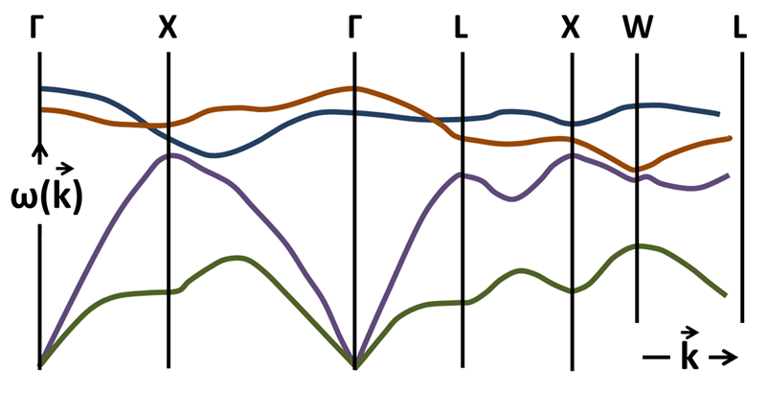
Phonons
A phonon is a collective excitation in a periodic, elastic arrangement of atoms or molecules in condensed matter, specifically in solids and some liquids
Phonons can be thought of as quantized sound waves, or quantized modes of vibrations for elastic structures of interacting particles
The thermodynamic properties of a solid are directly related to its phonon structure
Heat capacity is dominated by high frequency phonons while thermal conductivity is dominated by low frequency phonons
Animation showing 6 normal modes of a one-dimensional lattice

Slide 16
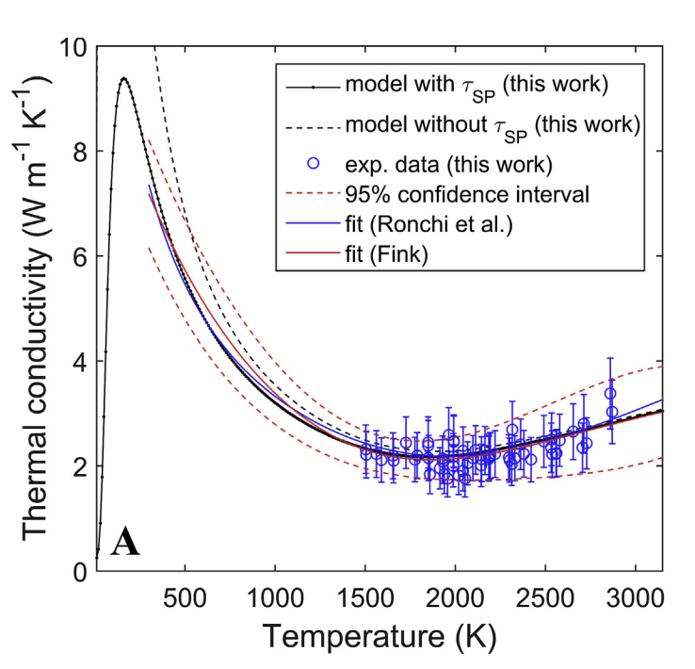
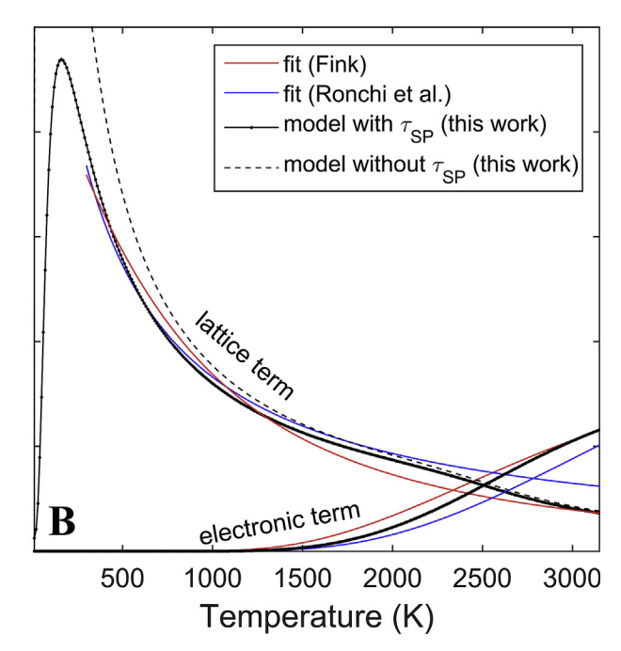
Phonon Scattering
Phonons can scatter through several mechanisms as they travel through the material:
phonon-phonon; phonon-impurity; phonon-electron; phonon-boundary
Temperature increases thermal fluctuations, and thus increases phonon scattering
Electronic contributions in UO2 become much more prevalent at higher temperatures, with an increases kth as T increases
https://doi.org/10.1016/j.actamat.2017.07.060

Slide 17
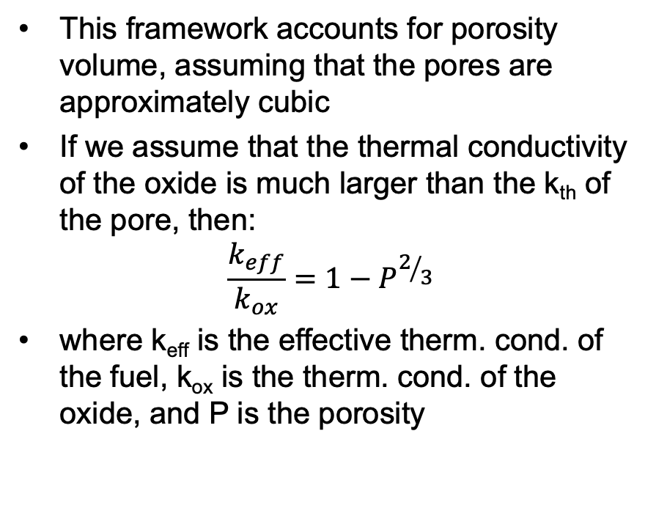
Thermal Conductivity with Porosity
Sintering creates a porous oxide with about 95% theoretical density
The pores provide space to accommodate fission gases, and thus reduce swelling, but diminish the thermal conductivity
Additional porosity develops from fission gas accumulation
Porosity will degrade thermal conductivity by creating scattering centers
Approximations for that degradation can be developed based upon a parallel thermal resistance framework
This framework accounts for porosity volume, assuming that the pores are approximately cubic
If we assume that the thermal conductivity of the oxide is much larger than the k_{th} of the pore, then:
$$\frac{k_{eff}}{k_{ox}}=1−P^{2/3}$$
where k_{eff} is the effective therm. cond. of the fuel, k_{ox} is the therm. cond. of the oxide, and P is the porosity

Slide 18
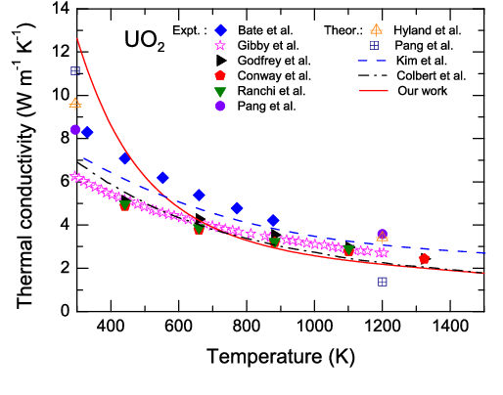
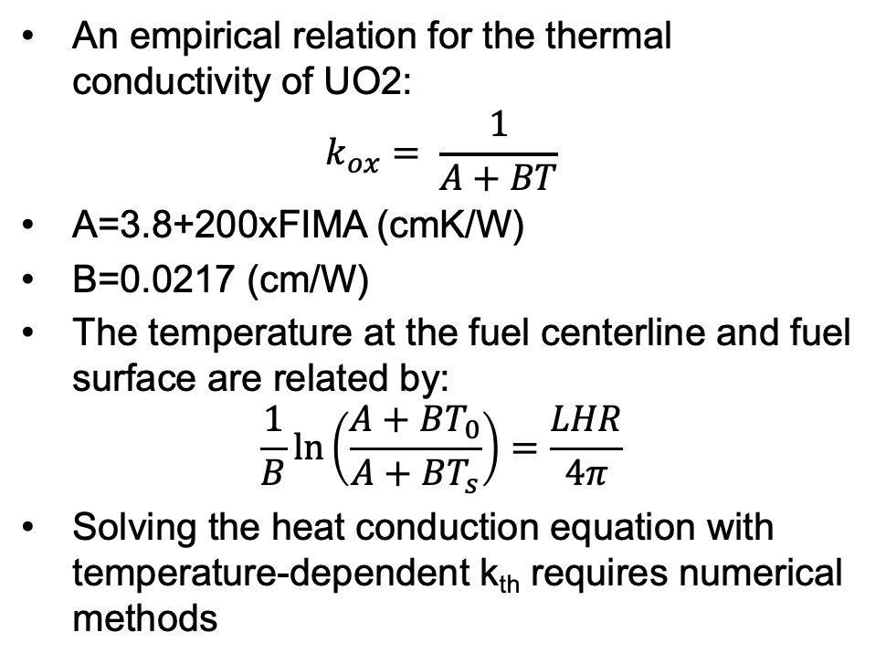
Thermal Conductivity with Burnup
An empirical relation for the thermal conductivity of UO2:
$$k_{ox}= \frac{1}{A+BT}$$
A=3.8+200xFIMA (cmK/W)
B=0.0217 (cm/W)
The temperature at the fuel centerline and fuel surface are related by:
$$\frac{1}{B}\ln\left(\frac{A+BT_{0}}{A+BT_{s}}\right)=\frac{LHR}{4π}$$
Solving the heat conduction equation with temperature-dependent k_{th} requires numerical methods

Slide 19
Numerical Solve

Slide 20
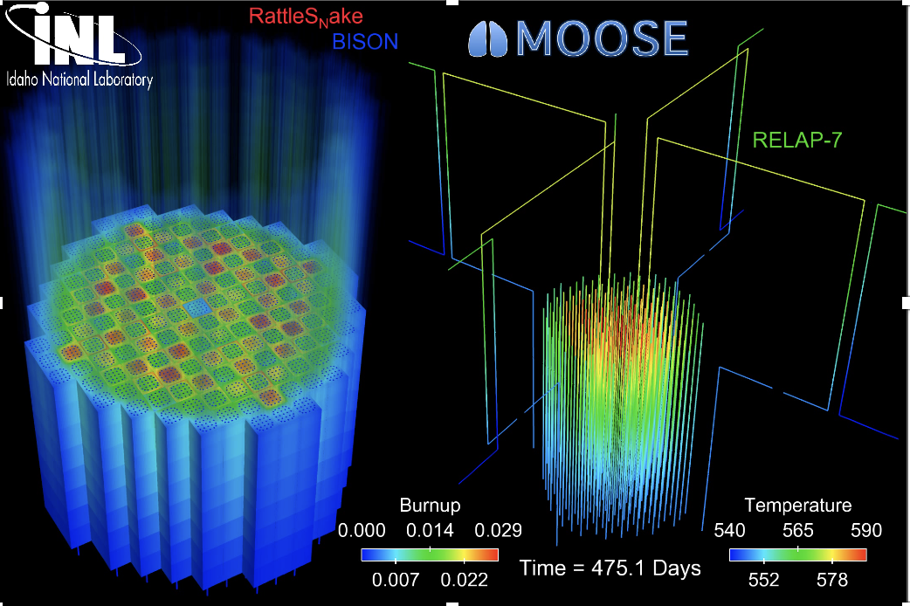
The most accurate solution is numerical, in 3D, requires modeling the entire core, and is multi-physics
Solution is 3D and changes in time
All the properties are functions of temperature
The boundary conditions come from information about the coolant flow
The heat generation rate comes from information about the neutronics in the reactor
No analytical solution is possible

Slide 21
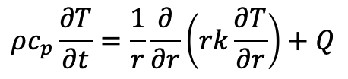
For numerical solutions, deal with discretization in space/time
Discretization in time
Forward Euler’s method (explicit)
Backward Euler’s method (implicit)
Discretization in space
Finite difference
Finite volume
Finite element
$$ρc_{p}\frac{∂T}{∂t}=\frac{1}{r}\frac{∂}{∂r}\left(rk\frac{∂T}{∂r}\right)+Q$$

Slide 22
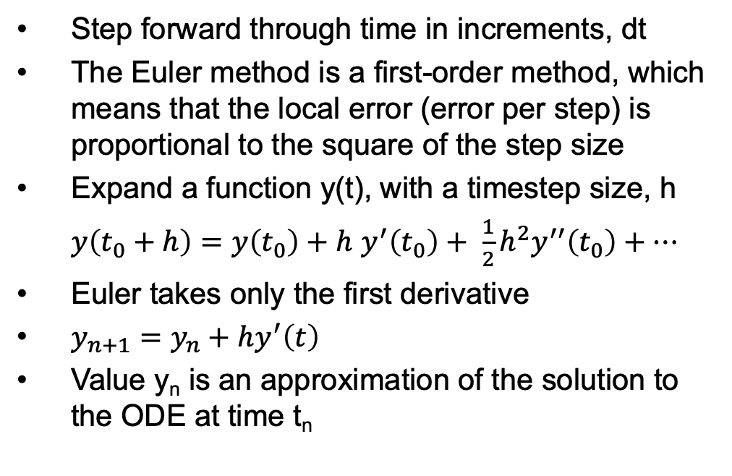
Forward Euler
Step forward through time in increments, dt
The Euler method is a first-order method, which means that the local error (error per step) is proportional to the square of the step size
Expand a function y(t), with a timestep size, h
$y\left(t_{0}+h\right)=y\left(t_{0}\right)+h$ $y^{′}\left(t_{0}\right)+ \frac{1}{2}h^{2}y^{′′}\left(t_{0}\right)+…$
Euler takes only the first derivative
$y_{n+1}=y_{n}+hy^{′}\left(t\right)$
Value y_{n} is an approximation of the solution to the ODE at time t_{n}

Slide 23
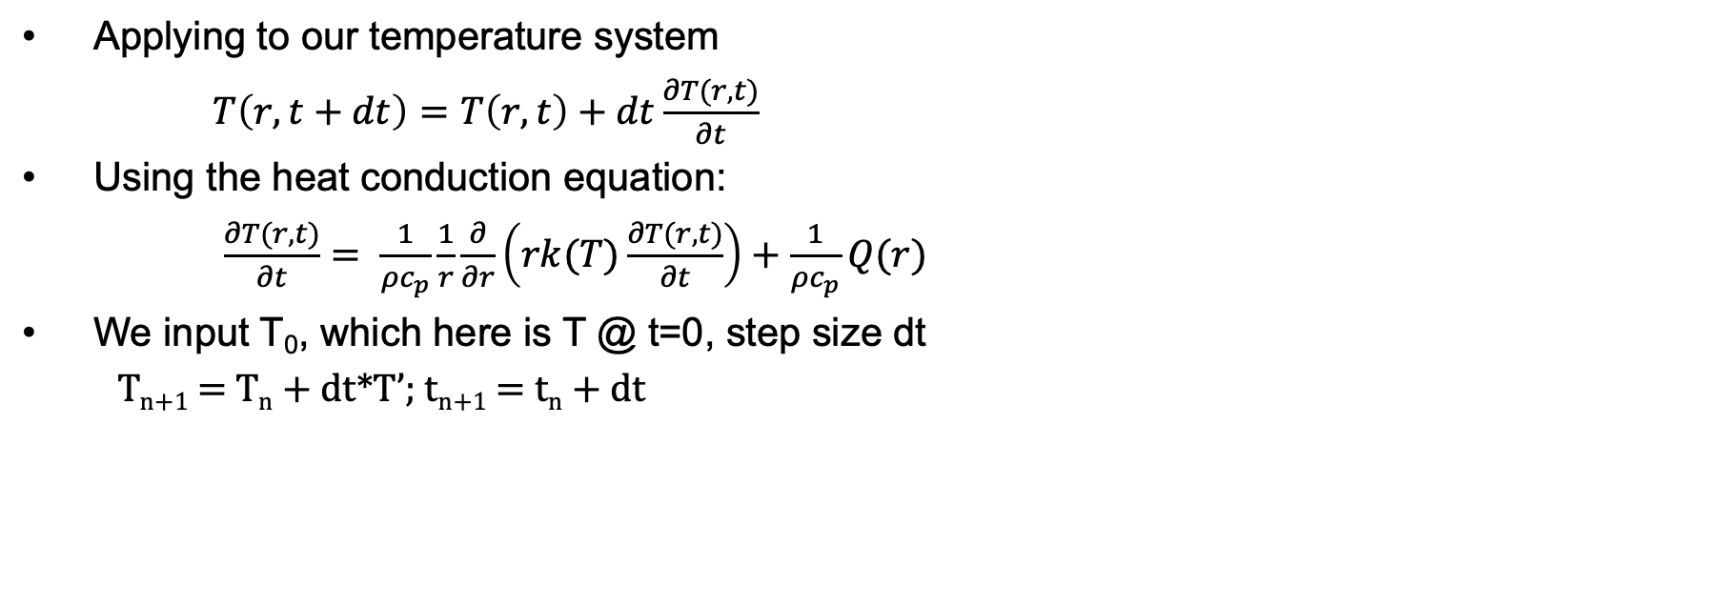
Forward Euler
Applying to our temperature system
$T\left(r,t+dt\right)=T\left(r,t\right)+dt\frac{∂T(r,t)}{∂t}$
Using the heat conduction equation:
$\frac{∂T(r,t)}{∂t}= \frac{1}{ρc_{p}}\frac{1}{r}\frac{∂}{∂r}\left(rk(T)\frac{∂T(r,t)}{∂t}\right)+\frac{1}{ρc_{p}}Q(r)$
We input T₀, which here is T @ t=0, step size dt
T_{n+1} = T_{n} + dt*T’; t_{n+1} = t_{n} + dt
T
t

Slide 24
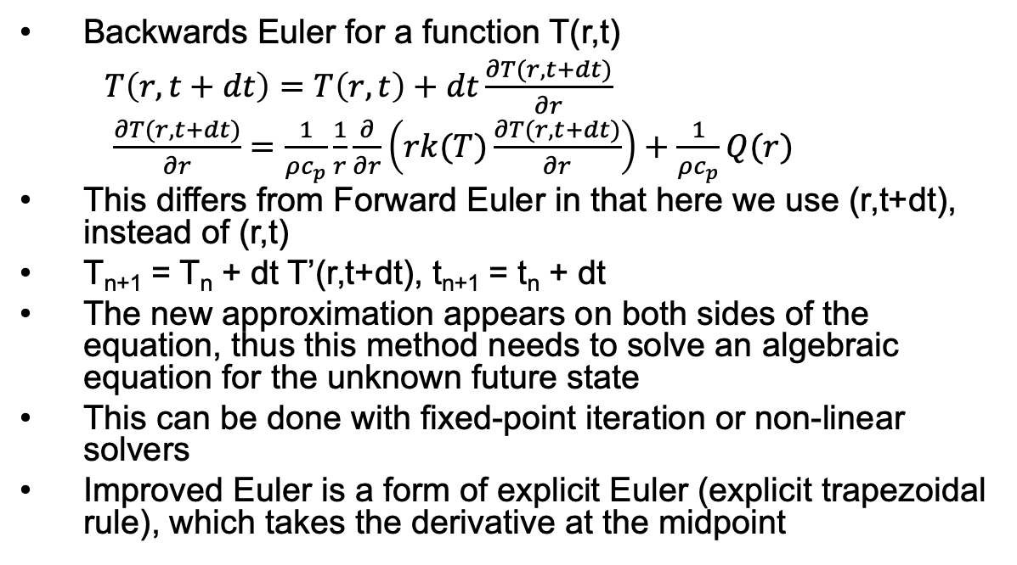
Backwards Euler
Backwards Euler for a function T(r,t)
$T\left(r,t+dt\right)=T\left(r,t\right)+dt\frac{∂T(r,t+dt)}{∂r}$
$\frac{∂T(r,t+dt)}{∂r}=\frac{1}{ρc_{p}}\frac{1}{r}\frac{∂}{∂r}\left(rk(T)\frac{∂T(r,t+dt)}{∂r}\right)+\frac{1}{ρc_{p}}Q(r)$
This differs from Forward Euler in that here we use (r,t+dt), instead of (r,t)
T_{n+1} = T_{n} + dt T’(r,t+dt), t_{n+1} = t_{n} + dt
The new approximation appears on both sides of the equation, thus this method needs to solve an algebraic equation for the unknown future state
This can be done with fixed-point iteration or non-linear solvers
Improved Euler is a form of explicit Euler (explicit trapezoidal rule), which takes the derivative at the midpoint
t

Slide 25
Explicit vs Implicit
Forward Euler is explicit
Explicit methods calculate the state of a system at a later time from the state of the system at the current time
Can be unstable if step size is too much
Backwards Euler is implicit
Implicit methods find a solution by solving an equation involving both the current state of the system and a later state
Implicit require an extra computation and they can be much harder to implement
Implicit methods are used because many problems arising in practice are stiff, for which the use of an explicit method requires very small timesteps

Slide 26
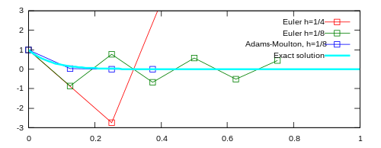



Stiff Equations
A stiff equation is a differential equation for which certain numerical methods for solving the equation are numerically unstable, unless the step size is taken to be extremely small
Consider the problem:
Where the exact solution is:
Euler's method with a step size of ℎ=1/4 oscillates wildly
Euler's method with half the step size, ℎ=/18, produces a solution within the graph boundaries, but oscillates about zero
The trapezoidal method (similar to backwards Euler) is implicit, and converges to the correct solution

Slide 27
Example Problem

Slide 28
Example Problem
y’=t*exp(-2t)
y0=4
dt=0.5
Backwards Euler

