Slide 1
Fuel Performance
NE 533: Spring 2023

Slide 2
Numerical time integration

Slide 3
For numerical solutions, deal with derivatives in space/time
Derivatives in time
Forward Euler’s method (explicit)
Backward Euler’s method (implicit)
Derivatives in space
Finite difference
Finite volume
Finite element

Slide 4
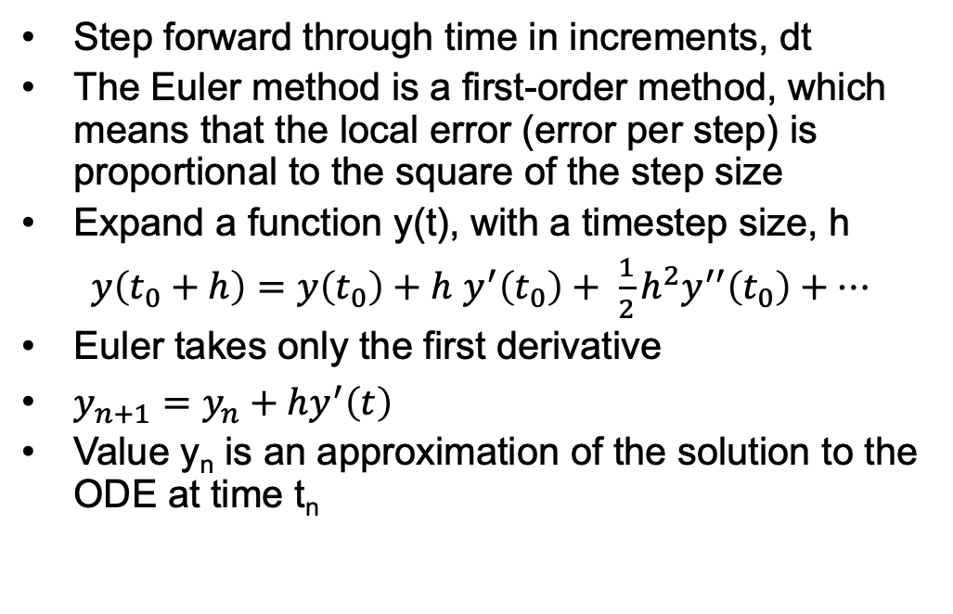
Forward Euler
Step forward through time in increments, dt
The Euler method is a first-order method, which means that the local error (error per step) is proportional to the square of the step size
Expand a function y(t), with a timestep size, h
$y\left(t_{0}+h\right)=y\left(t_{0}\right)+h$ $y^{′}\left(t_{0}\right)+ \frac{1}{2}h^{2}y^{′′}\left(t_{0}\right)+…$
Euler takes only the first derivative
$y_{n+1}=y_{n}+hy^{′}\left(t\right)$
Value y_{n} is an approximation of the solution to the ODE at time t_{n}

Slide 5
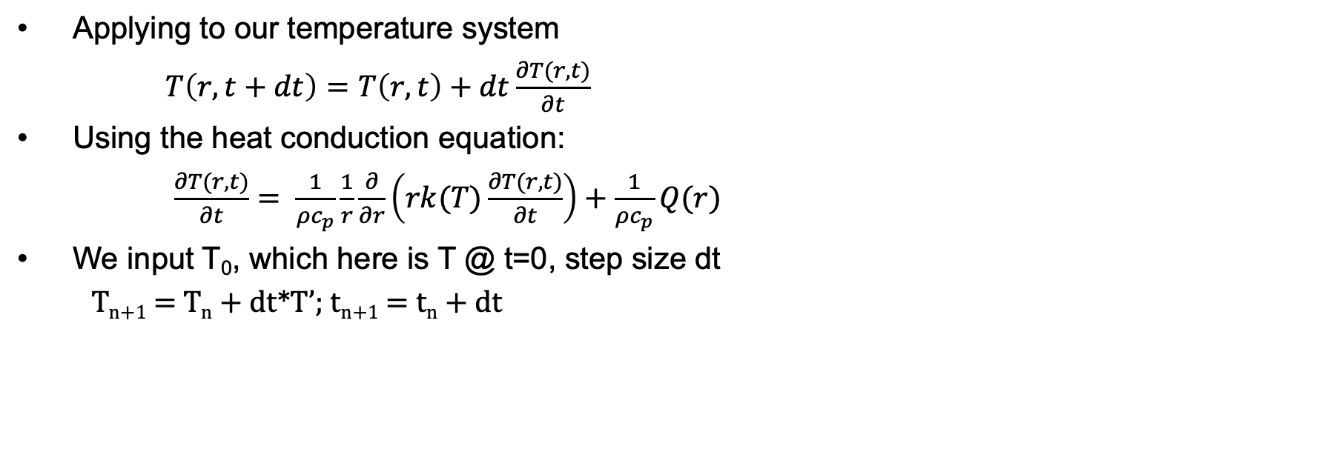
Forward Euler
Applying to our temperature system
$T\left(r,t+dt\right)=T\left(r,t\right)+dt\frac{∂T(r,t)}{∂t}$
Using the heat conduction equation:
$\frac{∂T(r,t)}{∂t}= \frac{1}{ρc_{p}}\frac{1}{r}\frac{∂}{∂r}\left(rk(T)\frac{∂T(r,t)}{∂t}\right)+\frac{1}{ρc_{p}}Q(r)$
We input T₀, which here is T @ t=0, step size dt
T_{n+1} = T_{n} + dt*T’; t_{n+1} = t_{n} + dt
T
t

Slide 6
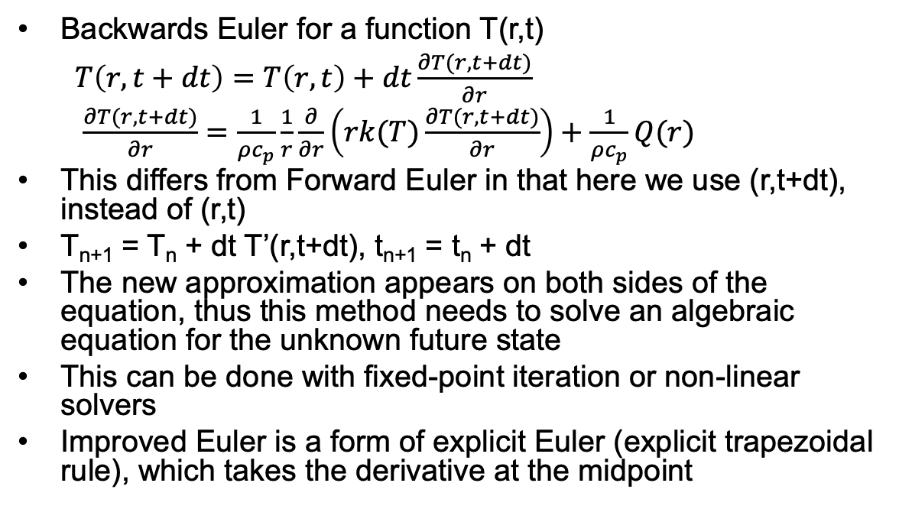
Backwards Euler
Backwards Euler for a function T(r,t)
$T\left(r,t+dt\right)=T\left(r,t\right)+dt\frac{∂T(r,t+dt)}{∂r}$
$\frac{∂T(r,t+dt)}{∂r}=\frac{1}{ρc_{p}}\frac{1}{r}\frac{∂}{∂r}\left(rk(T)\frac{∂T(r,t+dt)}{∂r}\right)+\frac{1}{ρc_{p}}Q(r)$
This differs from Forward Euler in that here we use (r,t+dt), instead of (r,t)
T_{n+1} = T_{n} + dt T’(r,t+dt), t_{n+1} = t_{n} + dt
The new approximation appears on both sides of the equation, thus this method needs to solve an algebraic equation for the unknown future state
This can be done with fixed-point iteration or non-linear solvers
Improved Euler is a form of explicit Euler (explicit trapezoidal rule), which takes the derivative at the midpoint
t

Slide 7
Explicit vs Implicit
Forward Euler is explicit
Explicit methods calculate the state of a system at a later time from the state of the system at the current time
Can be unstable if step size is too much
Backwards Euler is implicit
Implicit methods find a solution by solving an equation involving both the current state of the system and a later state
Implicit require an extra computation and they can be much harder to implement
Implicit methods are used because many problems arising in practice are stiff, for which the use of an explicit method requires very small timesteps

Slide 8
Example Problem

Slide 9
Spatial discretization

Slide 10
Spatial resolution
To numerically solve in space, we need to discretize
Finite difference
convert differential equations into a system of equations that can be solved by matrix algebra techniques
Finite volume
volume integrals in a partial differential equation that contain a divergence term are converted to surface integrals, using the divergence theorem. These terms are then evaluated as fluxes at the surfaces of each finite volume
Finite element
subdivides a large system into smaller, simpler parts that are called finite elements, the equations that model these finite elements are then assembled into a larger system of equations that models the entire problem

Slide 11
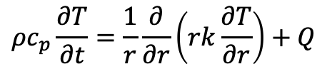
Finite Difference
$$ρc_{p}\frac{∂T}{∂t}=\frac{1}{r}\frac{∂}{∂r}\left(rk\frac{∂T}{∂r}\right)+Q$$
The finite difference method solves on a grid and uses numerical derivatives
Derivatives are approximated by differences
Boundary conditions must have either a fixed T or dT/dr
Typically restricted to handle rectangular shapes
Once you compute the time derivative, you can use either forward or backward Euler to march through time
T(r, t)
T(r + h, t)
T(r – h, t)

Slide 12
Finite Volume
$$ρc_{p}\frac{∂T}{∂t}=\frac{1}{r}\frac{∂}{∂r}\left(rk\frac{∂T}{∂r}\right)+Q$$
Discretize the domain by subdomains
Domain size h
We place points in the subdomain centers and on either boundary
The finite volume method balances fluxes across the boundaries of your divided subdomains
Integrate our PDE across the subdomain
Evaluate the integral using a linear approximation of the variable
Restricted to flux boundary conditions, often used in flow-type problems

Slide 13
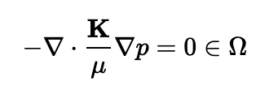

Finite Element
$$ρc_{p}\frac{∂T}{∂t}=\frac{1}{r}\frac{∂}{∂r}\left(rk\frac{∂T}{∂r}\right)+Q$$
In the finite element method, we interpolate the variable using nodal values and integrate over elements
Systematically recombine all sets of element equations into a global system of equations for the final calculation
Write the strong form of the equation, rearrange to get zero on the right-hand side, multiply by the test function, integrate over the domain, yielding weak form
The strong form states conditions that must be met at every material point, whereas weak form states conditions that must be met only in an average sense
Finite element works for any geometry and any boundary condition
e1
e2
e3
n1 n2 n3 n4

Slide 14
Spatial resolution
Finite difference
Advantages
Simple
Easy to code
Fast
Disadvantages
Difficult to model complex geometries
Difficult to model complex BCs
Only represents solution at points
Difficult to represent heterogeneous properties
Finite Volume
Advantages
Can model any geometry
Naturally conservative
Heterogeneous properties
Disadvantages
Boundary conditions add complexity
More complicated than finite difference
Finite Element
Advantages
Can model any geometry
Can model any BC
Continuous representation
Heterogeneous properties
Disadvantages
Complicated
Somewhat more expensive

Slide 15
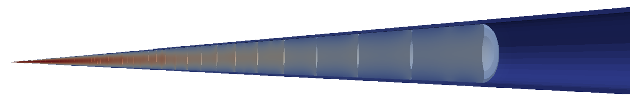
Different Fuel Performance Problems
Transient, full 3D
Transient, 2D axisymmetric with discrete pellets
Computational cost
Transient, 2D axisymmetric with smeared pellets
Accuracy
Transient, multiple 1D slices (1.5D)
Transient, 1D
Steady state, 1D (analytical)

Slide 16
Numerical Approaches to Different Fuel Performance Problems
Transient, full 3D
FEM or FV
Transient, 2D axisymmetric with discrete pellets
FEM or FV
Computational cost
Transient, 2D axisymmetric with smeared pellets
FEM, FV, or FD
Accuracy
Transient, multiple 1D slices (1.5D)
FEM, FV, or FD
Transient, 1D
FEM, FV, or FD
Steady state, 1D (analytical)

Slide 17
Heat equation solution approach summary
Approach | Solution | Assumptions
1D steady state | Analytical | Steady state, axisymmetric, no axial variation, constant k
1D transient | FEM, FD, FV | Axisymmetric, no axial variation
1.5D transient | FEM, FD, FV with multiple slices | Axisymmetric, no axial variation
2D transient, smeared pellets | FEM, FD, FV | Axisymmetric, fuel pellets act as one body, fuel pellets are perfect cylinders
2D transient, discrete pellets | FEM, FV | Axisymmetric
3D transient | FEM, FV | You have a big computer
Each numerical solution can be solved explicitly or implicitly

Slide 18
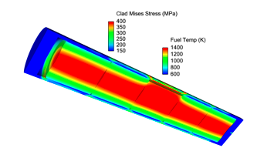
Solving with fuel performance codes
Fuel performance codes primarily use either finite difference or finite element
The earliest fuel performance codes solved the heat equation in 1.5D using finite difference (with multiple axial slices)
More modern codes have switched to finite element, due to more flexibility with geometry and boundary conditions
Finite volume is not used because it can’t solve for the stress

Slide 19
Summary
The heat equation can be solved using numerical methods.
Spatial derivative solution methods divide the domain up into smaller pieces
Finite difference
Finite volume
Finite element
Each discretization has strengths/weaknesses
Finite element is primary method for high fidelity fuel performance codes

Slide 20
Notes
Exam on Feb. 3
Will cover all classes through this Thursday
Will contain both conceptual and work-through problems
Major topics covered:
Fuel types; Heat generation; Reactor Systems; Fuel fabrication; Heat transfer; Analytical solution to heat transfer; Numerical solution to heat transfer; Thermal conductivity; Operational Limits
In-person: during class time
Online: total of 1.5 hours to complete the exam (class period plus 15-minute buffer)
Distance students: please schedule your exam with me, otherwise it will be assumed you will be completing it during class time
In person students: Option to complete in person during class, or online during the class period
Next time will be partial lecture and partial problem session

Slide 21
Time Integration From Class
t | y' |  | forward | backward |  | function
1 | 1 |  | 6 | 6 |  | 6
1.333333 | 1.3333E-06 |  | 6.333333 | 6.00000044 |  | 6.18518519
1.666666 | -1.6666627 |  | 6.33333344 | 5.44444678 |  | 5.92592704
1.999999 | -3.999992 |  | 5.77777978 | 4.11111744 |  | 5.000004
2.333332 | -6.9999867 |  | 4.44445044 | 1.77779089 |  | 3.18519452
2.666665 | -10.666647 |  | 2.11112389 | -1.7777544 |  | 0.25927704
2.999998 | -14.999972 |  | -1.4444214 | -6.7777401 |  | -3.99997
3.333331 | -19.999963 |  | -6.4444071 | -13.444388 |  | -9.8147681
3.666664 | -25.666619 |  | -13.111055 | -21.999919 |  | -17.407339

