Slide 1
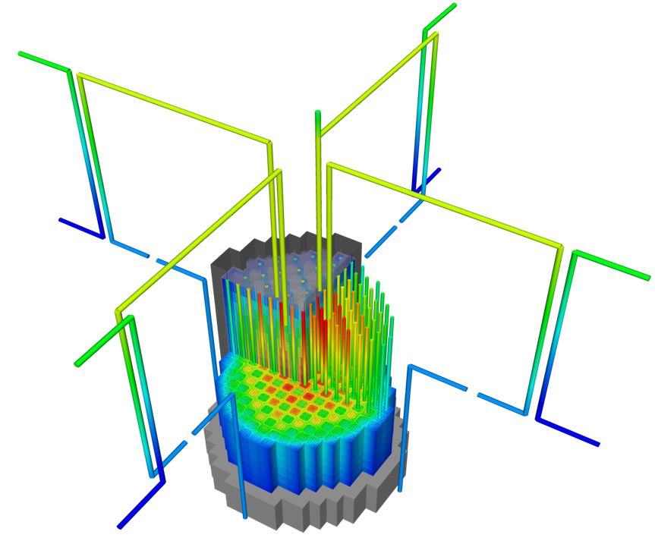
The most accurate solution of our problem must be numeric
Solution is 3D and changes in time
All the properties are functions of temperature
The boundary conditions comes from information about the coolant flow
The heat generation rate comes from information about the neutronics in the reactor
No analytical solution is possible

Slide 2
The most accurate solution is 3D, requires modeling the entire core, and is multiphysics
Movies from Tonks lecture 6
This simulation required 48 hours of computation using hundreds of processors

Slide 3
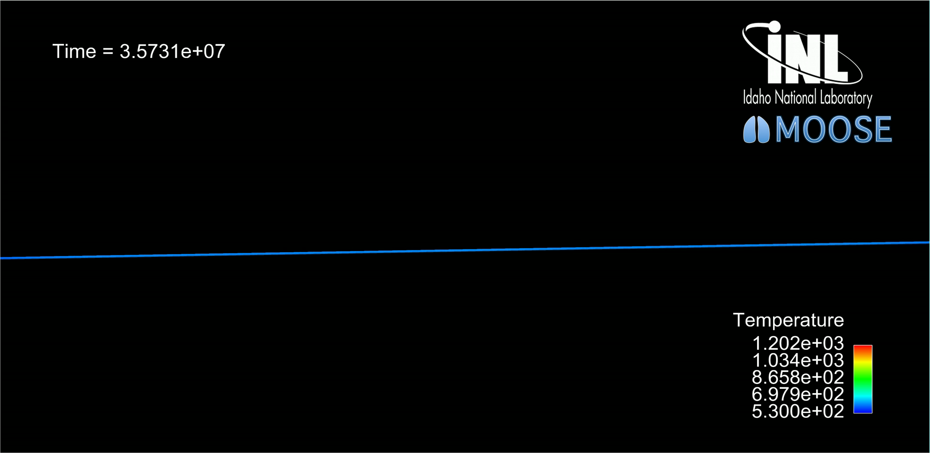
We can simplify the solution by making assumptions
Things would be much easier if we could model only one fuel rod
Assume a neutron flux that is a function of axial position and radius to decouple from the neutronics
Use a simple coolant channel model to decouple from the thermal hydraulics
This simulation still requires several days using hundreds of processors

Slide 4
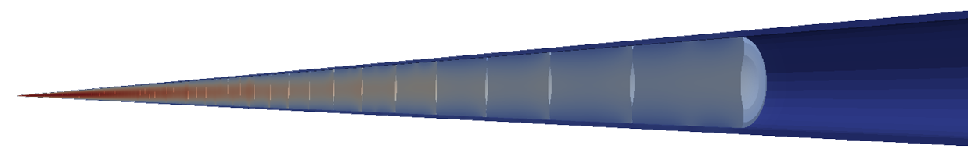
The more assumptions we make, the faster the calculation, but the less accurate the results are
Transient, full 3D
Transient, 2D axisymmetric with discrete pellets
Computational cost
Accuracy
Transient, 2D axisymmetric with smeared pellets
Transient, multiple 1D slices (1.5D)
Transient, 1D
Steady state, 1D (analytical)

Slide 5
In this course, we will focus on the less complex solutions
Transient, full 3D
Transient, 2D axisymmetric with discrete pellets
Computational cost
Accuracy
Transient, 2D axisymmetric with smeared pellets
Transient, multiple 1D slices (1.5D)
Transient, 1D
Steady state, 1D (analytical)
We will do in the homework You could do in the project

Slide 6
Summary
The temperature profile throughout the fuel and cladding is predicted by solving the heat equation
An accurate solution of the temperature profile in a fuel pellet requires a 3D numerical approach coupled to other physics codes
Typically we focus on a single fuel rod
We make simplifying assumptions to lower the computational cost, but it also decreases the accuracy
Transient, full 3D
Transient, 2D axisymmetric with discretized pellets
Transient, 2D axisymmetric with smeared pellets
Transient, 1.5D
Transient, 1D
Steady state, 1D (analytical)

