Slide 1
Zirconium Cladding
NE 591

Slide 2
Last time
The fuel thermal conductivity decreases with burnup
The NFIR model is a fairly accurate empirical model of the fuel thermal conductivity
Researchers are working to develop materials models for the fuel and cladding that are mechanistic rather than empirical and that are based on the evolution of the microstructure rather than the burnup
Zirconium alloys used as cladding
Zirconium fabricated into an alloy to increase corrosion resistance
There are a number of Zr alloys utilized in PWRs as cladding and structural materials

Slide 3
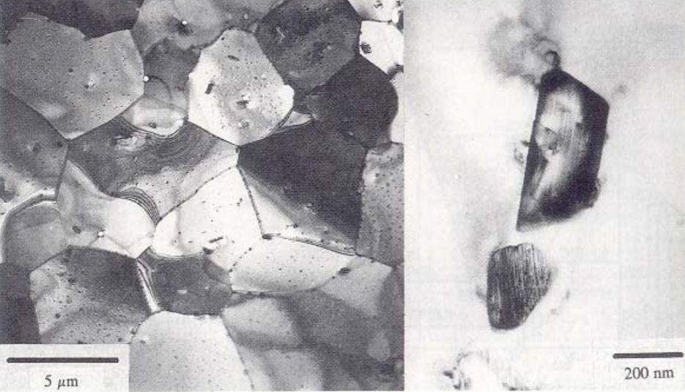
Alloying Elements
The alloying elements impact the microstructure of the material
The intermetallic precipitates significantly improve the oxidation behavior
In zircaloy 2, the precipitates are
Zr(Cr, Fe)₂
Zr₂(Ni, Fe)
In Zircaloy 4, the precipitates are
Zr(Cr, Fe)₂
Phosphides (Zr₃P) and silicides (Zr₃Si) are also occasionally found.
The precipitate distribution, size, morphology, and composition all impact the properties of the material

Slide 4
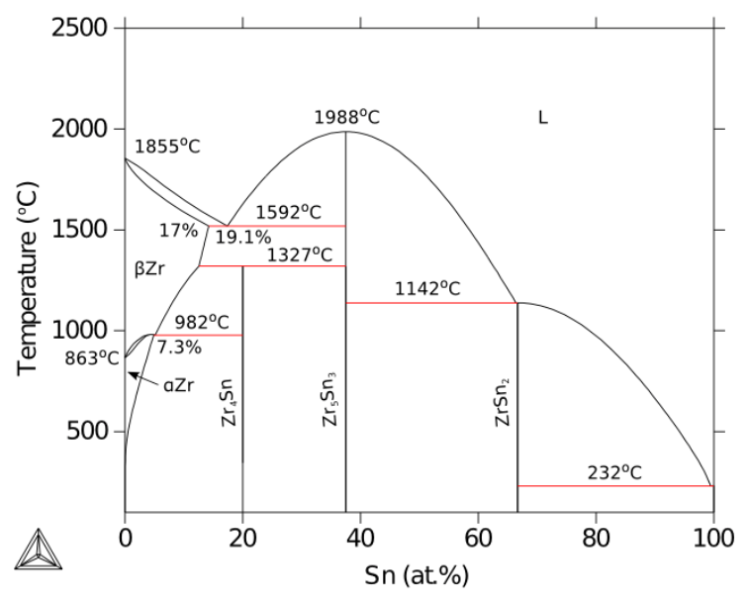
Zirconium Phases
The α-Zr phase has a hexagonal-close-packed (HCP) structure.
At temperatures below about 863ºC
Has the most desirable properties
The β-Zr phase has a body-centered cubic (BCC) structure
We try to avoid this phase

Slide 5
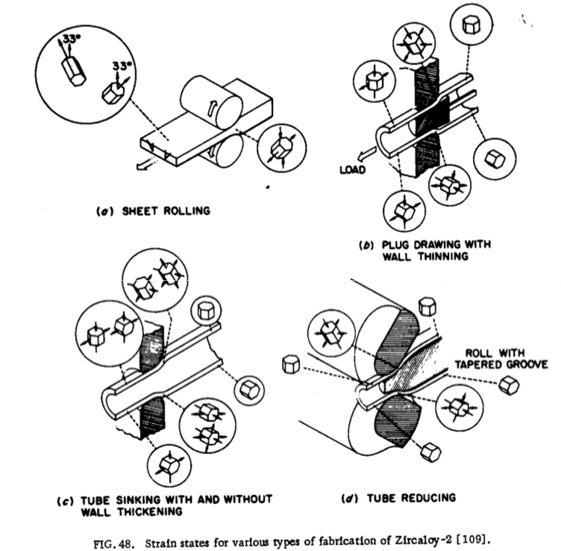
Zr Tube Fabrication
The cladding tubes are fabricated using various processes that SEVERELY deform the material
The severe plastic deformation causes significant dislocation hardening, that can make the tube material too brittle
Plastic deformation along slip planes results in reorientation of the grains
The properties of the material are controlled by heat treatment
Raising the temperature, but below 863°C, anneals the sample to reduce cold work (stress-relieved)
Raising the temperature above 863°C changes to the β phase. They then quench the sample to create a random texture in the α phase

Slide 6
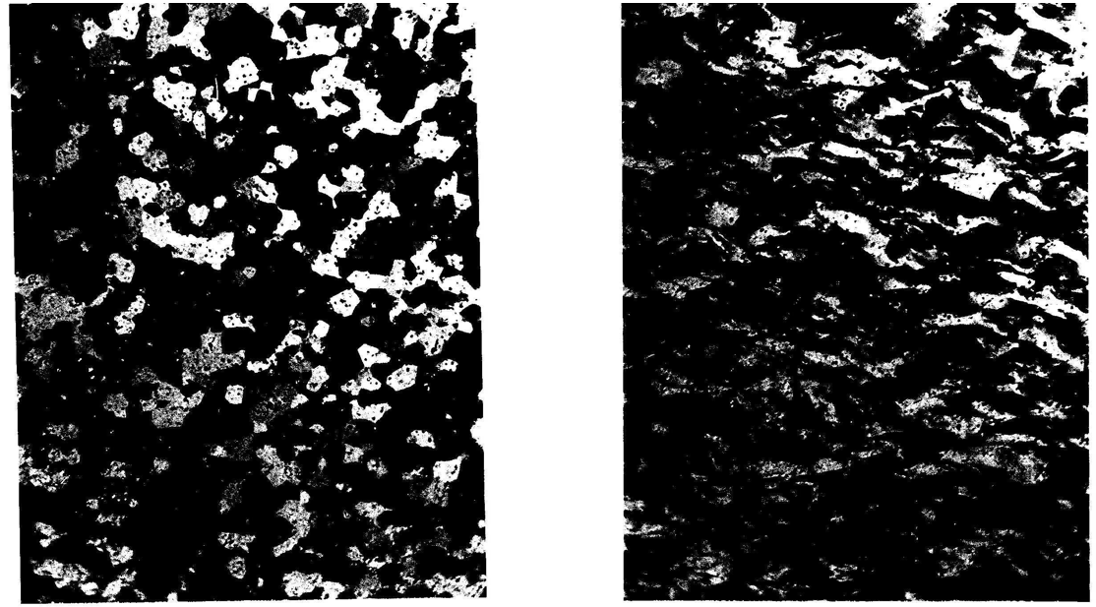
Zr alloy microstructures
Fully recrystallized after quench
Stress-relieved microstructure

Slide 7
Zirconium Creep and Growth
The cladding undergoes a very large amount of irradiation during its life, the main effects are:
Interstitial loops form on prism planes
Later in the reactor exposure, vacancy loops form on the basal plane
The overall number of displacements to the cladding can be calculated with the NRT model to be G ~ 8 x 10-8 dpa/s, which, over 3 years exposure gives a total of ~ 8 dpa (every atom in the solid is displaced on the average eight times)

