Slide 1
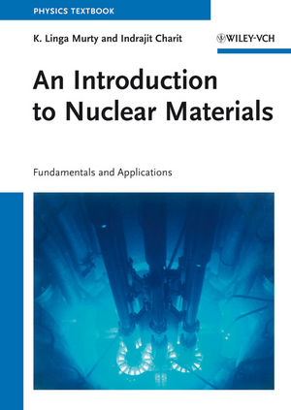
Nuclear Materials NE/MSE 409-509
Prof. K.L. Murty
North Carolina State University
Office: 3143 Burlington Eng Labs
Email: murty@ncsu.edu
Queries by email
TA/Co-Instructor: Mr. Mahmoud Hawary
Office: 3144 Burlington Eng Labs
Email: myhawary@ncsu.edu
Office Hours: M,W 10:00am-11:00am (In-person and Online)
Textbook
K.L. Murty and I. Charit, “Introduction to Nuclear Materials” published by Wiley, 2013.

Slide 2
Nuclear Materials (importance)
“We physicists can dream up and work out all the details of power reactors based on dozens of combinations of the essentials, but it’s only a paper reactor until the metallurgist tells us whether it can be built and from what.” – CO Smith
Main objectives are to introduce the students to:
The basic issues concerned with the selection of materials for various components in nuclear reactors
The effects of radiation and environment on various properties of materials in nuclear applications to get an appreciation of the materials' limitations on the operation of reactors

Slide 3
Course Outline
Overview of Nuclear Reactor Systems
Fundamental Nature of Materials
Fundamentals of Radiation Damage
Properties of Materials
Dislocation Theory
Radiation Effects on Materials
Reactor Materials (Cladding, RPVs, etc.)

Slide 4
Course Outline (detailed)
1. Overview of Nuclear Systems
a. Various types
b. Materials - Selection
5. Dislocation Theory
a. Types
b. Stress Fields and Strain Energy
c. Forces on Dislocations
d. Dislocation Interactions
e. Dislocation Sources and Pile-ups
f. Partial Dislocations
g. Strengthening Mechanisms
h. Static and Dynamic Strain Aging
2. Nature of Materials
a. Crystal Structure
b. Imperfections
c. Diffusion in Solids
3. Radiation Damage
a. Binary Elastic Collisions
b. Displacements due to PKA
6. Radiation Effects
a. Microstructural Changes
b. Friction and Source Hardening
c. Fracture and DBTT
d. Embrittlement and Fracture
4. Properties of Materials
a. Mechanical Properties
b. Fracture, Fatigue and Creep
c. Corrosion & SCC
7. Reactor Materials
a. LWR Core Materials Radiation Growth - Zircaloys
b. Void Swelling (Stainless Steels)
c. Radiation Induced vs Radiation Enhanced Creep
d. Pressure Boundary Material

Slide 5
Grading
NE/MSE 409
Homeworks: 20%
Tests #1 (25%); #2 (25%) – tentative dates: Tu 10/6, Tu 11/3
Final - (30%) – Thurs, Dec 8th @8AM
NE/MSE 509
Homeworks: 15%
Term-long Project: 10% - due Wed 11/30/2022 (see details)
Tests #1 (20%); #2 (25%) – tentative dates: Tu 10/6, Tu 11/3
Final - (30%) - Thurs, Dec 8th @8AM
+/- grading will be adopted: A+≥95 A≥92.5 A-≥90 B+≥85 B≥82.5 B-≥80 C+≥75 C≥72.5 C-≥70 D+≥65 D≥62.5 D-≥60 F<60
See Academic Regulation at: http://www.ncsu.edu/provost/academic_regulations/syllabus/reg.htm

Slide 6
Polices and Procedure
Assignments
Required homework is due on the assigned date (by 5pm to the TA/submit on Moodle).
Make sure to include your course number and section clearly (e.g., NE509-601, MSE509-001, ..)
Tests
Closed book
Last page with appropriate equations along with any other useful information such as universal constants, parameters, etc. (tear it for use)

Slide 7
Instructional Objectives – At the end of the course you will be able to:
evaluate the effect of radiation on mechanical property changes
estimate the damage accumulated in a material in reactors and thus the remaining useful life of the structure made of these materials
describe the various materials comprising the structures in nuclear reactors
compare two competing materials for a given application
explain why a specific material was chosen for a given application
identify problems (materials related) encountered in nuclear reactor structures
choose the best and optimum material for a given application
predict the reliability (dimensional stability) of a given component in a nuclear reactor
outline procedure(s) for detecting the problems and suggest plausible remedial solutions
distinguish between various effects resulting in the deterioration of a given component in-service

Slide 8
Lecture pdfs etc
pdfs of the lectures will be on the course web (Moodle) - please review before the class.
The course requires reading the appropriate sections of the text as well as references.
The course is built up on basic Materials Science concepts and thus a thorough review of MSE201 will be very helpful (but not required).
References
W.D. Callister, Materials Science and Engineering, Wiley, 7th Ed. (2007) pdf online
D. Hull and D.J. Bacon, Introduction to Dislocations, Pergamon Press (1965)
G.S. Was, Fundamentals of Radiation Materials Science, Springer (2007)
D.R. Olander and A. T. Motta, Light Water Reactor Materials, Volume I: Fundamentals, ANS (2017)
D.R. Olander, Fundamental Aspects of Nuclear Reactor Elements, NTIS, ERDA (1975) – out of print

Slide 9
509 Project Information
Project (10% of the grade) – report due Tuesday 11/30/2022
See the list of topics which involves literature search.
Some information may be found in many monographs on radiation effects including textbooks on the subject.
The research report should not exceed 10 typed pages (word processed – regular 8.5”x11” paper with 1” margin on top, bottom, left and right, with 11-size (or greater) font of Times Roman with figures in the text where appropriate not including references.
The write-up should be like a short review article you come across in journals, and research on the given topic is expected to be thorough.
Please let me know the project you plan to work on by Tues, Oct 4th – send me an e-mail with the title, your name along with your section and a brief summary – all not to exceed 1-page; - please name the file “509project-yourname”. Make sure to include your name and course (number/section) under the title along with your e-mail address.
If you would like to work on a different one (but related to radiation effects / materials), please send me an e-mail with a brief description before-hand.

Slide 10
509 List of Project
Project (10% of the grade) – report due Tuesday 11/30/2022
Radiation Embrittlement of Pressure Vessel Steels / Micromechanisms.
Assessment of radiation effects on mechanical and fracture properties using small (subsize) specimen testing (briefly review various techniques and emphasize one specific technique and show its viability).
Radiation effects on mechanical and fracture (or corrosion) characteristics of Zircaloys and their effects on in-reactor performance (LWRs).
Cracking problems associated with Steam Generator Tubing (LWRs) and mitigating methods.
Core shroud cracking in BWRs - probable mechanisms and methods for repairs.
NRC regulations on the PV steel (base, weld and HAZ) embrittlement and assessment of the degree of damage of operating reactors and solutions for life extension (annealing and radiation effects of annealed reirradiated steels).
Life assessment and prediction of a specific structural component in LWRs.
Liquid metal embrittlement of fast reactor cladding materials & effects of radiation.
New techniques for radiation damage assessment [choose one and describe in detail the technique, its applicability, limitations, etc., examples: Positron Annihilation (PA), Filed Ion Atom Probe (FIM-AP), SQUID magnetic measurements, Internal Friction (IF), Small Punch (SP) Test, Automated Ball Indentation (ABI), Small Angle Neutron Scattering (SANS), Mossbauer Spectroscopy (MS), Muon Spin Rotation (μSR), Acoustic Emission (AE), Molecular Dynamics and Computer Simulation, etc. Note that many of these techniques were attempted in understanding the radiation damage in PV steels.] - emphasis on nondestructive examination and testing (NDE & NDT).
Vanadium alloys for fusion applications.
Dry storage feasibility of LWR spent fuel - with emphasis on material problems (criteria prior to transfer from on-site pool to dry storage, reliability of the fuel bundles for 100-year storage)
Materials for Space Reactors; Materials for Next Generation Reactors
Mechanical and Creep properties of Graphite, SiC, etc., – effects of radiation

Slide 11
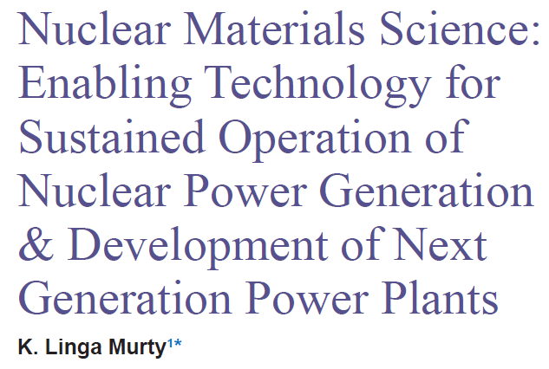

Significance of Nuclear Materials
Murty, J Nuclear Energy Science and Power Generation Technology 2012
http://dx.doi.org/10.4172/2325-9809.1000e104

