Slide 1
Nuclear Fuel Performance
NE-533
Spring 2026

Slide 2
Last Time
Radiation effects in UO2
Can increase lattice parameter and decrease Young’s modulus
High burnup structure
higher power on periphery, higher burnup, lower temperatures
leads to grain refinement and large amounts of porosity
fission gas is retained, despite high porosity
thermal conductivity slightly increases due to ‘clean’ grains
Fuel chemistry
different U charges can accommodate defects/substitutionals
O/M ratio is linked to oxygen partial pressure (oxygen potential)
O/M ratio is buffered by Mo in the fuel, and decreased near the cladding
stoichiometry affects fuel properties

Slide 3
Last Time
Five families of fission products
soluble oxides (in fluorite structure)
insoluble oxides (gray oxide phase)
metals (white inclusions, 5-metal precipitates)
volatiles (gas bubbles)
noble gases (gas bubbles)
Impact thermal conductivity and swelling in different ways
Which fission products are in which group change based upon oxygen potential

Slide 4
Fission Gas Release

Slide 5

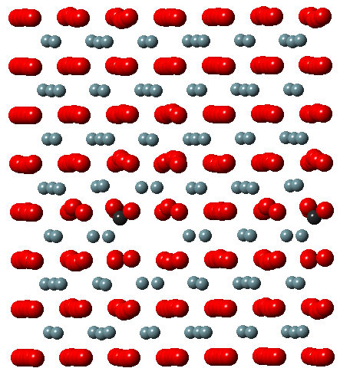
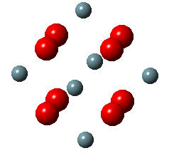
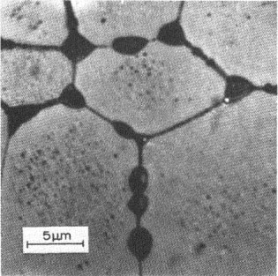
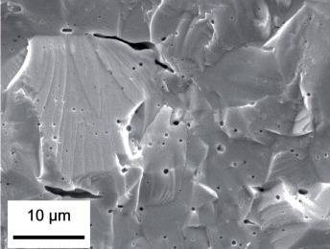
Fission Gas Release
Fission gases (Xe, Kr) are released in a process composed of three stages in UO2
Stage 1: Gas atoms are produced throughout the fuel due to fission and diffuse towards grain boundaries
Small intragranular bubbles form within the grains, but never get larger than a few nm radius due to resolution from energized particles
Gas atoms that don’t get trapped within the intragranular bubbles migrate to grain boundaries
Atoms forming a vacancy cluster

Slide 6
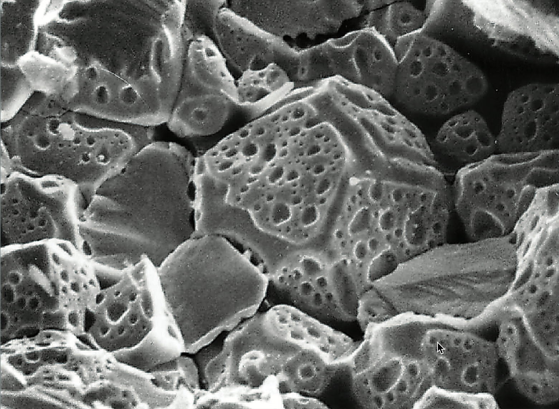
Fission Gas Release
Stage 2: Gas bubbles nucleate on grain boundaries, growing and interconnecting
Stage 3: Gas travels through interconnected bubbles to a free surface

Slide 7
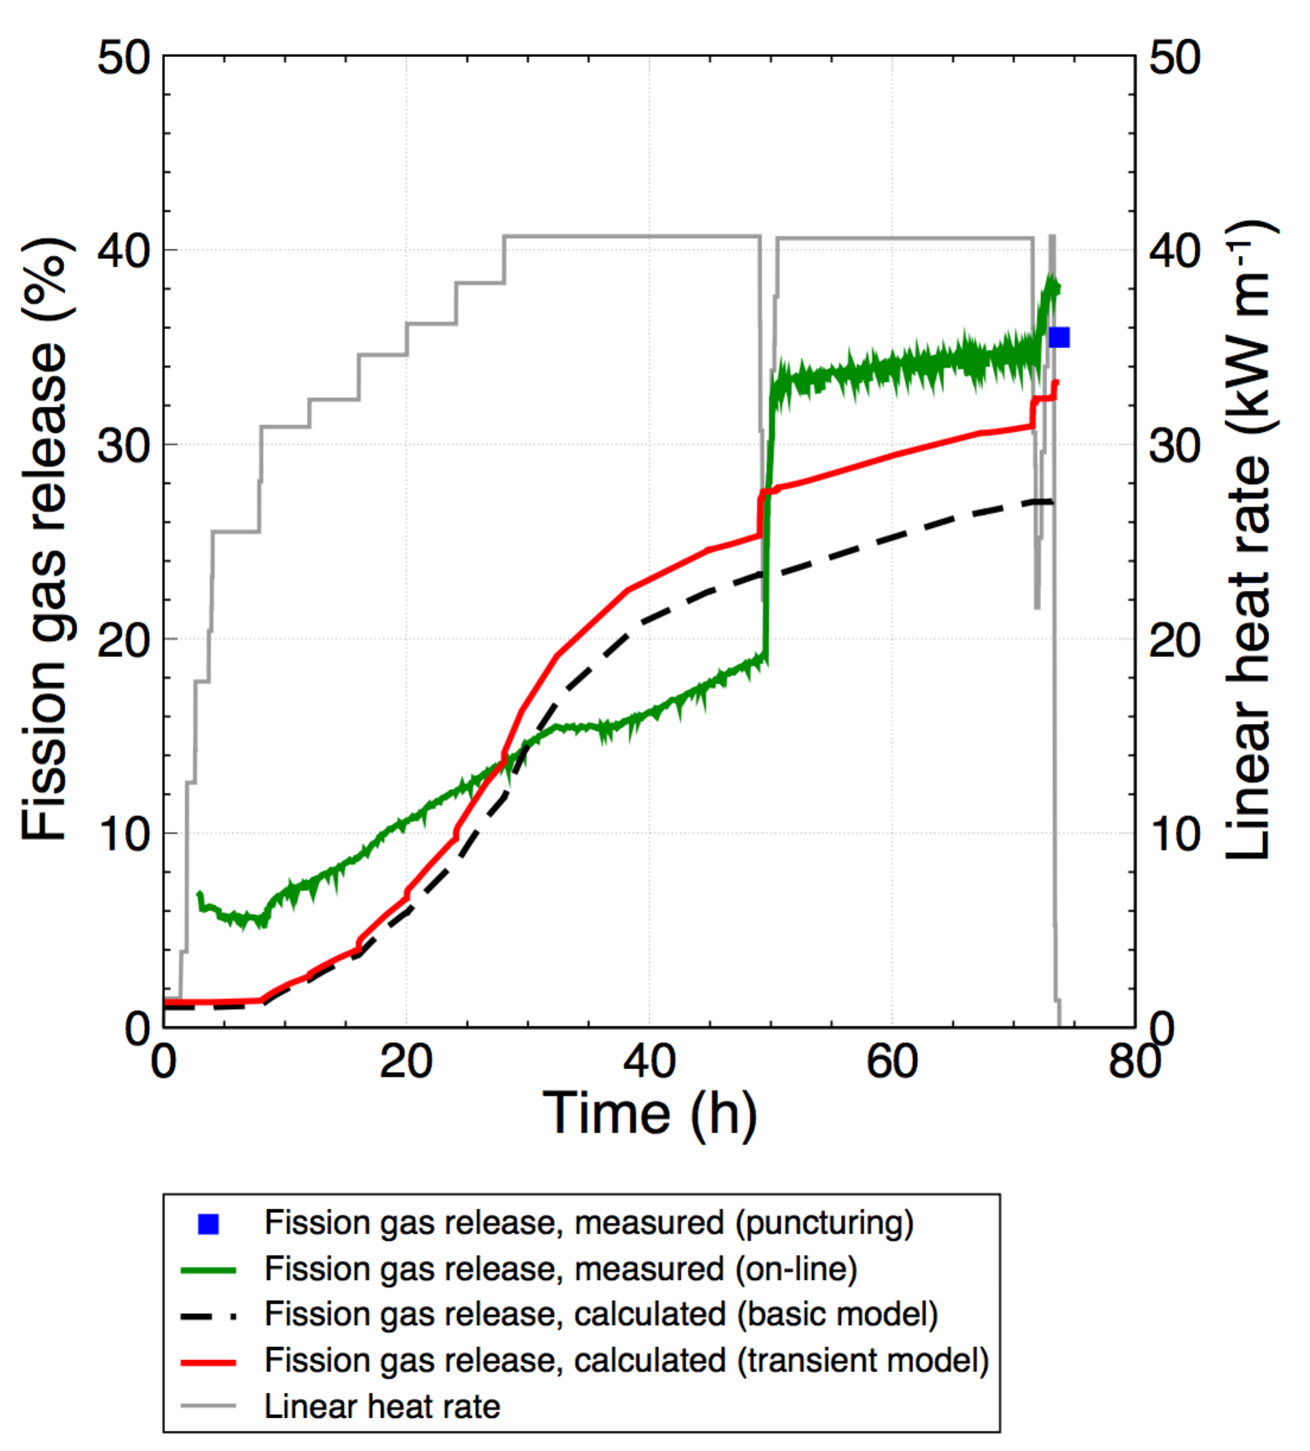
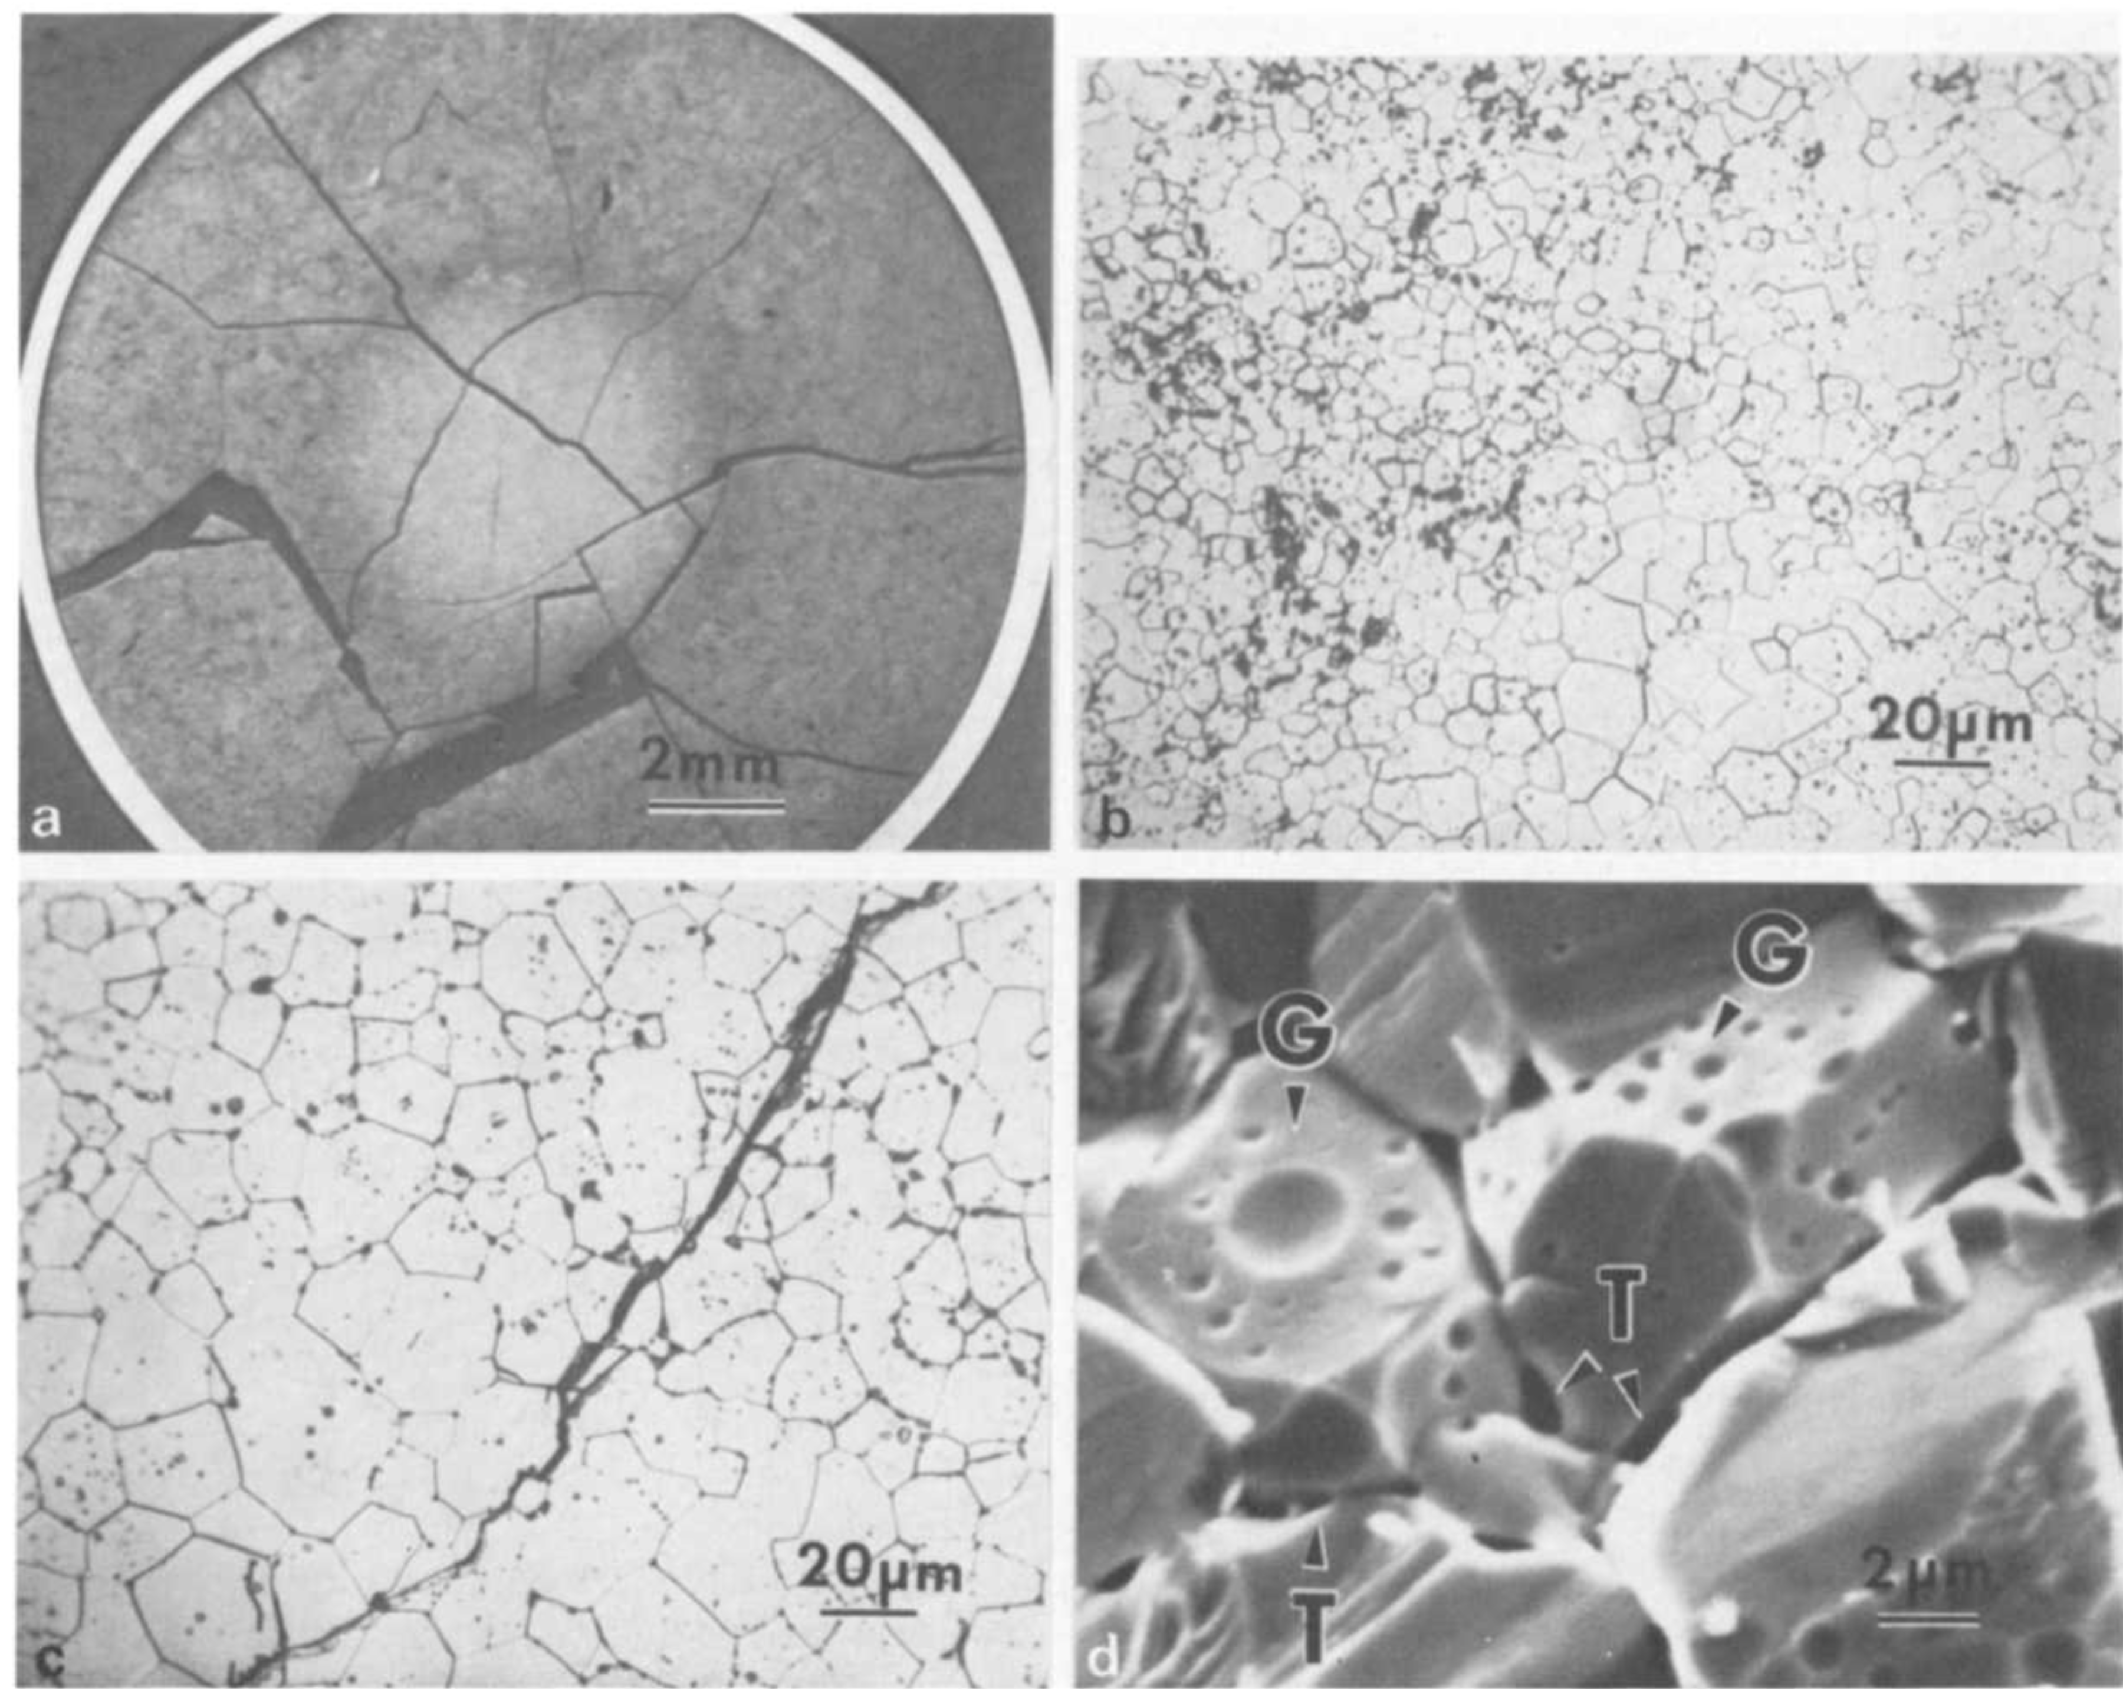
Fission Gas Release
Fission gas release also occurs due to mechanisms that don’t depend on diffusion
Release can occur to particle recoil and knockout at low temperature
It can occur due to fracture during rapid transients

Slide 8
Fission Gas Release
Released fission gas enters the gap and plenum, causing various problems
Xe and Kr have very low thermal conductivities, reducing the gap conductance
The plenum pressure increases
The volatile fission gases corrode the cladding
They are also radioactive and hazardous, causing problems when the cladding is breached
Fission gas release experiments:
Post irradiation annealing
Fuel is irradiated at low temperature; Fuel is then placed into a furnace and heated; Gas atom release is then measured
In-pile release
Gas release is measured during reactor operation; It is much more difficult than post-irradiation annealing; Total amount released is measured by puncturing cladding after irradiation; Release with time can be estimated using a pressure transducer inside an instrumented fuel rod

Slide 9
Fission Gas Release
Fission gas release models attempt to predict the rate at which gas is released from the fuel
To model fission gas release, ideally, we must model all three stages of gas release
Diffusion of gas atoms to grain boundaries
Growth and interconnection of grain boundary bubbles
Transport of gas atoms through interconnected bubbles to free surfaces
The earliest models only considered Stage 1
Most models now consider stage 1 and 2
There are no models that consider all three stages, but some are under development

Slide 10
Booth Model
The Booth model is the earliest model of fission gas release and only considers stage 1
A grain is considered as a simple sphere
Gas atoms are released at the grain boundary
The model solves the diffusion equation in 1D spherical coordinates
Assumptions
c_{g}(r, t)
All grains are spheres of radius a
D is constant throughout the grain
Gas is produced uniformly throughout the grain
Gas is released once it reaches the grain boundary
Release
Gas atoms
Grain boundary
ICs and BCs
c_{g}(r, 0) = 0
c_{g,r}(0, t) = 0
c_{g}(a, t) = 0 (release)

Slide 11
Modeling post-irradiation annealing
The initial gas concentration is c_{g}⁰
No gas is produced
Solving this equation tells us the value of c_{g} at any radius or time
However, we want to know the fraction of gas atoms that have made it to the grain boundary
We use the flux at the grain boundary
Release
Gas atoms
Grain boundary
ICs and BCs
c_{g}(r, 0) = c_{g}⁰
c_{g,r}(0, t) = 0
c_{g}(a, t) = 0 (release)

Slide 12
Solving the Booth Model
This equation is solved using a Laplace transform after nondimensionalization
Will not go through the derivation (shown in Olander)
τ = D x t / a²
Release
Gas atoms
Grain boundary
τ < π⁻²
τ ≥ π⁻²

Slide 13
Booth Example
For a diffusion coefficient for Xe of D = 8e-15 cm²/s, what fraction of the fission gas trapped in a post-irradiation annealed fuel pellet has escaped after one hour? It has an average grain size of 10 microns
D = 8e-15 cm²/s
a = 10e-4 cm
t = 3600 s
Which f? τ = D x t/a² = 2.88E-4 < π⁻² = 0.101
f = 6*sqrt(8e-15*3600/(pi*(10e-4)^2)) – 3*8e-15*3600/(10e-4)^2 = 0.0181

Slide 14
Different expressions for fission gas release
Given the data from the previous example, can plot both
τ < π⁻²
τ > π⁻²

Slide 15
Modeling in-pile release
The initial gas concentration is 0
Gas is produced due to fission, where y is the chain yield (y = 0.3017 for Xe and Kr) and the fission rate
Gas can also decay, where λ is the decay constant
If we only consider stable stable products, λ = 0
For in pile release, the fraction is equal to
After solving with with a Laplace transform
The total gas production is gas atoms/cm³
Release
Gas atoms
Grain boundary
ICs and BCs
c_{g}(r, 0) = 0
c_{g,r}(0, t) = 0
c_{g}(a, t) = 0 (release)

Slide 16
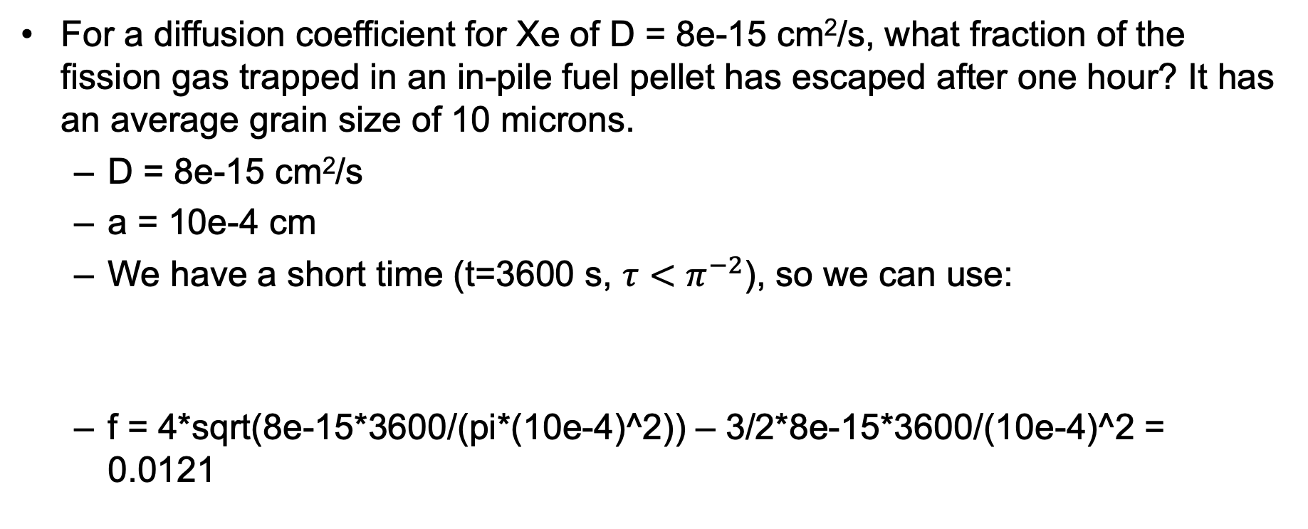

Example
For a diffusion coefficient for Xe of D = 8e-15 cm²/s, what fraction of the fission gas trapped in an in-pile fuel pellet has escaped after one hour? It has an average grain size of 10 microns.
D = 8e-15 cm²/s
a = 10e-4 cm
We have a short time (t=3600 s, $τ<π^{−2}$), so we can use:
f = 4*sqrt(8e-15*3600/(pi*(10e-4)^2)) – 3/2*8e-15*3600/(10e-4)^2 = 0.0121
$$τ= \frac{Dt}{a^{2}}$$

Slide 17
As time progresses, both the fraction released and the produced gas increase

Slide 18
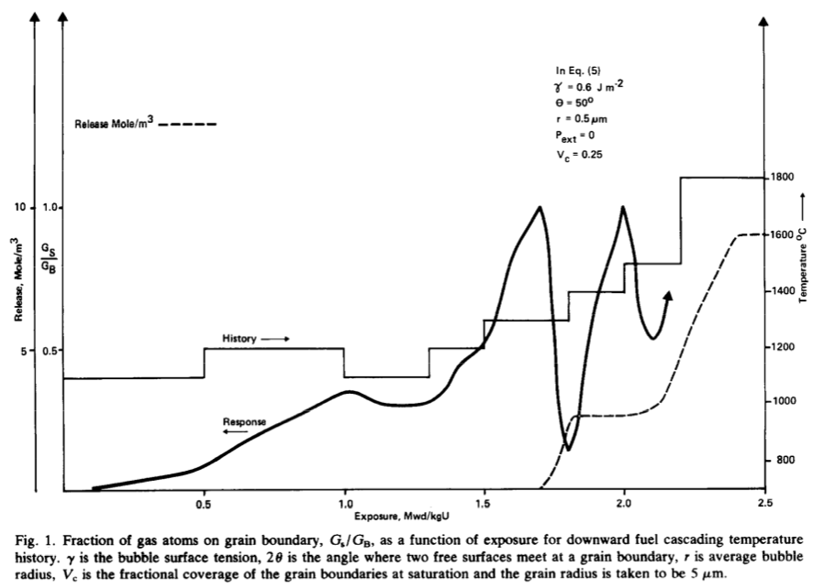
Forsberg-Massih model
The Booth model ONLY considers stage one of fission gas release
Two stage Forsberg-Massih mechanistic model
Considers intragranular diffusion diffusion to grain boundaries (stage 1)
Also, grain boundary gas accumulation, resolution back into grain, saturation (stage 2)
Assumes that once the bubbles on the grain face are interconnected, it is released (no stage 3)

Slide 19
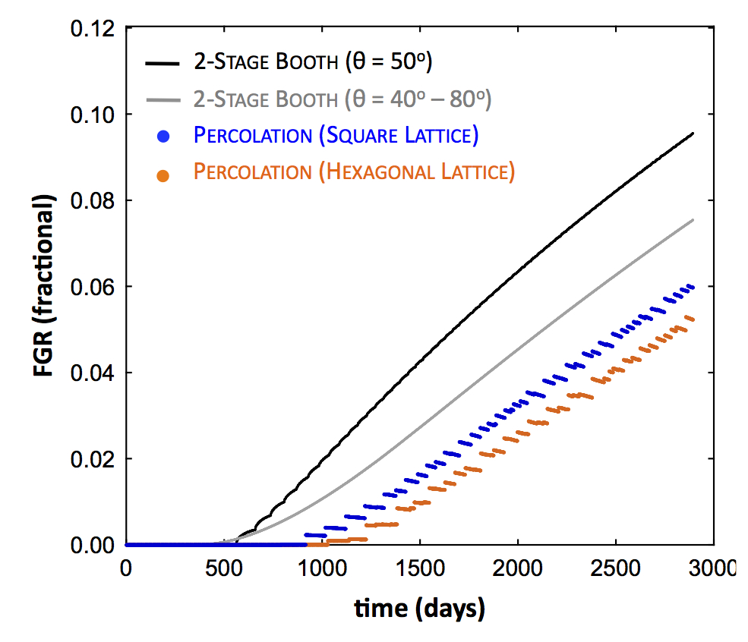
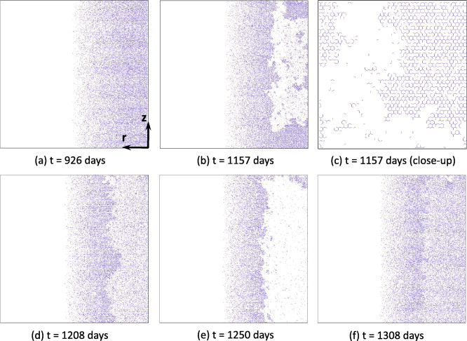
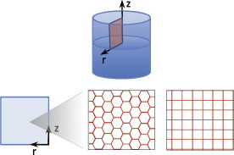
Forsberg-Massih model
2-stage F-M model over-predicts gas release because it neglects grain boundary bubble percolation (Stage 3)
Millett, Tonks, and Biner. JNM, 424.1 (2012): 176-182.

Slide 20
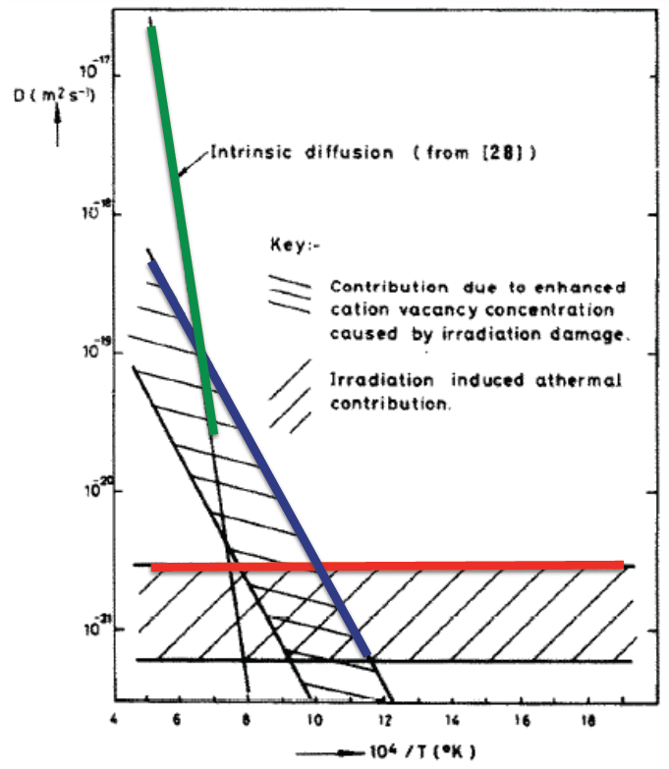
Gas diffusion
The diffusivity of the fission gas depends on temperature and on irradiation
Experimental data shows three different regimes for the diffusivity
D = D₁ + D₂ + D₃ cm²/s

Slide 21
Gas diffusion
The effective fission gas diffusivity is slower due to trapping by intragranular bubbles
As the gas atoms diffuse towards the grain boundary, some are trapped by the small intragranular bubbles
Some are later knocked out by energized particles (called resolution)
The effective diffusion constant depends on the trapping rate r_{t} and the resolution rate r_{r}

Slide 22
Fuel Swelling/Dimensional Change

Slide 23
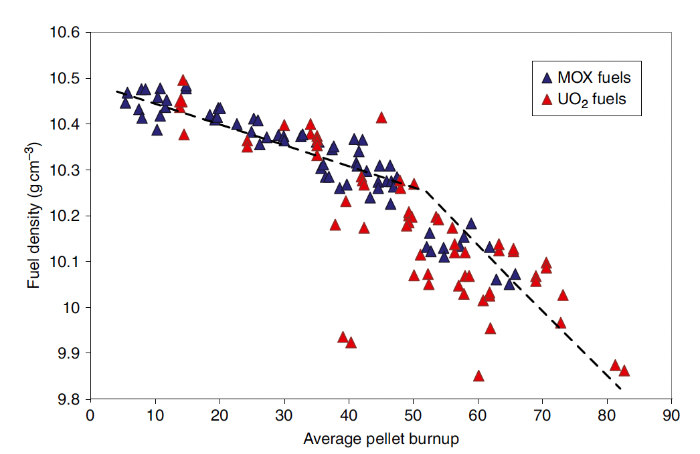
Fuel changes size and shape under reactor operation
Thermal expansion:
increase in volume, decrease in density, caused by increasing temperature
Densification:
Decrease in volume, increase in density, caused by shrinking of porosity left after sintering
Swelling:
Increase in volume, decrease in density, caused by fission products
Irradiation Creep:
Change in shape, constant density, occurs with applied stress less than σ_{y}

Slide 24
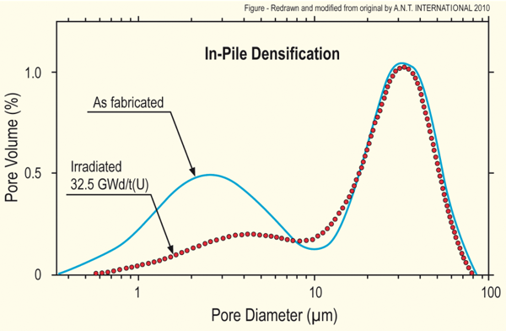
Densification
Densification takes place during initial 5 - 10 MWd/kgU
Small, as-built pores close due to effects of fission spikes and vacancy diffusion
Large pores stable (in absence of large hydrostatic stress)
Empirical correlation for densification is a function of
β - Burnup (in FIMA)
Δρ₀ – Total densification that can occur (a common value is 0.01)
β_{D} – Burnup at which densification stops ( a common value is 5 MWD/kgU)
C_{D} = 7.235 − 0.0086 (T(°C) − 25) for T < 750°C and CD = 1 for T ≥ 750 °C
[Maier et al, 1988]

Slide 25
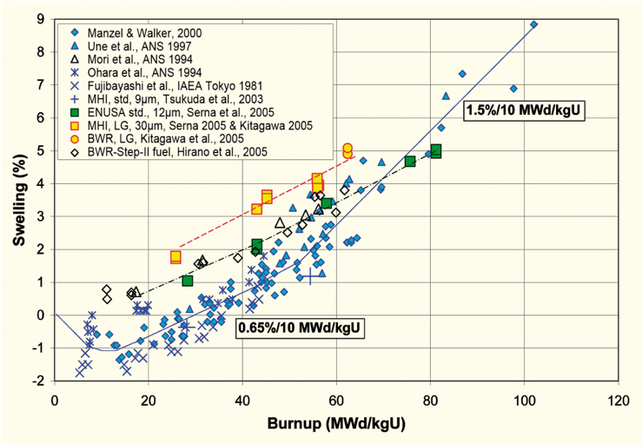
Fission product induced swelling
Fission product swelling results from three changes in the fuel microstructure
Solid swelling: Accumulation of soluble and insoluble fission products in fuel matrix
Gaseous swelling: Accumulation of gaseous and volatile fission products in intragranular and intergranular pores
High burnup swelling: Restructuring of pellet rim with the accumulation of fission gas in a large number of small pores
after Garzarolli in [Rudling et al, 2007]

Slide 26
Solid fission product swelling
The solid fission product swelling model is a function of:
β – Burnup (in FIMA)
ρ – Initial UO₂ density (g/cm³)
Includes contributions from soluble oxides, insoluble oxides, and metallic precipitates

Slide 27
Gaseous fission product swelling
Gaseous swelling varies strongly with temperature, fission rate, and stress
Empirical relationships dependent upon burnup and temperature
T < 1000K
Fission gas atoms remain in fuel matrix or collect in small, isolated, intragranular pores (<1 nm)
Intragranular pore size limited by fission spikes that drive gas back into fuel matrix
Gaseous swelling constrained by fission gas release
T = 1000 to 1700 K
Swelling takes place at hot interior of pellet
Gas atoms in fuel matrix diffuse to grain boundaries and collect in pores
Gas pressure causes bubbles to increase in size and to coalesce into larger pores
Gaseous swelling opposed by applied stress
Gaseous swelling also constrained by fission gas release

Slide 28
The overall swelling behavior depends on temperature

Slide 29
Total change in volume
The total change in volume is found by adding all components of dimensional change
ε_{tot} = ε_{th} + ε_{D} + ε_{sfp} + ε_{gfp}
Example:
fission rate = 2.5e13 f/(cm³ s)
T(fuel) = 1400 K
T_{ref} = 300 K
For densification: Δρ₀ = 0.01 and β_{D} = 5 MWD/kgU
Total time: 2 weeks

Slide 30
Example
Will do this example in the problem session

