Slide 1
Nuclear Fuel Performance
NE-533
Spring 2026

Slide 2
MOOSE– Massively Object-Oriented Simulation Environment
the multiphysics framework
https://mooseframework.inl.gov/

Slide 3
Accessing Hazel
Everyone has been added to a Hazel project: ne533s26
Hazel main page: https://hpc.ncsu.edu/main.php
If you are not familiar with Hazel, go through the Quick Start tutorial: https://hpc.ncsu.edu/QuickStart/QuickStart.php
Either need some kind of terminal
linux/mac is native, for windows need something like PuTTY, Cygwin, MobaXterm, etc.
Or access via browser
https://servood.hpc.ncsu.edu/

Slide 4
Access to MOOSE on Hazel
Follow conda setup:
https://hpc.ncsu.edu/Software/Apps.php?app=Conda
Only need to go through "Loading and Initializing Conda" section
conda activate /usr/local/usrapps/beeler1/bwbeeler/moose
cd /share/ne533s26/$USER
#Make your 'input.file'
mpirun -np 4 /usr/local/usrapps/beeler1/ben_moose/ben_moose-opt -i input.file

Slide 5
Handy bash commands
ssh username@login.hpc.ncsu.edu : allows you to get on the cluster
sftp username@login.hpc.ncsu.edu : allows you to transfer files to/from cluster
ls : list files in a directory; pwd: print working directory; cd : change directory; cp : copy a file
file editors: vi, vim, emacs, nano, atom
You should not need a submission script to run on Hazel (don’t need that many cores), but I recommend running on an interactive node
bsub -Is -n 8 -x -W 30 bash
requests 8 cores and 30 minutes of walltime, exclusively on a single node

Slide 6
MOOSE Resources
https://mooseframework.inl.gov/
Under getting started tab, have workshop slides, workshop video, and other tutorials
There is a lot there, work through examples, understand what the examples are doing
https://mooseframework.inl.gov/getting_started/examples_and_tutorials/index.html
The sooner you dive deep into MOOSE, the easier all of this will be

Slide 8
MOOSE Physics Modules
Chemical Reactions Contact External PETSc Solver Fluid Properties Function Expansion Tools Heat Conduction Level Set Navier Stokes
Phase Field Porous Flow rDG Stochastic Tools Tensor (solid) Mechanics XFEM Shallow Water (work in progress) Ray Tracing (work in progress)

Slide 9
Governing Equations

Slide 10
Input Files

Slide 11
Input File

Slide 13
Run Example via Command Line
An executable is produced by compiling an application or a MOOSE module. It can be used to run input files.

Slide 14
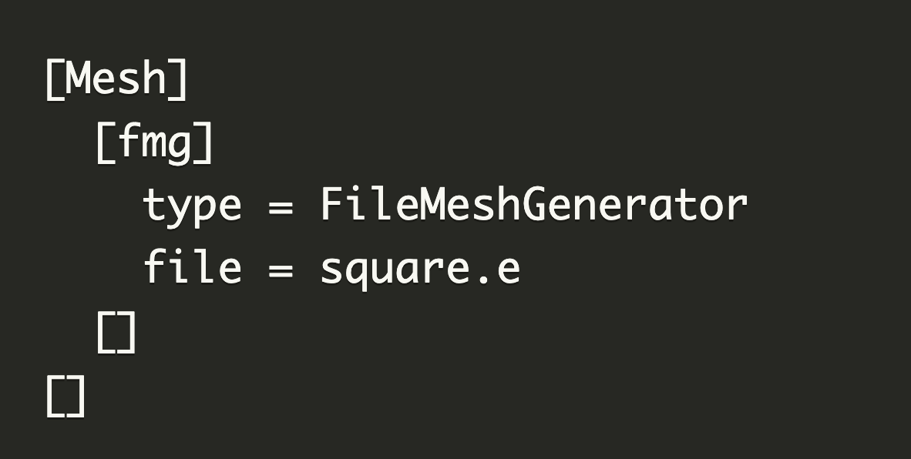
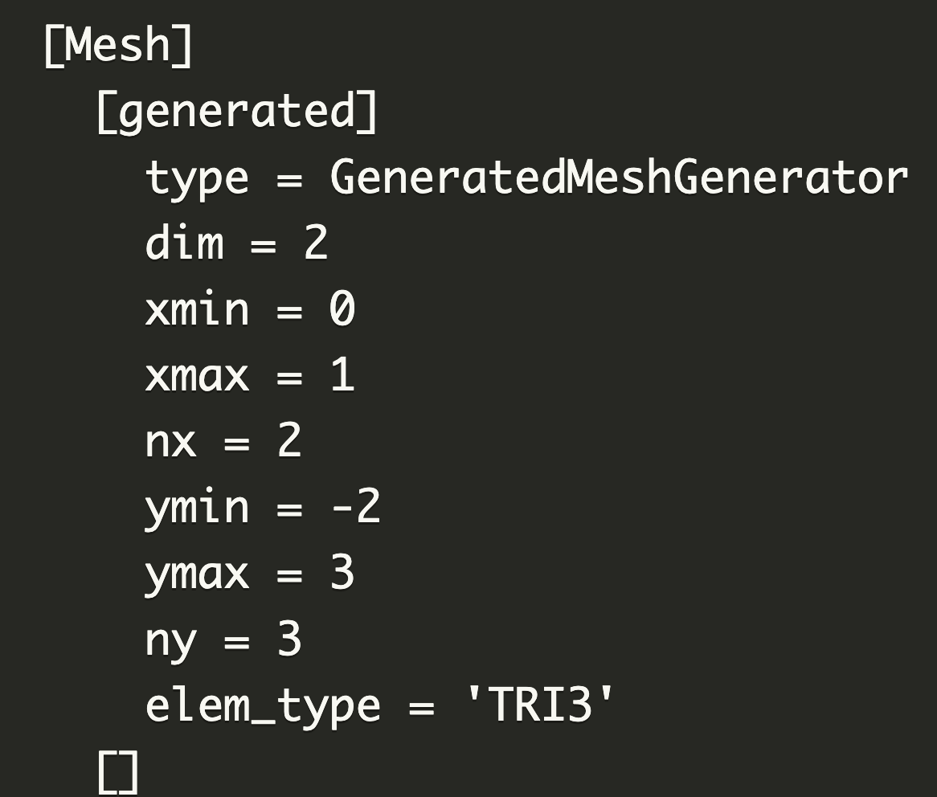
Mesh
Meshes in MOOSE are built or loaded using MeshGenerators
To only generate the mesh without running the simulation, you can pass --mesh-only on the command line
FileMeshGenerator is the MeshGenerator to load external meshes
Built-in mesh generation is implemented for lines, rectangles, rectangular prisms or extruded reactor geometries
The sides are named in a logical way and are numbered :
1D: left=0, right=1
2D: bottom=0, right=1, top=2, left=3
wont need more than 2D here
Human-readable names can be assigned to blocks, sidesets, and nodesets that can be used throughout an input file.
A parameter that requires an ID will accept either numbers or "names".
Names can be assigned to IDs for existing meshes to ease input file maintenance.

Slide 15
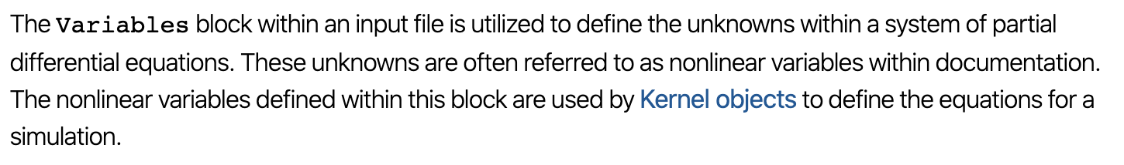
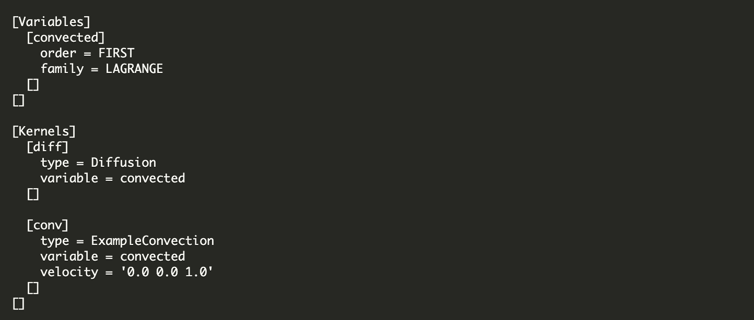
Variables

Slide 16
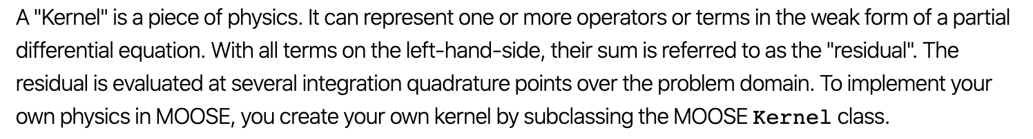
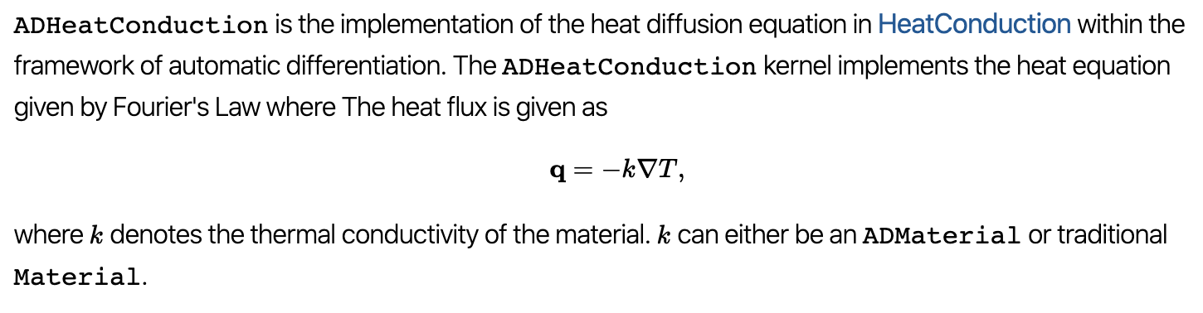
Kernel

Slide 17
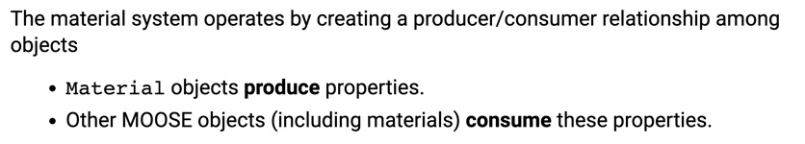
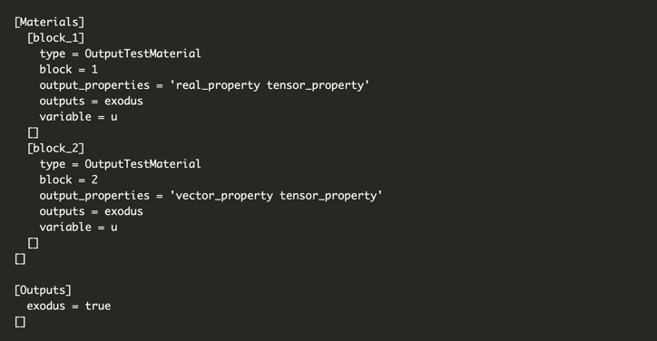
Materials

Slide 18
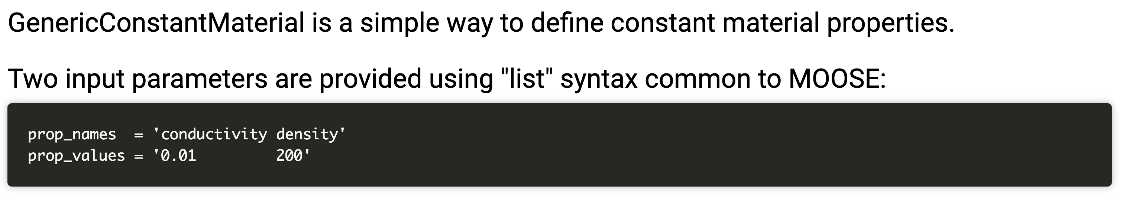
GenericConstantMaterials

Slide 19
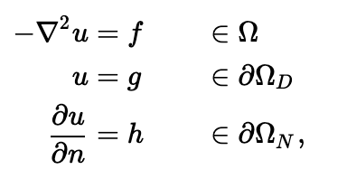
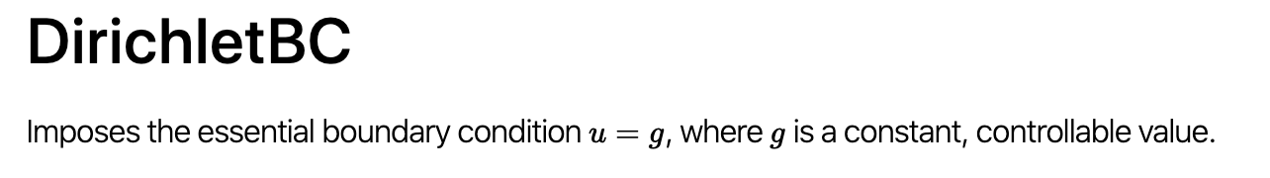
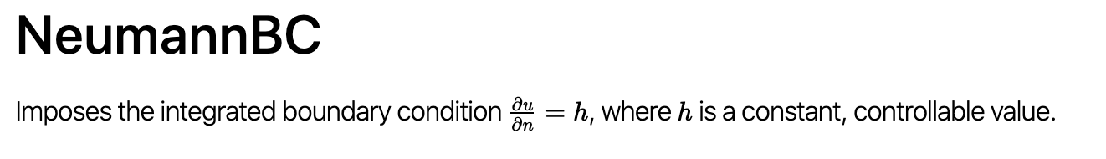
Boundary Conditions

Slide 20
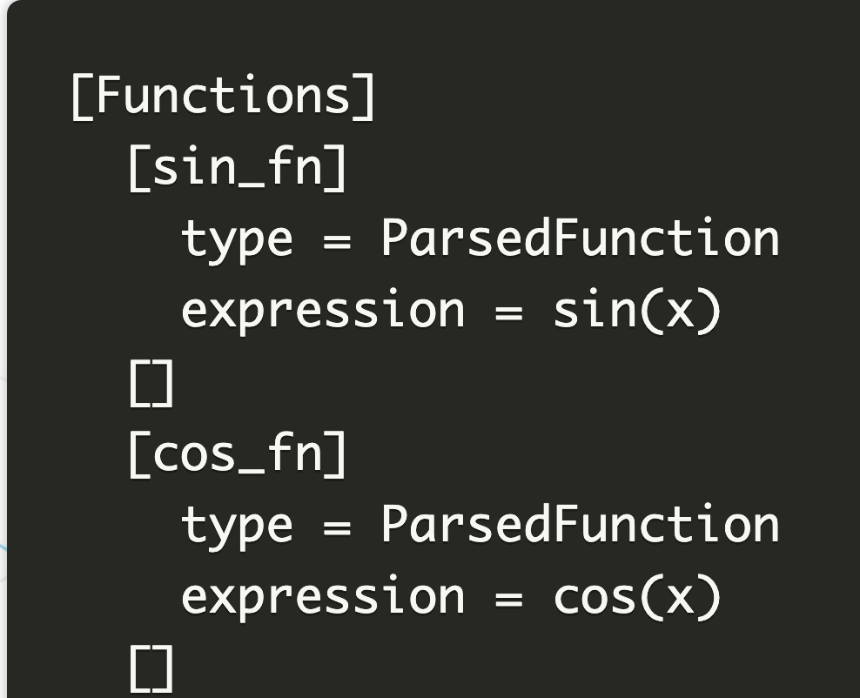
Functions
Many objects exist in MOOSE that utilize a function, such as:
FunctionDirichletBC, FunctionNeumannBC, FunctionIC, BodyForce
Each of these objects has a "function" parameter which is set in the input file, and controls which Function object is used
A ParsedFunction allows functions to be defined by strings directly in the input file

Slide 21
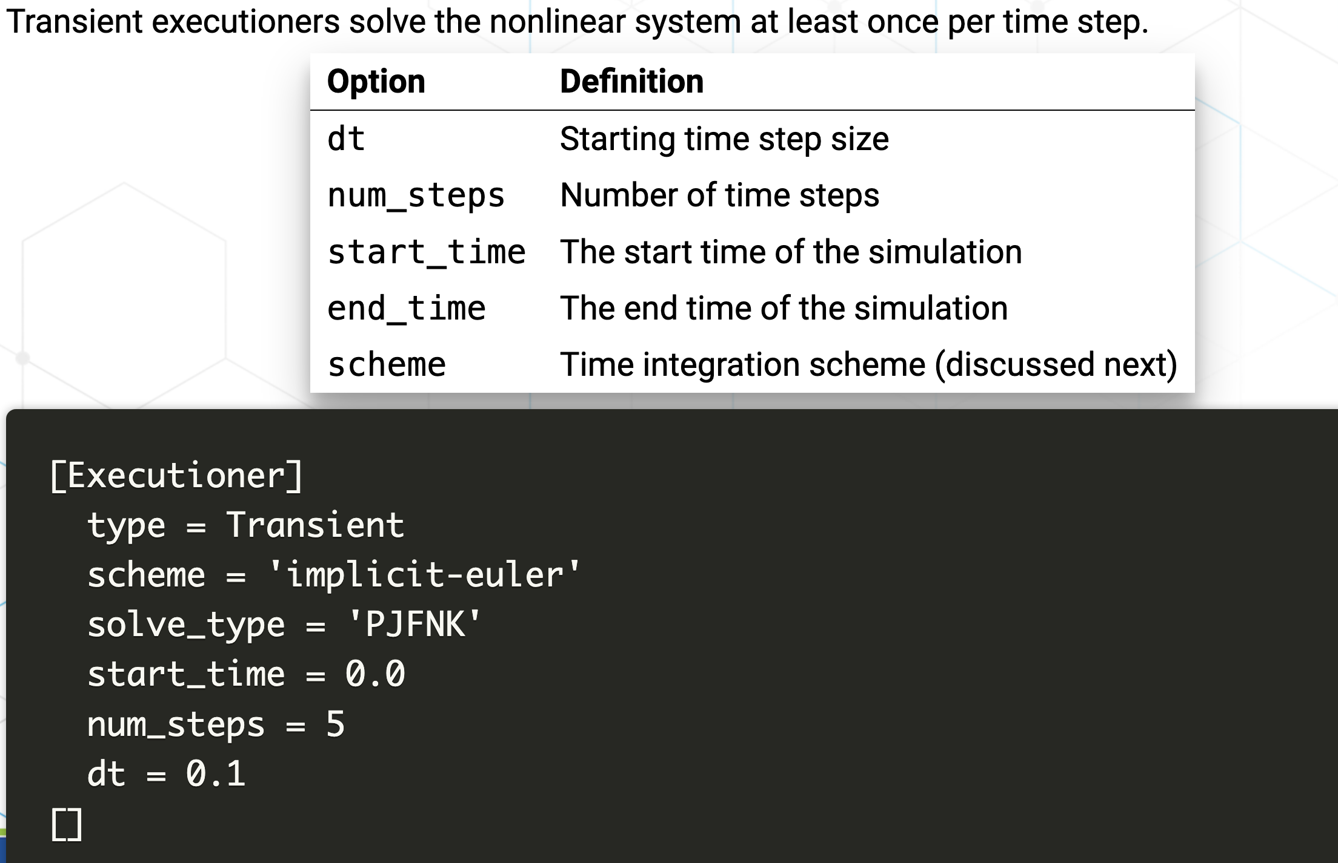
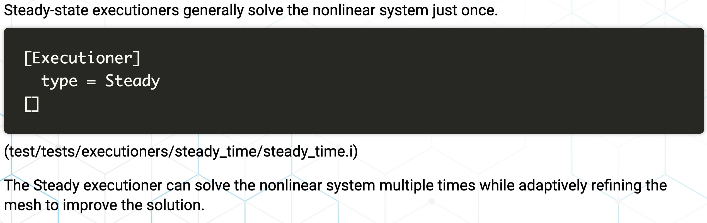
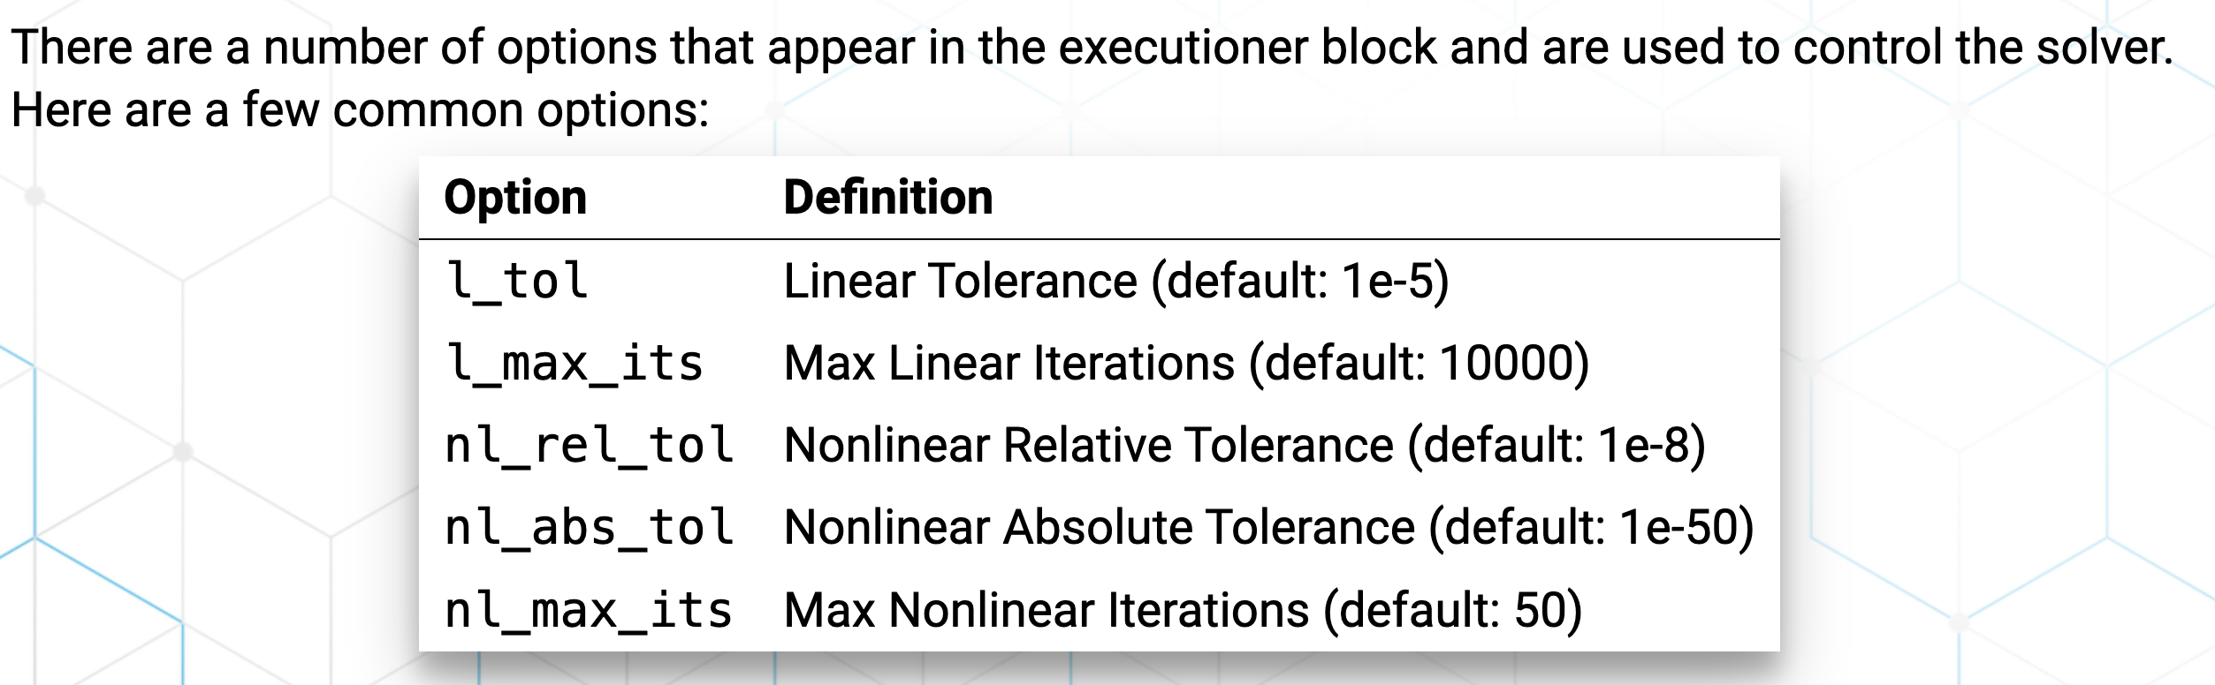
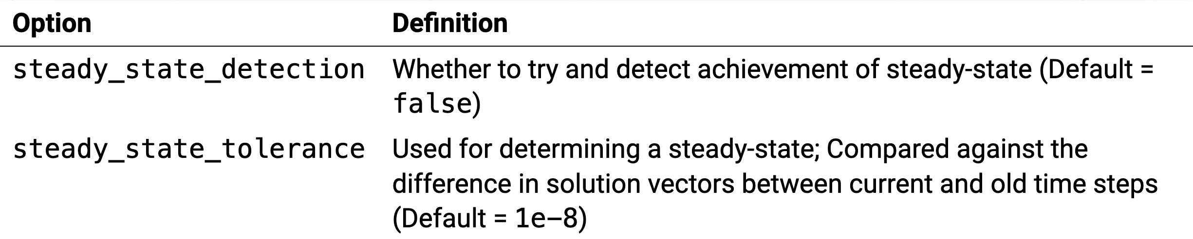
MOOSE Executioner

Slide 22
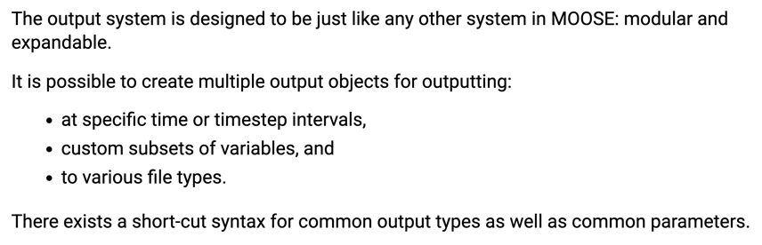
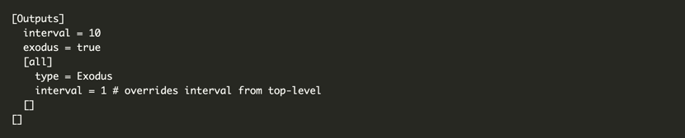
Outputs

Slide 23
Visualization
Two ways to visualize
Peacock: MOOSE GUI
Paraview: External software program that can read exodus files
I recommend downloading paraview
It is free and open source
Very flexible
Less buggy than peacock
But, if you try peacock, and it works for you, great!

Slide 24
Paraview
Open new
Move forward in time
Select Properties

Slide 25
MOOSE C++ Fundamentals
Will not cover here, if you feel like you need some background, go to below site, where they have some basics
https://mooseframework.inl.gov/workshop/#/11

Slide 26
Tutorials/Examples
https://mooseframework.inl.gov/getting_started/examples_and_tutorials/index.html
Has a 21-step tutorial, with each step adding in some complexity or additional physics/BCs/outputs/etc.
This is a VERY valuable exercise to work through
Also should go through Heat Transfer Physics Module Example
Tip : ./mooseapp-opt --dump > syntax.out creates a file “syntax.out” with all of the moose syntax and usage
Better tip: mooseframework.org is a great resource with everything documented
The biggest hurdle for the first part is correctly generating the mesh…

