Slide 1
Nuclear Fuel Performance
NE 533: Spring 2026

Slide 2
Last Time
Axial temperature profile
Thermal operating limits
CHF and DNBR
Phonon-based thermal conductivity
Numerical discretization
Forward/backward Euler

Slide 3
Spatial discretization

Slide 4
Spatial resolution
To numerically solve in space, we need to discretize
Finite difference
convert differential equations into a system of equations that can be solved by matrix algebra techniques
Finite volume
volume integrals in a partial differential equation that contain a divergence term are converted to surface integrals, using the divergence theorem. These terms are then evaluated as fluxes at the surfaces of each finite volume
Finite element
subdivides a large system into smaller, simpler parts that are called finite elements, the equations that model these finite elements are then assembled into a larger system of equations that models the entire problem

Slide 5
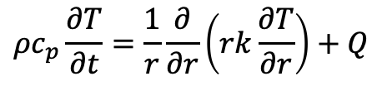
Finite Difference
$$ρc_{p}\frac{∂T}{∂t}=\frac{1}{r}\frac{∂}{∂r}\left(rk\frac{∂T}{∂r}\right)+Q$$
The finite difference method solves on a grid and uses numerical derivatives
Derivatives are approximated by differences
Boundary conditions must have either a fixed T or dT/dr
Typically restricted to handle rectangular shapes
Once you compute the time derivative, you can use either forward or backward Euler to march through time
T(r, t)
T(r + h, t)
T(r – h, t)

Slide 6
Finite Volume
$$ρc_{p}\frac{∂T}{∂t}=\frac{1}{r}\frac{∂}{∂r}\left(rk\frac{∂T}{∂r}\right)+Q$$
Discretize the domain by subdomains
Domain size h
We place points in the subdomain centers and on either boundary
The finite volume method balances fluxes across the boundaries of your divided subdomains
Integrate our PDE across the subdomain
Evaluate the integral using a linear approximation of the variable
Restricted to flux boundary conditions, often used in flow-type problems

Slide 7
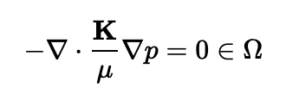

Finite Element
$$ρc_{p}\frac{∂T}{∂t}=\frac{1}{r}\frac{∂}{∂r}\left(rk\frac{∂T}{∂r}\right)+Q$$
In the finite element method, we interpolate the variable using nodal values and integrate over elements
Systematically recombine all sets of element equations into a global system of equations for the final calculation
Write the strong form of the equation, rearrange to get zero on the right-hand side, multiply by the test function, integrate over the domain, yielding weak form
The strong form states conditions that must be met at every material point, whereas weak form states conditions that must be met only in an average sense
Finite element works for any geometry and any boundary condition
e1
e2
e3
n1 n2 n3 n4

Slide 8
Spatial resolution
Finite difference
Advantages
Simple
Easy to code
Fast
Disadvantages
Difficult to model complex geometries
Difficult to model complex BCs
Only represents solution at points
Difficult to represent heterogeneous properties
Finite Volume
Advantages
Can model any geometry
Naturally conservative
Heterogeneous properties
Disadvantages
Boundary conditions add complexity
More complicated than finite difference
Finite Element
Advantages
Can model any geometry
Can model any BC
Continuous representation
Heterogeneous properties
Disadvantages
Complicated
Somewhat more expensive

Slide 9
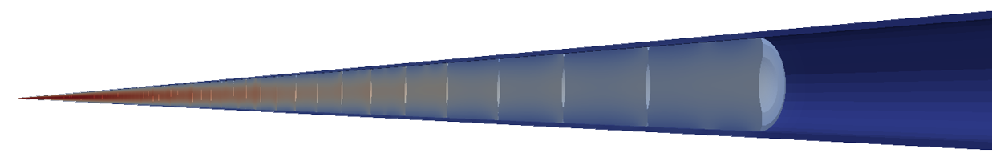
Different Fuel Performance Problems
Transient, full 3D
Transient, 2D axisymmetric with discrete pellets
Computational cost
Transient, 2D axisymmetric with smeared pellets
Accuracy
Transient, multiple 1D slices (1.5D)
Transient, 1D
Steady state, 1D (analytical)

Slide 10
Numerical Approaches to Different Fuel Performance Problems
Transient, full 3D
FEM or FV
Transient, 2D axisymmetric with discrete pellets
FEM or FV
Computational cost
Transient, 2D axisymmetric with smeared pellets
FEM, FV, or FD
Accuracy
Transient, multiple 1D slices (1.5D)
FEM, FV, or FD
Transient, 1D
FEM, FV, or FD
Steady state, 1D (analytical)

Slide 11
Heat equation solution approach summary
Approach | Solution | Assumptions
1D steady state | Analytical | Steady state, axisymmetric, no axial variation, constant k
1D transient | FEM, FD, FV | Axisymmetric, no axial variation
1.5D transient | FEM, FD, FV with multiple slices | Axisymmetric, no axial variation
2D transient, smeared pellets | FEM, FD, FV | Axisymmetric, fuel pellets act as one body, fuel pellets are perfect cylinders
2D transient, discrete pellets | FEM, FV | Axisymmetric
3D transient | FEM, FV | You have a big computer
Each numerical solution can be solved explicitly or implicitly

Slide 12
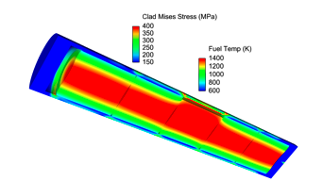
Solving with fuel performance codes
Fuel performance codes primarily use either finite difference or finite element
The earliest fuel performance codes solved the heat equation in 1.5D using finite difference (with multiple axial slices)
More modern codes have switched to finite element, due to more flexibility with geometry and boundary conditions
Finite volume is becoming an option

Slide 13
Summary
The heat equation can be solved using numerical methods
Explicit or implicit time integration can be used
Spatial derivative solution methods divide the domain up into smaller pieces
Finite difference
Finite volume
Finite element
Each discretization has strengths/weaknesses
Finite element is primary method for high fidelity fuel performance codes

Slide 14
End of Module 1
Problem session on Thursday 29th
Exam on Feb 3rd
Exam to be completed during class period
bring calculators, can use your own paper or what I provide
Reminder of office hours on Wednesdays at 9am
Reminder of slack channel for rapid communication
Will schedule exams with distance students
Will provide equation sheet for students in class. Will share equation sheet before hand.

