Slide 11
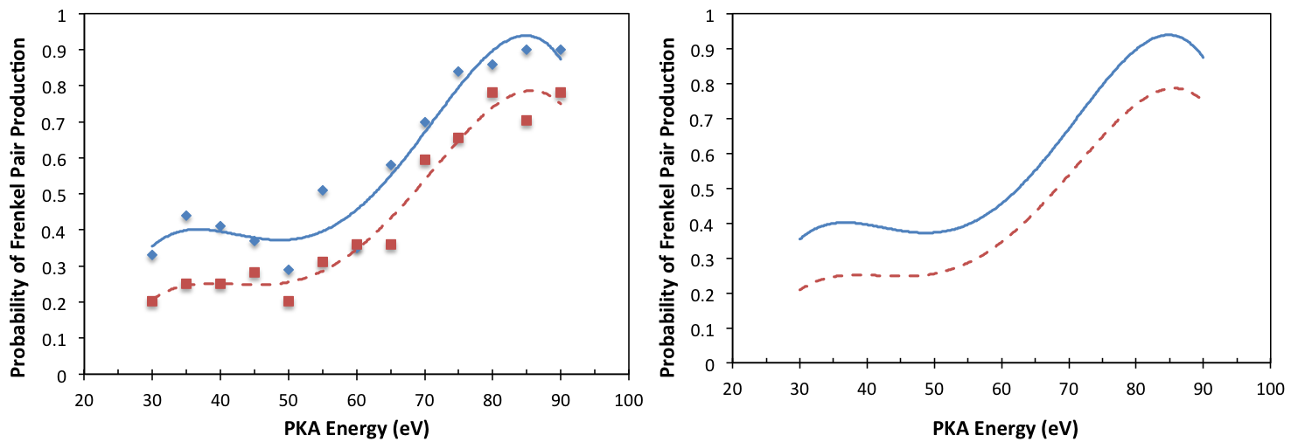
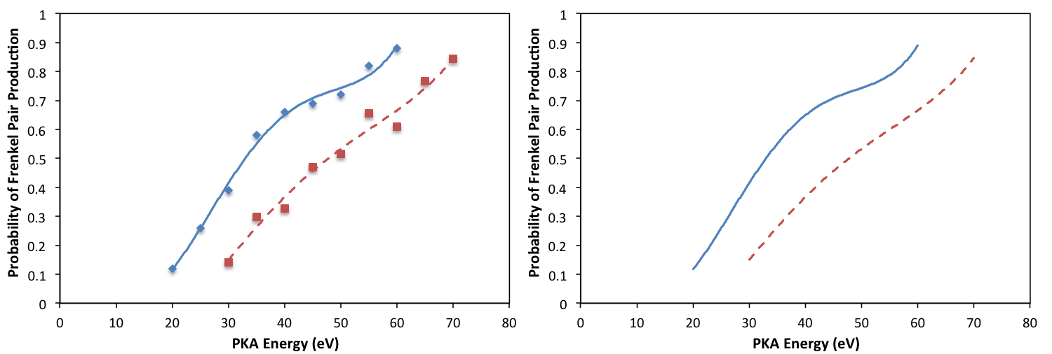
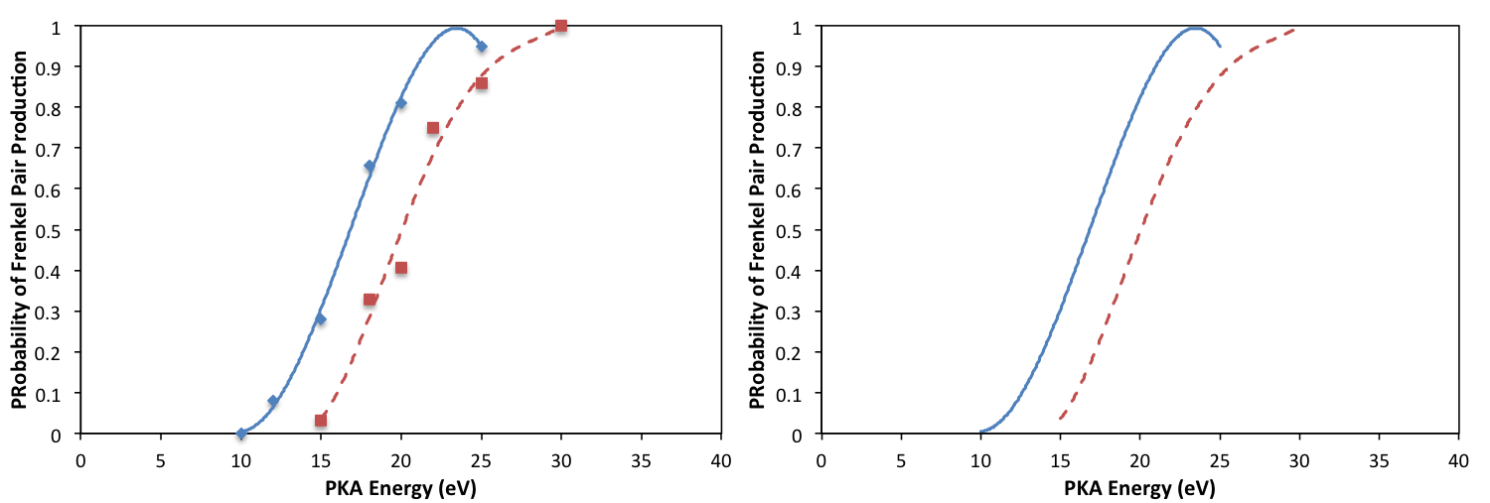
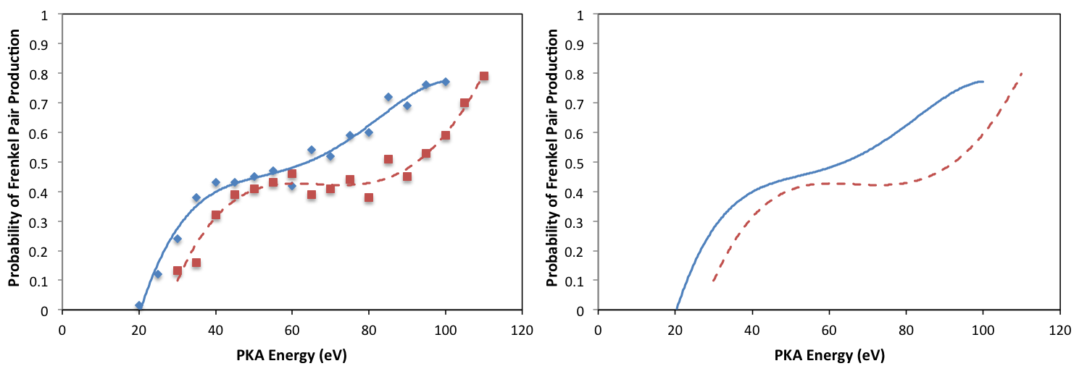
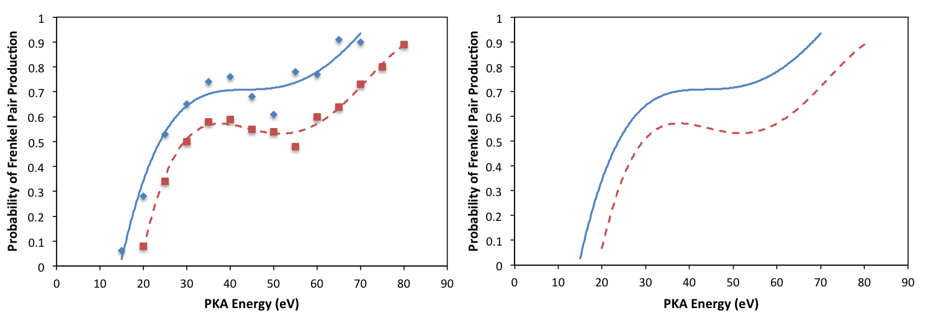
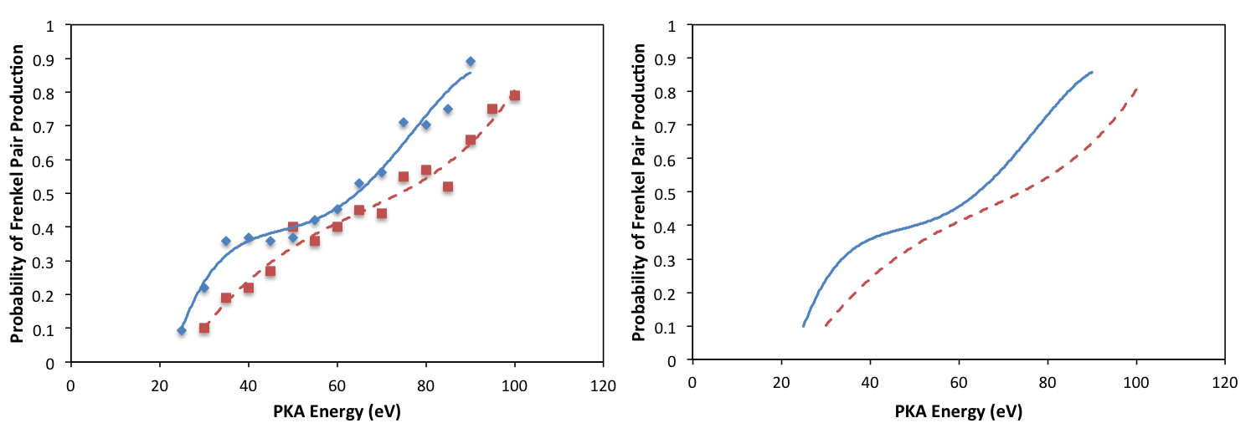
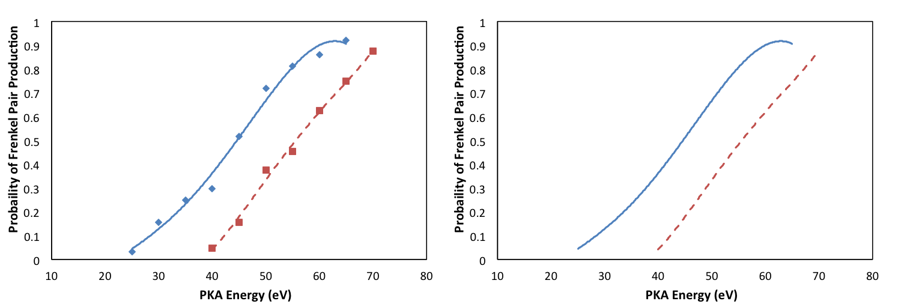
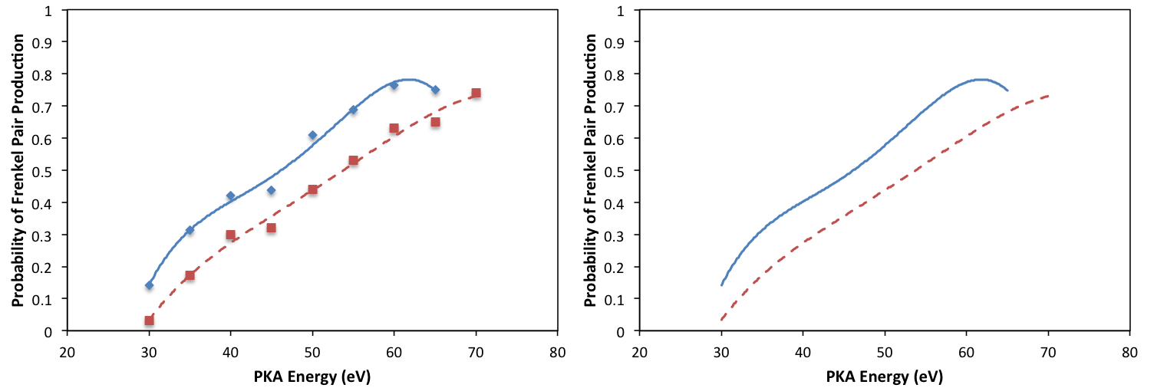
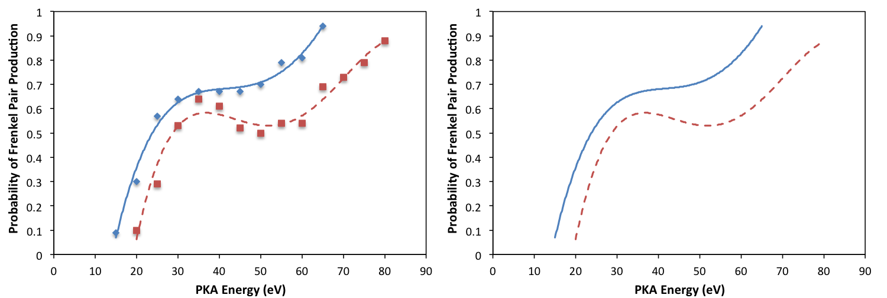
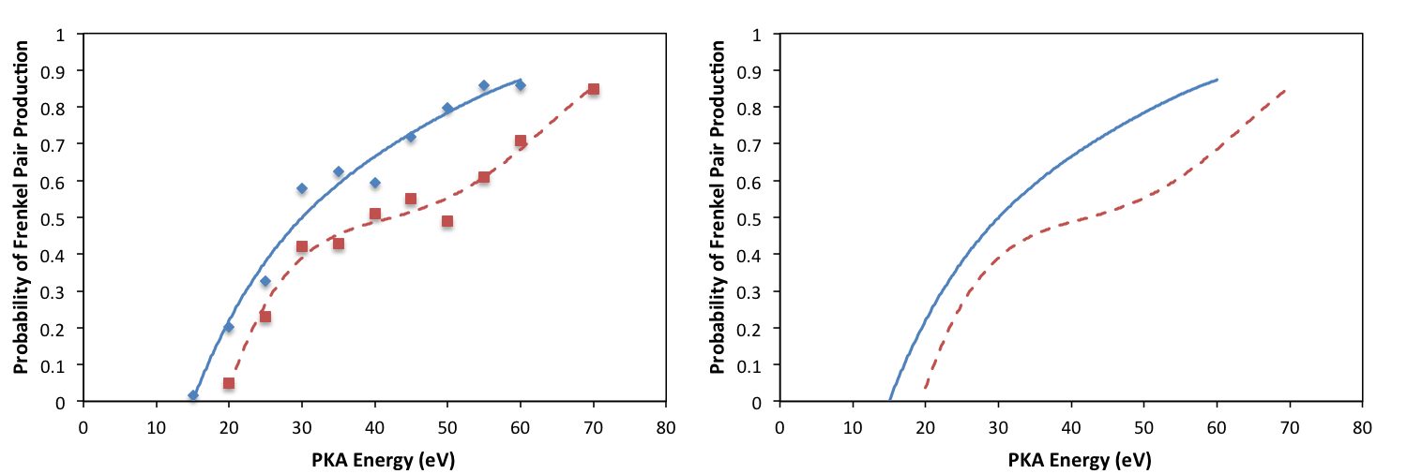
dir 1
dir 6
dir 2
dir 7
dir 3
dir 8
dir 4
dir 9
dir 5
dir 10

Slide 12
dir 1
dir 6
dir 2
dir 7
dir 3
dir 8
dir 4
dir 9
dir 5
dir 10

Slide 13
dir 1
dir 6
dir 2
dir 7
dir 3
dir 8
dir 4
dir 9
dir 5
dir 10

Slide 14
dir 1
dir 6
dir 2
dir 7
Probability of Frenkel Pair Production
dir 3
dir 8
dir 4
dir 9
dir 5
dir 10
PKA Energy (eV)

Slide 15
dir 1
dir 6
dir 2
dir 7
Probability of Frenkel Pair Production
dir 3
dir 8
dir 4
dir 9
dir 5
dir 10
PKA Energy (eV)

