Slide 1

Helping Investors Gain Confidence with a Dedicated Approach to Their Finances
ADVISOR LOGO
Introducing Our New Investment Partner, Simplicity Wealth
Investment advisory and financial planning services are offered through Simplicity Wealth, LLC, an SEC-registered investment adviser. SEC registration does not constitute an endorsement of the firm, nor does it indicate that the adviser has attained a particular level of skill or ability. Insurance, Consulting and Education services offered through [DBA]. [DBA] is a separate and unaffiliated entity from Simplicity Wealth.
REMINDER: CO-ADVISERS AND SUB-ADVISERS (RIAs) MUST SUBMIT TO THEIR OWN COMPLIANCE DEPARTMENT.
Notes:
Protecting one’s future requires one simple focus and that is creating an environment for investors to to achieve their financial goals with the least amount of personal risk.
Accomplishing this requires a proven and intelligent approach for helping this come to fruition.
During this presentation, I will be walking you through our three-step process on how we are executing this at ______________(Financial Firm Name).
I believe at the end of this presentation; you will have a clear understanding of what this looks like and how it may benefit your personal financial situation.

Slide 2

New Investment Partner
PNG LOGO
Notes:
In order to be successful in life and in business, it is all about aligning yourself with the right partners.
This is why we have partnered with Simplicity Wealth, one of the nation’s leading independent financial institutions to help us deliver the level of service and investments that we believe our clients deserve.

Slide 3



Our Approach
Our Foundation
Six fundamental financial planning considerations
Longevity
Liquidity
Inflation
Market
Mortality
Taxes
Start
Smart
Relevant risk management
Apply Discipline
Efficient portfolio execution
Communicate Progress
Engaged
partnership
Notes:
As part of our partnership with Simplicity, we have a three-step approach that are based on six fundamental financial planning considerations…
First, Start Smart – First, we gain a thorough understanding of your current financial situation, goals and objectives, and the key considerations that should be addressed when developing your strategic plan.
Apply Discipline- Next, we design an investment strategy that actively works to optimize your wealth and protect your finances, keeping your goals and objectives at the forefront of our planning process.
Communicate Progress – Lastly and continually, we work to ensure transparency of your investment plan by providing visibility, proactive outreach, and accessibility to our team throughout our working relationship.

Slide 4






Our Foundation: Financial Planning Considerations
Taxes
Longevity
Decreased income and assets and/or the impairment of legacy assets from increasing taxes
Outliving financial assets as the result of a longer life
Mortality
Liquidity
Loss of financial assets as the result of a partner’s or spouse’s death
Limited access to assets to meet life’s unexpected financial needs
Market
Inflation
Unexpected reduction in the value of financial assets at the time of withdrawal
Reduction in real purchasing power as the result of increasing cost of living
Notes:
When it comes to one’s retirement and the income for what you need and want in life, it’s important to take a holistic view. This holistic view can be anchored to six fundamental financial considerations: Longevity; Liquidity; Inflation; Market; Mortality; and Taxes. These considerations are comprehensive, intuitive, interrelated, and affect just about everyone to varying degrees. This approach can help you understand how best to accomplish your financial goals and overcome the considerations that are of greater concern to your specific financial situation.
Longevity: Outliving financial assets as the result of a longer life
Liquidity: Limited access to assets to meet life’s unexpected financial needs
Inflation: Reduction in real purchasing power as the result of increased cost of living
Market: Unexpected reduction in the value of financial assets at the time of withdrawal
Mortality: Loss of financial assets as the result of a partner’s or spouse’s death
Taxes: Decreased income and assets and/or the impairment of legacy assets from increased taxes
We believe that it’s important to evaluate investor sentiment towards each consideration through a succinct questionnaire. This allows us to examine the potential effects ofthese considerations on an investor’s assets today and in the future.

Slide 5
Start Smart
Notes:
The first step in our process is starting smart. Again, we gain a thorough understanding of your current financial situation, goals and objectives, and
the key considerations that should be addressed when developing your strategic plan.

Slide 6


Risk Comes Down to…
What an investor can do
What an investor can do
What an investor should do
What an investor should do
Notes:
The first component to starting smart is understanding risk tolerance. Investment risk tolerance refers to an investor's ability and willingness to endure potential losses or fluctuations in the value of their investment portfolio. It is a measure of how much risk an investor is comfortable taking in pursuit of potential returns.
Another way to think about risk is what an investor CAN DO versus what an investor SHOULD DO. Often these aren’t the same and it’s important to get an accurate read on the investor’s current financial situation and sentiment towards risk.

Slide 7

Start Smart: Relevant Risk Management
Simplicity’s proprietary algorithm is based on Value at Risk (VaR) methodology and incorporates the investor’s emotional tolerance with respect to the potential magnitude and speed of investment loss.
VaR
Notes:
Risk scoring can help us understand the client’s unique risk tolerance and allows us to help set realistic risk-return expectations in the portfolio.
Through our new investment partner, Simplicity Wealth, we will leverage a proprietary algorithm that is based on Value at Risk (VaR) methodology and incorporates the investor’s emotional tolerance with respect to the potential magnitude and speed of investment loss.

Slide 8
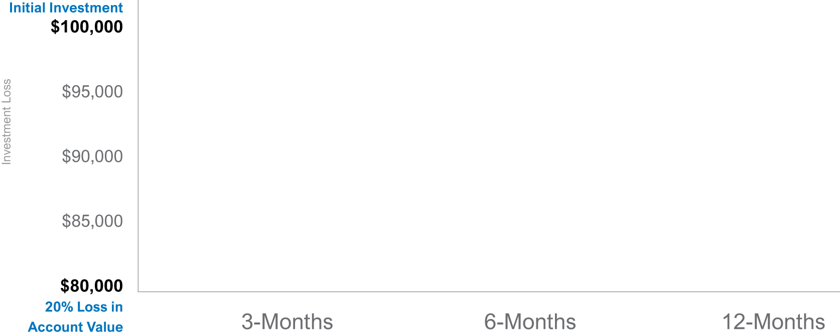
Start Smart: Relevant Risk Management
Hypothetical Example: Speed of Loss
$100,000 Initial Investment Experiences a 20% Loss Over a 3-Month vs. 12-Month Period
Notes:
In this example we have two investors with the same level of risk as it relates to the “magnitude” of loss. Meaning the maxmiune about they are willing to lose. The only difference is the “speed” meaning the experience in which that take place.
Investor A: The loses are experienced in 3-months
Investor B: The loses are experienced in 12-months
Again, both agreed on the front side of a total lose of 20%, but their experiences were completely different.
Do you think this would produce different outcomes of success?
The answer is obviously yes.
This is why I believe ”speed”/ experience is more important than magnitude with looking at established the proper right profile.
As mentioned, the aspect of VaR that is unique to this platform is that it evaluates the speed of loss. In this hypothetical example, let’s say you have $100,000 and you experience a 20% loss… does losing $20,000 feel differently in three months time versus 12-months time?

Slide 9
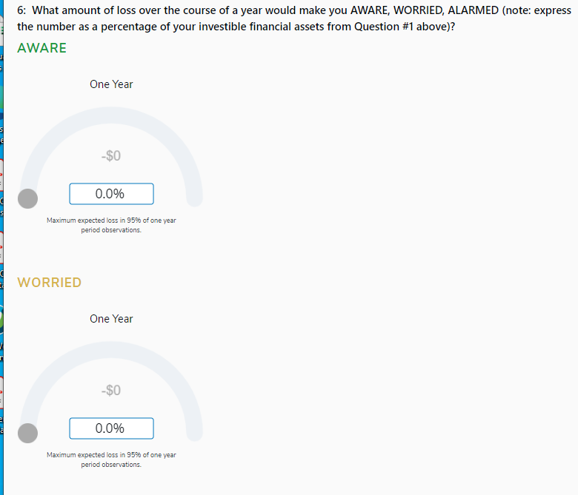
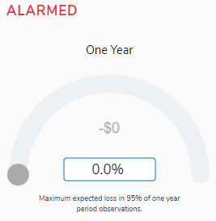
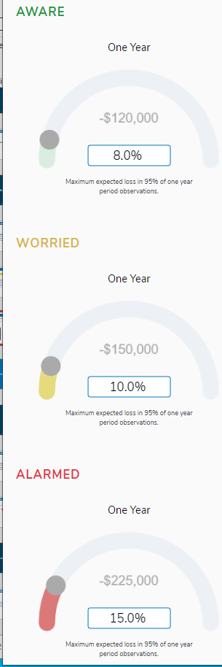
Start Smart: Relevant Risk Management
KEY QUESTION:
What percentage of loss over the course of a year would make you AWARE, WORRIED, and ALARMED?
Notes:
To help us gauge an investor’s speed of loss sentiment, we ask the question, “What percentage of loss over the course of a year would make you aware, worried, and alarmed?

Slide 10
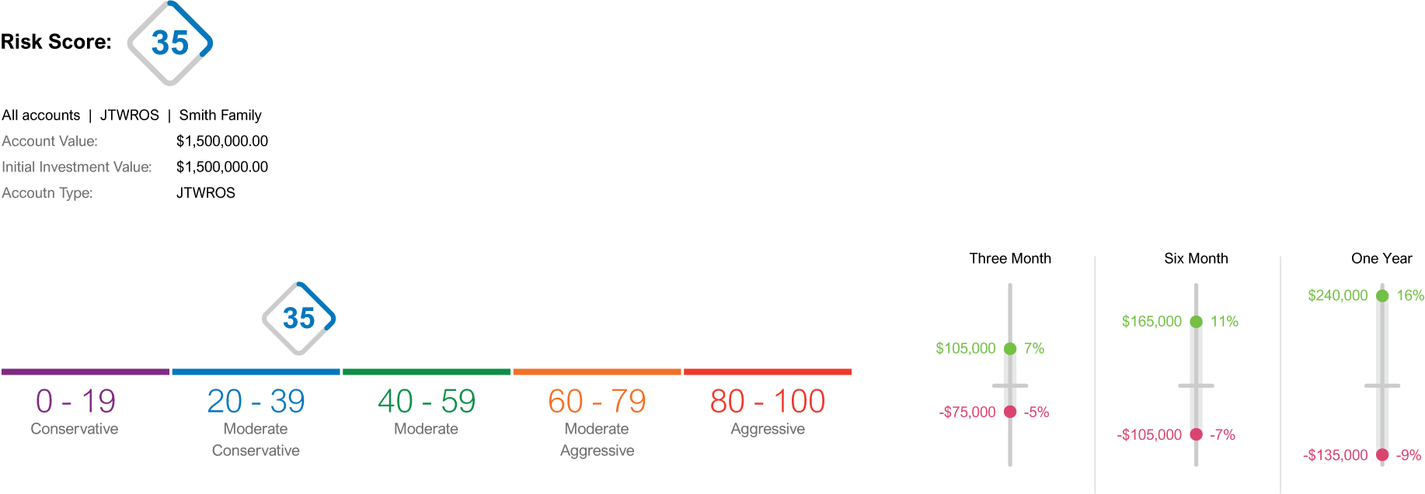
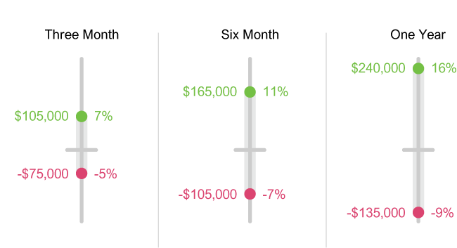
Start Smart: Relevant Risk Management
Notes:
This VAR score of 35 communicates to all parties the desired ”household” risk profile..
We can also see what the return/risk profile looks like for this VAR score as well.
The investor’s answer to that question will directly impact their VaR Score.

Slide 11
Apply Discipline
Notes:
Next, we design an investment strategy that actively works to optimize your wealth and protect your finances, keeping your goals and objectives at the forefront of our planning
process.

Slide 12
Apply Discipline
Design
Portfolio
Monitor
Portfolio
Notes:
So not only do we we use VAR to help design the portfolios, but equally as important we use the proprietary tool to monitor the ongoing performance.

Slide 13
Apply Discipline
150+ Money Managers and 1,000+ Strategies
Investment Research and Due Diligence Process
VaR
Continued Monitoring
15-25 Money Managers and 200-300 Strategies
Notes:
Simplicity works with over 150 third-party managers that provide more than 1,000 distinct investment strategies, forming a foundation of solutions for helping to solve different problems and investment objectives.
Simplicity pursues a consistent due diligence process that culminates in a review and approval by our investment committee.
The best part – we compare all those great managers to form a short list of the “best of the best” managers for client use.
We continue to monitor those managers for performance persistency and through our VaR risk scoring to ensure that risk desired equals risk taken.
THIS PROCESS IS CRITICAL FOR MANAGING CLIENT EXPECTATIONS AND SETTING THEM UP FOR SUCCESS. IT SUPPORTS YOUR FIDUCIARY DUTY AS AN ADVISOR.

Slide 14
VaR Analysis of Money Managers
Comparable Moderate Models VaR Scores
Columbia Threadneedle
38
Globalt
50
Inspire
61
Notes:
VaR not only supports decision making but is intuitive in understanding potential risk.
Let’s take a look at what at first appears to be comparable “moderate” models. We say appear comparable because Moderate is how each manager labels their portfolio.
Three different managers, three moderate models. With the VaR scoring approach, you can see that all balanced moderate models are not created equal.
Our first manager is Columbia Threadneedle with a moderate conservative VaR score of 38.
Next is Globalt with a moderate VaR score of 50.
And lastly, Inspire with a moderate aggressive VaR score of 61.
Can you see how these portfolios are different when viewed from the perspective of risk?

Slide 15
Apply Discipline: Money Manager Due Diligence
Money managers and investment strategies are vetted and monitored on a continuous basis to help ensure clients remain on track to achieve their financial goals.
BlackRock
Capital Group | American Funds
Clark Capital
Columbia Threadneedle
First Trust
Globalt Investments
Invesco
John Hancock Investment Management
State Street Global Advisors
Sterling Capital
The Leuthold Group
WestEnd Advisors
The list is not all inclusive and does not represent an endorsement of any entity.
Please make sure to review any money manager disclosure documents before any investment.
Notes:
As mentioned, our money managers and investment strategies are vetted and monitored on a continuous basis to help ensure clients remain on track to achieve their financial goals. Some of our key managers include…

Slide 16




Apply Discipline: Investment Strategies
Active
Passive
Income
Sustainable
Taxable and Tax-Aware strategies available within each category.
Notes:
Among the vetted managers available, we have…
Active strategies, those with an enhanced risk and return profile.
Passive strategies, those that aim to replicate the performance of a broad market index
Income strategies, those that are focused on dividend and interest concentration
And lastly, Sustainable impact strategies, or those that are values-based investing
It’s important to note that within each category we have Taxable and Tax-Aware strategies.

Slide 17
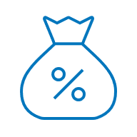
Apply Discipline: Advanced Tax Services
Direct Indexing is when a target index (e.g., S&P 500) is replicated using individual stocks and allows for those stocks to be individually traded.
Tax-Loss Harvesting is selling some stocks at a loss to offset the gains realized by selling other stocks at a profit.
A Tax-Optimized Transition is a sophisticated transfer strategy for eliminating an investor’s tax-burdened legacy positions (a portfolio containing unrealized gains and/or losses) by gradually transferring assets to a new portfolio tax efficiently.
Notes:
We also have access to sophisticate tax services including…
Direct Indexing is when a target index (e.g., S&P 500) is replicated using individual stocks and allows for those stocks to be individually traded.
Tax-Loss Harvesting is selling some stocks at a loss to offset the gains realized by selling other stocks at a profit.
A Tax-Optimized Transition is a sophisticated transfer strategy for eliminating an investor’s tax-burdened legacy positions (a portfolio containing unrealized gains and/or losses) by gradually transferring assets to a new portfolio tax efficiently.

Slide 18
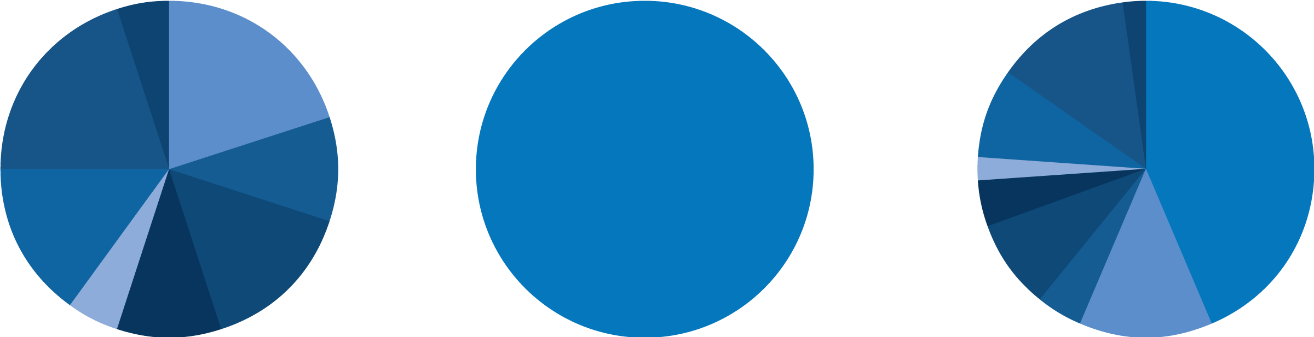
Apply Discipline: Lowering Volatility with Annuity Inclusion
Client Proposal
Managed Account + Annuity
Managed Account
Annuity
Insurance services are offered outside of Simplicity Wealth.
Notes:
Another thing that makes this platform unique is the annuity integration. When appropriate, an annuity can help lower the overall risk in a household portfolio and provide guaranteed income in retirement.
Historically these have been two different financial vehicles… what we did is integrate the investment portfolio and the annuity product so that you have a household – holistic snapshot of what is taking place.

Slide 19
Apply Discipline: Planning Process
Obtain Risk Score
Qualitative
Quantitative
Tax
Management
Portfolio
Focus
Management Style
Specialty
Financial Planning Considerations
Holistic Approach
Income Sources & Expenses
L.LI.M.M.T.
Time Horizon
Qualified
Tax Sensitivity
Asset Location
Tax Loss Harvesting
Tax Transition
Muni-Bonds
Tax Concerns
Income
Growth
Risk
Total Return
Time Horizon
Annuity Inclusion
Active vs Passive
Market Cycle
Multi-Manager
Cost Conscious
Strategic
Tactical
ESG/SRI
Buffered
Direct Indexing
Individual Bonds
SMA
Portfolio Analysis
Account Objectives
Investment Characteristics
Investable Assets
Portfolio Focus & Style
Investment Proposal
Notes:
Now that we have an understanding of the vast investment offering, let’s take a quick look into the Planning process.
As mentioned, we start by obtaining your risk score though the Risk Tolerance Questionnaire – which will measure qualitative and quantitative data.
Secondly, we as you to complete the Financial Planning Considerations Questionnaire – this will help us determine your sentiment towards things like longevity, liquidity, inflation, market, mortality, and taxes. This allow provides us with the most up-to-date holistic picture of your household
Lastly, we take a deep dive into account objectives, portfolio focus, and style. This includes tax needs – tax sensitivity, if strategies like tax-loss harvesting would benefit you, and so on.
Then we look at your portfolio focus including objectives such as tax concerns, income needs, growth, risk, total return, time horizon, and annuity inclusion.
Next, we evaluate the management style. Active versus passive, market cycles, multi-manager, cost conscious, etc.
Lastly, we identify any specialty needs such as socially responsible investing, direct indexing, separately managed accounts, and so on.
Once this process has been completed, we produce an investment proposal that will provide you with a comparison of your current strategy to your proposed strategy. We will then walk you through how we arrived at this recommendation.

Slide 20
Communicate Progress
Notes:
Once the investment plan has been implemented, lastly and continually, we work to ensure transparency of your investment plan by providing visibility, proactive outreach, and accessibility to our team throughout our working relationship.

Slide 21



Communicate Progress: A.C.T.
We A.C.T. on each investor’s behalf...
Accessible
Consistent
Transparent
Notes:
As part of our mission to keep clients informed, we like to say that we “ACT” on each investor’s behalf...
Accessible: We aim to be available to our clients and work to answer questions and address concerns as promptly as possible.
Consistent: We jointly determine communication preferences and frequency and provide critical market updates throughout the year.
Transparent: Our clients have access to a secured online portal that will allow them to view their current financial landscape in one location on any online device.

Slide 22
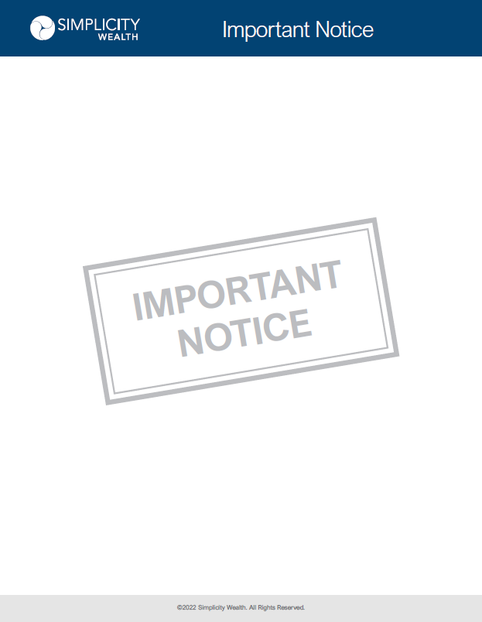
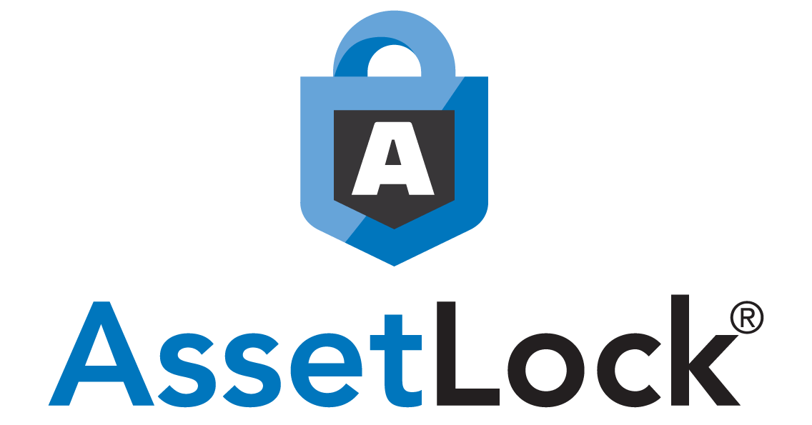
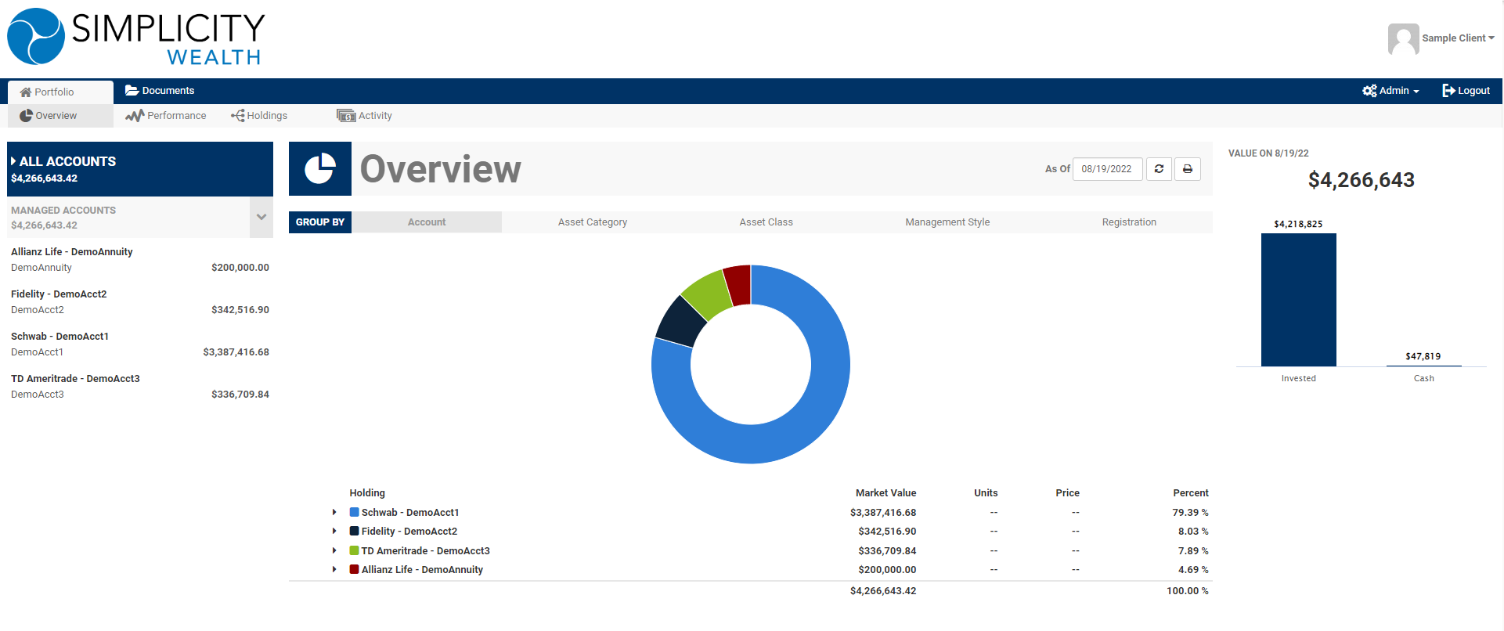
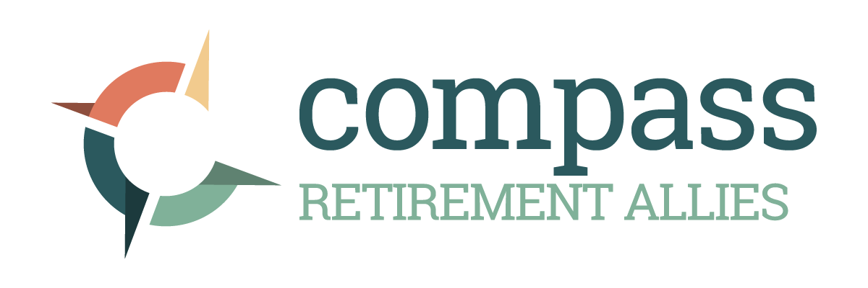
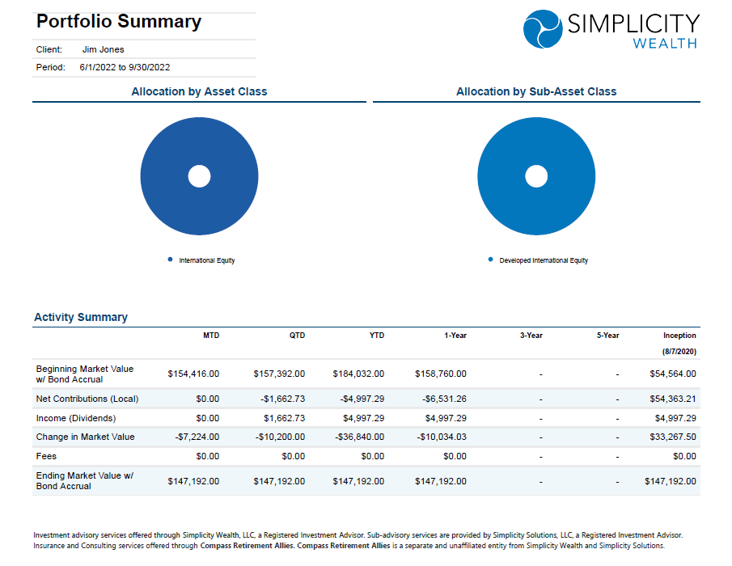
Communicate Progress: Engaged Partnership
Quarterly client account reports
Timely updates, as needed
24/7 accessible online client portal
Automated portfolio communications
AssetLock® is tracking software used to monitor performance of a client’s portfolio, and to predetermine the amount of downside the client is willing to tolerate. It is NOT an actual stop order and will NOT automatically sell the individual securities in the portfolio. The AssetLock® Value is a reference point to encourage a conversation between the client and the advisor/firm.
Notes:
We will deliver…
Quarterly client account reports
Timely updates, as needed
24/7 accessible online client portal
Automated account communications through AssetLock

Slide 23
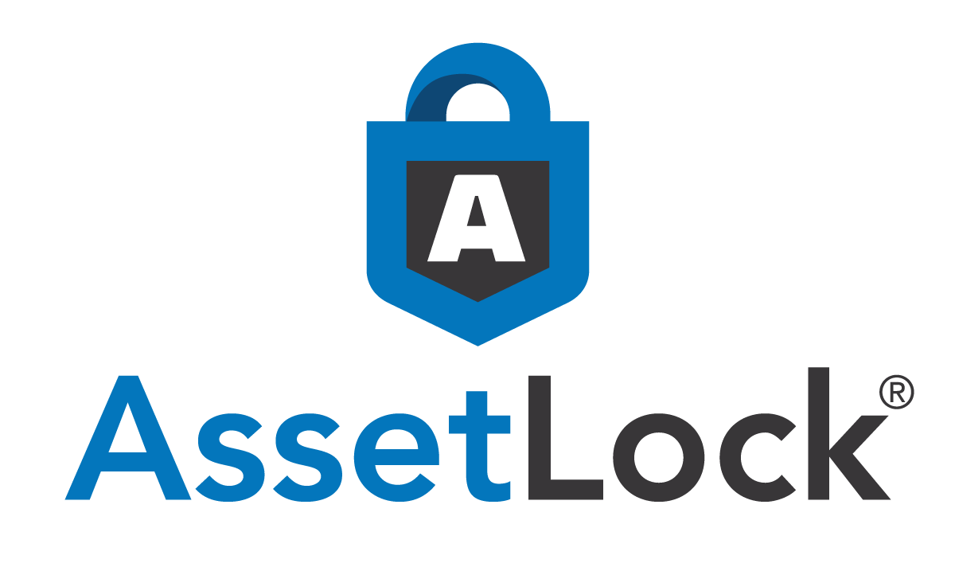
Communicate Progress: AssetLock®
AssetLock is a proprietary, investment portfolio monitoring service that delivers personalized email and text communications to investors in a secure environment.
This technology keeps investors informed about the progression of their portfolio in accordance with their risk tolerance.
AssetLock® is tracking software used to monitor performance of a client’s portfolio, and to predetermine the amount of downside the client is willing to tolerate. It is NOT an actual stop order and will NOT automatically sell the individual securities in the portfolio. The AssetLock® Value is a reference point to encourage a conversation between the client and the advisor/firm.
Notes:
Let’s dive a little deeper into AssetLock.
AssetLock is a proprietary, investment portfolio monitoring service that delivers personalized email and text communications to investors in a secure environment.
This technology keeps investors informed about the progression of their portfolio in accordance with their risk tolerance.

Slide 24
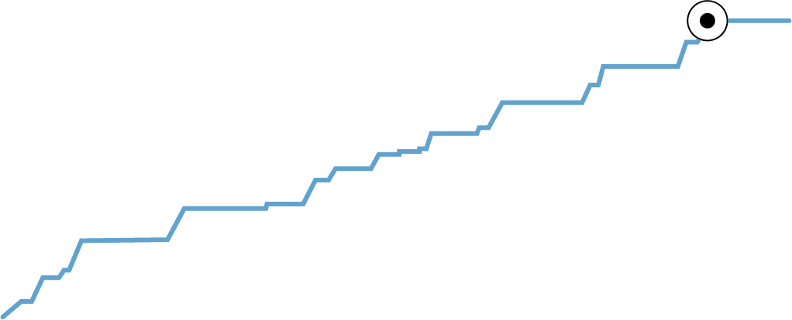
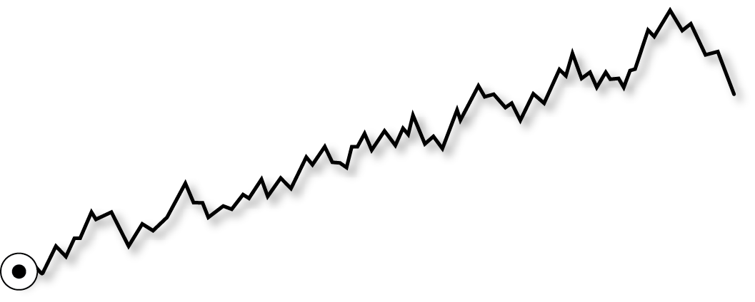

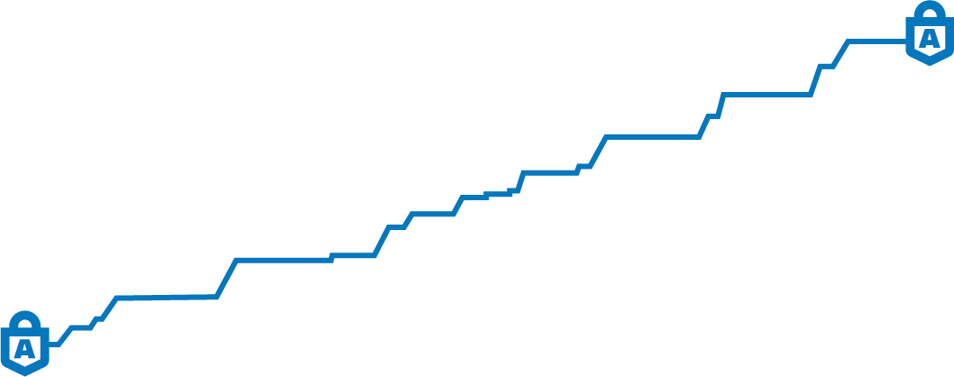
AssetLock® Definitions
Portfolio Value: Daily portfolio value based on data at the close of the Stock Market the previous business day.
High-Water Value: Highest value the account has reached. This value increases as an account grows and will not decrease with market loss.
AssetLock Threshold: The maximum percentage of downside the investor is willing to accept inside the portfolio as determined by the household and portfolio Value at Risk Scores.
AssetLock Value: Portfolio value at which AssetLock will alert the investor and advisor. This value is based off the High-Water Value less the AssetLock Percentage.
High-Water Value
$146,793
$132,114
Portfolio Value
$100,000
AssetLock
Threshold
-10%
AssetLock Value
$90,000
Unless otherwise specified, all return figures above are for illustrative purposes only and are not actual customer or model returns. Actual returns will vary greatly and depend on personal allocation and market circumstances. Your advisor will determine the best time for you to re-enter the market. AssetLock® is tracking software used to monitor performance of a client’s portfolio, and to predetermine the amount of downside the client is willing to tolerate. It is NOT an actual stop order and will NOT automatically sell the individual securities in the portfolio. The AssetLock® Value is a reference point to encourage a conversation between the client and the advisor/firm.
Notes:
Portfolio Value: Daily portfolio value based on data at the close of the Stock Market the previous business day.
High-Water Value: Highest value the account has reached. This value increases as an account grows and will not decrease with market loss.
AssetLock Threshold: The maximum percentage of downside the investor is willing to accept inside the portfolio as determined by the household and portfolio Value at Risk Scores.
AssetLock Value: Portfolio value at which AssetLock will alert the investor and advisor. This value is based off the High-Water Value less the AssetLock Percentage.

Slide 25
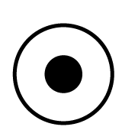
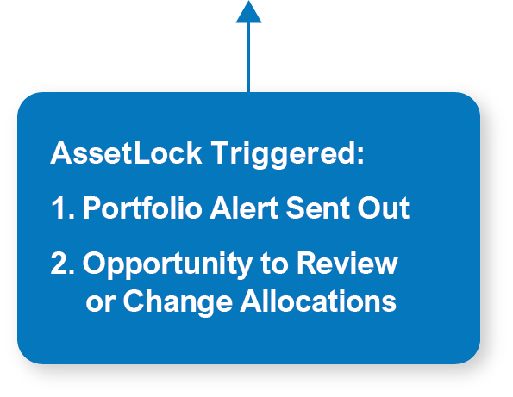
How AssetLock® Works
High-Water Value
$146,793
$132,114
Portfolio Value
$100,000
AssetLock
Threshold
-10%
Starting AssetLock Value
$90,000
Unless otherwise specified, all return figures above are for illustrative purposes only and are not actual customer or model returns. Actual returns will vary greatly and depend on personal allocation and market circumstances. Your advisor will determine the best time for you to re-enter the market. AssetLock® is tracking software used to monitor performance of a client’s portfolio, and to predetermine the amount of downside the client is willing to tolerate. It is NOT an actual stop order and will NOT automatically sell the individual securities in the portfolio. The AssetLock® Value is a reference point to encourage a conversation between the client and the advisor/firm.
AssetLock® is tracking software used to monitor performance of a client’s portfolio, and to predetermine the amount of downside the client is willing to tolerate. It is NOT an actual stop order and will NOT automatically sell the individual securities in the portfolio. The AssetLock® Value is a reference point to encourage a conversation between the client and the advisor/firm.
Notes:
AssetLock is provided to you free of charge.
AssetLock helps you monitor your investment accounts and keeps you informed when important account benchmarks have been met. This can include account highs or dividend deposits. In the event your account value dips near your AssetLock Value.
The chart above demonstrates a portfolio with a 10% AssetLock Value. Assuming an initial deposit of $100,000 and eventual growth to $146,793, the resulting AssetLock Value is $132,114 and may elect to discuss possible changes to your investment strategy.

Slide 26
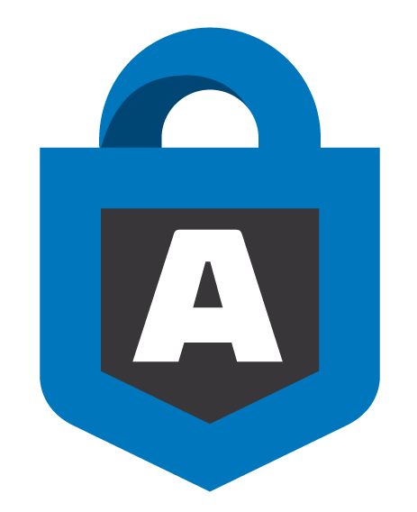
How AssetLock® Works
$146,793
High-Water Value
Green Status = Acceptable Market Movement
-10% ($132,114)
Red Status: AssetLock Value Reached
AssetLock® is tracking software used to monitor performance of a client’s portfolio, and to predetermine the amount of downside the client is willing to tolerate. It is NOT an actual stop order and will NOT automatically sell the individual securities in the portfolio. The AssetLock® Value is a reference point to encourage a conversation between the client and the advisor/firm.
Notes:
Let’s take a closer look to what happens when the portfolios are moving closer to their AssetLock Value.
From 0% -→ -7.5% the account is in the GREEN. This means that is normal market movement.
-10% AssetLock Value: This is where myself (the advisor) and you the investor are having a conversation about what is happening that has caused this to take place and if changes are needed.

Slide 27
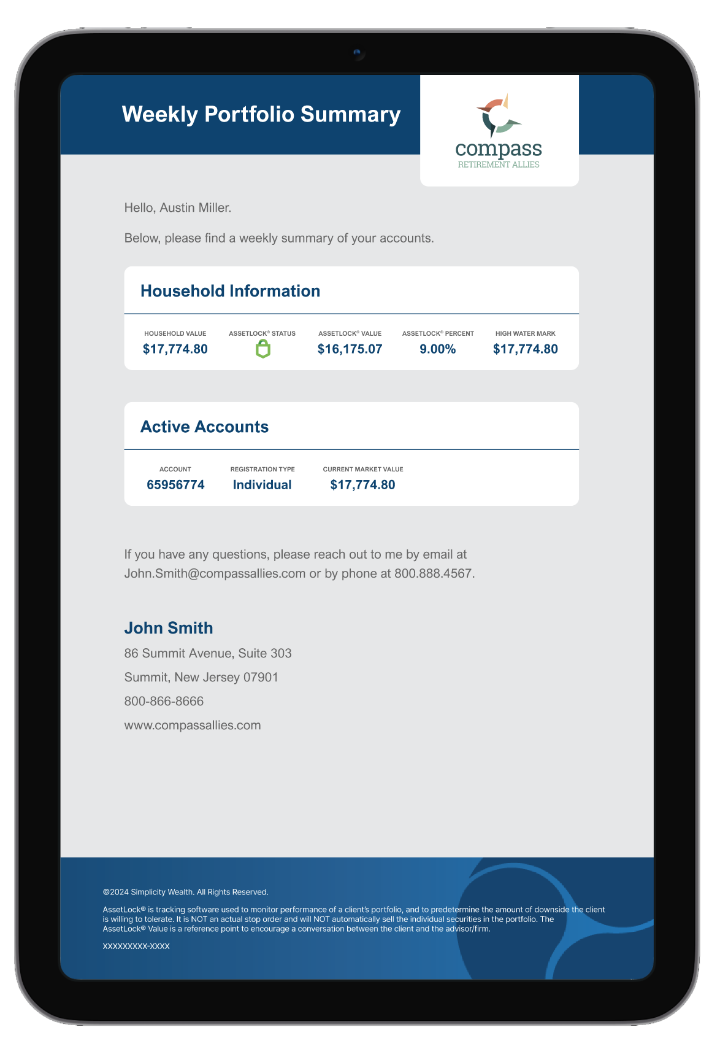
AssetLock Portfolio® Communications
Email and Text Notifications
*Investors may opt out or update their communication preferences at any time.
Weekly Portfolio Summary
Household Portfolio Value, AssetLock Status, AssetLock Value, AssetLock Threshold, New High-Water Value, Active Accounts, Account Value and New Dividends
Triggered Notifications
Welcome (Email Only), AssetLock Value Reached (Red Status), Communication Preferences Updated, and AssetLock Discontinuation
*Standard message and data rates may apply.
Notes:
AssetLock delivers email and text notifications. You may opt out or update your communication preferences at any time.
Weekly Portfolio Summary
Household Portfolio Value, AssetLock Status, AssetLock Value, AssetLock Threshold, High-Water Value, Active Accounts, Account Value and New Dividends
Triggered Notifications
Welcome (Email Only)
New High-Water Value Reached
AssetLock Value Reached (Red Status)
Communication Preferences Updated
AssetLock Discontinuation

Slide 28
Frequently Asked Questions

Slide 29

Frequently Asked Questions
Do I have to change custodians?
Will my investment fees increase?
How will my service change?
Will I have visibility of my assets?
Notes:
Now let’s address some of the FAQs…
Do I have to change custodians?
No. Simplicity is custodian agnostic and works with both Schwab and Fidelity, major institutional custodians for advisory practices. If your accounts are at Schwab or Fidelity today, that will stay the same.
Will my investment fees increase?
Investment fees are dependent on the services provided, but the costs for managers and investment you use today should be the same.
How will my service change?
We believe the tools and resources provided by Simplicity will allow us to better serve you and increase the probability of achieving your investment goals.
Will I have visibility of my assets?
Through a client portal, performance reporting, and most importantly AssetLock, you should always have complete transparency regarding the status of your investment accounts.

Slide 30
Next Steps

Slide 31
Next Steps
Complete account paperwork
Complete the Financial Planning Considerations Questionnaire
Complete the Risk Tolerance Questionnaire
Notes:
In order to for us to get your VAR score established and get Assetlock in place we have only a couple pieces of paperwork that we need to get completed.
First, complete your account transition paperwork.
Second, complete the Financial Planning Considerations Questionnaire, again, this helps gauge your sentiment towards those six key considerations we addressed early.
And third, complete the Risk Tolerance Questionnaire so that we may determine your VaR score and AssetLock Value.

Slide 32
Thank You

Slide 33
Disclosures
Investment advisory and financial planning services are offered through Simplicity Wealth, LLC, an SEC-registered investment adviser. SEC registration does not constitute an endorsement of the firm, nor does it indicate that the adviser has attained a particular level of skill or ability. Insurance, Consulting and Education services offered through [DBA]. [DBA] is a separate and unaffiliated entity from Simplicity Wealth.
This content is for informational purposes only and does not intend to make an offer or solicitation for sale or purchase of any securities. Investing involves risk, including the potential loss of principal. No investment strategy, such as asset allocation or diversification, can guarantee a profit or protect against loss in periods of declining values. All investment strategies involve risk and have the potential for profit or loss. Changes in investment strategies, contributions or withdrawals, and economic conditions may materially affect the performance of your portfolio. There are no assurances that a portfolio will match or outperform any particular benchmark. Investors should carefully consider the investment objectives, risks, fees and expenses before investing. For this and other important information please obtain the investment company fund prospectus and disclosure documents from your Advisor. Read this information carefully before investing.
Registration with the SEC or state does not constitute an endorsement of the firm by regulators, nor does it indicate that the adviser has attained a particular level of skill or ability. This content is for informational purposes only and does not intend to make an offer or solicitation for sale or purchase of any securities. Investing involves risk, including the potential loss of principal. No investment strategy, such as asset allocation or diversification, can guarantee a profit or protect against loss in periods of declining values.
All investment strategies involve risk and have the potential for profit or loss. Changes in investment strategies, contributions or withdrawals, and economic conditions may materially affect the performance of your portfolio. There are no assurances that a portfolio will match or outperform any particular benchmark.
VaR (Value at Risk) is used to calculate risk associated with an investment or a group of investments. The Performance data is generated by using a trailing 5-year blended benchmark in which multiple indexes’ historical performance are combined in order to reflect the investment style’s desired allocations. Past performance is not indicative of future results. Performance projections are hypothetical and reflect figures that are gross of fees. Projections reflected are not guaranteed. Actual results may be higher or lower than projections. All data used in this analysis is believed to be accurate at the time of publication.
Links and references to other websites and third-party content providers are offered for your convenience. We do not necessarily prepare, monitor, review or update the information provided by third parties. We make no representation or warranty with respect to the completeness, timeliness, suitability, or reliability of the referenced content.

