Slide 1

01
THE NAIL
AND THE BOARD
Crucifixion-style execution predates
Christianity by centuries
THE DYING GAUL
In 479 BC, Athenians nailed the Persian governor Artaÿctes to a wooden board at the Hellespont — on the very spot where Xerxes had bridged two continents. The spectacle was a message: imperial power can be unmade where it was made.
Roman marble copy, c. 230–220 BC
Capitoline Museums, Rome
A defeated warrior's final moments — vulnerability and defiance made eternal in stone.
DOMINION — TOM HOLLAND — CHAPTER 1: ATHENS, 479 BC

Slide 2
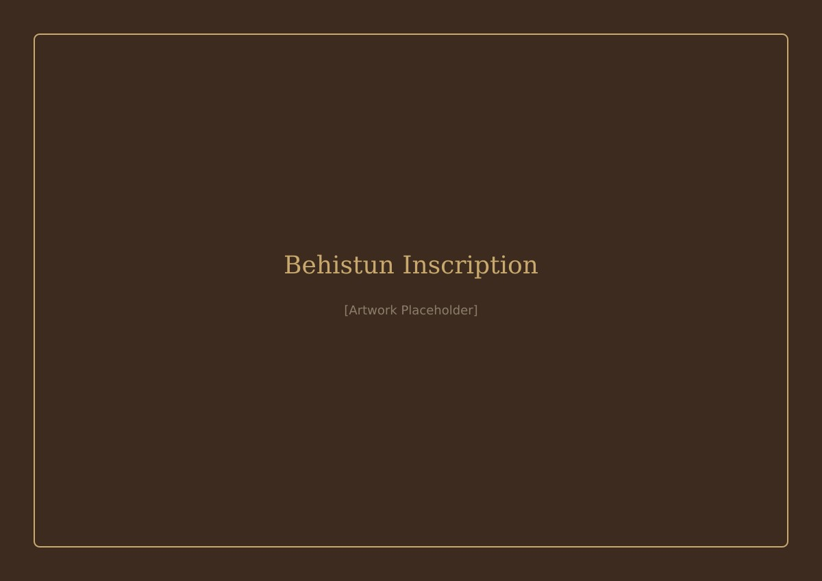
02
THE COSMIC
CRUSADE
Persia believed its empire
was a moral project
BEHISTUN INSCRIPTION
Darius and his heirs ruled in the name of Ahura Mazda, the god of light and truth. All resistance was allegiance to 'the Lie' — a cosmic darkness threatening the universe. Punishment wasn't cruelty; it was spiritual hygiene.
Rock relief, c. 520 BC
Mount Behistun, Kermanshah, Iran
Darius tramples a rebel beneath the winged figure of Ahura Mazda — carved 100 metres above the road, meant to be seen but never touched.
DOMINION — TOM HOLLAND — CHAPTER 1: ATHENS, 479 BC

Slide 3
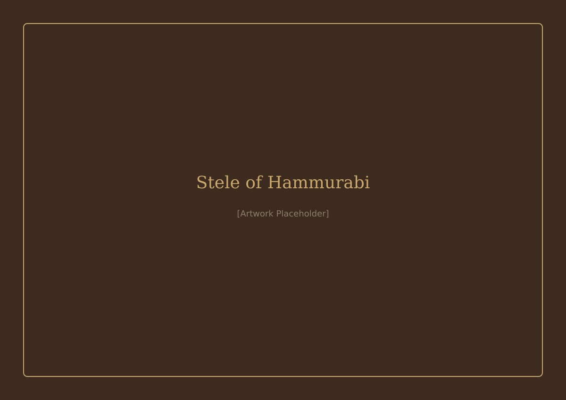
03
DIVINE
MANDATE
The first universal moral order
backed by empire
STELE OF HAMMURABI
Drawing on Mesopotamian traditions stretching back to Hammurabi, the Persian kings claimed a sacred charge: to bring justice to the world. Their precedent — a king receiving law from a god — would echo across millennia.
Basalt, c. 1792–1750 BC
Musée du Louvre, Paris
The sun-god Shamash hands Hammurabi the rod and ring of justice — the earliest surviving monument of law as sacred trust.
DOMINION — TOM HOLLAND — CHAPTER 1: ATHENS, 479 BC

Slide 4

04
THE EYE
ON STAGE
Greeks saw Persian universalism
as terrifying despotism
TERRACOTTA THEATRE MASK
Aristophanes put an actor on stage wearing an enormous eye on his head — mocking the Persian 'King's Eye' surveillance network. Where Persia saw cosmic order, Athens saw tyranny. Comedy became resistance.
Greek, 2nd–1st century BC
The Metropolitan Museum of Art, New York
The exaggerated mouth of the comic mask — designed to carry laughter to 15,000 people in an open-air theatre.
DOMINION — TOM HOLLAND — CHAPTER 1: ATHENS, 479 BC

Slide 5
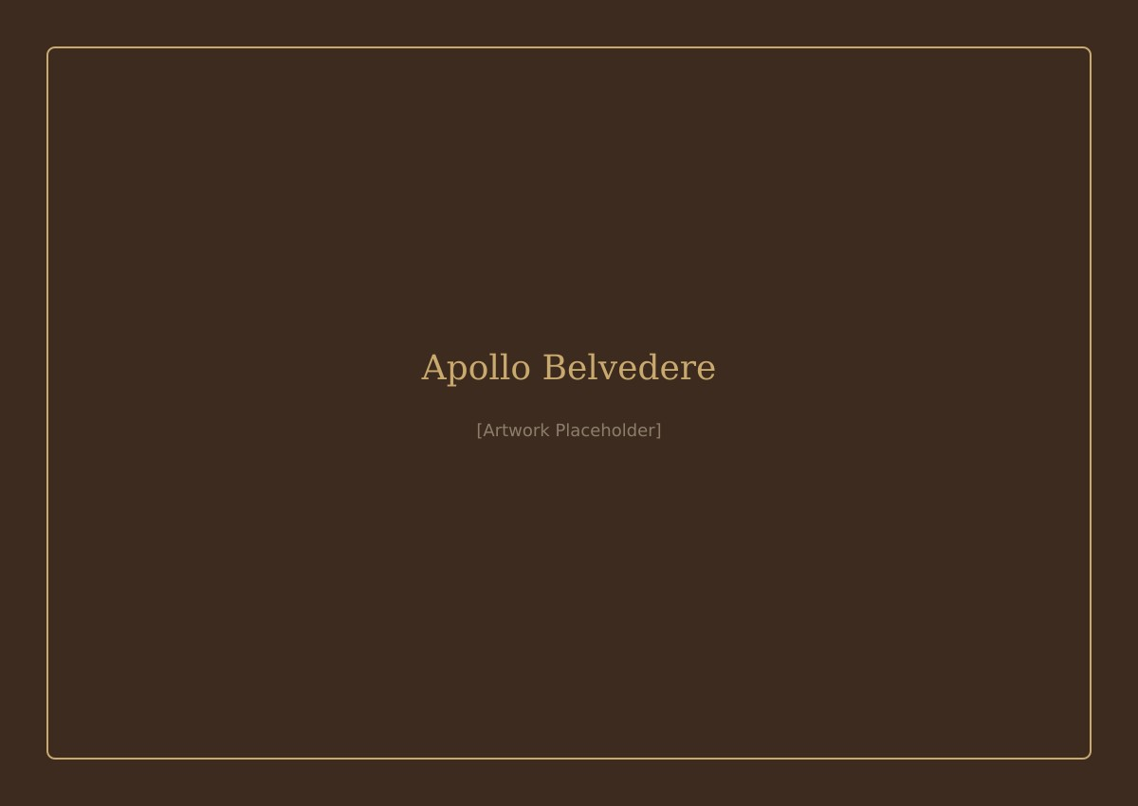
05
THE OBLIQUE
ONE
Greek gods were capricious, amoral,
and radically contradictory
APOLLO BELVEDERE
Apollo was healer and plague-bringer. Zeus raped mortals as a shower of gold. The gods demanded sacrifice and punished insults — but offered no ethical code. Light itself had a darkness to it.
Roman marble copy, c. AD 120–140
Musei Vaticani, Vatican City
The god of light, music, healing — and plague. Perfect beauty concealing perfect indifference.
DOMINION — TOM HOLLAND — CHAPTER 1: ATHENS, 479 BC

Slide 6
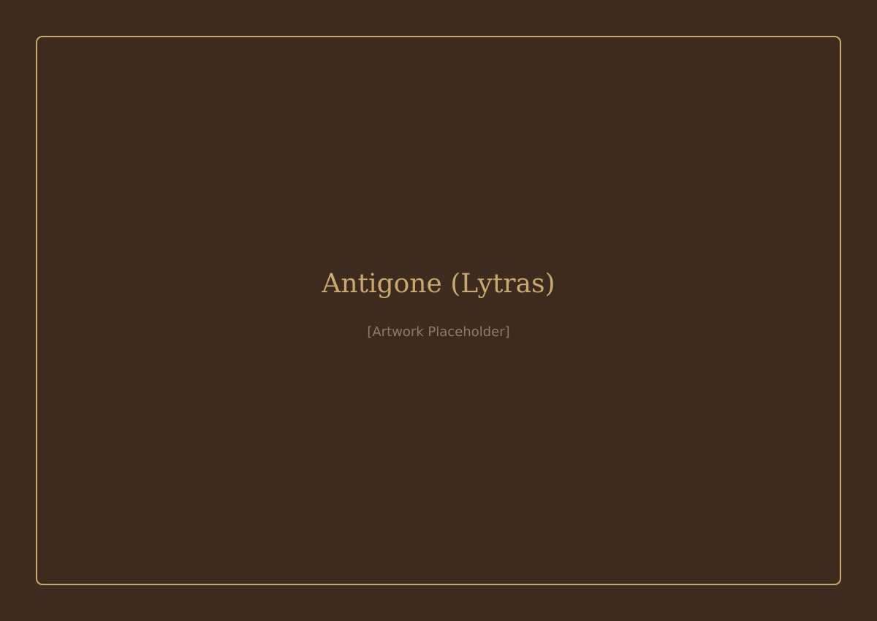
06
THE UNWRITTEN
LAW
Greeks intuited a higher law
but couldn't pin down its source
ANTIGONE BEFORE THE BODY OF POLYNICES
In Sophocles' Antigone, a princess defies a king's decree to honour unwritten divine laws — 'neither today nor yesterday were they born; they are eternal.' The tension between human legislation and timeless moral order remains unresolved.
Nikiforos Lytras, oil on canvas, 1865
National Gallery, Athens
The solitary act of conscience against the machinery of the state — a woman, dust in her hands, over a forbidden corpse.
DOMINION — TOM HOLLAND — CHAPTER 1: ATHENS, 479 BC

Slide 7
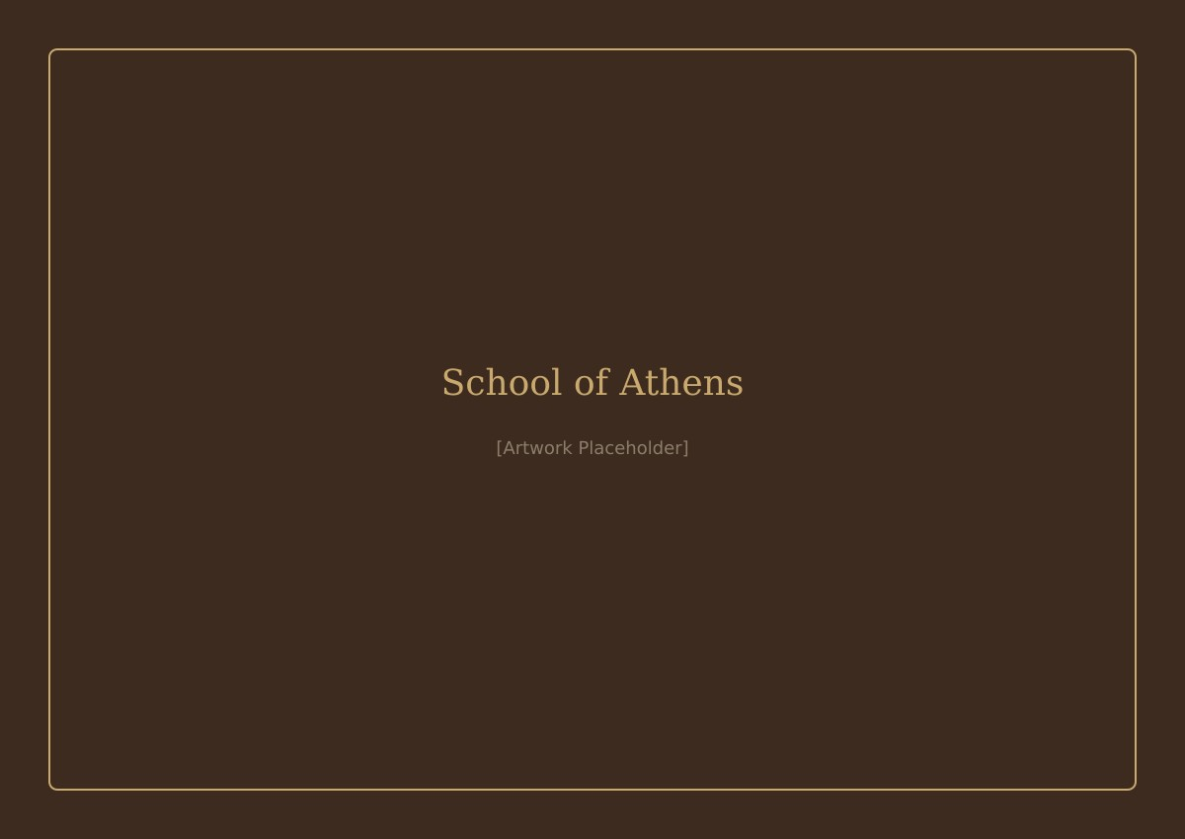
07
BEYOND
THE ALTAR
Philosophy emerged to resolve
the contradictions of myth
THE SCHOOL OF ATHENS
From Xenophanes to Aristotle, thinkers rejected Homer's quarrelsome gods and searched for rational, mathematical principles governing the cosmos. The 'unmoved mover' replaced Zeus — but at the cost of a god who cared.
Raphael, fresco, 1509–1511
Apostolic Palace, Vatican City
Plato points upward to the ideal; Aristotle gestures toward the earth. Twenty-five centuries of philosophy framed in a single gesture.
DOMINION — TOM HOLLAND — CHAPTER 1: ATHENS, 479 BC

Slide 8
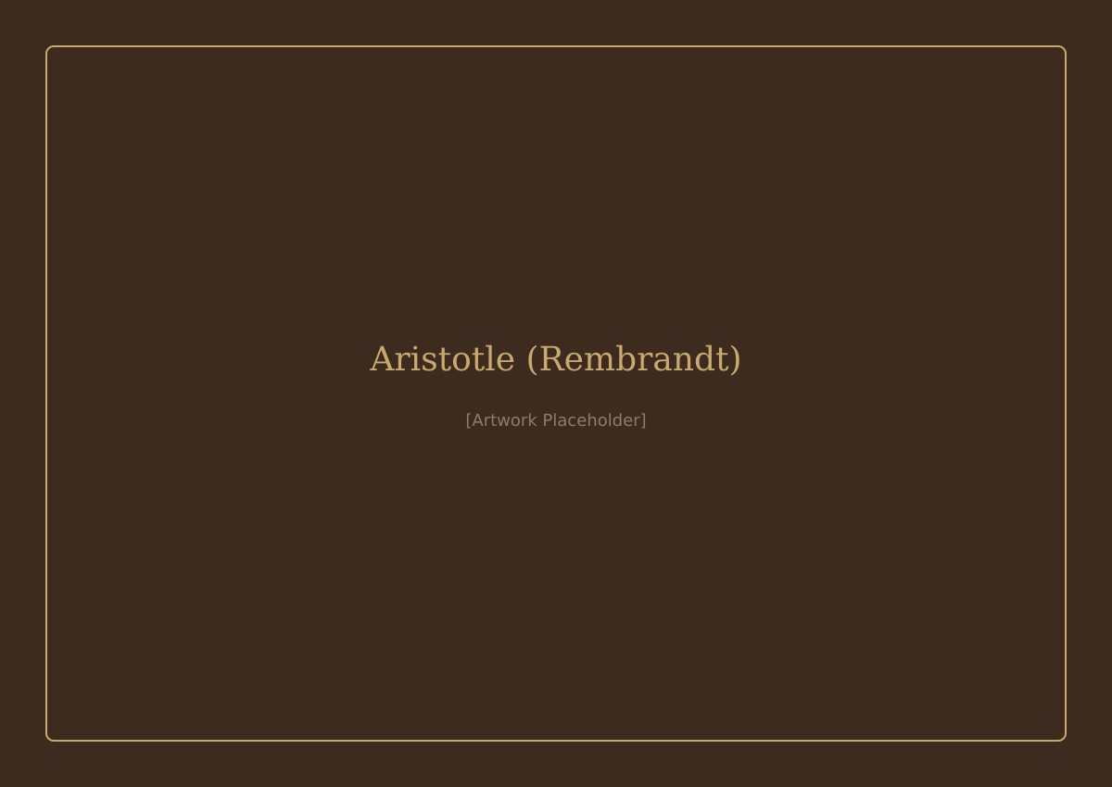
08
THE NATURAL
ORDER
Aristotle's rational universe
justified brutal hierarchies
ARISTOTLE WITH A BUST OF HOMER
The same cosmic framework that found divine pattern in the stars also concluded that men should rule women, Greeks should rule barbarians, and the poor were unfit for citizenship. Philosopher-rule in Athens stripped the masses of their votes.
Rembrandt van Rijn, oil on canvas, 1653
The Metropolitan Museum of Art, New York
The philosopher's hand rests on the blind poet — reason confronting the mythos it claims to supersede, unable to let go.
DOMINION — TOM HOLLAND — CHAPTER 1: ATHENS, 479 BC

Slide 9

09
THE WORLD
BROKEN OPEN
Alexander's conquests shattered
the old Greek world
ALEXANDER MOSAIC
The scale of the new Macedonian empires dwarfed the city-state. Traditional gods seemed inadequate to explain events this enormous. People turned to Fortune — Tyche — a terrifying, impersonal force of blind chance.
Floor mosaic, c. 100 BC (after a c. 310 BC painting)
National Archaeological Museum, Naples
Alexander charges Darius III at Issus — the moment one world-order collapses into another.
DOMINION — TOM HOLLAND — CHAPTER 1: ATHENS, 479 BC

Slide 10

10
THE SPARK
WITHIN
The Stoics offered the most radical
response: nature itself is God
FARNESE ATLAS
A divine rational principle — the Logos — pervaded all matter. Every human, regardless of sex, ethnicity, or status, carried a divine spark: syneidesis, conscience. This was a genuinely universalist claim — and it would seed the future.
Roman marble, 2nd century AD
National Archaeological Museum, Naples
Atlas bears the celestial sphere — the oldest known depiction of the classical constellations. The cosmos as burden, as beauty, as order.
DOMINION — TOM HOLLAND — CHAPTER 1: ATHENS, 479 BC

Slide 11
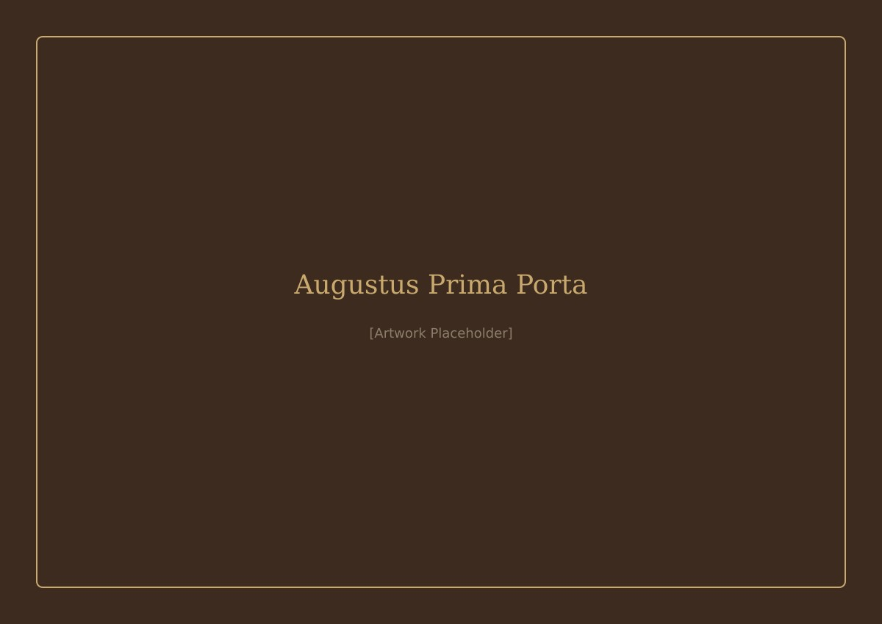
11
EMPIRE
AS DESTINY
Rome co-opted Greek philosophy
to justify its conquests
AUGUSTUS OF PRIMA PORTA
Posidonius and Cicero repackaged Stoic natural law as vindication. Wars, slavery, plunder — all fated, rational, in accordance with cosmic order. 'Natural law' became the moral armour of an empire.
Marble, 1st century AD
Musei Vaticani, Vatican City
The emperor as god-touched commander — barefoot like a deity, breastplate telling the story of cosmic victory.
DOMINION — TOM HOLLAND — CHAPTER 1: ATHENS, 479 BC

Slide 12

12
THE FUTURE
BELONGS
TO THE STRONG
Before Christianity, competing visions
of power all served the powerful
WINGED VICTORY OF SAMOTHRACE
Persian cosmic justice. Greek divine caprice. Philosophical rational order. Imperial destiny. Each claimed universality. Each ultimately served the strong. The stage is set — for a revolution that would invert it all.
Parian marble, c. 190 BC
Musée du Louvre, Paris
Striding into the wind at the prow of a ship — triumph without a face, momentum without mercy.
DOMINION — TOM HOLLAND — CHAPTER 1: ATHENS, 479 BC

