Slide 1
Bloom Filters
Applications in Computer Networks
ECE 658 Internet Engineering
Bennie Blunt, Jr
April 14, 2013

Slide 2
Outline
Introduction
Brief History of Bloom Filters
Theory of the Bloom filter
Several uses for Bloom Filters in computer networks
Motivation and application of Bloom filters to the Army's network routing issues
current routing protocols in use in the lower tactical internet
Inter-domain routing mobility (IDRM)
future research areas

Slide 3
Introduction
Over the years the US Army has inherited a conglomerate of heterogeneous networks
They began connecting these networks together with an attempt to create a homogenous centrally administered network to support the war fighter
That network connects to the Department of Defense’s Global Information Grid for collaboration with Joint Services and US Allies
One of the major issues is the use of terrestrial based routing protocols like OSPF, RIP and BGP for mobile networks
Those protocols work fine for fixed locations, but were not well suited as the network was pushed out to the edge
In addition to pushing that network out to the soldiers on missions, those soldiers are on the move

Slide 4
Introduction continued
The network administrators have been forced to create sets of static configurations to try and accommodate that mobility
Any scenario outside of the preplanned sets of configurations are just not supported, thus limiting the network flexibility and resulting in isolated networks
Networking vendors have been slow to design protocols that are explicitly for these tactical networks
Most of the solutions consists of retrofitting OSPF, RIP, and BGP into the mobile routing nodes
Other solutions support various spectrum wave forms, but have poor scalability

Slide 5
Introduction continued
The current group I am a member of, QUEST, is conducting research into a routing protocol designed to handle these mobile network nodes
The key concept that has promise is based on Bloom Filters
We currently have Dr. Mario Gerla and You Lu of UCLA developing code in C++ for an Inter-domain Routing protocol (IDRM)
The code is being tested with Network Simulator 3 (NS3) on the LINUX operating system
The use of open source is to foster the collaboration of multiple researchers with the understanding this problem will take contributions from many

Slide 6
Brief History of Bloom Filters
Burton Bloom introduced Bloom filters in the 1970s
Simply put, A Bloom filter is a simple space-efficient randomized data structure for representing a set in order to support membership queries
They can have false positive but no false negatives
Initially they were used in database systems
More recently they have been employed in network applications
[2]

Slide 7
Theory of the Bloom filter
Bloom Filter - is a simple space-efficient randomized data structure for representing a set in order to support membership queries [5]
The space efficiency is achieved at the cost of a small probability of false positives, but often this is a convenient trade-off [5]

Slide 8
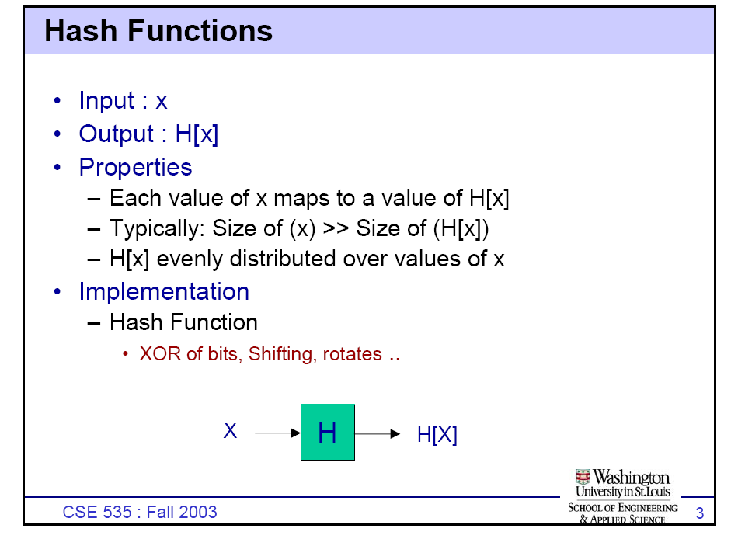

Slide 9
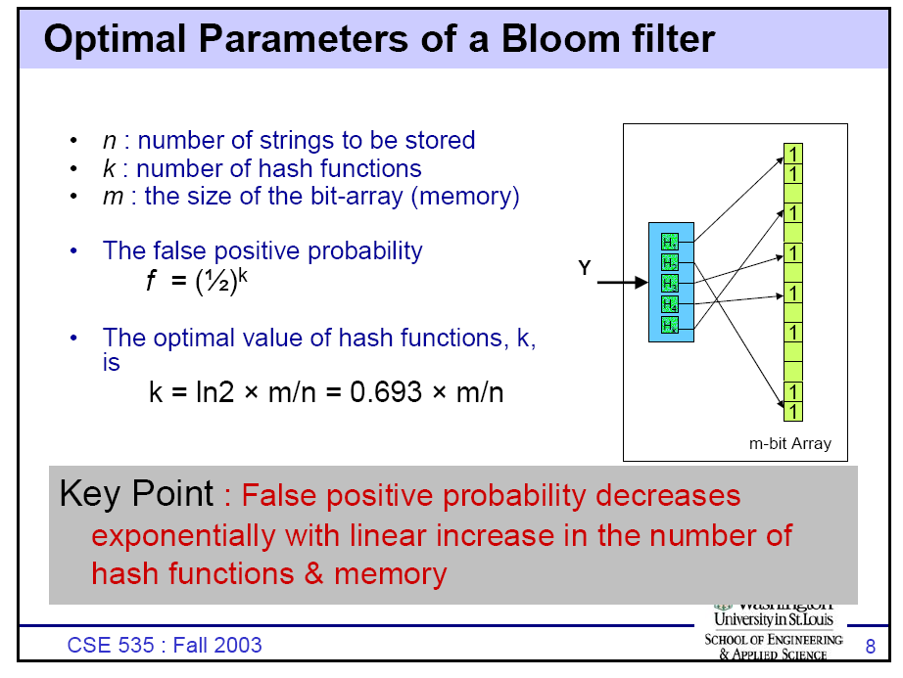

Slide 10
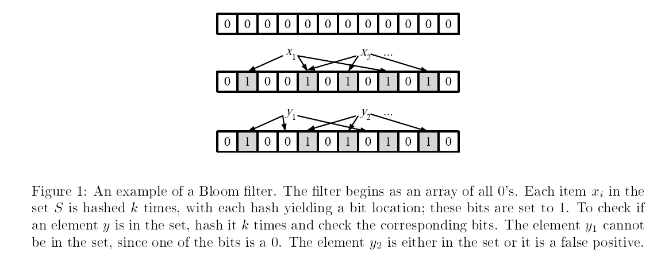
Example taken from [7]

Slide 11
Example uses for Bloom Filters in computer networks
Collaborating in overlay and peer-to-peer networks: Bloom filters can be used for summarizing content to aid collaborations in overlay and peer-to-peer networks.
Resource routing: Bloom filters allow probabilistic algorithms for locating resources
Packet routing: Bloom filters provide a means to speed up or simplify packet routing protocols.
Measurement: Bloom filters provide a useful tool for measurement infrastructures used to create data summaries in routers or other network devices [2]
Deep Packet Inspection using Parallel Bloom Filters [7]

Slide 12
Extensions and Applications
Counting filters - provide a way to implement a delete operation on a Bloom filter without recreating the filter afresh []
Data synchronization - Bloom filters can be used for approximate data synchronization [9]
stable Bloom filters – The idea is that since there is no way to store the entire history of a stream (which can be infinite), Stable Bloom filters continuously evict stale information to make room for more recent elements [8]
compact approximates – associates to each key an element of a lattice (the standard Bloom filters being the case of the Boolean two-element lattice). Instead of a bit array, they have an array of lattice elements [11]
scalable Bloom filters – technique is based on sequences of standard bloom filters with increasing capacity and tighter false positive probabilities, so as to ensure that a maximum false positive probability can be set beforehand [10]

Slide 13
Extensions and Applications
attenuated Bloom filters – using attenuated Bloom filters consisting of multiple layers, services at more than one hop distance can be discovered while avoiding saturation of the Bloom filter by attenuating (shifting out) bits set by sources further away [12]
Character Dependent Multi-Bloom Filters – used in network forensics and allows for wildcard queries[13]

Slide 14
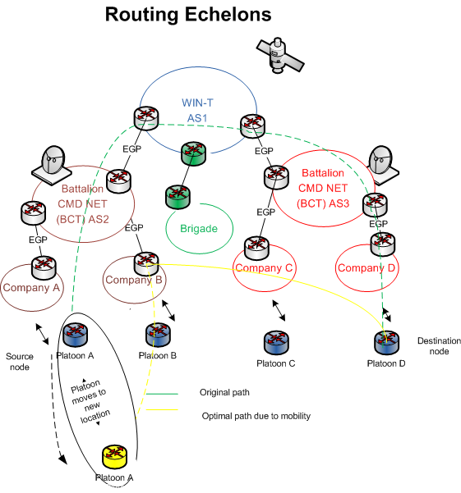
Motivation and application of Bloom filters to the Army's network routing issues

Slide 15
Why not use routing protocols in existence ?
OSPF – link state(proactive), hierarchical (uses gateways), load balance across multiple links, standards based, tried and proven
The problem is it wasn’t designed for mobility
Nodes would generate constant link state changes, gateway elections, cause area zero splits, etc.
To date OSPF MANET extensions haven’t worked out well either
Most mobile routers (tactical) are really using RIPv2, great for small static networks

Slide 16
What about BGP ?
Border Gateway Protocol 4 (BGP4) – was designed to enable routing between domains separately administered
All types of mechanism to handle extremely large networks and policy - multi-exit discriminator (MED), address summarization, hierarchical, peering between gateways, federations, route reflecters, etc.
Tried and proven; used to stitch the internet and service providers networks together
It has it issues but it does work
Unfortunately tactical networks are mobile
There won’t always be a hierarchy, gateways will need to be configured to communicate with new gateways
Gateways will change
As nodes move the address space loses it’s nice neat aggregation
BGP has to peer and have reachability through it’s interior gateway protocol (IGP), usually OSPF, ISIS
Not very friendly to constant change, that is why dampening is used to handle route flaps

Slide 17
What about the existing MANET routing protocols ?
MANET protocols were designed to handle mobility and to be self organizing to a point
proactive – OLSR [15], Better approach to mobile adhoc networking (BATMAN)[16], others
Reactive – Ad hoc On-demand Distance Vector(AODV)[17], Dynamic Source Routing (DSR)[18], others
Hybrid – ZRP (Zone Routing Protocol)[19]
Hierarchical Routing Protocols - CBRP (Cluster Based Routing Protocol) [20]
FSR (Fisheye State Routing protocol) [21]
Others - IMEP (Internet Manet Encapsulation Protocol) [22]

Slide 18
Existing MANET shortcomings pertaining to Tactical networks
While the aforementioned protocols and many others have usable features, none fit the needs of the Army’s tactical networks
There have been numerous surveys, studies, simulations, retrofitting existing protocols
Usually use unrealistic mobility patterns like random waypoint
None that I have read to date scale upwards of 2500 nodes
Don’t address the issue of discontinuous address space, dynamic gateway, routing domain splits and merges
Inter-domain routing

Slide 19
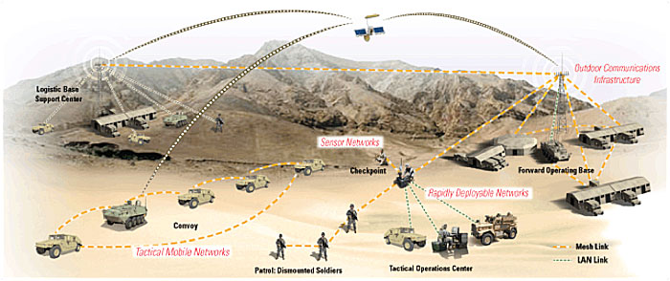

Slide 20
What are the needs of a tactical network
Connectivity to the edge where the dismounted soldiers are
Support soldiers mobility within their routing domain, but more importantly outside that domain
Dynamic configurations while in transit
Inter-domain routing, secure transmission, mobile network management, quality of service to support converged applications, and others
Bloom filters can contribute to the inter-domain routing need

Slide 21




Origin of the work on IDRM
IMR was originally developed under the ARL USUK-ITA
Research project from 2007 – 2009
Joint US UK International Technology Alliance (US UK ITA)
Matching funds (6.1) from MoD (Ministry of Defense) and ARL
Funded researchers at Cambridge University, UCLA, and IBM
QUEST obtained S&TCD mission funding to investigate, prototype, develop,
and eventually standardize an Inter-MANET Routing (IMR) protocol
based upon Army requirements
OSD NCCP (Network Communications Capabilities Program) funding to investigate joint services need for MIDR
QUEST is funding Professor Mario Gerla at UCLA to help with aspects of IMR

Slide 22
Inter-domain routing mobility (IDRM)
IMR will enable inter-domain routing for MANETs
Still allows domain control of its own routing policy
Each domain will have one (or more) gateway(s)
The gateway will run an IGP (ie, AODV, DSDV, etc.) and IMR protocol
Gateway has knowledge and connectivity of other domain’s gateways
They bridge technology seams between MANETs at physical, MAC, or protocol translation (ie., run multiple radio technologies)
It supports internal gateway selection and detects network splits and merges

Slide 23
IDRM functionality
Handling domain-level topology changes
Gateways maintain a soft state by periodically sending beacons to each other
After a partition is detected, gateways in same partition should generate a new MANET ID (domain)
A pseudo random number generator is used using IDs of all gateways to limit gateway ID collisions
Membership announcement and management
In addition to MANET ID generation, the gateway will collect the IDs of all the nodes in it’s MANET for advertisement to other domains
The membership list can be just a plain membership digest for smaller domains less than a 1000
For larger domains a more scalable solution based on bloom filters is used

Slide 24
IDRM functionality continued
Policy support
Inter-domain routing policy similar to BGP, using path vector routing
Administrator can still enforce next-hop-based policy routing
Data plane operations
When a node sends packets destined for an external domain, it sends them to the reachable intra-domain gateway
The gateway sends the packet to the destination gateway where the destination node resides
If for some reason the destination is unreachable, the IMR doesn’t provide feedback so it doesn’t generate unnecessary traffic

Slide 25
More IDRM functionality
Three types of nodes: Normal, Gateway, Gateway Candidate
IMR info message is beaconed between all the Gateways and Gateway Candidates. Normal Nodes do not hear this message.
Each Gateway Candidate announces the number of neighbors (currently one hop) it has via IMR info message
The Gateway Candidate with the most neighbors will be elected the new active Gateway

Slide 26
Bloom Filter routing (IDRM)
A bloom filter (BF) is a method for representing a set of n elements in a compact data structure which allows for membership queries
Solves current IP aggregation issue (where prefix based schema in BGP not viable to properly aggregate IP addresses in MANET)
Each MANET generates one bloom filter of all members
MANETs exchange bloom filters with each other
BF has two functions
constructBF: inserts the member's IP address into the BF in his group
Bfcontain: returns TRUE or FALSE to decide if a IP exists in this BF or not
The BF is helpful for the scalability. Since we cannot use the traditional IP prefix to identify and digest each group, the BF is a good substitute to work as the group ID and member digest

Slide 27
Think of id1, id2…. As network prefixes
Figure 1 shows the construction of the Bloom Filter according to a plain member list.
A bit vector of m bits is used to represent a set of n members {id1, id2, …, idn}.
Originally all the bits in the Bloom Filter are set to “0”. By hashing each item using a hash function of log 2 (m) bits, the Bloom Filter will set the corresponding bit to “1” To check the membership of the element x, it is sufficient to verify whether the bit corresponding to h(x) is set to “1”.
The verification will cause “false positive”, i.e., an element not belonging to the set may be checked as a member. But Bloom Filter is free from false negatives, i.e., any element verified as a non-member shall not belong to the set.
Many hash functions such as MD5 and SHA-1 are evenly distributed in the “bit vector” domain, so the false positive probability can be decreased to a large extent.

Slide 28
Example

Slide 29
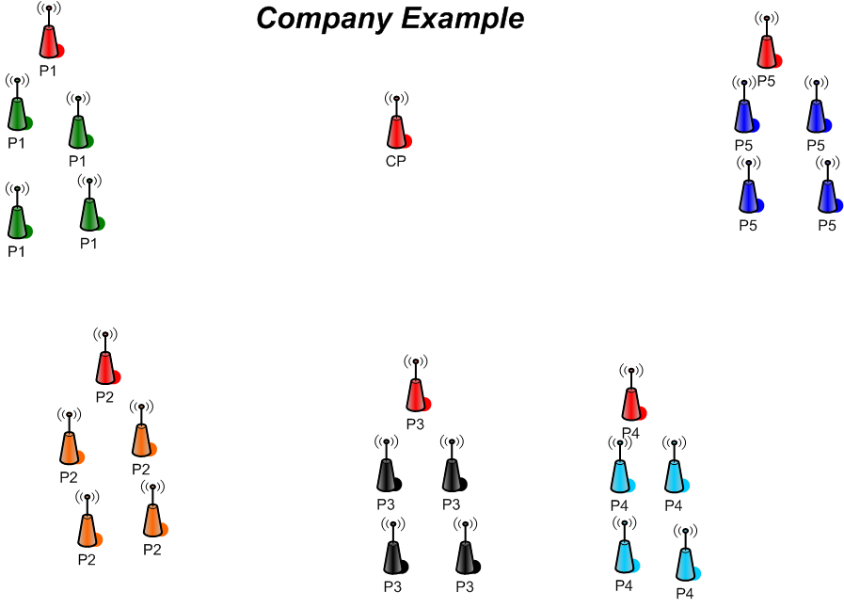
Example of split/merge

Slide 30
How does IDRM handle splits and merges ?
The previous diagram shows five platoons and one company node
Each group represents a MANET with one gateway
If a platoon or a few members of a platoon were to migrate away from there home platoon
A node that is a candidate gateway would detect the split
A gateway election would occur and the candidate node with the most adjacencies would win
A new MANET id would be created for the new MANET
The newly elected gateway would try and establish communication with ant gateway it is able to close a L2 radio link with
The gateways would exchange prefixes and the new MANET would now be able to communicate through the new connected path

Slide 34
testing of current IDRM features against the requirements
handle splits and merges caused by troop mobility
handling of discontinuous address space
dynamic gateway selection for new domain
network connectivity after split and a merge
route convergence time
application (voice, data,) performance
overhead generated

Slide 35
Future Areas That Need Work
how to secure the protocol
multicast routing (will it support multicast)
quality of service mechanisms
How will it handle more than one positive for a search
Code that works on outside simulator (on a Linux OS natively)
Test those nodes within a live network lab environment
Circulate code within the community and to industry
Support for multicast, native or overlay

Slide 36
References
1. Calvert, Kenneth L., James Griffioen, and Su Wen. "Lightweight network support for scalable end-to-end services." ACM SIGCOMM Computer Communication Review 32.4 (2002): 265-278.
2. Broder, Andrei, and Michael Mitzenmacher. "Network applications of bloom filters: A survey." Internet Mathematics 1.4 (2004): 485-509.
3. Song, Haoyu, et al. "Ipv6 lookups using distributed and load balanced bloom filters for 100gbps core router line cards." INFOCOM 2009, IEEE. IEEE, 2009.
4. Dharmapurikar, Sarang, et al. "Deep packet inspection using parallel bloom filters." High Performance Interconnects, 2003. Proceedings. 11th Symposium on. IEEE, 2003.
5. Broder, Andrei, and Michael Mitzenmacher. "Network applications of bloom filters: A survey." Internet Mathematics 1.4 (2004): 485-509.
6. Dharmapurikar, Sarang, et al. "Deep packet inspection using parallel bloom filters." Micro, IEEE 24.1 (2004): 52-61.
7. Dharmapurikar, Sarang, et al. "Deep packet inspection using parallel bloom filters." High Performance Interconnects, 2003. Proceedings. 11th Symposium on. IEEE, 2003.
8. Deng, Fan; Rafiei, Davood (2006), "Approximately Detecting Duplicates for Streaming Data using Stable Bloom Filters", Proceedings of the ACM SIGMOD Conference, pp. 25–36.
9. Byers, John W.; Considine, Jeffrey; Mitzenmacher, Michael; Rost, Stanislav (2004), "Informed content delivery across adaptive overlay networks", IEEE/ACM Transactions on Networking 12 (5): 767, doi:10.1109/TNET.2004.836103.
10. Almeida, Paulo; Baquero, Carlos; Preguica, Nuno; Hutchison, David (2007), "Scalable Bloom Filters", Information Processing Letters 101 (6): 255–261, doi:10.1016/j.ipl.2006.10.007

Slide 37
References
11. Boldi, Paolo; Vigna, Sebastiano (2005), "Mutable strings in Java: design, implementation and lightweight text-search algorithms", Science of Computer Programming 54 (1): 3–23.
12. Koucheryavy, Y.; Giambene, G.; Staehle, D.; Barcelo-Arroyo, F.; Braun, T.; Siris, V. (2009), "Traffic and QoS Management in Wireless Multimedia Networks", COST 290 Final Report (USA): 111.
13. Haghighat, M., Mehdi Tavakoli, and Mehdi Kharrazi. "Payload Attribution via Character Dependent Multi-Bloom Filters." (2013): 1-1.
14. Burbank, J.L.; Chimento, P.F.; Haberman, B.K.; Kasch, W., "Key Challenges of Military Tactical Networking and the Elusive Promise of MANET Technology," Communications Magazine, IEEE , vol.44, no.11, pp.39,45, November 2006
15. Clausen, Thomas, et al. "Optimized link state routing protocol (OLSR)." (2003).
16. Abolhasan, Mehran, Brett Hagelstein, and JC-P. Wang. "Real-world performance of current proactive multi-hop mesh protocols." Communications, 2009. APCC 2009. 15th Asia-Pacific Conference on. IEEE, 2009.
17. Das, Samir R., Elizabeth M. Belding-Royer, and Charles E. Perkins. "Ad hoc on-demand distance vector (AODV) routing." (2003).
18. Johnson, David B., David A. Maltz, and Josh Broch. "DSR: The dynamic source routing protocol for multi-hop wireless ad hoc networks." Ad hoc networking 5 (2001): 139-172.

Slide 38
References
19. Haas, Zygmunt J., Marc R. Pearlman, and Prince Samar. "The zone routing protocol (ZRP) for ad hoc networks." draft-ietf-manet-zone-zrp-04. txt (2002).
20. Basu, Prithwish, Naved Khan, and Thomas DC Little. "A mobility based metric for clustering in mobile ad hoc networks." Distributed Computing Systems Workshop, 2001 International Conference on. IEEE, 2001.
21. Sun, Allen C. Design and Implementation of Fisheye Routing Protocol for Mobile Ad Hoc Networks. Diss. Massachusetts Institute of Technology, 2000.
22. Bansal, Meenakshi, Rachna Rajput, and Gaurav Gupta. "Mobile ad hoc networking (MANET): Routing protocol performance issues and evaluation considerations." (1999).
23. Chau, Chi-Kin, et al. "IDRM: Inter-Domain Routing Protocol for Mobile Ad Hoc Networks." University of Cambridge Technical Report UCAM-CL-TR-708 (2008).
24. Lee, Seung-Hoon, et al. "Inter-Domain Routing for Heterogeneous MANETs."

