Slide 1
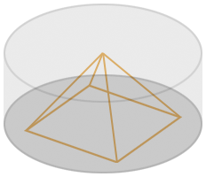
Theta Quadrant
Animated Deep 3D Holographic LED Display
Ben Boldt
April 27, 2009

Slide 2
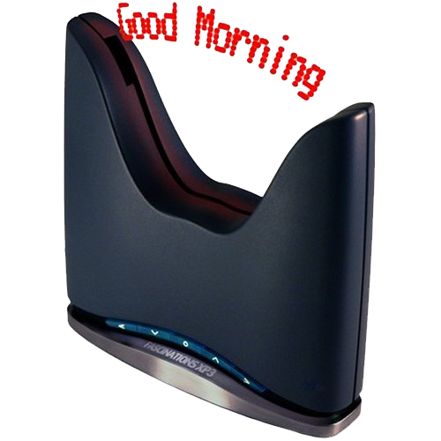
The Illusion
Theta Quadrant is an extension of the floating clock idea from 2D into 3D.
The Illusion: “Persistence of vision”
Notes:
Theta Quadrant is an extension of the floating clock idea from 2D into 3D.
The 3D image is not actually there; it’s an illusion. Persistence of vision causes an LED to remain lit in our vision for some time after it has actually turned off. This technique has been used for a long time in old CRT television sets and computer monitors. There is basically one bright point that scans very quickly across the surface of a CRT, but our vision detects a complete 2D image out of it.

Slide 3
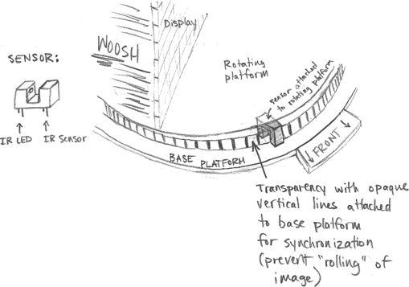
Sketch

Slide 4
Comparison
Floating Clock
2-dimensional + time
8 LED line segment
8x64 resolution
  512 2D pixels
Refresh Rate
  Multiplexing: (n/a)
  New Data: 640 Hz
  Rotation: 10 Hz
Theta Quadrant
3-dimensional + time
1024 LED Plane
32x32x180 resolution
  184,320 3D pixels
Refresh Rate
  Multiplexing: 15 kHz
  New Data: 1.3 kHz
  Rotation: 7.1 Hz
Notes:
NOTE:
430 RPM

Slide 5
The Name “Theta Quadrant”
Cylindrical / Rectangular conversion
Theta refers to the cylindrical system
  (r, θ, z)
Quadrant refers to the rectangular system
Also a slight reference to Star Trek.
Notes:
Theta Quadrant graphs straight lines in a cylindrical system by converting back and forth from cylindrical to rectangular systems.
Star Trek: Alpha, Beta, Gamma, Delta

Slide 6
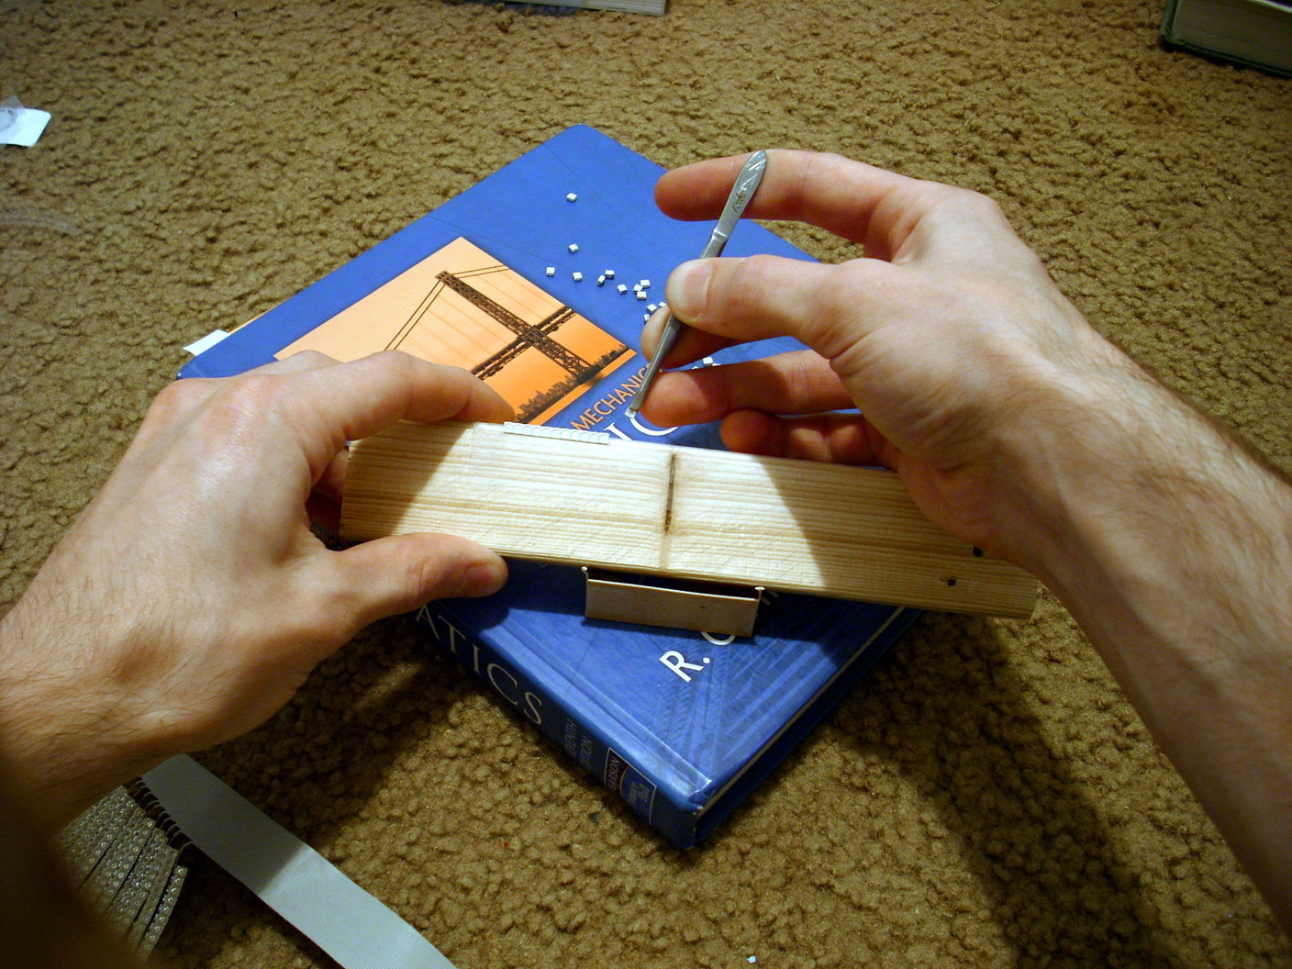
LED Display: Rows
Notes:
One-bit amber surface-mount LEDs
Multiplexed
30 gauge solid copper ribbon
Viewable from both sides

Slide 7
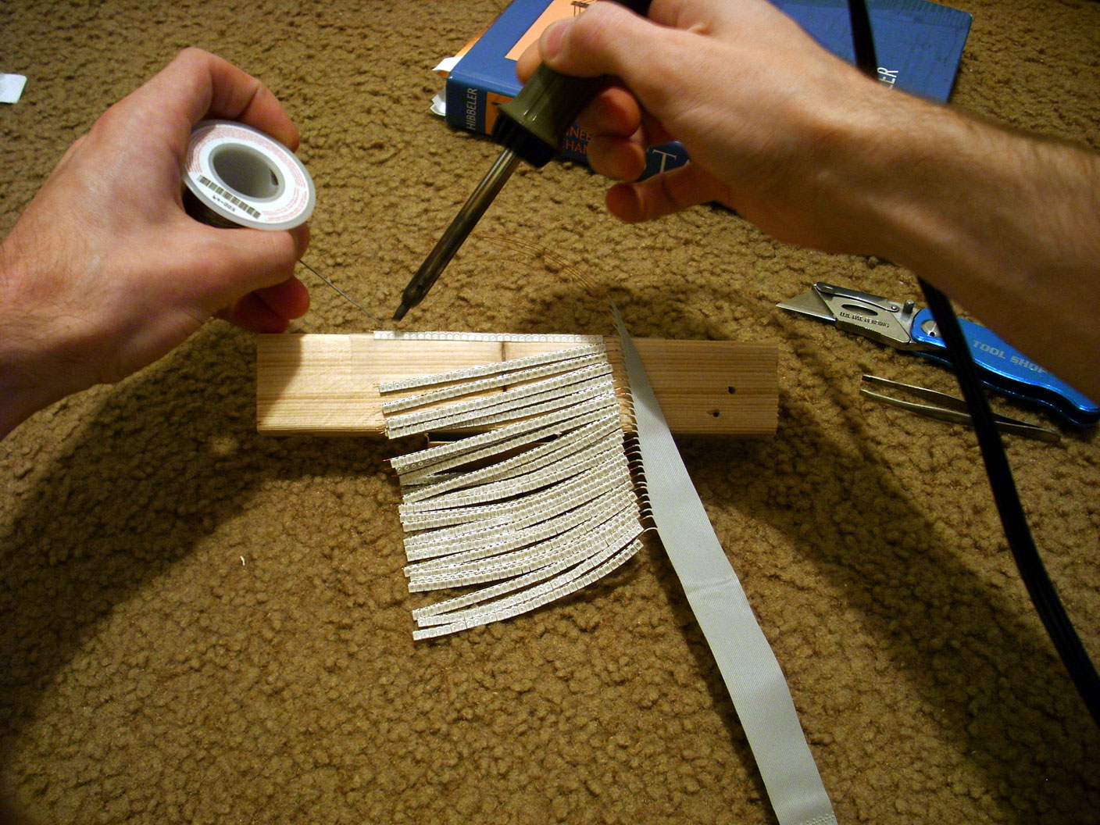
LED Display: Rows

Slide 8
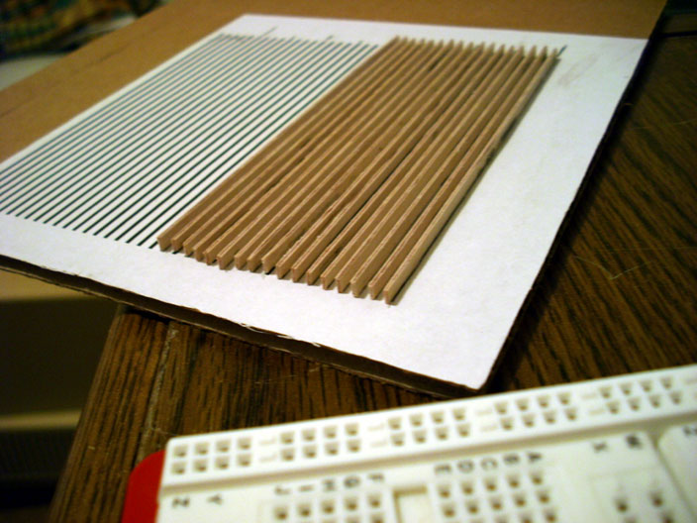
LED Display: Columns

Slide 9
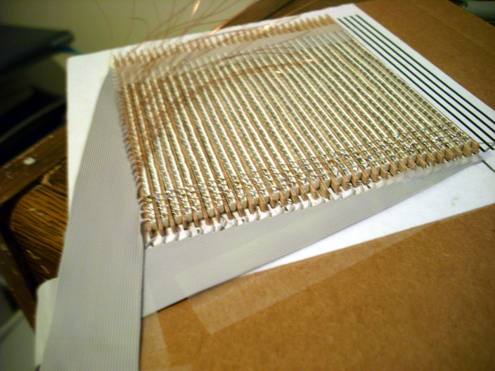
LED Display: Columns

Slide 10
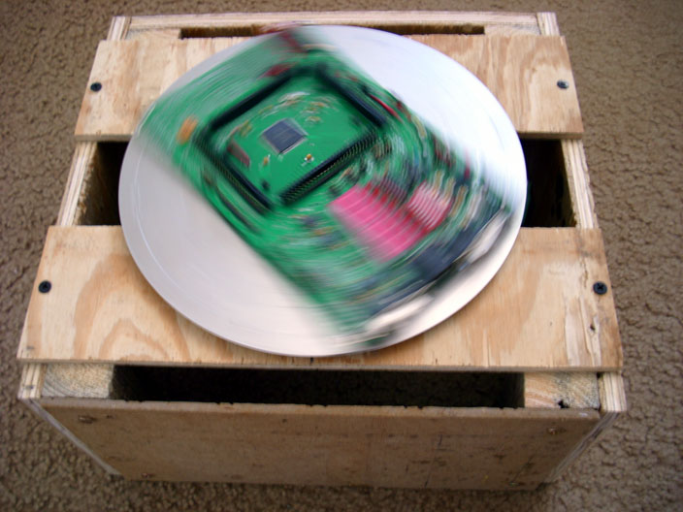
Aluminum Disc
Notes:
This is a picture of the aluminum disc mounted on a wooden box. The Dragon board is mounted on the disc. Between the box and the disc are Lazy Susan bearings, which are perfect for this project.
The disc is from Denise down in the physics shop.

Slide 11
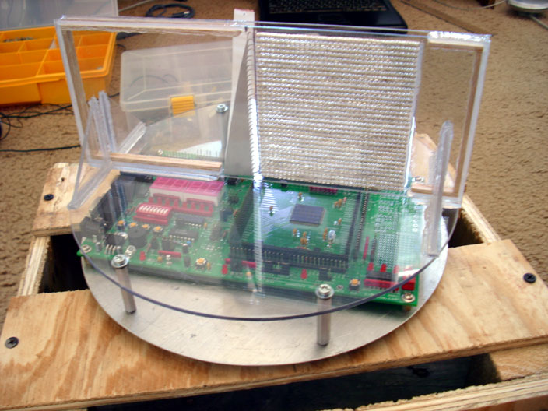
Display Mounted in Lexan
Notes:
Here’s when I mounted the display in plexiglass. As you can see, the project is taking shape at this point, but there are still many things left to do.

Slide 12
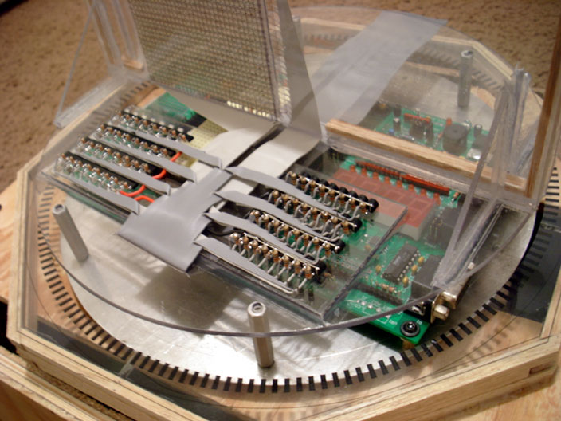
Transistor Banks
Notes:
Transistor banks are required because the microcontroller and the decoder chips are not powerful enough to drive the display on their own. The voltage levels are also too high. Using transistors buffers the display from the digital electronics and also allows me to precisely control the voltage of the LEDs with an adjustable voltage regulator.

Slide 13
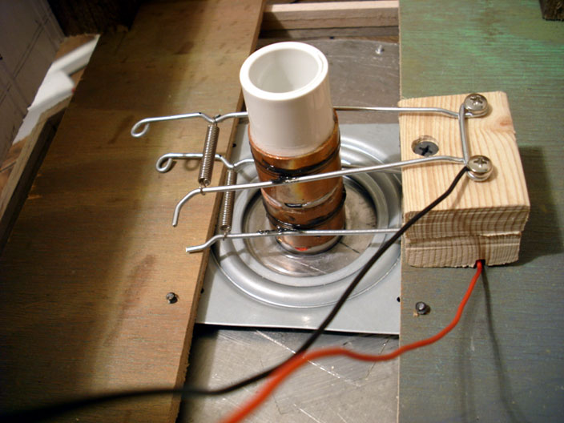
Electrical Contacts
Notes:
• Made of PVC, Copper fittings, galvanized steel wire.
• Used automotive grease.
• Contact voltage is 12V DC and
• Disc has large capacitors and voltage regulators to the stabilize the power.

Slide 14
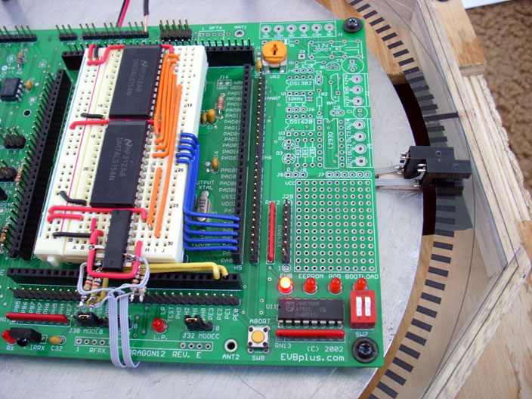
Photo Interrupter
Notes:
An external interrupt is triggered each time a dark line printed on the transparency enters the sensor. This runs an interrupt subroutine that updates the information in a RAM display database that is being refreshed on the LED display. In other words, it triggers the program to calculate the next “slice” of the cylinder.
Notice that there are actually 2 sensors and one extra-long line on the transparency. This establishes the 0-degree home position.

Slide 15
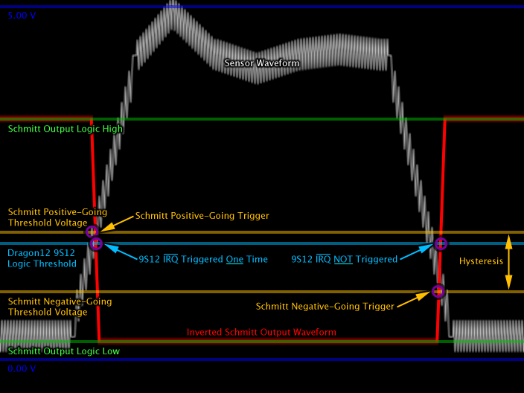
Schmitt Trigger
Notes:
A Schmitt Trigger was necessary because of noise on the sensor. I was receiving multiple interrupts from each trip of the sensor. I scratched my head over this problem for a good while. Then I went and talked to Dr. Carroll and he was just like, “use a Schmitt Trigger”. Needless to say, problem solved.

Slide 16
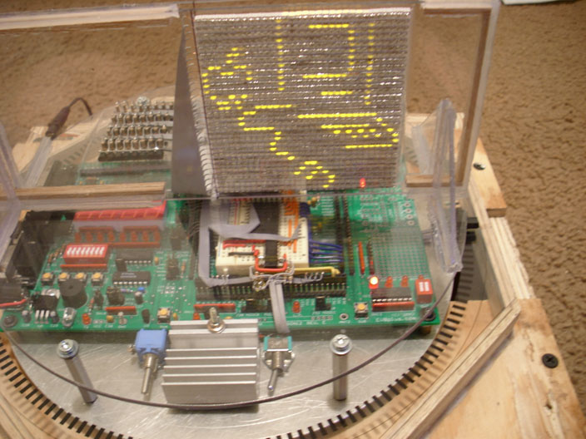
Testing the Display
Notes:
This is right when I got all the electronics done for the display. I made a program that would just display a 32x32 pixel bitmap image on the display. That’s all that it does.
Let’s try it; I still have the binary.

Slide 17
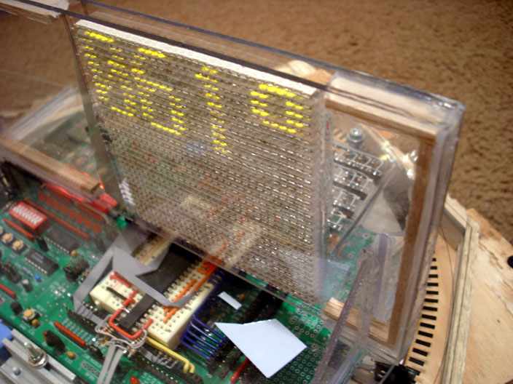
Testing the Angle Sensor
Notes:
Next I wrote a program just to test the angle sensor. It displays the angle of the display on the display in a large font.
Let’s see this one too.

Slide 18
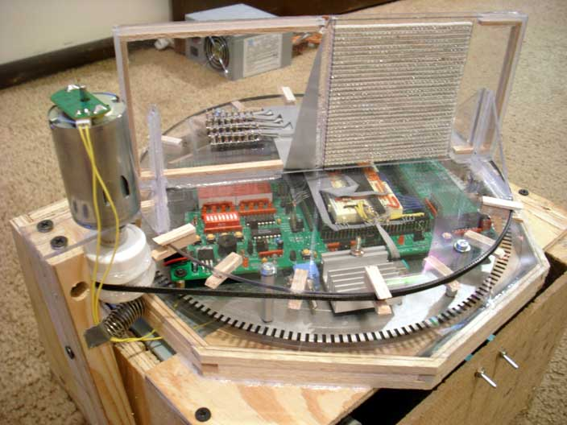
Belt Drive
Notes:
Up until now I had been spinning the display by hand.
This is a pretty rudimentary setup for spinning the display, but it’s a huge improvement because you can take your time and look at the 3D image from any angle.

Slide 19
Animated 3D Demonstration
Buckle up!
Notes:
PRESS B TO TURN SCREEN BLACK.

Slide 20
Mathematics
Define the display as a plane using the normal vector <sin(θ), cos(θ), 0> and point (0,0,0)
Define the line as parametric equations in terms of the start and end points
Set the line and plane equal to each other and solve in Mathematica to get equations for r and z in terms of θ and the endpoints

Slide 21
Equations
Notes:
Start and end points for each line are in cylindrical form, so any time you see a start or end subscript, that’s a reference to an endpoint.
R corresponds to the horizontal axis of the LED display and Z refers to the vertical axis. Theta with no subscript corresponds to the angle that the display is currently at.
You can see a shortcut if you look closely. Both denominators are identical so it is only calculated once in the actual program.

Slide 22
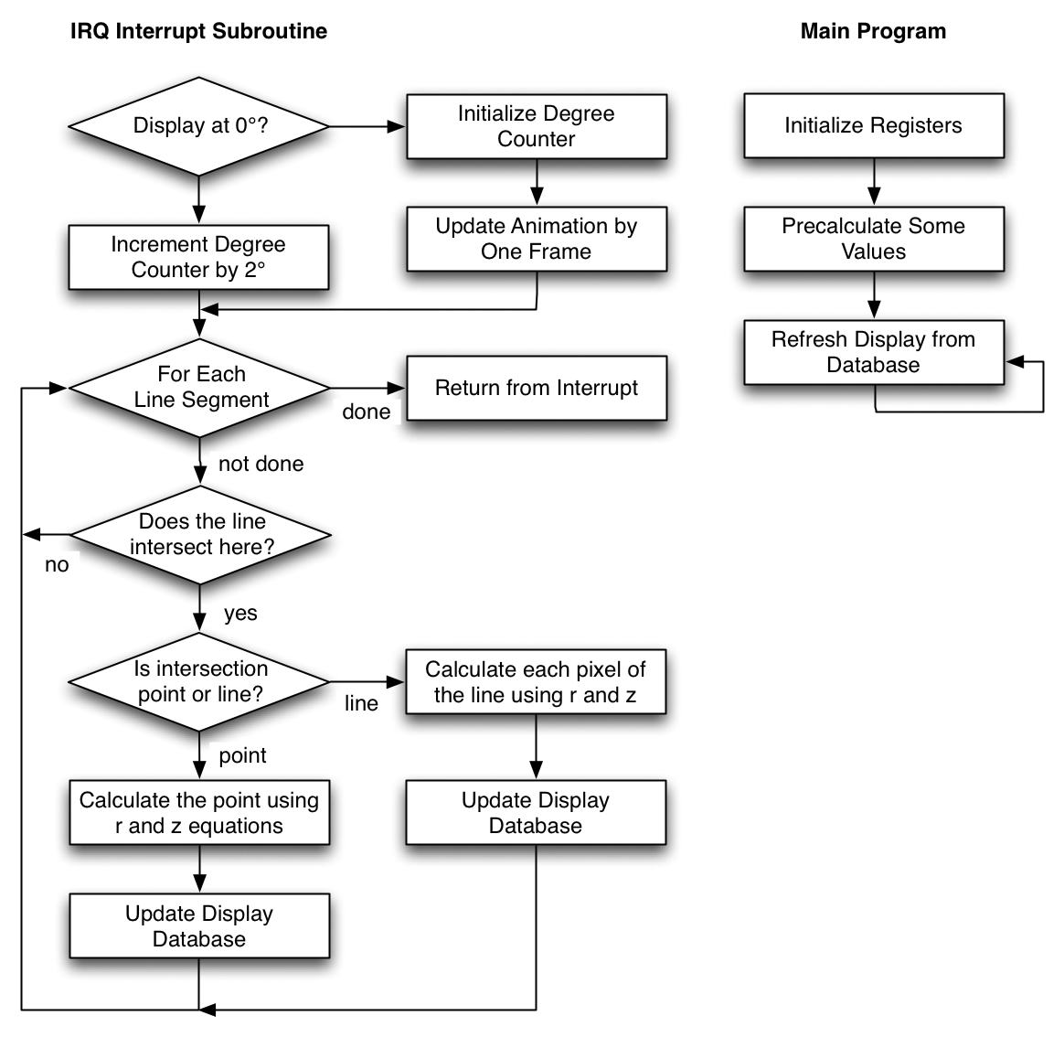
Condensed
Software
Flowchart

Slide 23
Limitations
Physical Danger
Computation Versus RPM
Brightness
Notes:
Physical Danger: You would not want to stick your hand into this display, and that is exactly what little kids or unaware adults would be tempted to do. Some sort of clear protective cover would have to be installed. There is also a risk of parts working loose and flying out of the apparatus.
Computation versus RPM: The higher the RPM, the faster the calculation must be. The display must be recalculated each 2 degrees, during which time the display is left blank. If RPM climbs too high, the computation time will outweigh the display time. At first this will cause the display to get dim. If the calculation takes longer than the available time, the image will lose sync with the optical sensors.
Brightness is also a limitation. The very fact that we’re in the Planetarium so we can dim the lights demonstrates this.

Slide 24
Future Development
This apparatus could be used as a platform for another senior design project!
More robust animation
Bitmap textures and fill
Memory management techniques to dynamically store redundant calculations
Anti-aliasing and rounding
Replace NPN transistor bank

Slide 25
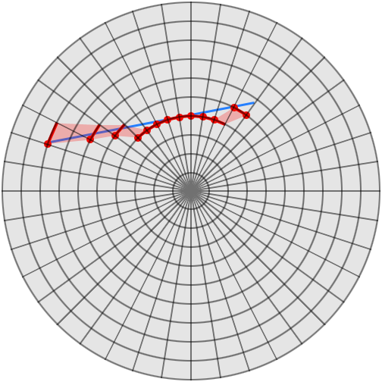
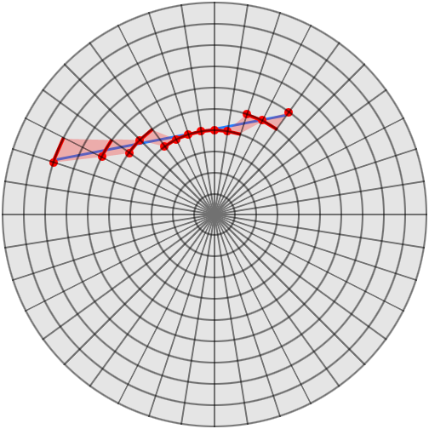
Rounding Errors
No Rounding
Proper Rounding
Notes:
Not rounding causes artifacts.

Slide 26
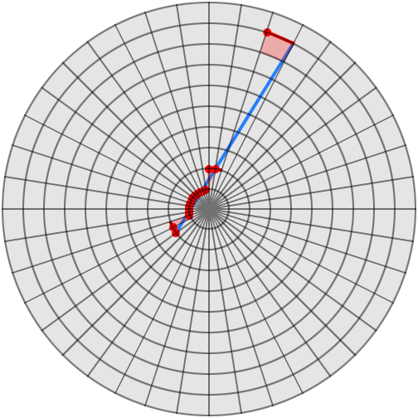
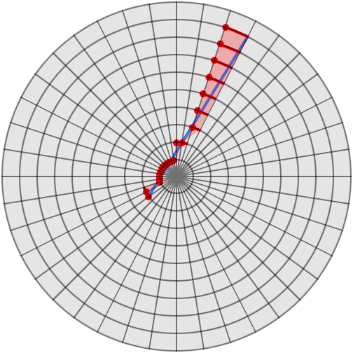
Almost Parallel to Display
Gaps
Gaps Filled In

Slide 27
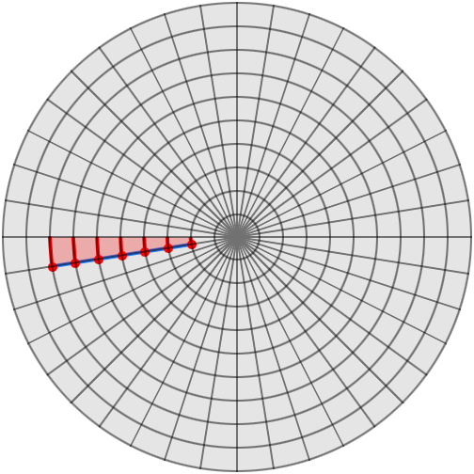
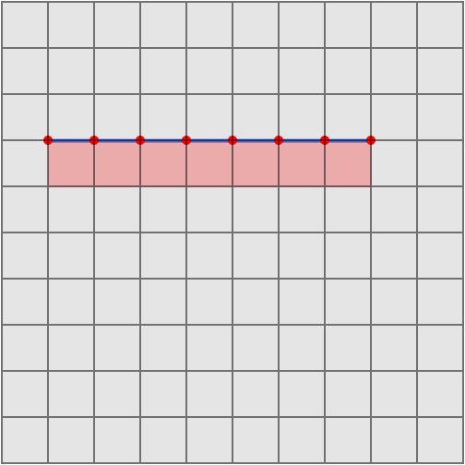
Parallel to Display
Top View
Side View (LED Panel)

Slide 28
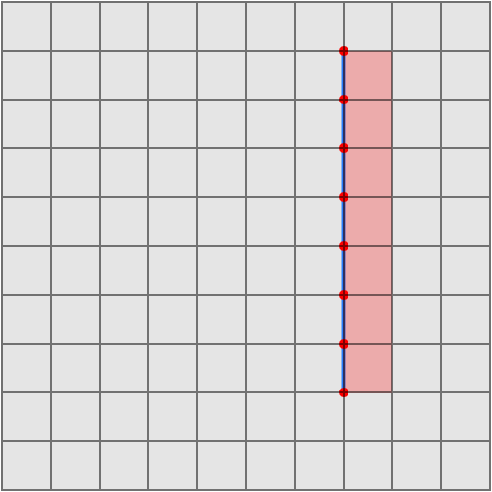
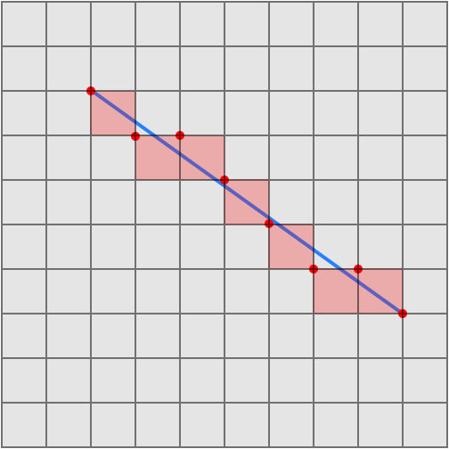
Parallel to Display
Vertical Line Intersection
Diagonal Line Intersection

Slide 29
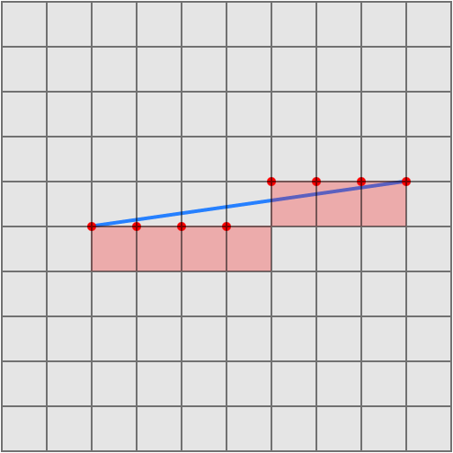
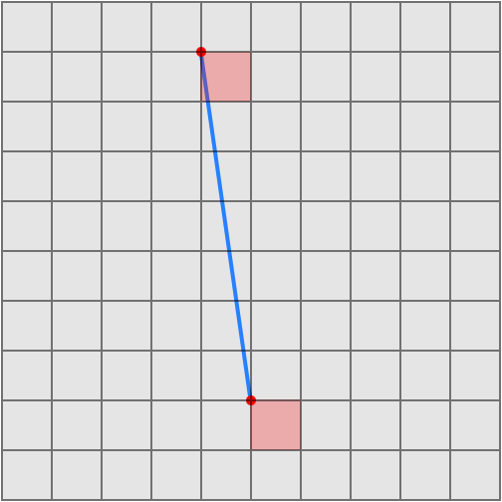
Parallel to Display
Small Slope
Large Slope

Slide 30
Hurdles Along the Way
Getting power onto the moving disc
Having to finish the project myself
Cutting a circle out of plexiglass
Visualizing the 3D geometry
Motorized belt drive
Notes:
These are unexpected things that happened that managed to fix or work around.

Slide 31
Recap
Animated 3D holographic LED display
Very cool that it works
Possibility of being used for another senior design project

Slide 32
Acknowledgements
A special thanks to my project advisor: Dr. Chris Carroll
ECE 1315, 2325
MATH 1297, 3280
Notes:
Dr. Carroll:
Countless tips
Permission to continue alone
Booked the Planetarium

Slide 33
This was a Fun Project!
Thanks for coming.
Please ask questions!
Theta Quadrant

