Slide 1
Performance Analysis of a PDEVS Simulator Supporting Multiple Synchronization Protocols
Ben Cardoen, Stijn Manhaeve, Tim Tuijn
Yentl Van Tendeloo, Kurt Vanmechelen, Hans Vangheluwe, Jan Broeckhove

Slide 2


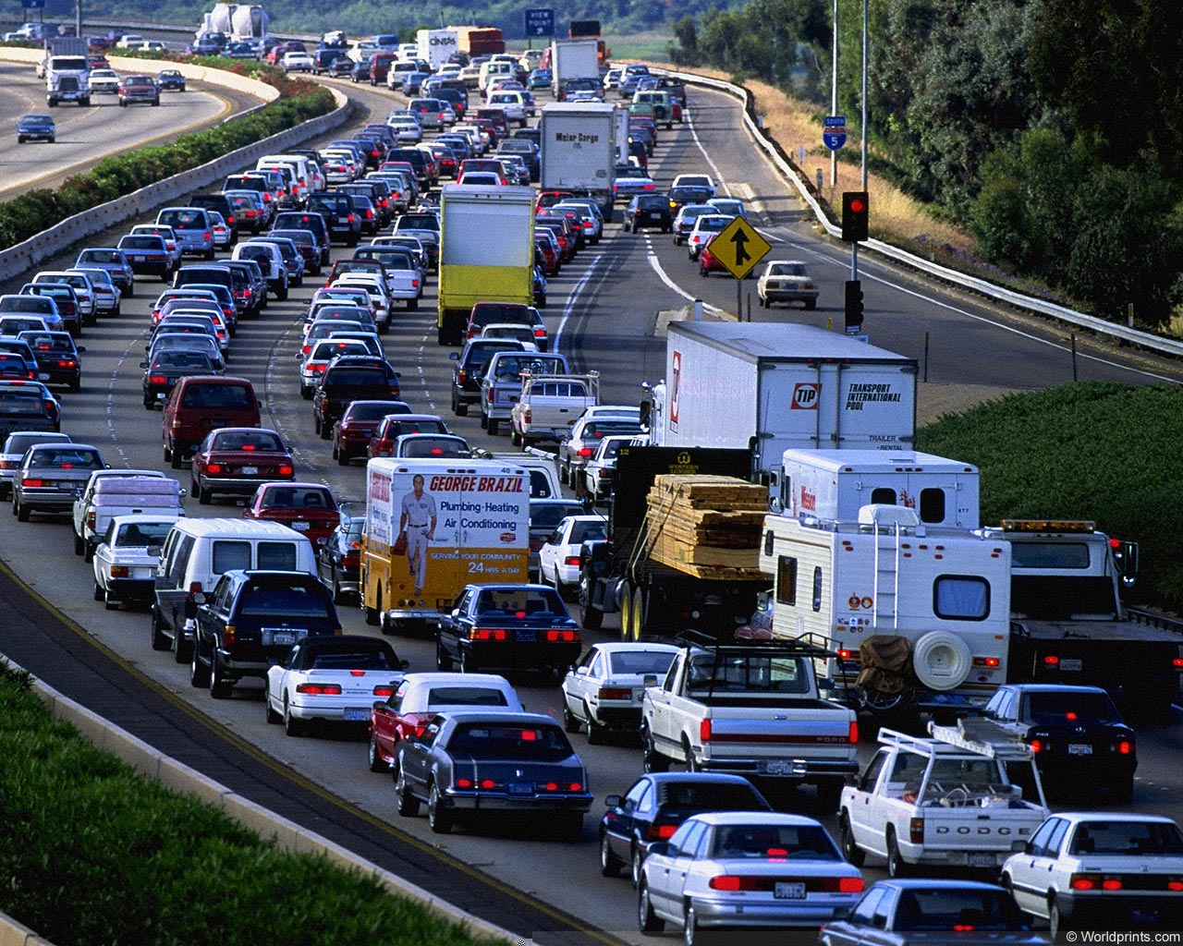

Slide 3
Simulated time
A
B
Wall-clock time

Slide 4
Simulated time @ A
A
B
Wall-clock time

Slide 5
Simulated time @ A
A
B
Wall-clock time

Slide 6
A
B
✓
✗
✓

Slide 7
Sequential
Conservative
Kernel
Optimistic
…

Slide 8
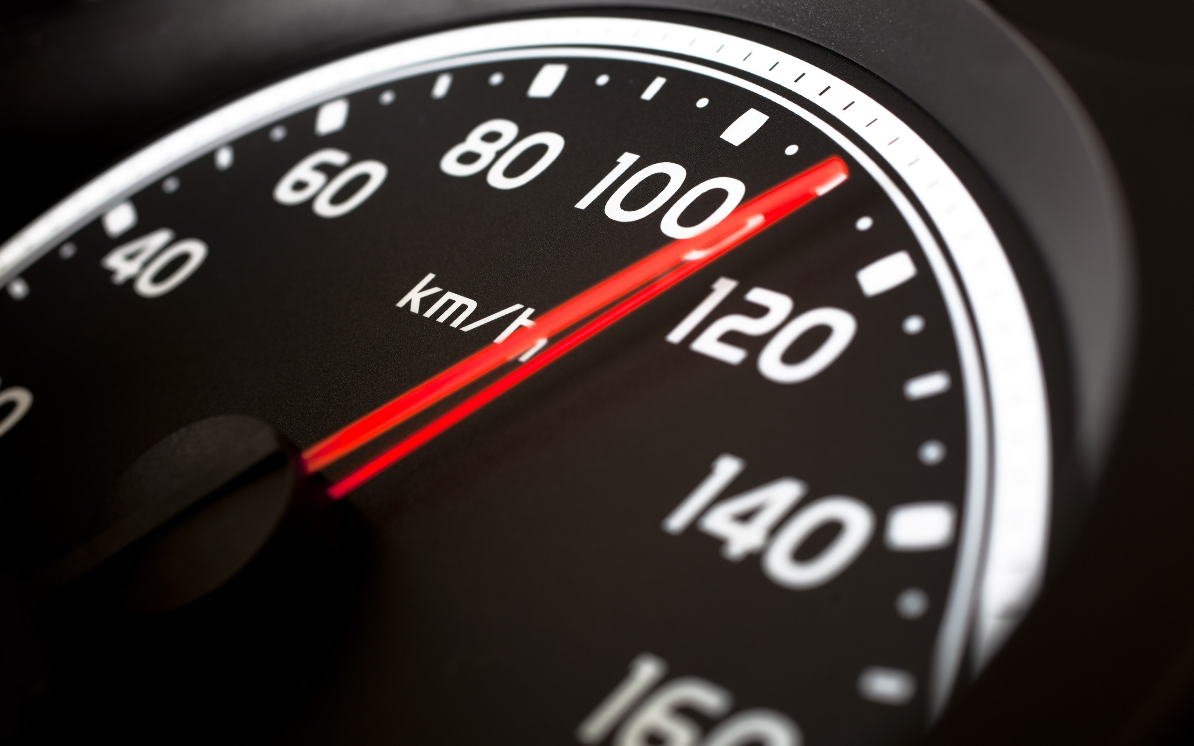

Slide 9
Queue
G
1
2
3
4
Interconnect
PHOLD
1
2
1
2
3
3

Slide 10
1
2
G
1
2
3
4
3

Slide 11
1
2
G
1
2
3
4
3

Slide 12
1
2
3

Slide 13
G
1
2
3
4
1
2
3
1
2
3

Slide 14



