Slide 1
Football Training Camp Performance Analysis
4 Day Simulated GPS Monitoring Study
20 Athletes
Sport Science Portfolio Project
Ben Carney | UA Kinesiology Masters Student

Slide 2
Objective & Dataset Overview
Objective:
Evaluate external workload and physiological responses across a simulated 4-day football training camp using athlete monitoring metrics
Dataset:
20 athletes
4-day training camp (80 total athlete-day observations)
Position groups: Skill (WR/RB), Lineman (RT/LT/G/C), Hybrid (QB/TE/FB)
Metrics: Player Load (AU), Top Speed (mph), % Body Mass Loss (Fluid Loss), Maximum Velocity (mph), High-Speed Running Distance (yards), baseline weight & post practice weight (lbs)

Slide 3
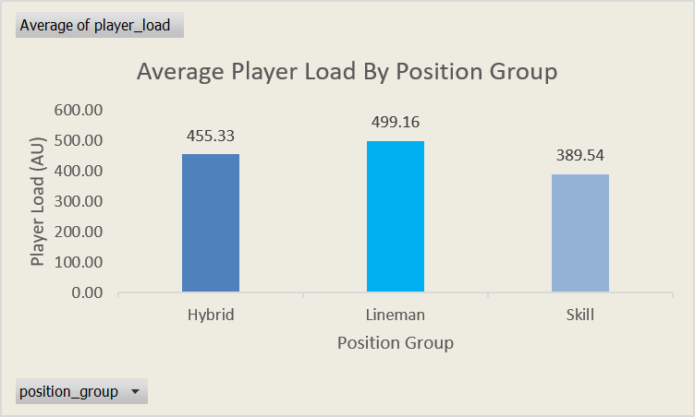
Player Load by Position Group
Linemen recorded the highest average Player Load, indicating the greatest overall mechanical workload
Hybrid athletes demonstrated moderate workload levels relative to other groups
Skill position athletes exhibited lower overall mechanical load

Slide 4
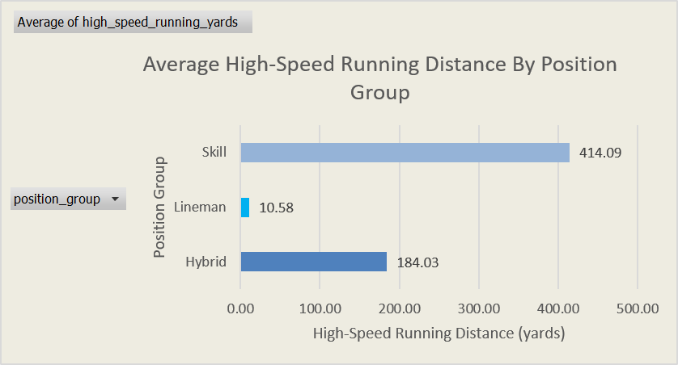
High-Speed Running Distance by Position Group
Skill athletes accumulated the highest High-Speed Running Distance, reflecting greater positional sprint demands
Hybrid athletes demonstrated moderate movement demand during the training camp
Linemen recorded minimal high-speed running exposure due to positional role requirements

Slide 5
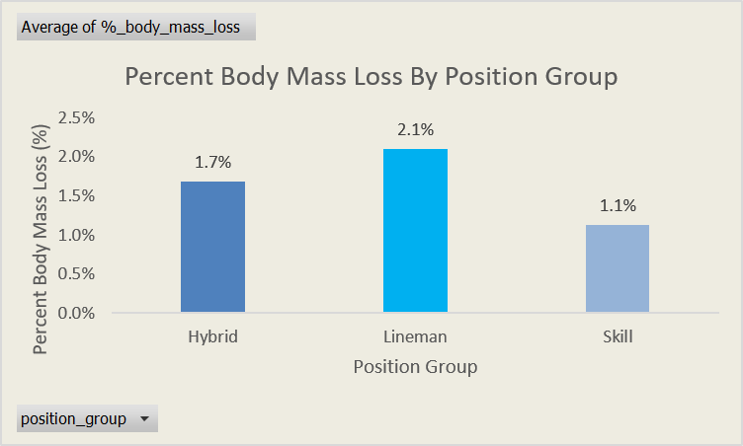
Physiological Response (%Body Mass Loss)
Linemen experienced the highest average Percent Body Mass Loss (2.1%), indicating greater physiological strain compared to other position groups
Skill athletes demonstrated the lowest relative hydration loss across the 4-day training period
Results suggest positional differences in fluid loss due to responses from training load

Slide 6
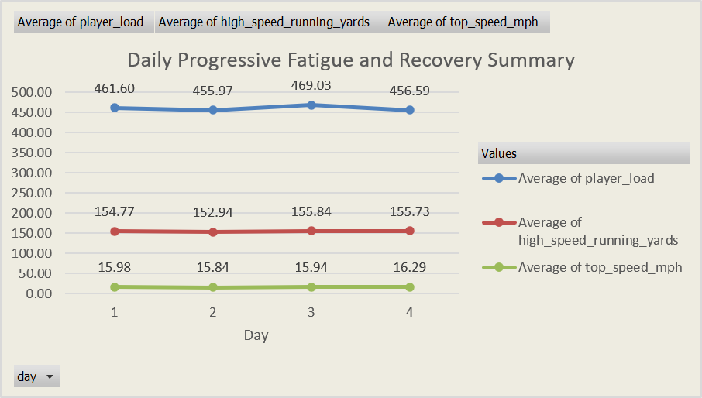
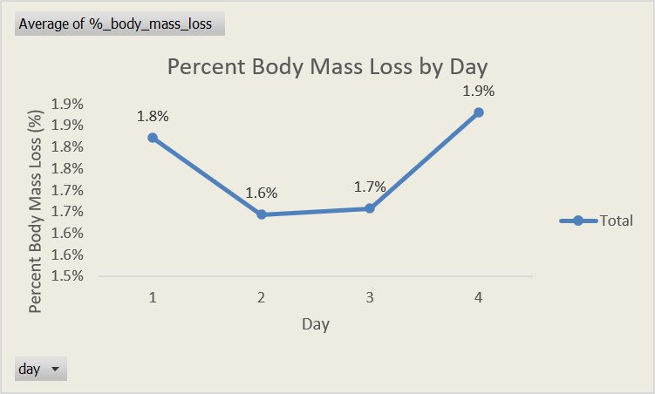
Training Camp Load & Fatigue Trends
Player Load peaked on Day 3 of the training camp
Percent Body Mass Loss increased toward Day 4, suggesting cumulative physiological fatigue
External workload and physiological response peaked on different days, indicating a delayed internal response to training stress

Slide 7
Key Takeaways
Positional demands significantly influence external workload and movement profiles
External load and physiological response do not always align temporally across a training microcycle
Monitoring multiple performance metrics provides a more complete understanding of athlete stress and fatigue
Simulated GPS data effectively replicates real-world athlete monitoring workflows for analysis purposes

