Slide 1
Network Presentation
BenNo Ltd.

Slide 2
Introduction
This network is designed to solve BalancePro accounting company's struggles with workplace expansion.
We, the BenNo Ltd. were contacted to make a template and build up the expanded offices' and renew the existing office's network.
Notes:
Antal Bence

Slide 3
Teamwork
Antal Bence
Project manager (PM)
Network actualization
Documentation and Presentation
Network Tester
Batári Noel
Network actualization
Documentation
Video
Notes:
Antal Bence

Slide 4
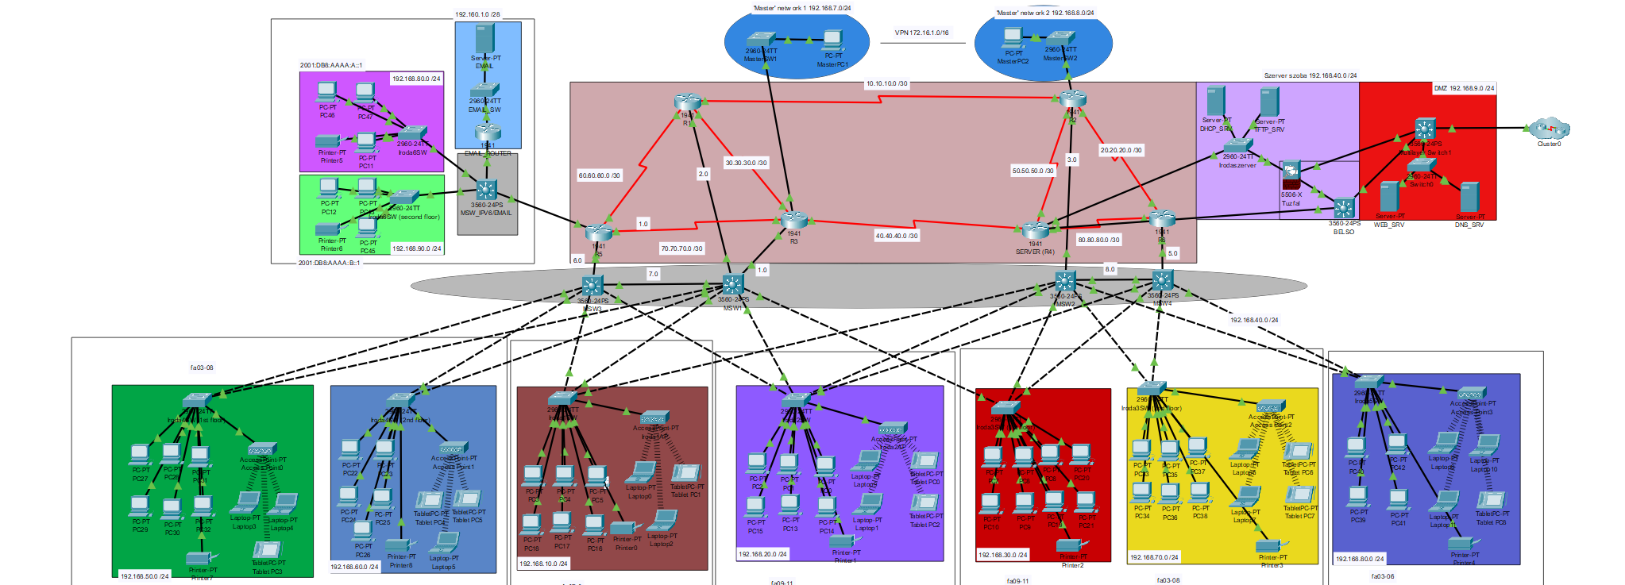
Network structure
Complex topology:
Star topology
Tree topology
Hierarchical topology
Notes:
Antal Bence

Slide 5
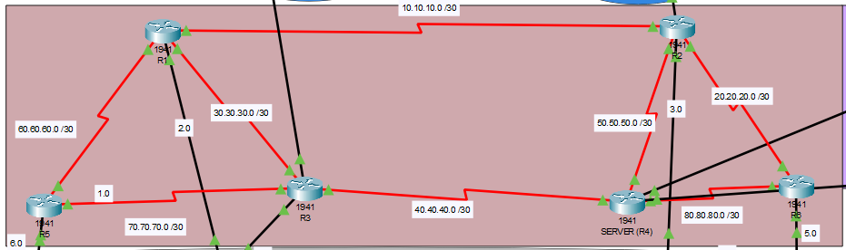
Routers
OSPF
Static NAT
VPN
ACL
Daily message
Privileged password
TFTP backup
SSH
Notes:
Antal Bence

Slide 6
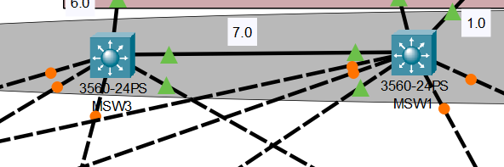
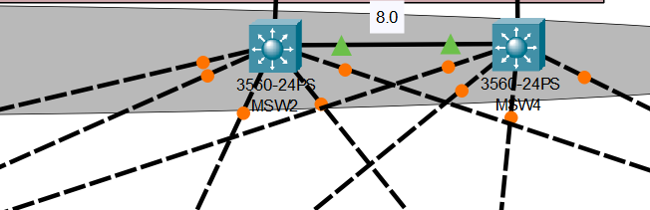
Multilayer switches
OSPF
VLAN
Privileged passwords
Daily message
Hostname
TFTP backup
SSH
Notes:
Batári Noel

Slide 7
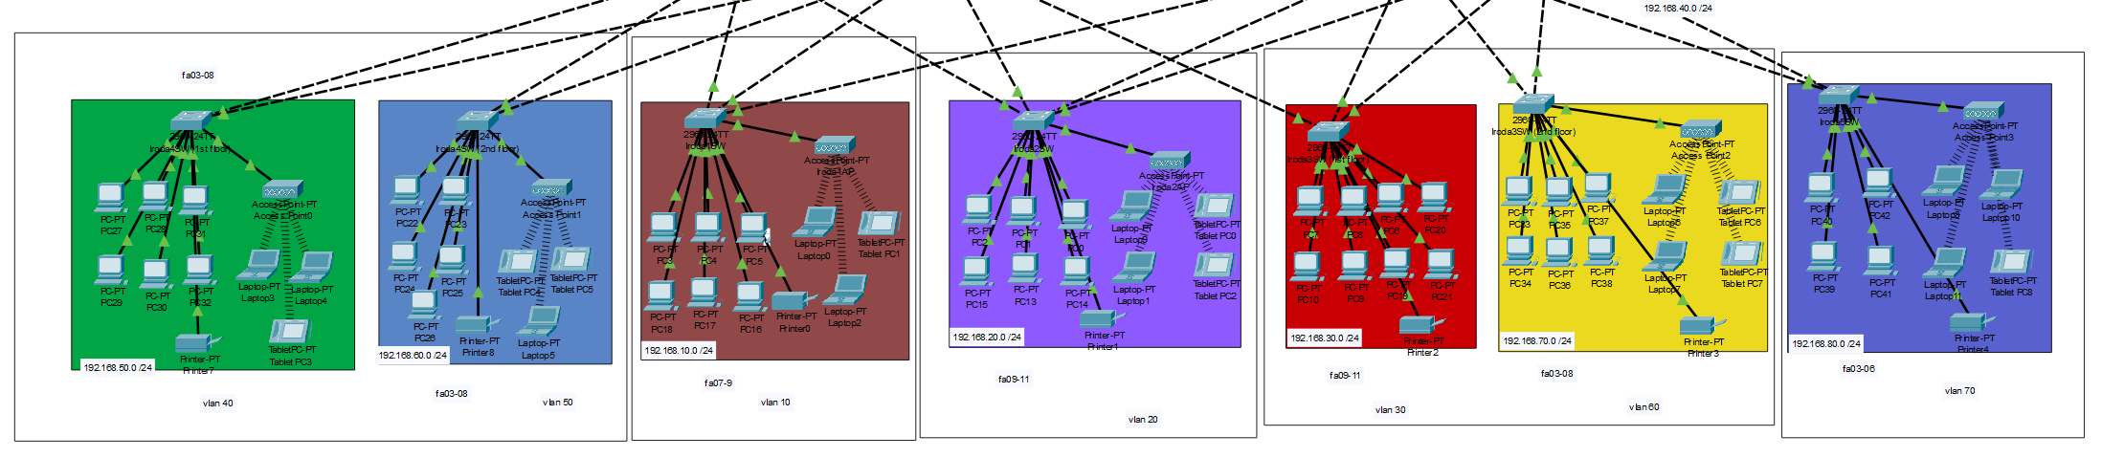
Subnetworks
VLAN
Wireless networking
Privileged passwords
Daily message
Hostname
TFTP backup
SSH
Notes:
Batári Noel

Slide 8
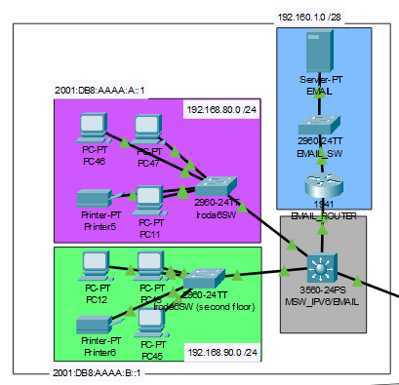
IPV6 address
OSPF
DHCP
E-mail host
Privileged passwords
Dailiy message
hostname
TFTP backup
Dynamic NAT
Notes:
Batári Noel

Slide 9
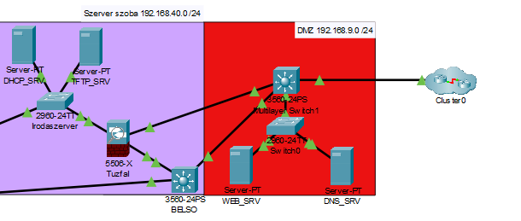
Servers room
DHCP host
TFTP backup host
ACL
Firewall
Webserver host
DNS host
WAN Access
Privileged passwords
Daily message
hostname
TFTP backup
SSH
Notes:
Batári Noel

Slide 10
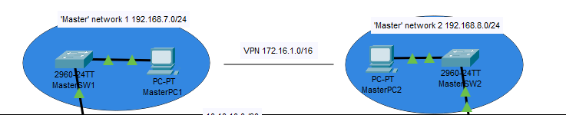
Master network
VPN
ACL
Static routing
Privileged passwords
Daily message
hostname
TFTP backup
SSH
Notes:
Antal Bence

Slide 11
Scrum
The Scrum model has three roles: Product Owner, Scrum Master, and Development Team.
Their collaboration ensures agile efficiency.
Notes:
The Product Owner manages the product, the Scrum Master facilitates processes, and the team develops the product.
Antal Bence

Slide 12
Jira
Jira is a project management and issue-tracking software for agile teams.
It helps with task management, sprint planning, and reporting.
It is widely used for development and business processes.
Notes:
Antal Bence

Slide 13
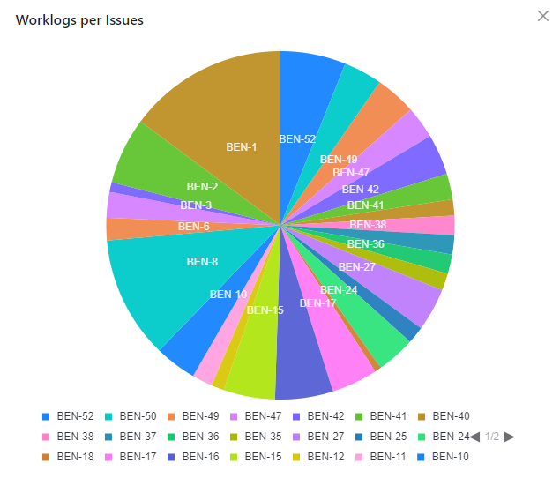
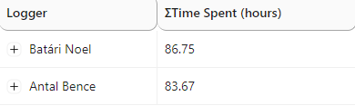
Workflow
Notes:
Antal Bence

Slide 14
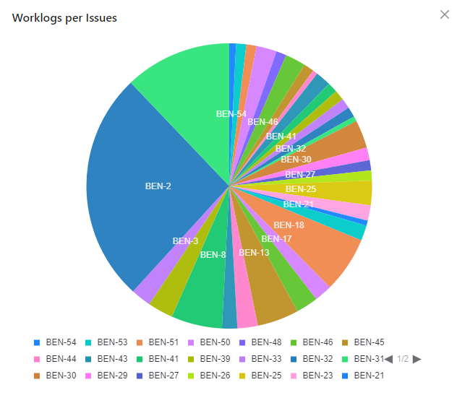
Workflow
Notes:
Batári Noel

Slide 15
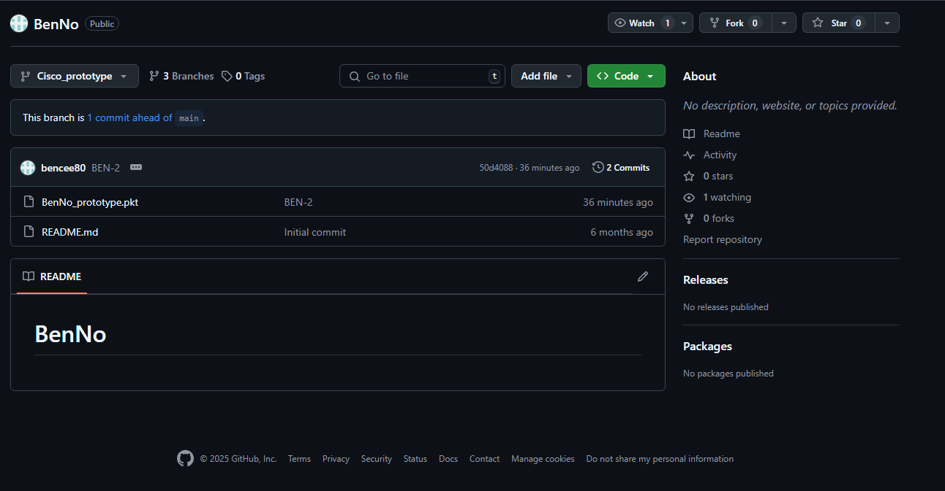
Git
Git is a powerful version control system
It enables branching and merging
Notes:
Batári Noel

Slide 16
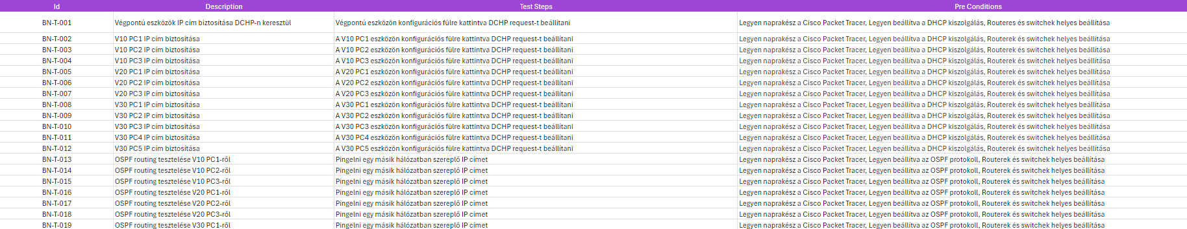
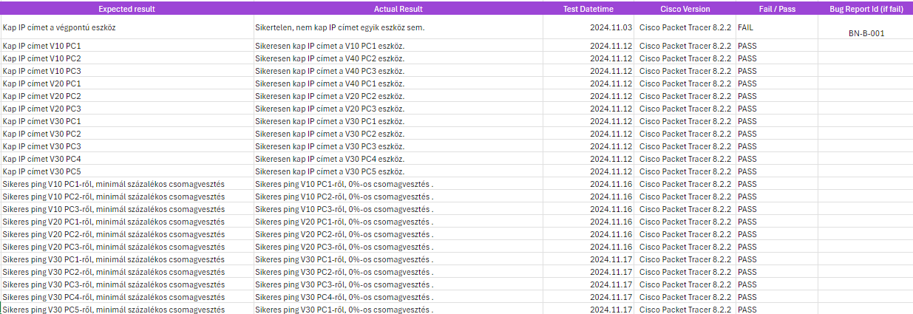
Tests
Notes:
Batári Noel

Slide 17
SWOT
Strenghts
Weaknesses
Time-consuming problem-solving
Insufficient knowledge
Decreasing morale
Low brand awareness
Cordinated teamwork
Common agreement
Productive work
Creativity
Opportunities
Threats
Scalable
New companies/business
Possibility of market expansion
Market gap
Competing companies/business
Weakening need of market
Loss of customers
Supplier issues
Notes:
Batári Noel

Slide 18
Future plans
The network can be improved from multiple aspects, such as:
Firewall and Security
More endpoint devices
Increasing redundancy
Development for the website running on the web server
Server expansion (e.g., email server)
Expansion of admin networks
Notes:
Batári Noel, Antal Bence

Slide 19
Thanks for the attention
You may ask any questions related to our project.
Made by:
Antal Bence
Batári Noel

