Slide 1
Team GeoUnity
GeoAttendance
Bence Danko, Da Thao Trinh (Lead)
Github URL: https://github.com/bencejdanko/GeoAttendance

Slide 2
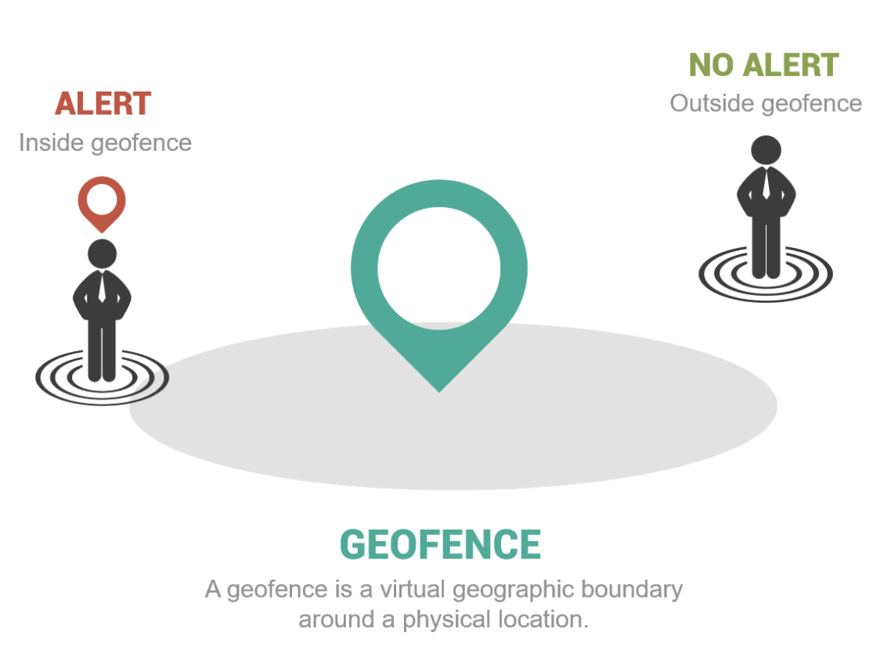
Project Description
GEO: short for geography or location.
FENCE: is usually a boundary line such as between you and your neighbor.
GeoAttendance leverages geofencing technology to enhance the accuracy and convenience of attendance tracking.

Slide 3
Project Description
Users within boundaries will be able to check-in
Upon checking-in, the users will receive an email which confirms their attendance status
Real-time updates on attendance and historical attendance

Slide 4
Job Assignments
Task | Member
APIs | Bence
Backend | Bence
UI/UX | Da Thao
Frontend | Da Thao
Setting up development environments & Testing | Bence & Da Thao

Slide 5
Milestones
Milestone 1 (2/5 - 2/16): Initialize technology frontend, backend development environments.
Milestone 2 (2/12 - 2/23): Build User API, UI for Login and Registration Forms.
Milestone 3 (2/26 - 3/8): Implement Geolib library, UI for Attendance Check-ins & Testing.
Milestone 4 (3/11 - 3/22): Implement Attendance API & Testing.
Milestone 5 (3/25 - 4/5): Complete prototype & Testing.
Milestone 6 (4/8 - 4/16): Deployment.
(Stretch) Milestone 7 (4/17 - End of semester): Integrate Facial Recognition Technology.

Slide 6
Frontend/Backend
Technologies Used
[Frontend] HTML, CSS, React, JavaScript
[Backend] Nodejs, PostgreSQL
Nodejs (Express)
PostgreSQL
User
WebPack (React)

Slide 7
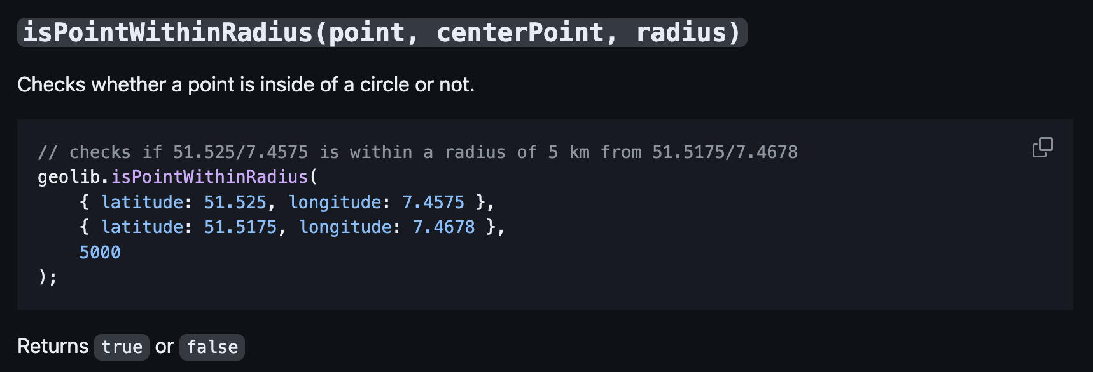
Algorithms/AI Schemes
GeoLib Library (https://github.com/manuelbieh/geolib)
Correctness: tested with various inputs, including points inside and outside the circle, as well as edge cases such as at the center of the circle or when the inputs are undefined.
Also handle negative coordinates and non-integer values.

Slide 8
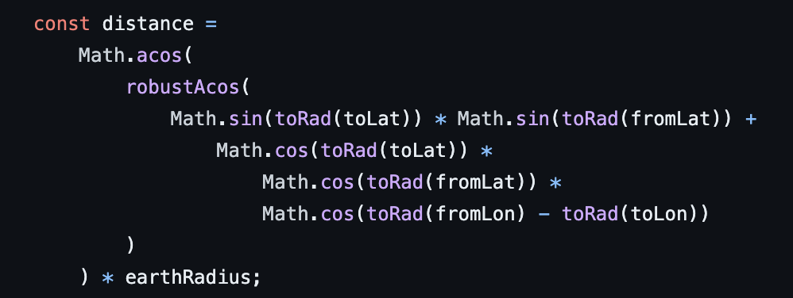
Algorithms/AI Schemes
GeoLib Library (https://github.com/manuelbieh/geolib)
Complexity: O(1) - Haversine formula - Basic arithmetic operations.

Slide 9
Algorithms/AI Schemes
Possible Additional Algorithms (Stretch):
Use facial recognition technology to improve the accuracy of the attendance tracking process
Historical attendance data
Calculate simple trends in attendance
Identify outlier students

Slide 10
Market Space
Streamlines attendance tracking for professors and other hosts
Allows attendees to easily find meeting spots through their phone, without the hassle of going through manual instructions
Host can update events, or modify sign-ups – All attendees simultaneously track any changes or updates immediately

