Slide 1
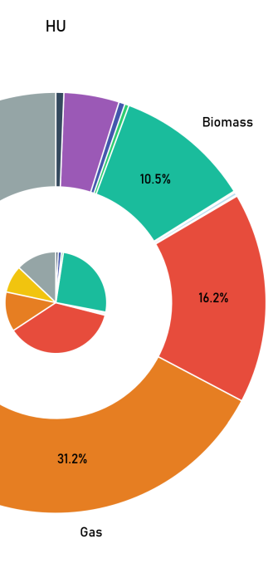
The outer circle shows the composition of consumption with each wedge representing a different energy source
The inner circle shows the composition of energy production in a country, its radius shows how much of the consumption local production can supply, more the inner circle fills the inside of the donut more the local production can cover

