Slide 1
EVOLUTION OF INFORMATION TECHNOLOGY

Slide 2
BEFORE WE START
Information Technology ⬄ IT
IT is huge – a few of the larger branches right now:
Software Development
Big Data
AI
Cybersecurity
DevOps/IT Automation
Corporate IT

Slide 3

MEET OUR SOFTWARE ENGINEER
Name: Alex
Born: 1968
Degree: Computer Science
Graduated: 1990

Slide 4
SOFTWARE ENGINEERING IN THE 1990’S

Slide 5
THE INTERNET
Connect to the internet by dial-up - Dialing up
Internet speed
14.4 kbps (1993) -> Downloading 1GB of data takes ~7 days
56 kbps (1998) -> Downloading 1GB of data takes ~1.5 days
No significant adoption
~2.5 million users (~0.05% world population)

Slide 6
WHAT’S CHANGED
1990 Windows 3.0 Photoshop
1991 Linux kernel
1993 Mosaic
1995 Java 1.0 Windows 95
1998 iMac G3
1999 WiFi in homes
Info from: Computer history

Slide 7
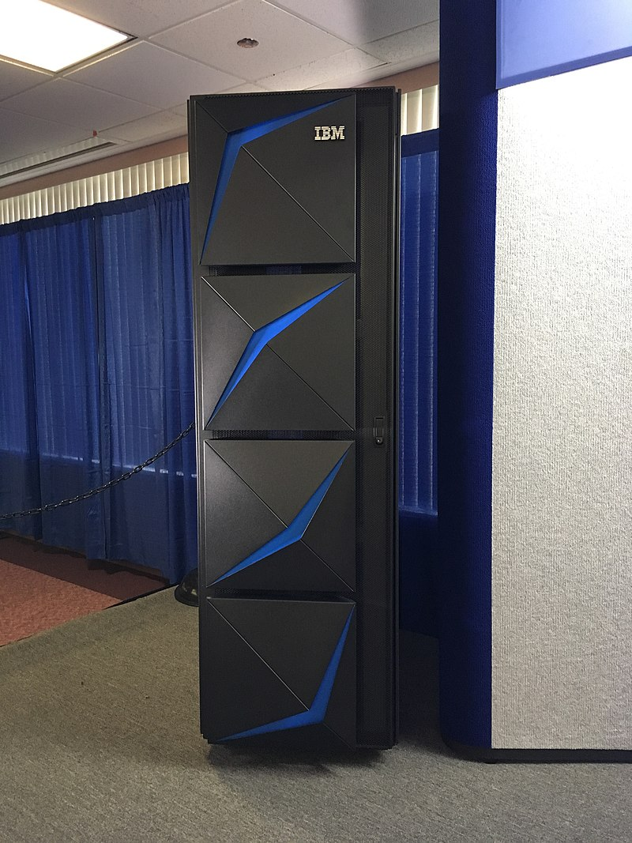
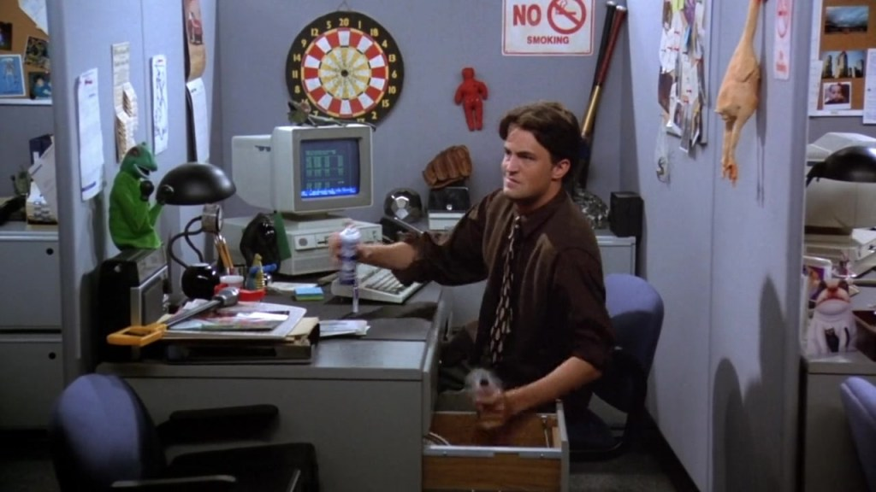
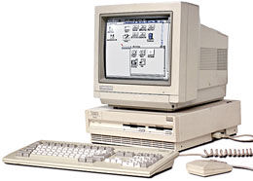
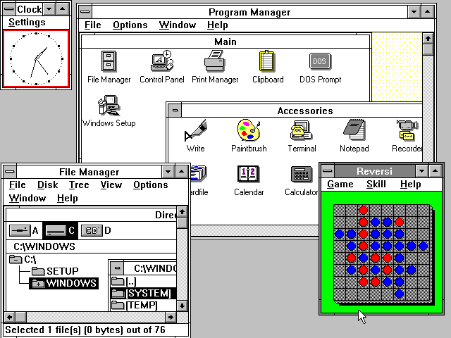
ALEX’S FIRST JOB
Computer: Amiga 3000
Operating System: Windows 3.0
Infrastructure: Mainframe computer
Nature of work: Corporate IT, eg automated reporting
Programming languages: FORTRAN, COBOL
Working practice: ‘Waterfall’
Deployment frequency: 1-3 months

Slide 8
SOFTWARE ENGINEERING IN THE 2000’S

Slide 9
THE INTERNET
Broadband has arrived!
Internet speed
25mbps -> Downloading 1GB of data takes ~6 minutes
Broadband increasing adoption
~304 million users (~5.8% world population)

Slide 10
WHAT’S CHANGED
2000 First camera phone USB flash drives
2001 Xbox iTunes
2003 MySpace founded
2006 AWS launched Nintendo Wii
2007 First iPhone
2008 MacBook Air
2009 Minecraft Bitcoin
Info from: Computer history

Slide 11
THE CLOUD
TODO

Slide 12

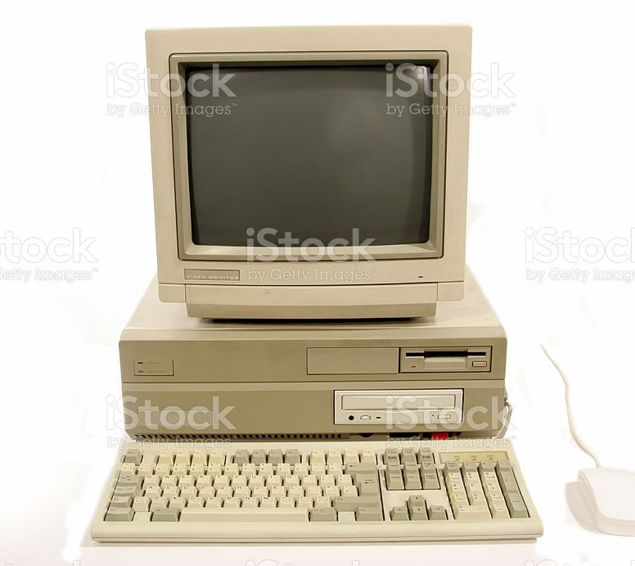
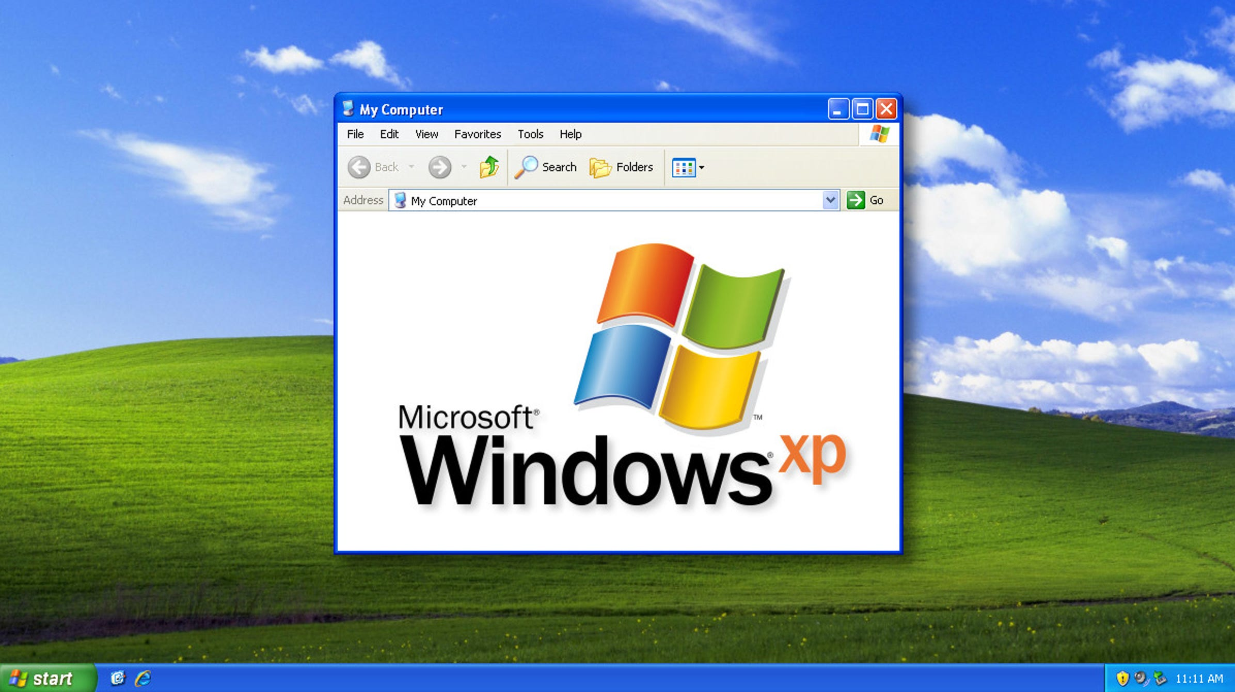
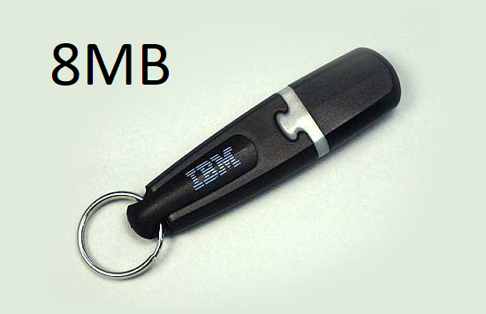
ALEX’S SECOND JOB
Computer:
Operating System: Windows XP
Infrastructure:
Nature of work: Web developer
Programming languages:
Working practice: SCRUM
Deployment frequency: Weekly

Slide 13
SOFTWARE ENGINEERING IN THE 2010’S

Slide 14
THE INTERNET
Broadband is becoming more available as infrastructure is built out
Internet speed
100mbps -> Downloading 1GB of data takes ~1.5 minutes
Adoption continues to increase
~2 billion users (~28.7% world population)

Slide 15
WHAT’S CHANGED
2010 iPad released
2011 Steve Jobs passes
2013 PlayStation 4
2014 Apple Pay
2015 Apple Watch
2016 Amazon delivery drones SpaceX vertical landing
2018 Bitcoin crashes
Info from: Computer history

Slide 16
BIG DATA
TODO

Slide 17
ALEX’S THIRD JOB
Computer:
Operating System:
Infrastructure: Cloud
Nature of work:
Programming languages:
Working practice:
Deployment frequency: Daily

Slide 18
SOFTWARE ENGINEERING IN THE 2020’s

Slide 19
THE INTERNET
5G released, internet is everywhere
Internet speed
1000mbps -> Downloading 1GB of data takes ~9 seconds
Widely adopted
~4.8 billion users (~62% world population)

Slide 20

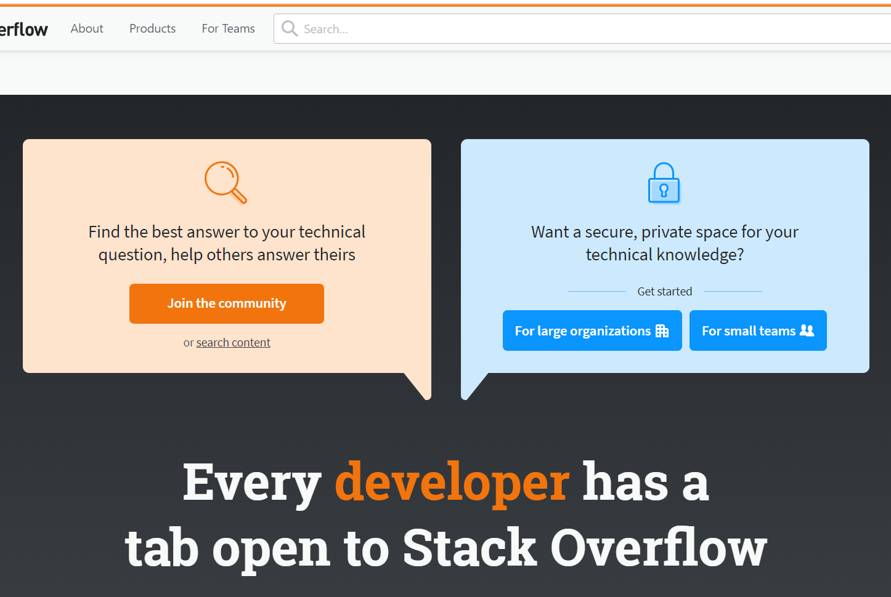

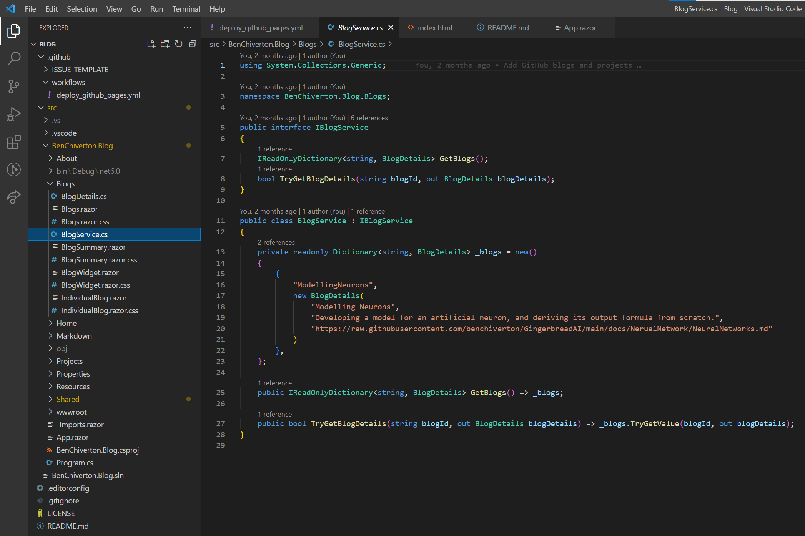

ALEX’S FOURTH JOB
Computer: MacBook pro
Operating System: MacOS
Infrastructure: Multi-region cloud
Nature of work: Big data & AI
Programming languages: Python,
Working practice: Scaled Agile
Deployment frequency: multiple times per day

Slide 21
SUMMARY OF CHANGE

Slide 22
INTERNET TIMELINE
1990 56kbps dial-up
2000 25mbps broadband
2010 100mbps broadband
2020 1000mbps 5G

Slide 23
INTERNET GROWTH
DATE | # USERS | % WORLD
2000 | 304M | 5.8%
2005 | 888M | 13.9%
2010 | 1,966M | 28.7%
2015 | 3,270M | 45.0%
2020 | 4,833M | 62.0%
Data: Internet world stats

Slide 24
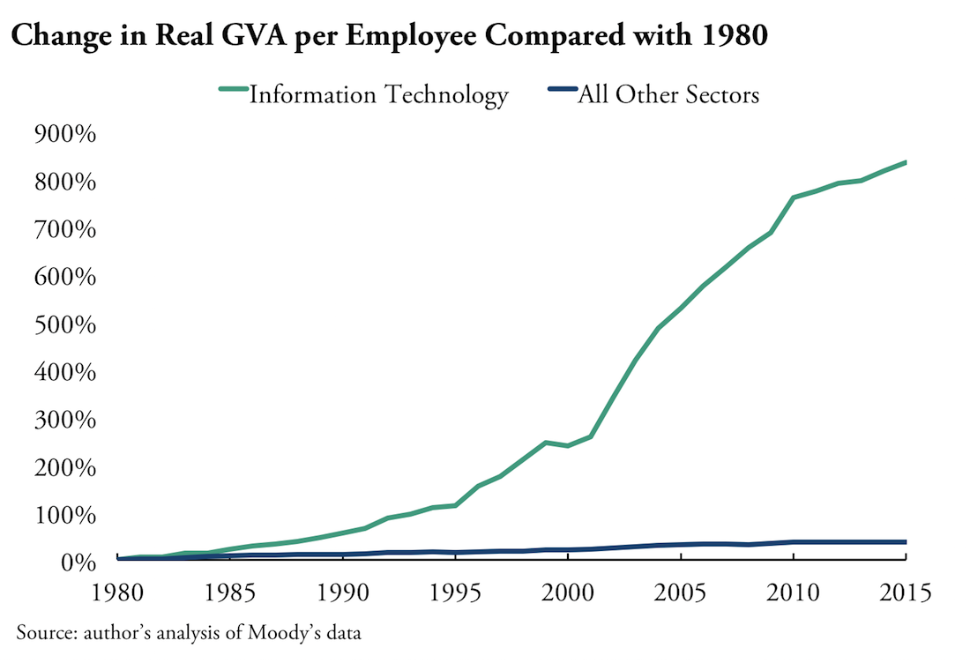
INDUSTRY GROWTH
GVA = Gross Value Added
GVA = GDP + (subsidies of products) – (taxes on products)
Good measure of economic growth and wellfare
Graph: Ian Hathaway - How Big is the Tech Sector?

Slide 25
MODERN SOFTWARE ENGINEERING

Slide 26
End user
🔒 Compliance team
Network team
Frontend applications
EXAMPLE:
Data processing with AI
Frontend team
Cloud platform
Backend applications
Machine learning team
Backend team
ML team
Application databases
Data warehouse
DBA team
Data team
Platform team

Slide 27
EXAMPLE ENGINEERING TEAM
Product owner
Prioritise work
Business analyst
1/team
Analyse requirements
Design/build applications
1/team
Software engineers
3/team
Test engineers
2/team
Test applications
DBA
1/team
Design databases
IT project manager
1/team
Team oversight and reporting
One is the team lead

Slide 28
WHAT’S NEXT?

Slide 29
EMERGING TECHNOLOGY
TODO

