Slide 1
EVOLUTION OF INFORMATION TECHNOLOGY

Slide 2
BEFORE WE START
Information Technology ⬄ IT
IT is huge – a few of the larger branches right now:
Software Development
Big Data
AI
Cybersecurity
DevOps/IT Automation
Corporate IT

Slide 3
THE INTERNET

Slide 4
INTERNET TIMELINE
1990 56kbps dial-up
2000 25mbps broadband
2010 100mbps broadband
2020 1000mbps 5G

Slide 5
INTERNET GROWTH
DATE | # USERS | % WORLD
2000 | 304M | 5.8%
2005 | 888M | 13.9%
2010 | 1,966M | 28.7%
2015 | 3,270M | 45.0%
2020 | 4,833M | 62.0%
Data: Internet world stats

Slide 6
THE INDUSTRY

Slide 7
2000’s
2000 First camera phone USB flash drives
2001 Xbox iTunes
2003 MySpace founded
2006 AWS launched Nintendo Wii
2007 First iPhone
2008 MacBook Air
2009 Minecraft Bitcoin
Info from: Computer history

Slide 8
2010’s
2010 iPad released
2011 Steve Jobs passes
2013 PlayStation 4
2014 Apple Pay
2015 Apple Watch
2016 Amazon delivery drones SpaceX vertical landing
2018 Bitcoin crashes
Info from: Computer history

Slide 9
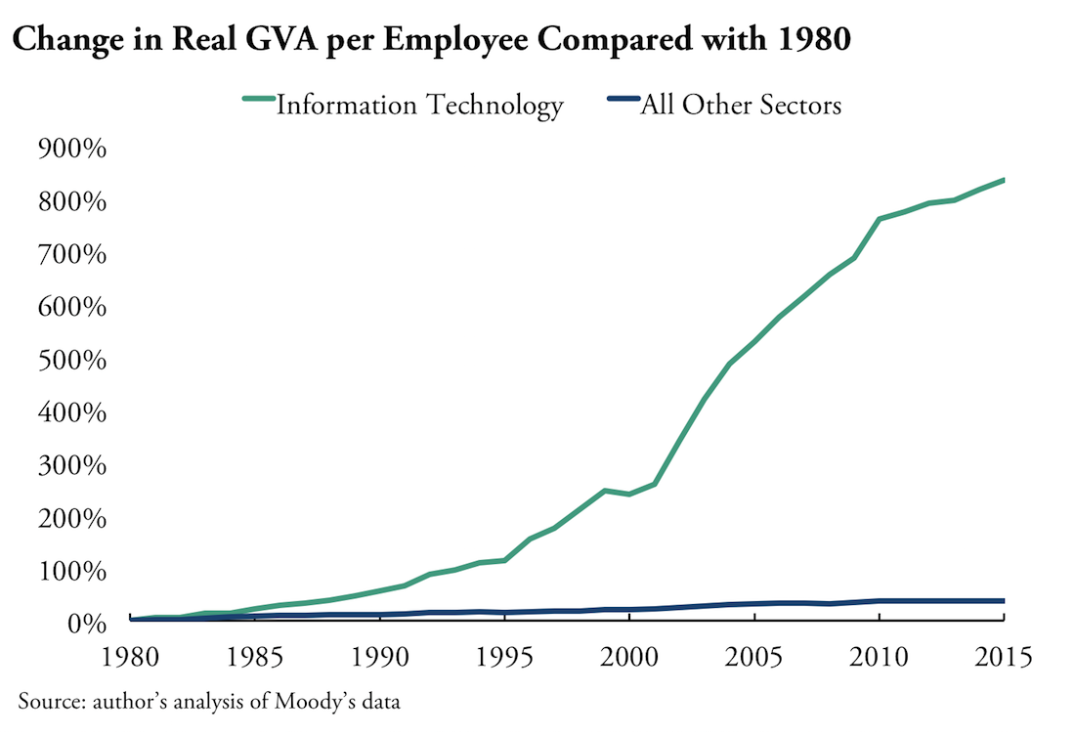
INDUSTRY GROWTH
GVA = Gross Value Added
GVA = GDP + (subsidies of products) – (taxes on products)
Good measure of economic growth and wellfare
Graph: Ian Hathaway - How Big is the Tech Sector?

Slide 10
SOFTWARE ENGINEERING

Slide 11


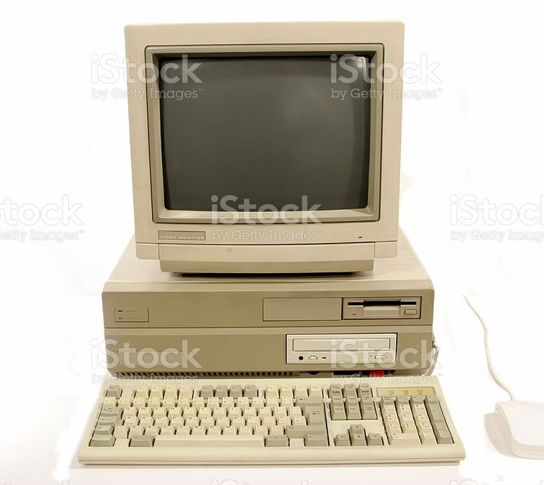
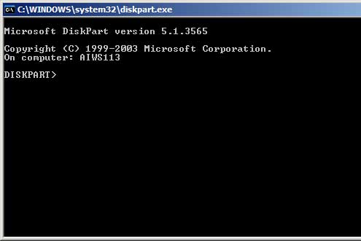

2000
Windows XP
Apps hosted on servers (often in a room in your office)
Books on how to write code – no Google!
Slow, less available internet
Storing data is difficult and expensive
Compute is expensive

Slide 12



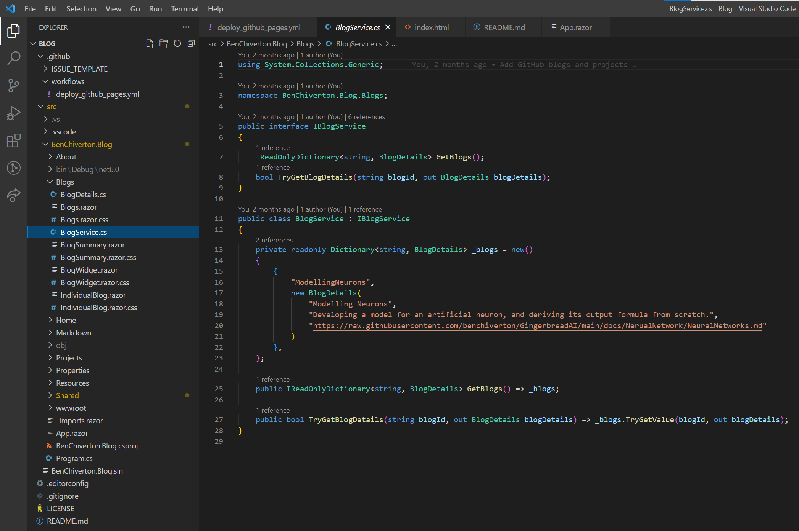

2020
Cross-platform development
Apps hosted in the cloud (can be in different continents)
Google everything you need to know
Fast, highly available internet (streaming, 5G)
Storing data is easy and cheap (big data)
Compute is cheap (AI)

Slide 13
End user
🔒 Compliance team
Network team
Frontend applications
Frontend team
Cloud platform
Backend applications
Machine learning team
Backend team
ML team
Application databases
Data warehouse
DBA team
Data team
Platform team

Slide 14
EXAMPLE ENGINEERING TEAM
Product owner
Prioritise work
Business analyst
1/team
Analyse requirements
Design/build applications
1/team
Software engineers
3/team
Test engineers
2/team
Test applications
DBA
1/team
Design databases
IT project manager
1/team
Team oversight and reporting

Slide 15
‘GOOD’ SOFTWARE ENGINEERS
Understand the ‘full stack’
TODO

Slide 16
WHAT’S COMING?

Slide 17
EMERGING TECHNOLOGY
TODO

