Slide 1
In this ppt all figures describe the droplet motion affected by radiation, drag and gravity force.

Slide 2
Investigate how power on and off affect droplet
This experiment compare the cases: 1. power always on (left figure); 2. power off between t = 0.15 and t = 0.16(right figure).
Paramerters: no_of_rays = 400;
Lase power: 200mW
Beam sigma: 10 E-6
Beam radius: 40 um
Air pressure: 101325Pa (const)

Slide 3
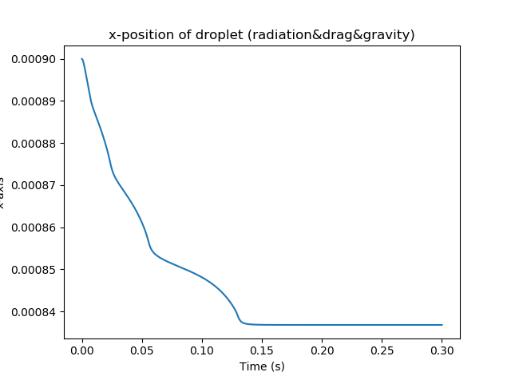
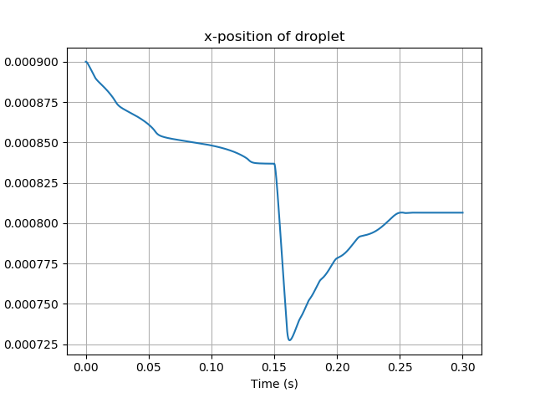
X-direction
Identical
Power off
Stable x about 835um
Power on
This figure turns the power off at t = 0.15s and turn on at t =0.16s

Slide 4
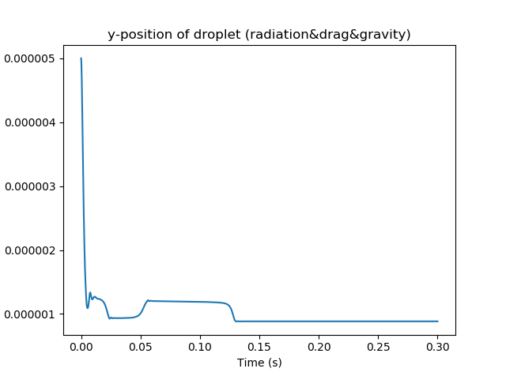
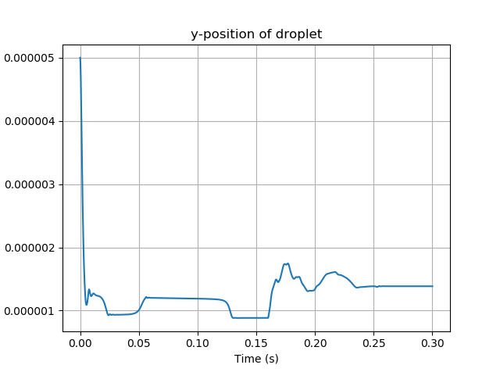
Y -direction
Power off
Power on
Stable y about 0.9um
You can drag the right picture to left to see that they
overlap perfectly before t = 0.16
Stable point (835,0.9)um

Slide 5
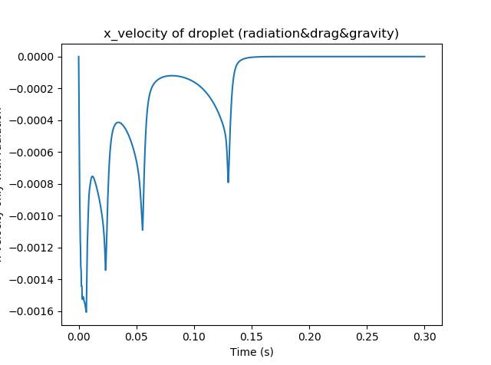
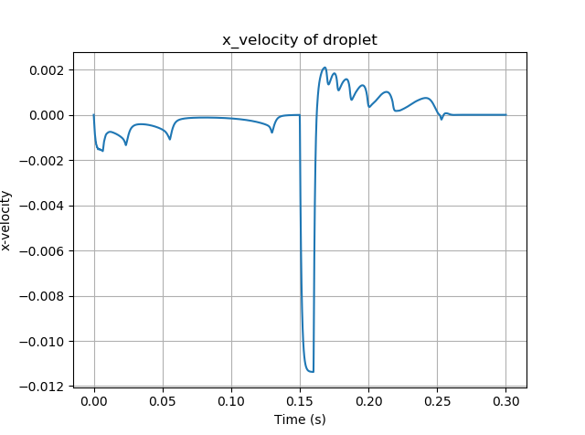
x -velocity
Power off
Power on

Slide 6
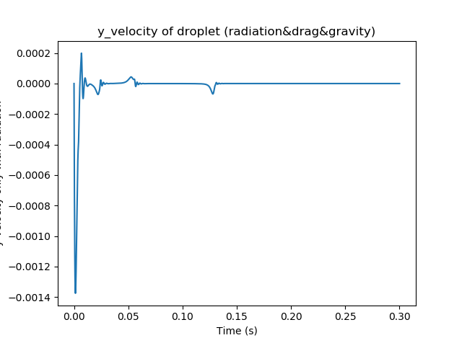
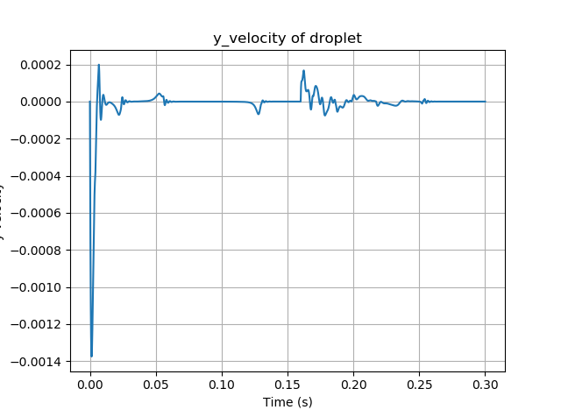
Y -velocity
Power off
Power on
Since before t = 0.15, the droplet is on its stable point (835, 0.1)um, so the power on or off won’t affect the velocity on y direction. however, at t =0.16, when the power on again, the droplet has left the stable point, and the velocity is no more 0.

Slide 7
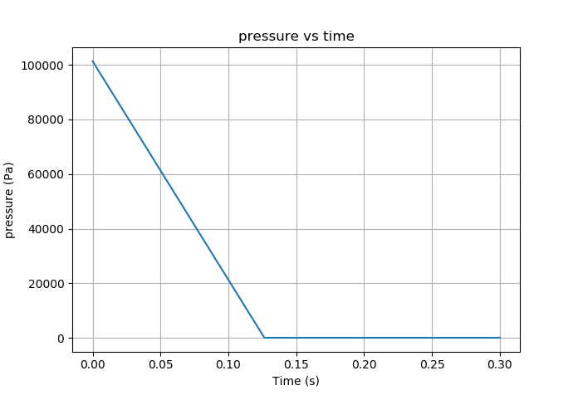
Investigate how air pressure affect droplet
This experiment compare the cases: 1. pressure is const (left figure); 2. the pressure drop from 101325Pa to 100Pa.
Paramerters: no_of_rays = 400;
Lase power: 200mW
Beam sigma: 10 E-6
Beam radius: 40 um
For convenience, assume the air pressure drop linearly.
100 Pa

Slide 8
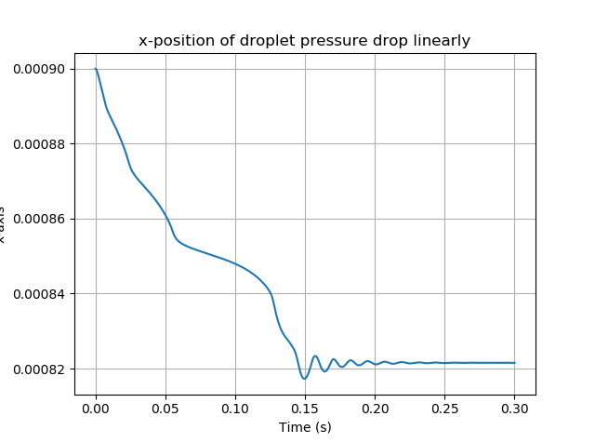
X-direction
Damped oscillation, agree expectation

Slide 9
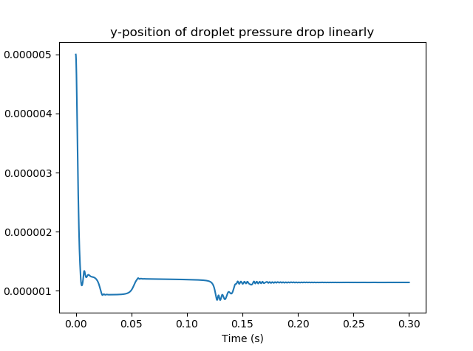
Y -direction

Slide 10
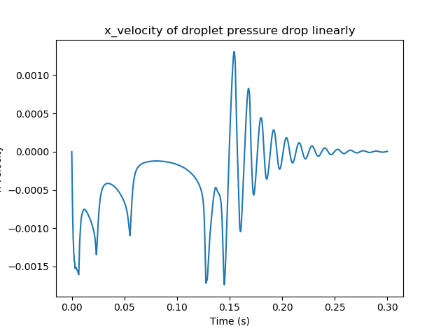
x -velocity

Slide 11
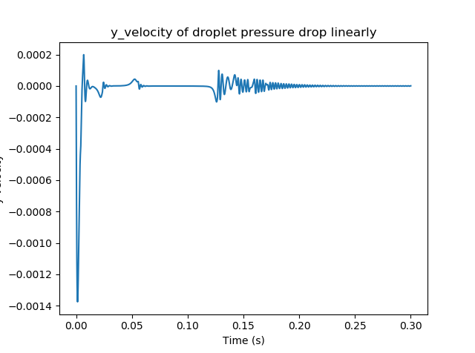
Y -velocity

Slide 12
Next week job
Substitute the circle by ellipse.
Calculate the torque and rotation of ellipse droplet.
If the two tasks are achieved in a short time, I will try to write the code in 3-D.

