Slide 1
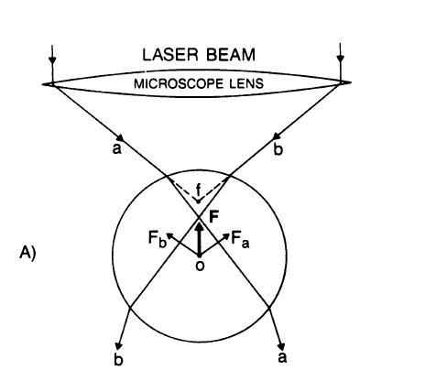
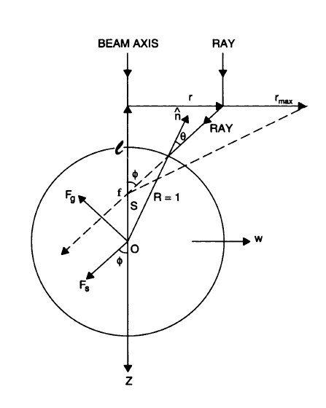
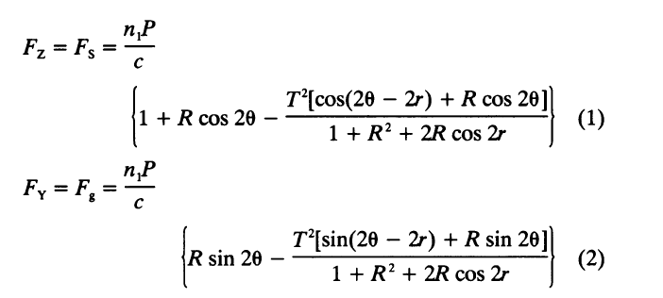
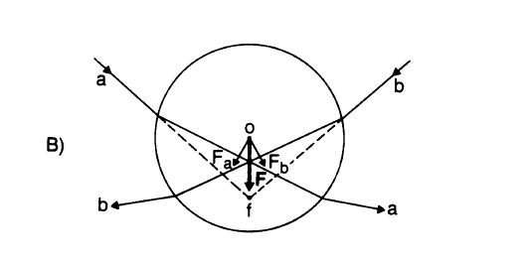
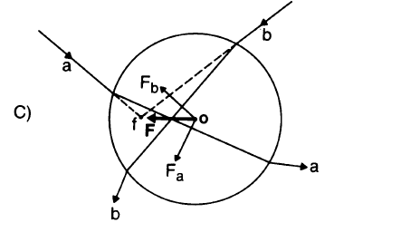
Forces of a single-beam gradient laser trap on a dielectric sphere
in the ray optics regime (by Ashkin)
P is the power of single ray
Theta and r are angle of incident and refraction,
R and T are Fresnel reflection and
transmission coefficients

Slide 2
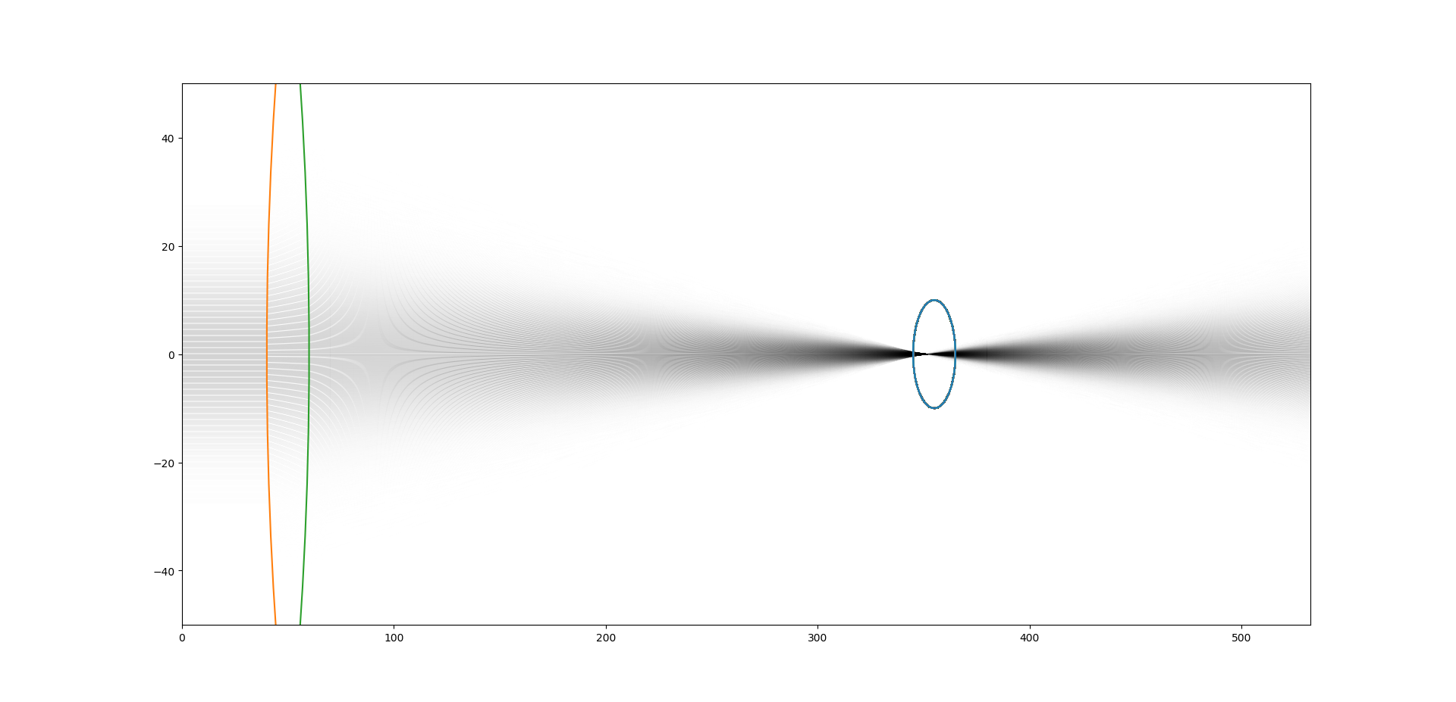

Droplet=(355,0,10) →(x,y,r)

Slide 3
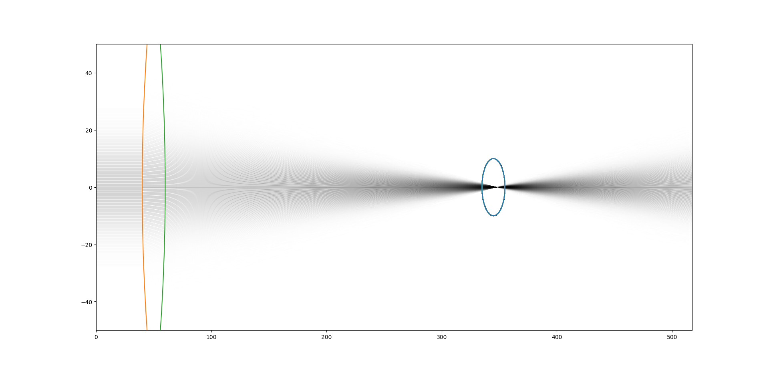

Droplet=(345,0,10) →(x,y,r)

Slide 4
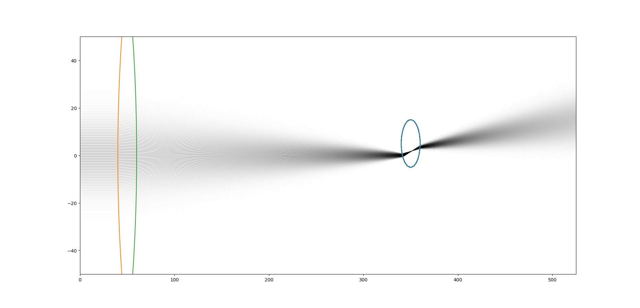

Droplet=(345,0,10) →(x,y,r)

Slide 5
The y direction forces looks correct, but the in the first case: (345,0,10), the total force point backwards in Ashkin’ theory, but in my simulation, the force is still forwards.
Based on the assumption: the droplet has no absorption.

Slide 6
Radiation forces on spheres in loosely focused Gaussian beam: ray-optics regime (by Kim)
In Kim’s paper, he mentioned that we could calculate how many photons reflected and how many photons refracted, so that the forces can be calculated.
Will try this method next week.

Slide 7
GPU
Tried function ‘jit ’ in numba library,
the time used without GPU is 255s 10,000 rays
the time used with GPU is 260s
Possible Reason : GPU is fast in pure calculation like +-*/, but too many logical judgement in this code, so this GPU is not that useful.
Will try multiprocesses, which run iteration parallelly, it could speed up the code.

Slide 8
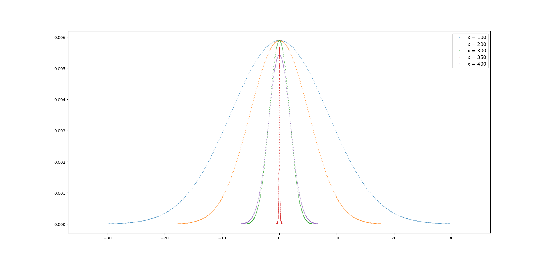
Cross-section
Intensity
Should use Bin method to replot the figure

