Slide 1
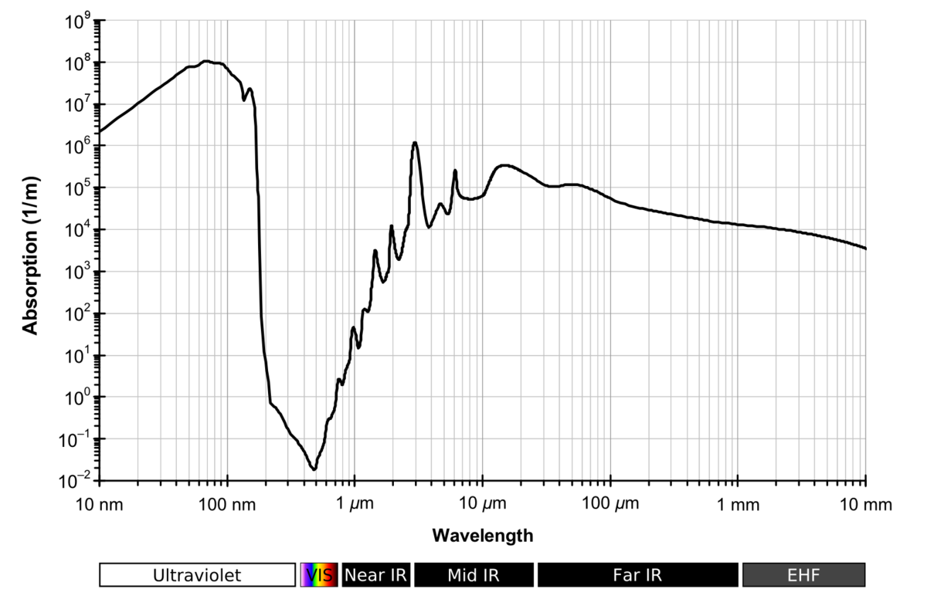
Laser choice
激光选择
Absorption of Water
The minimum absorption exist at about 500nm
Ashkin’s choice was 514.5nm Ar ion laser (gas laser)
The semiconductor laser was invented in 1970, and Ashkin’s paper
was published at 1970 so he can only chose Ar ion laser to
generate CW laser.
4.
https://commons.wikimedia.org/wiki/File:Absorption_spectrum_of_liquid_water.png

Slide 2
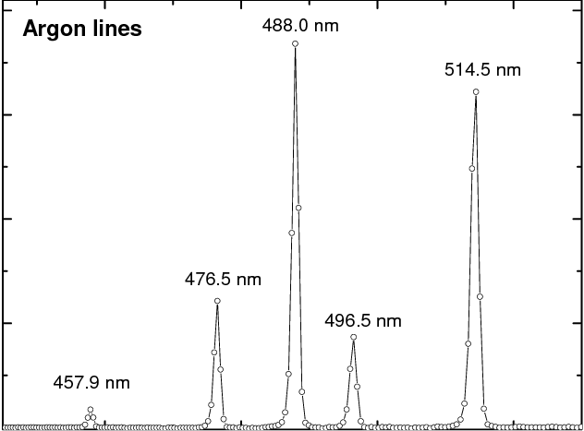
Two choices:488nm or 514.5nm
Why 514??
Spectrum of Argon ion laser

Slide 3
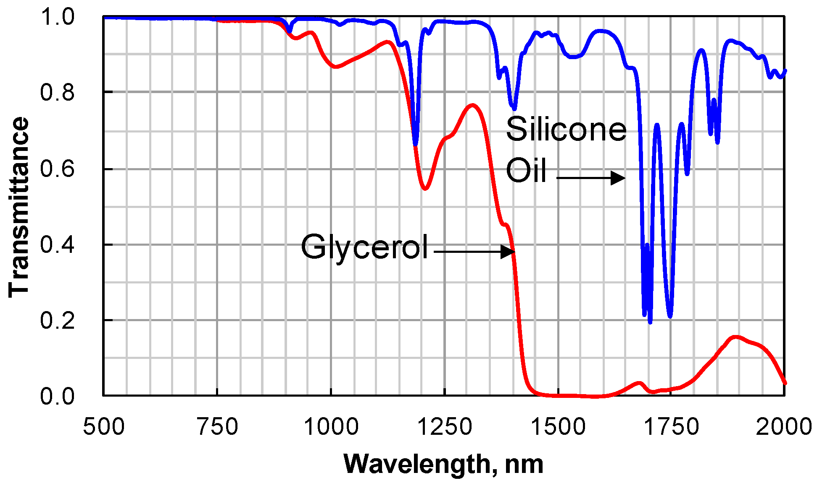
In Roland’s experiment, 532nm laser was used
1. Green laser is suitable for water,
silicon oil and glycerol
2. Since the development of laser, the semiconductor
Can be chosen as the source of stable continuos laser.
Compered with Ar ion laser, semiconductor laser
is more efficient.
There are two kinds of green lasers.
Infrared Optical Switch Using a Movable Liquid Droplet
(Miao XU)

Slide 4
 | Diode Laser 520nm | Diode-pumped solid-state laser 532nm
Max power | ~80mW | Up several Watt
Stability | Low (hop between modes) | High
effciency | Low | 20%-35% (48% in theory)

Slide 5
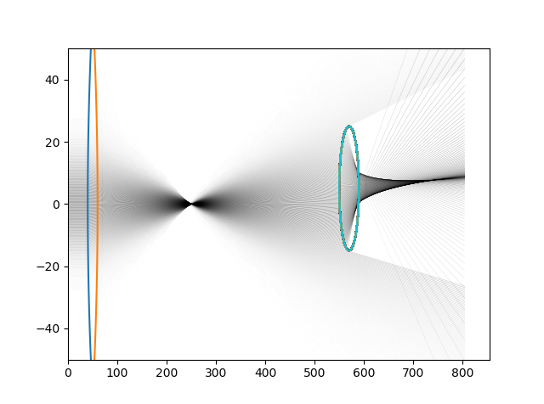
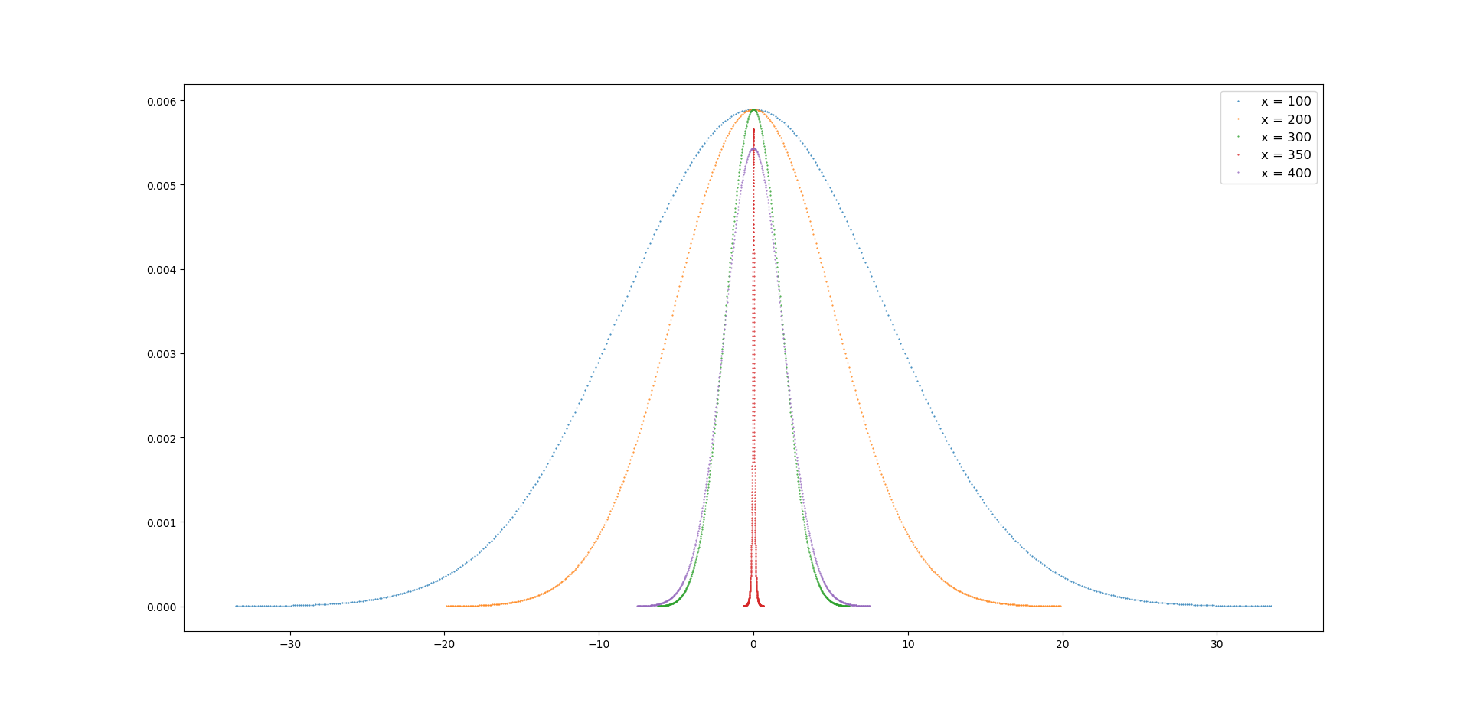
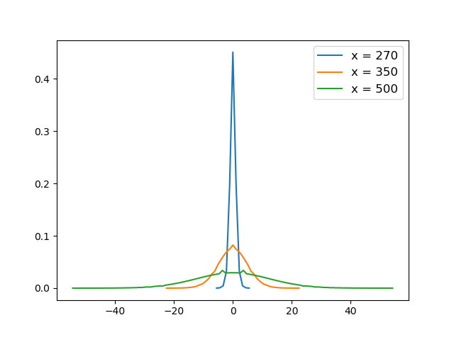
Cross-section intensity
Before
After

Slide 6
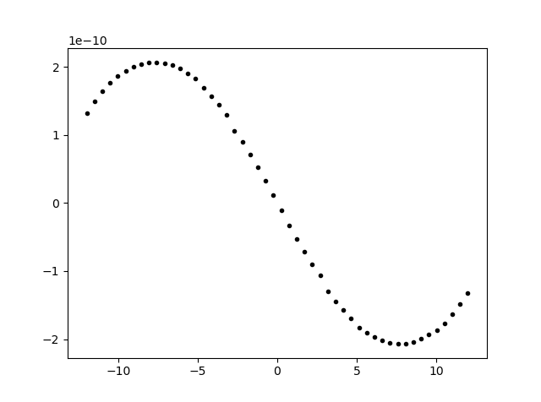
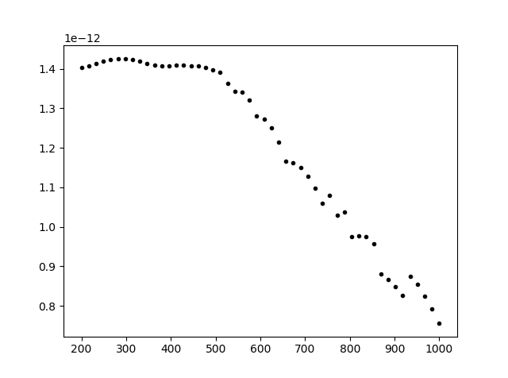
Forces
All rays hit the droplet,
The force stay constant
force
Droplet move away from the focal point, less rays hit the droplet, so the force decrease
Y-displacement
X-displacement

Slide 7
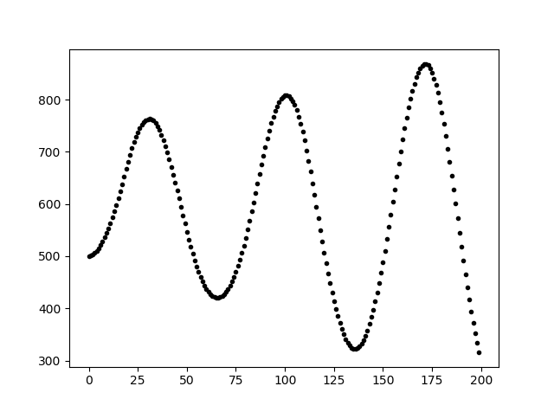
Position respect to time
Delta t = 0.1
The oscillation diverges,
tried to solve this problem by adjusting the power of laser
When the acceleration is negative, increase the power;
When the acceleration is positive, decrease the power;
X position
time

Slide 8
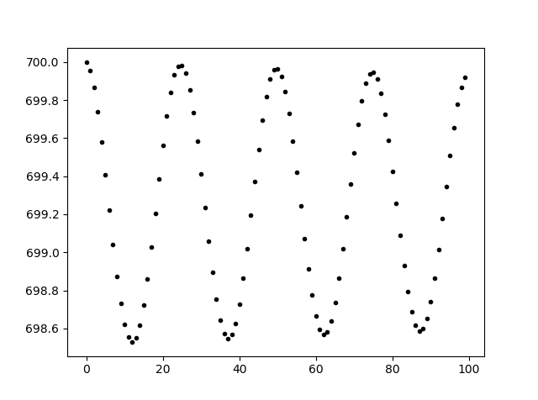
X position
time

Slide 9
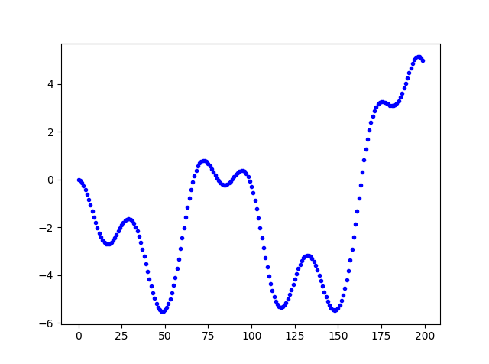
The Y position of the droplet will diverge as well
Tried the same logic by adjusting the position of laser
When the acceleration is upward, move up the laser;
When the acceleration is downward, move down the laser
Y position
On y direction, there exist bugs: when the radius is 20, it wroks, but if the radius is 5, this does not work.
time

Slide 10
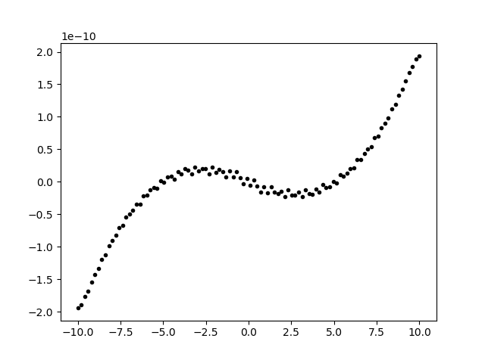
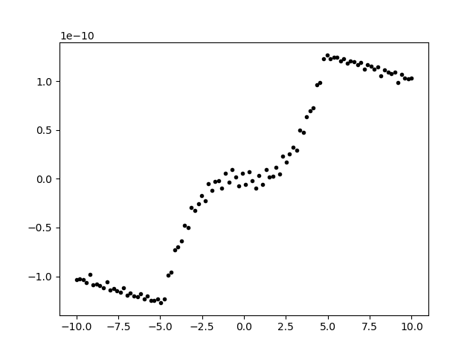
Bug on y axis
R = 10
force
force
Y displacement
force
Y displacement
R = 5
R = 20
Y displacement

