Slide 1
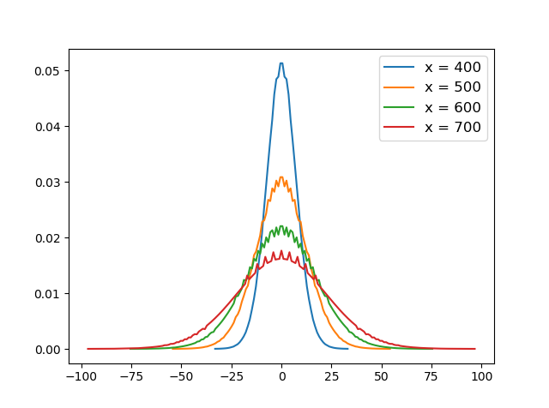
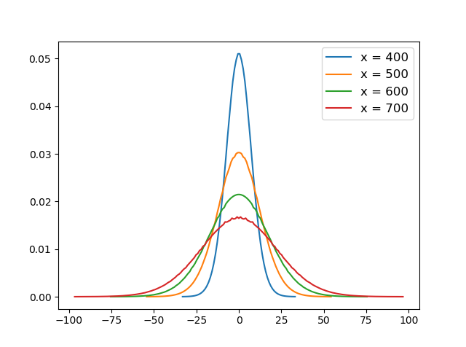
Cross-section Intensity
Cross section Intensity by tracing 2,000 rays
Cross section Intensity by tracing 10,000 rays
Execute time:18s
Execute time:300s
1. The more rays we trace, the more smooth intensity curve we will get.
2. This is because we divide the x-axis into

Slide 2
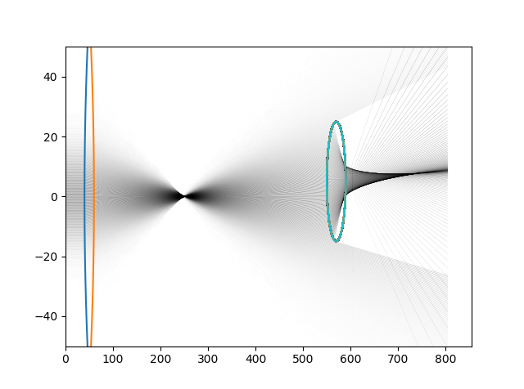
Cross section Intensity by tracing 10,000 rays
Execute time:300s
1. The more rays we trace, the more smooth intensity curve we will get.
2. This is because we divide the x-axis into several intervals, like [0,1],[1,2],[2,3],etc
and add up the intensity of all rays that in each interval, for example in range [0,1], there are 4 rays, add these four,
If in range [10,11], there are only 2 rays, just add these two. The saw tooth exist because the case that in range
[0,1], there 5rays, and in range [1,2] there are 4 rays, in range [2,3 ] there are 5 rays again.

Slide 3
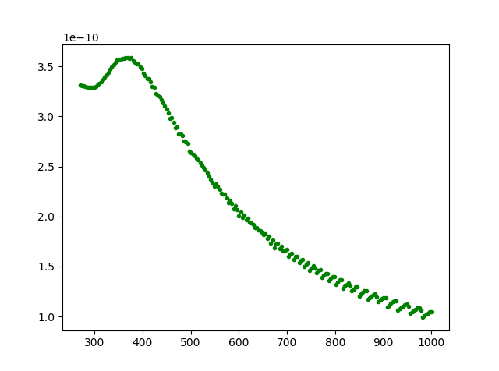
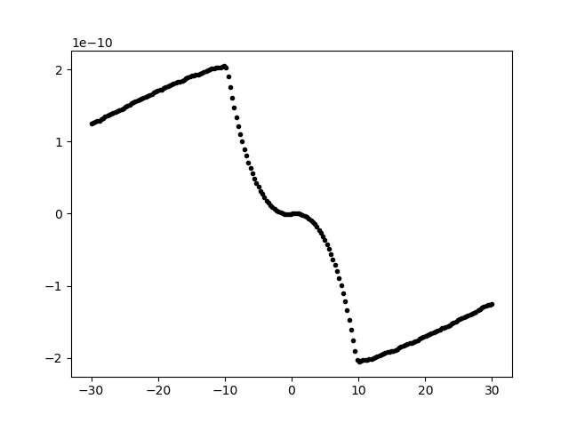
Analyse the force respect to the position of droplet
1
2
force
3
X -position
y -position

Slide 4
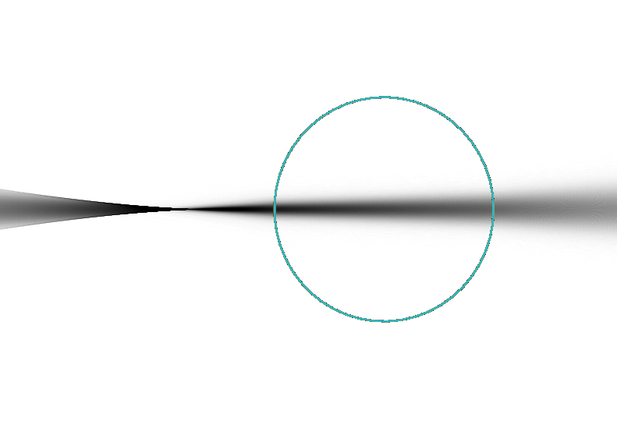
Analyse the force respect to the position of droplet-x
1
The increasement corresponding to the case that all
rays pass the droplet. When the droplet goes towards right,
The force will increase for the incident angle increase.
force
X -position

Slide 5
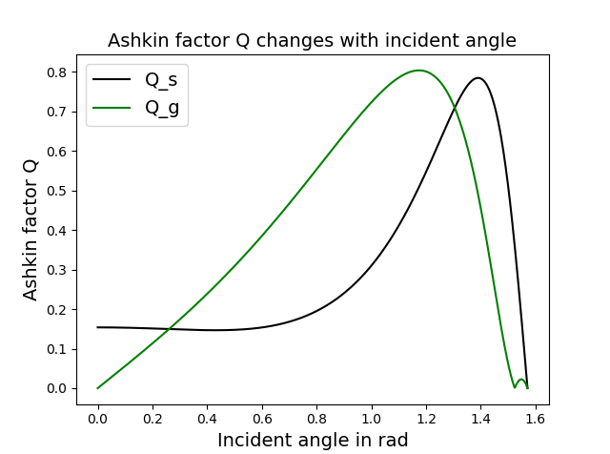
Analyse the force respect to the position of droplet-x
1
force
The increasement corresponding to the case that all
rays pass the droplet. When the droplet goes towards right,
The force will increase for the incident angle increase. And the
Maximum value exist at about 1.2 rad (69 degree)for Q_g
and 1.4 (80 degree) for Q_s.
X -position

Slide 6
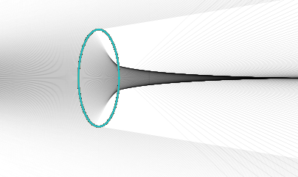
Analyse the force respect to the position of droplet-x
2
force
The force decreases for the droplet interact with less rays .
This is easy to understand
X -position

Slide 7
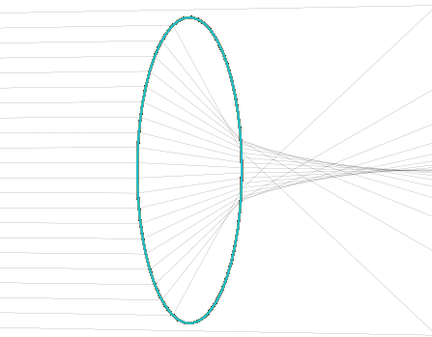
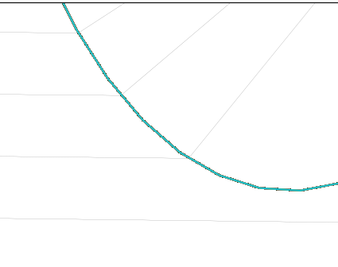
Analyse the force respect to the position of droplet-x
force
3
The period force caused by the same reason at condition 1.
More rays will fall on the large incident angle area, so the force
will increase and keep increasing, the side ray will go off the
Droplet, so the for force drop quickly, that why there is a periodic
force.
X -position

Slide 8
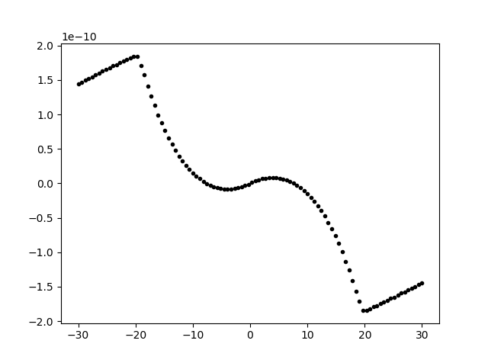
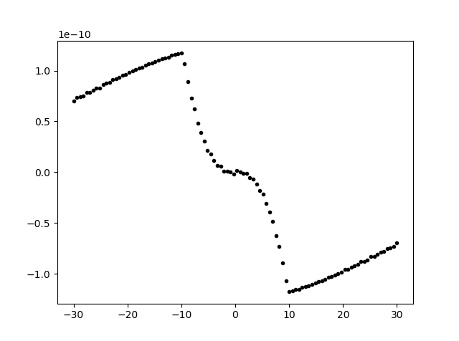
Analyse the force respect to the position of droplet-y
Force
Y displacement
Y displacement
Last time I only calculate the force from -10 to 10, if we zoom out , we can see the potential barrier.
Also last time I made some mistake about direction.

Slide 9
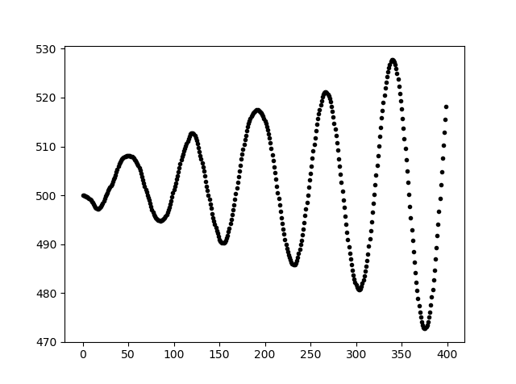
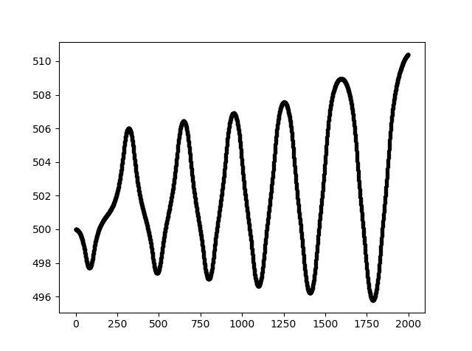
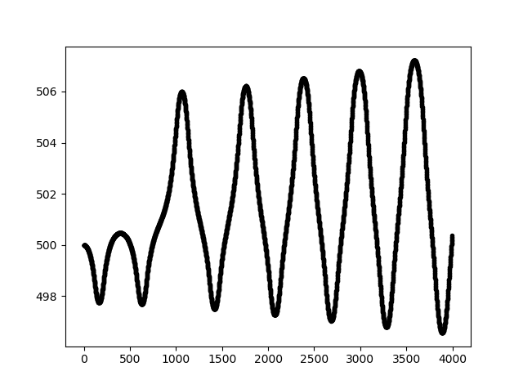
Delt t = 0.5
Delt t = 0.1
This is obvious that smaller delt time will due less divergence.
Delt t = 0.05

Slide 10
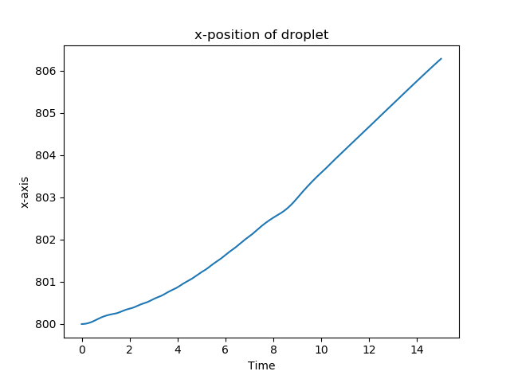
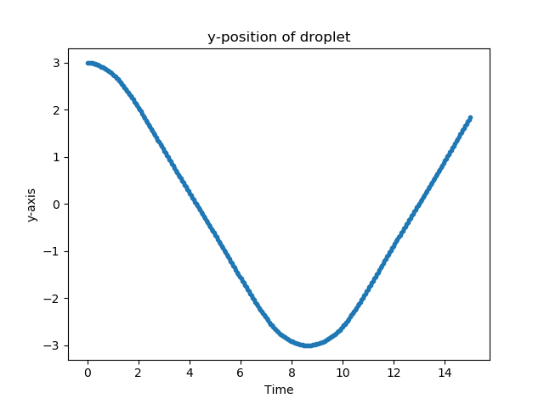
ODE integrate
This method supposed to be work, I only simulate 15 s by scipy.odeint method, which takes about 4 hours.

Slide 11
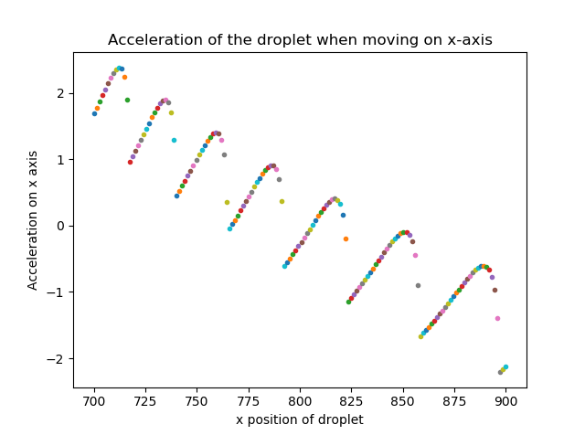
From this figure, we can judge that the equilibrium position is about 800

Slide 12
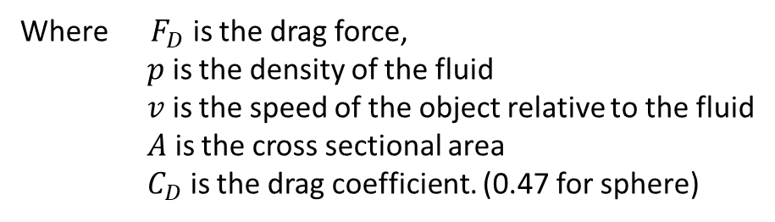
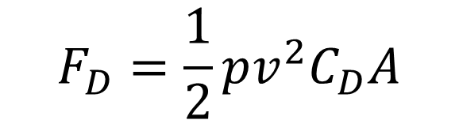
Drag force
$$F_{D}=\frac{1}{2}pv^{2}C_{D}A$$
Where ${ F}_{D}$ is the drag force,
$p$ is the density of the fluid
$v$ is the speed of the object relative to the fluid
$A$ is the cross sectional area
$C_{D}$ is the drag coefficient. (0.47 for sphere)
I have wrote the block of drag force but have not test it yet for the speed of odeint is so slow.

Slide 13
Speed up
Multiprocesses (doesn’t speed up)
Multithreading (Python do not support this, or we could say multithreading is pseudo multithreading)
GPU (doesn’t speed up)
Proposal: the data is saved by list, if save them in dic, may speed up.
because dic won’t slow down while the number of data increase.

