Slide 1
No. of rays: 400
Lase power: 200mW
Beam sigma: 10 E-6
Beam radius: 40 um
NOTE: In this PPT, the air pressure is constant

Slide 2
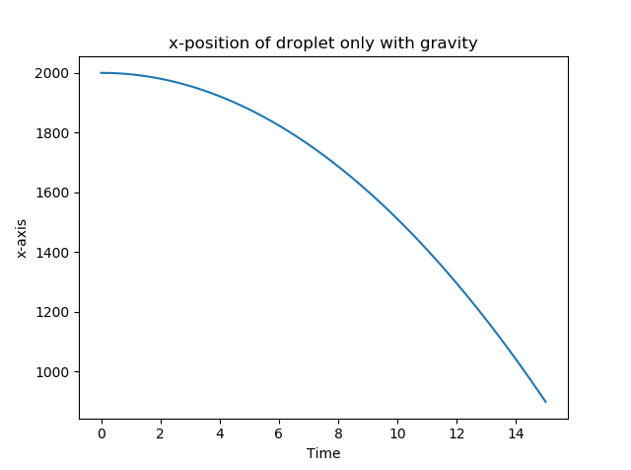
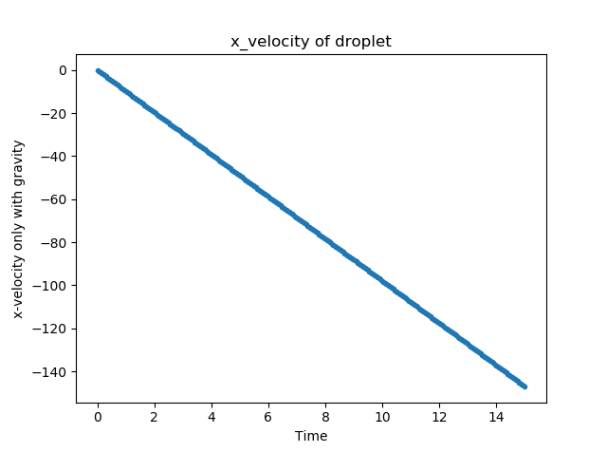
Gravity only（ode）
Init_state = (2000,0,0,0)um ->(x,y,vx,vy)

Slide 3
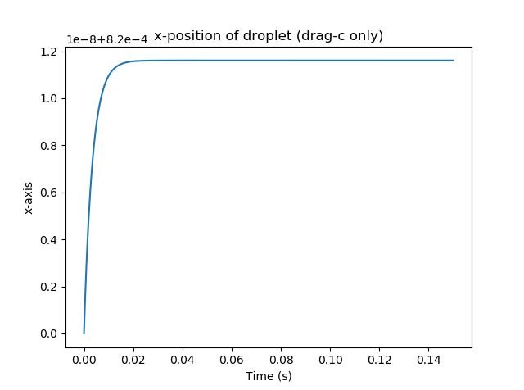
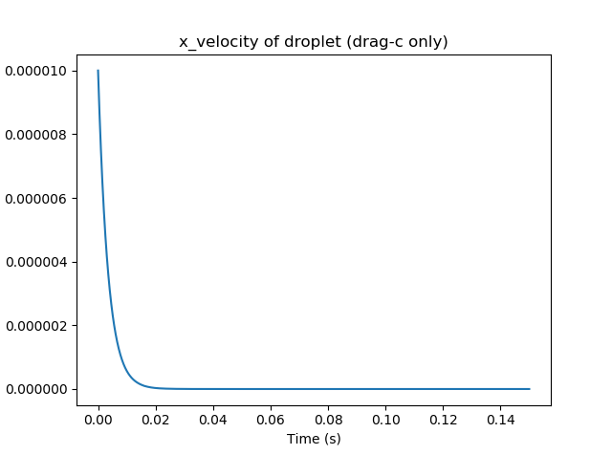
Drag force only F= -6pi*n*R*v/C(kn)
Init_state = (800,0,10,0) um ->(x,y,vx,vy)

Slide 4
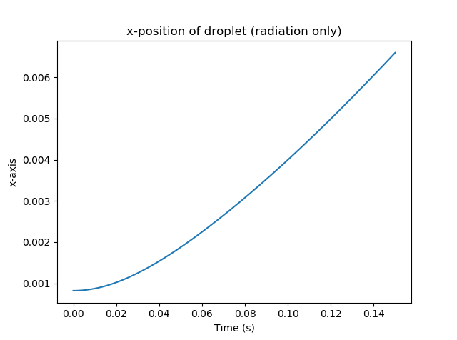
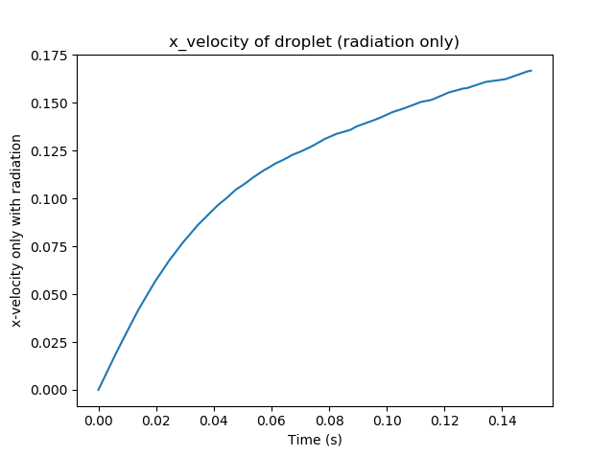
Radiation force only – x (bundle)
Init_state = (800,2,0,0)um ->(x,y,vx,vy)

Slide 5
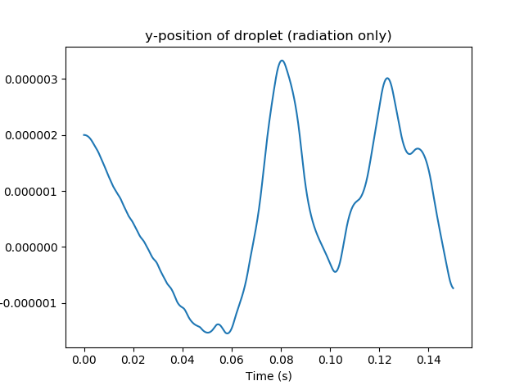
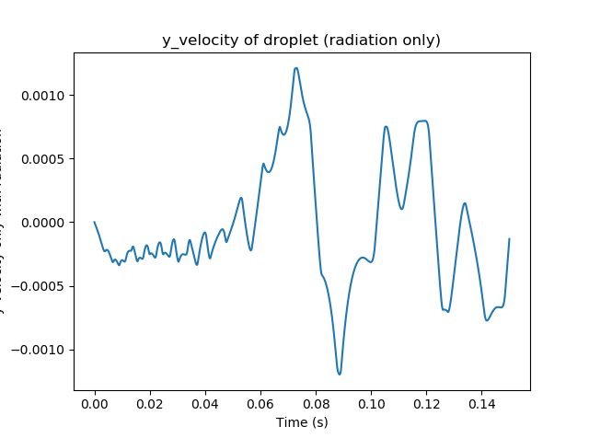
Radiation force only - y
Init_state = (800,2,0,0)um ->(x,y,vx,vy)

Slide 6
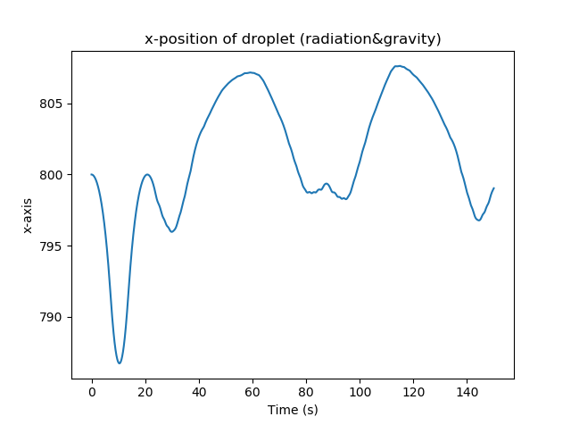
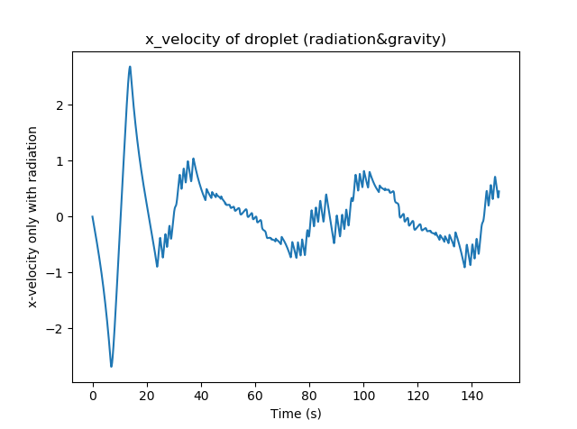
Radiatoin & gravity-x-state1
init_state(800,0,0,0)um ->(x,y,vx,vy)

Slide 7
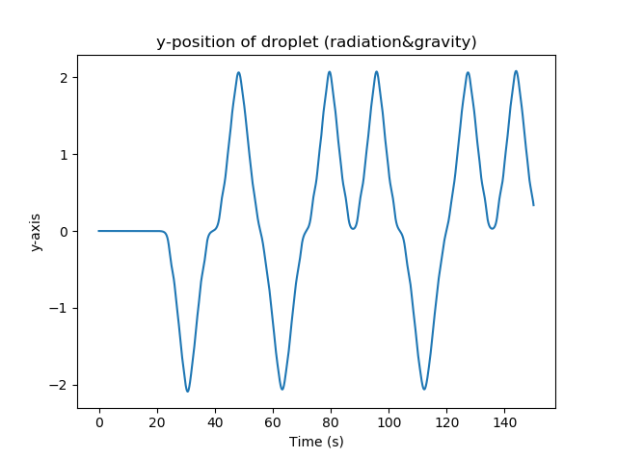
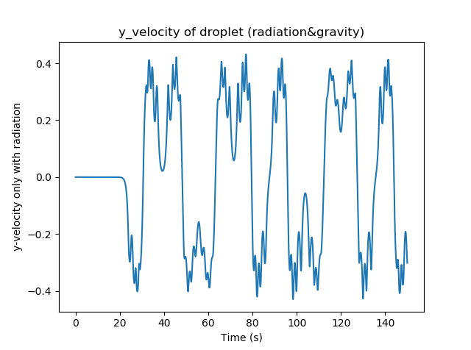
Radiatoin & gravity-y-state1
init_state(800,0,0,0)um ->(x,y,vx,vy)

Slide 8
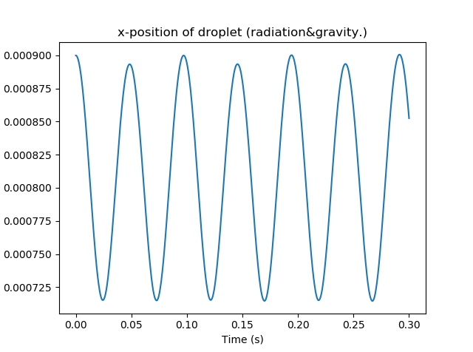
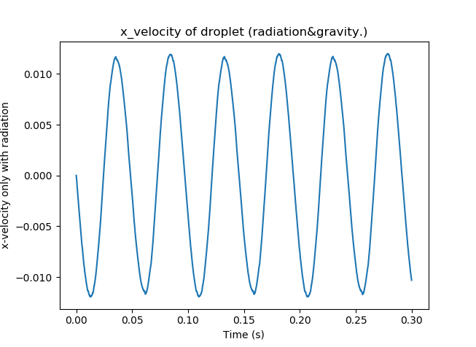
Radiatoin & gravity-x-state2
init_state(900,5,0,0) um -> (x,y,vx,vy)

Slide 9
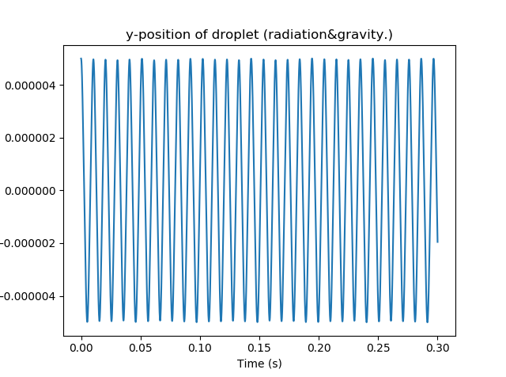
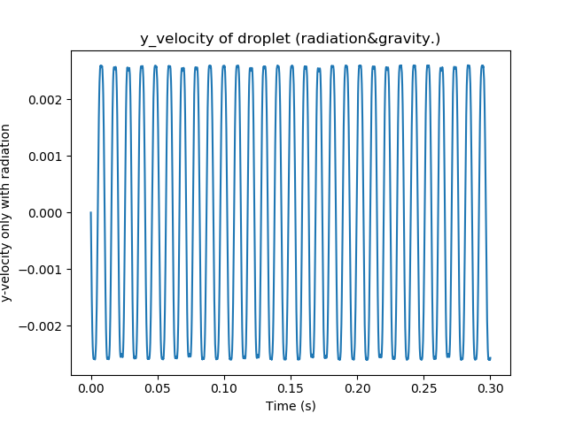
Radiatoin & gravity-y-state2
init_state(900,5,0,0) um -> (x,y,vx,vy)

Slide 10
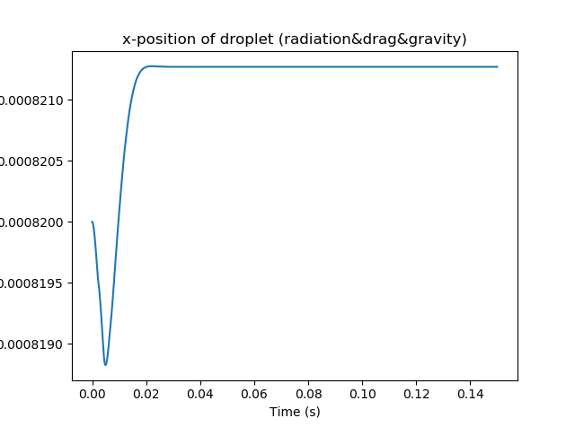
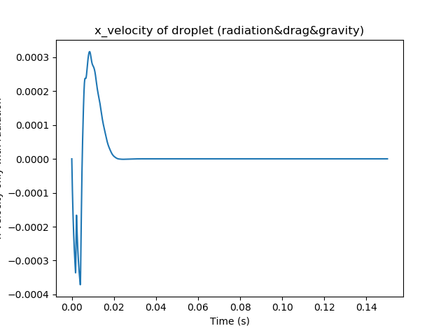
Radiation&gravity&drag-x-state1
init_state(820,2,0,0) um -> (x,y,vx,vy)

Slide 11
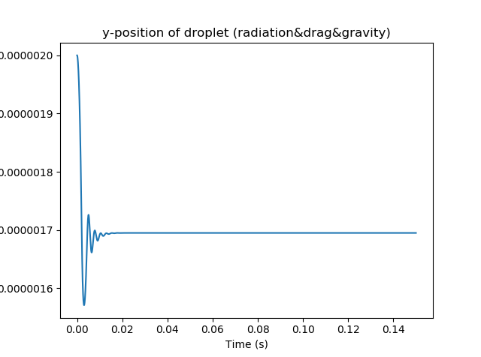
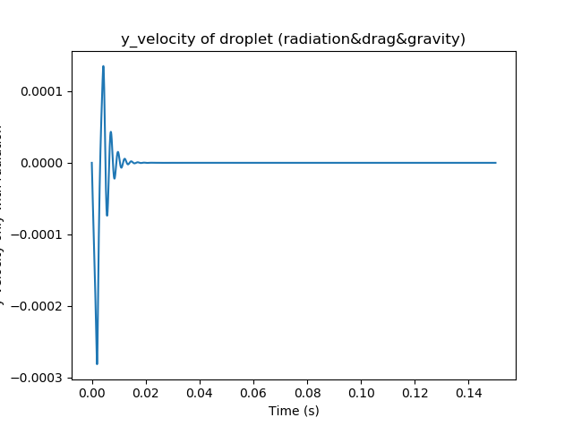
Radiation&gravity&drag-y-state1
Guess:If release the droplet far from the stable position e.g.(1000,10,0,0)
The curvature should be a better decayed .
init_state(820,2,0,0) um -> (x,y,vx,vy)

Slide 12
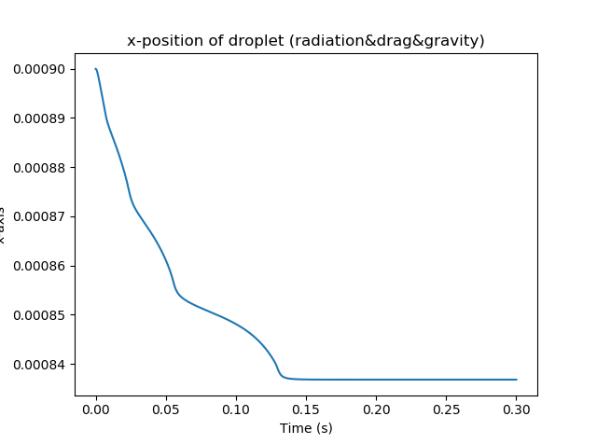
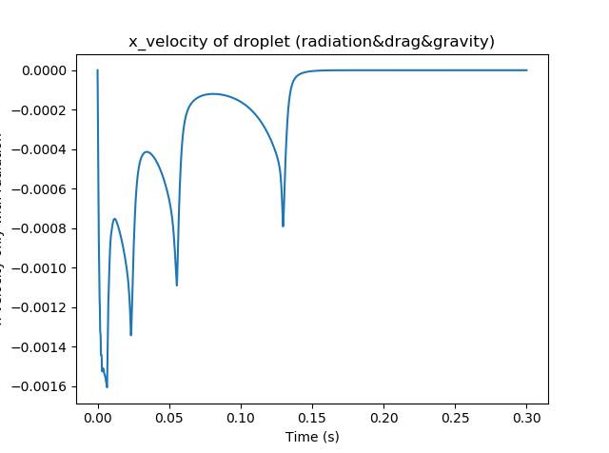
Radiation&gravity&drag-x-state2
init_state(900,2,0,0) um -> (x,y,vx,vy)

Slide 13
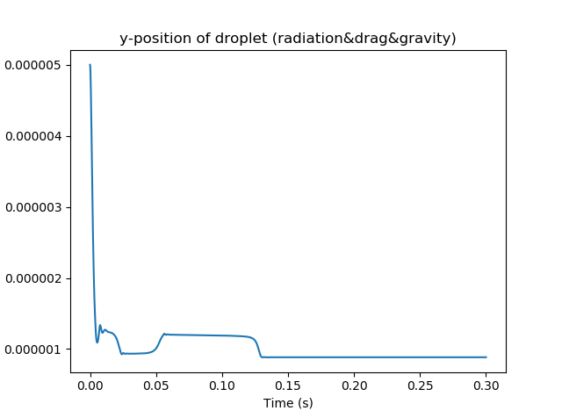
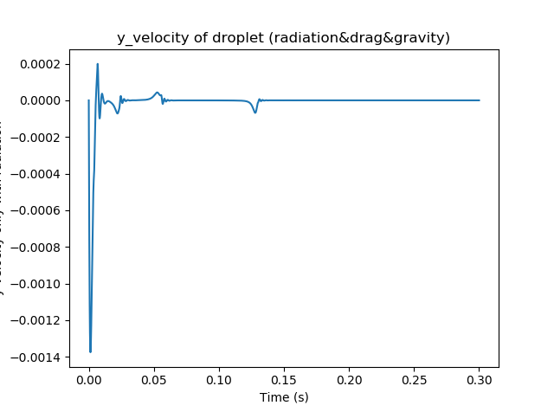
Radiation&gravity&drag-x-state2
init_state(900,2,0,0) um -> (x,y,vx,vy)

Slide 14
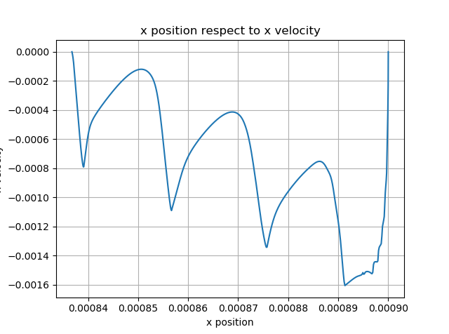
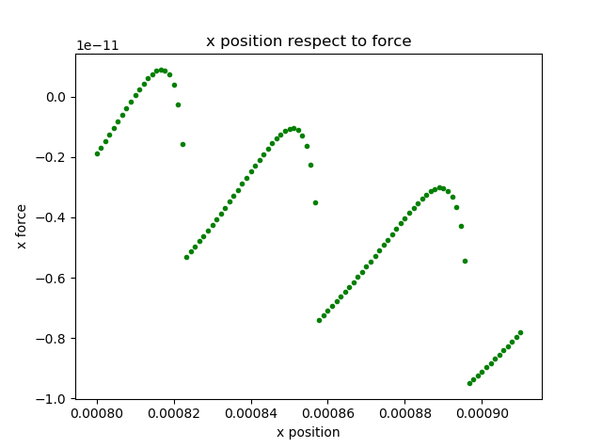
??
This figure contain gravity, radiation and no drag
This figure contain gravity, radiation,drag
If we take the drag force into consideration, the curve should
be flattened and more close to 0

Slide 15
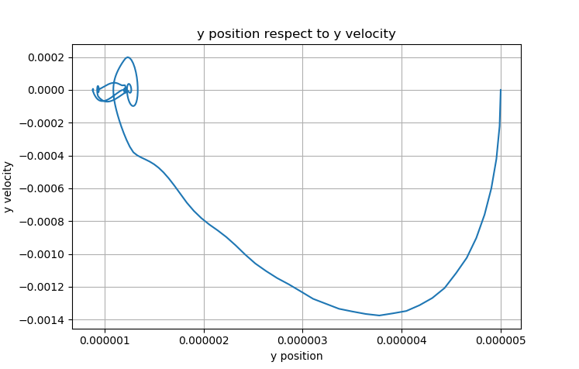
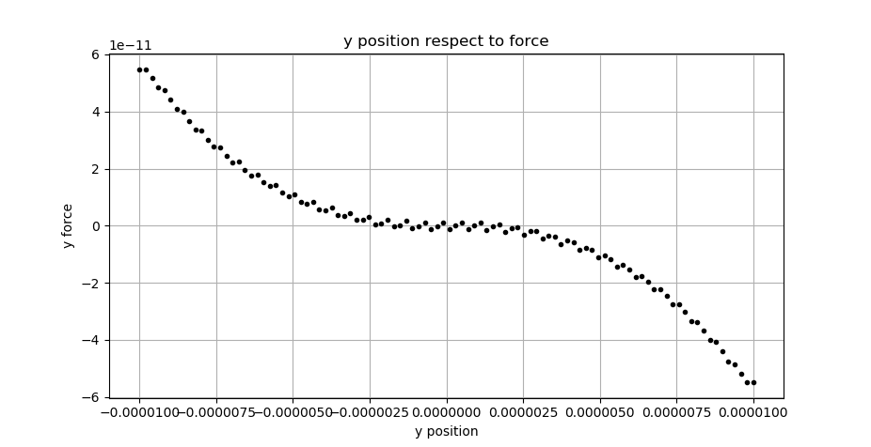
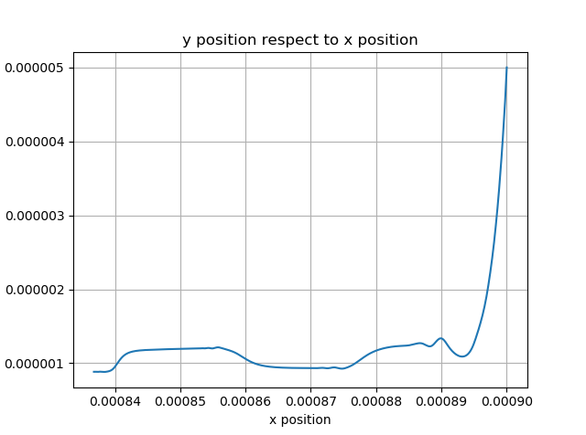
Radiation&gravity&drag-y-state2
Turning point means force direction changed
This figure contain gravity, radiation,drag
This figure contain gravity, radiation and no drag
If we take the drag force into consideration, the curve should
be flattened and more close to 0

Slide 16
Questions
How the pressure of the chamber decay? Exp decay or linear decay, and how long will the pump needs to reach the desired pressure (1/1000 atm pressure)? 1-1/100 linear then exp 10min
For Re number, what is the critical point to divide the turbulence and laminar flow, some paper say 2100, some say 2500 (not important for in this case, the Re value is about 10^-4).

