Slide 1


Slide 2

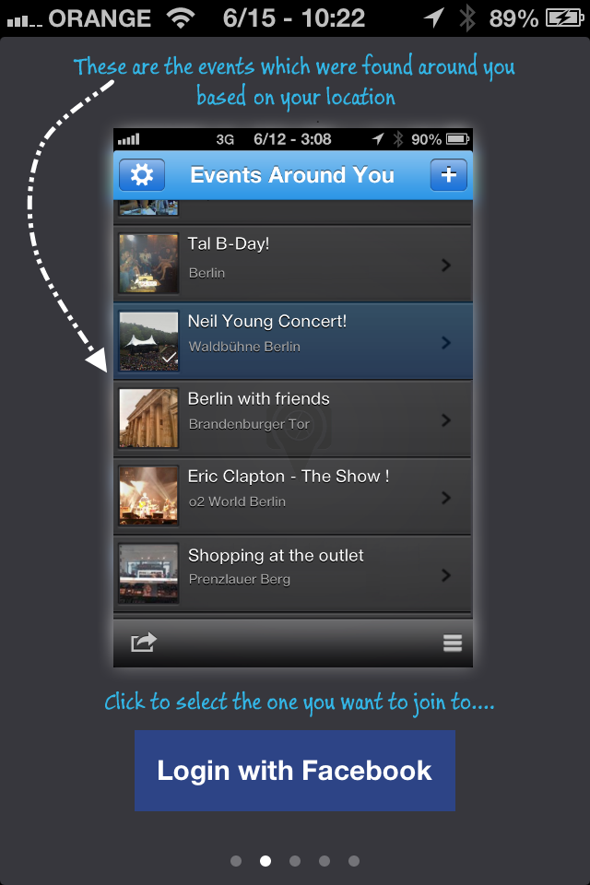
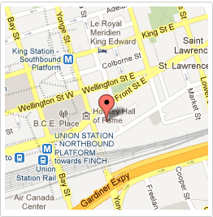
Events
Around you
Where are you?
The application detects your location.
You are suggested to Select the event you are at from a list of local events.

Slide 3
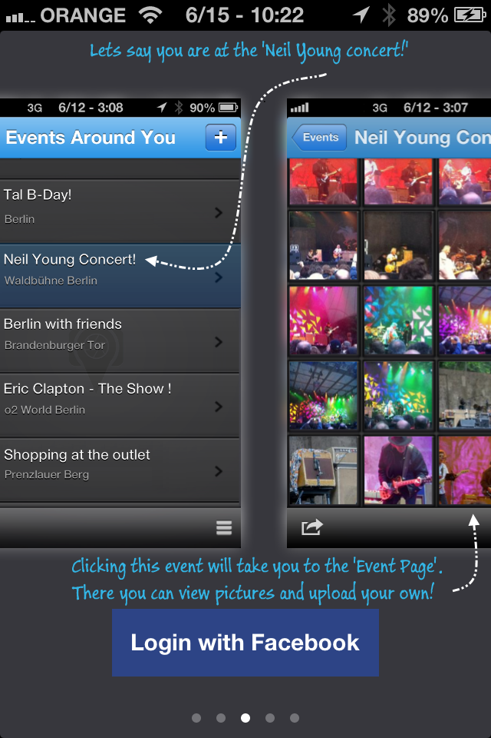

Join
an event
View & Upload…
Joining an album is like accepting an invitation.
From the list of local events, join the event your at.

Slide 4
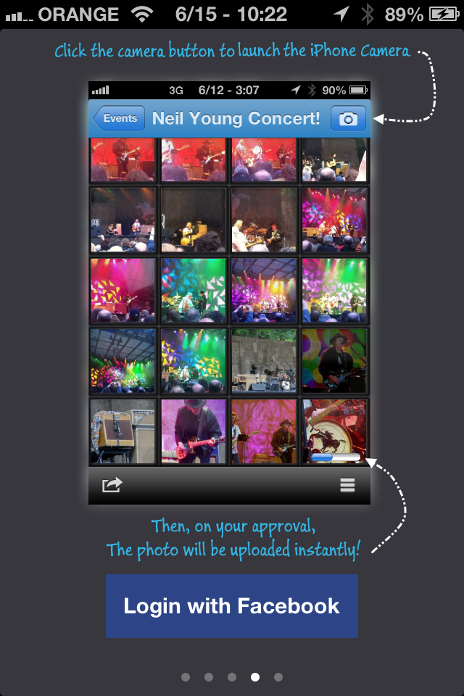


Capture
The momvent
Smile, uploading!
All the pictures that you and the other participants are taking will be instantly saved to this same shared event album on the cloud.

Slide 5
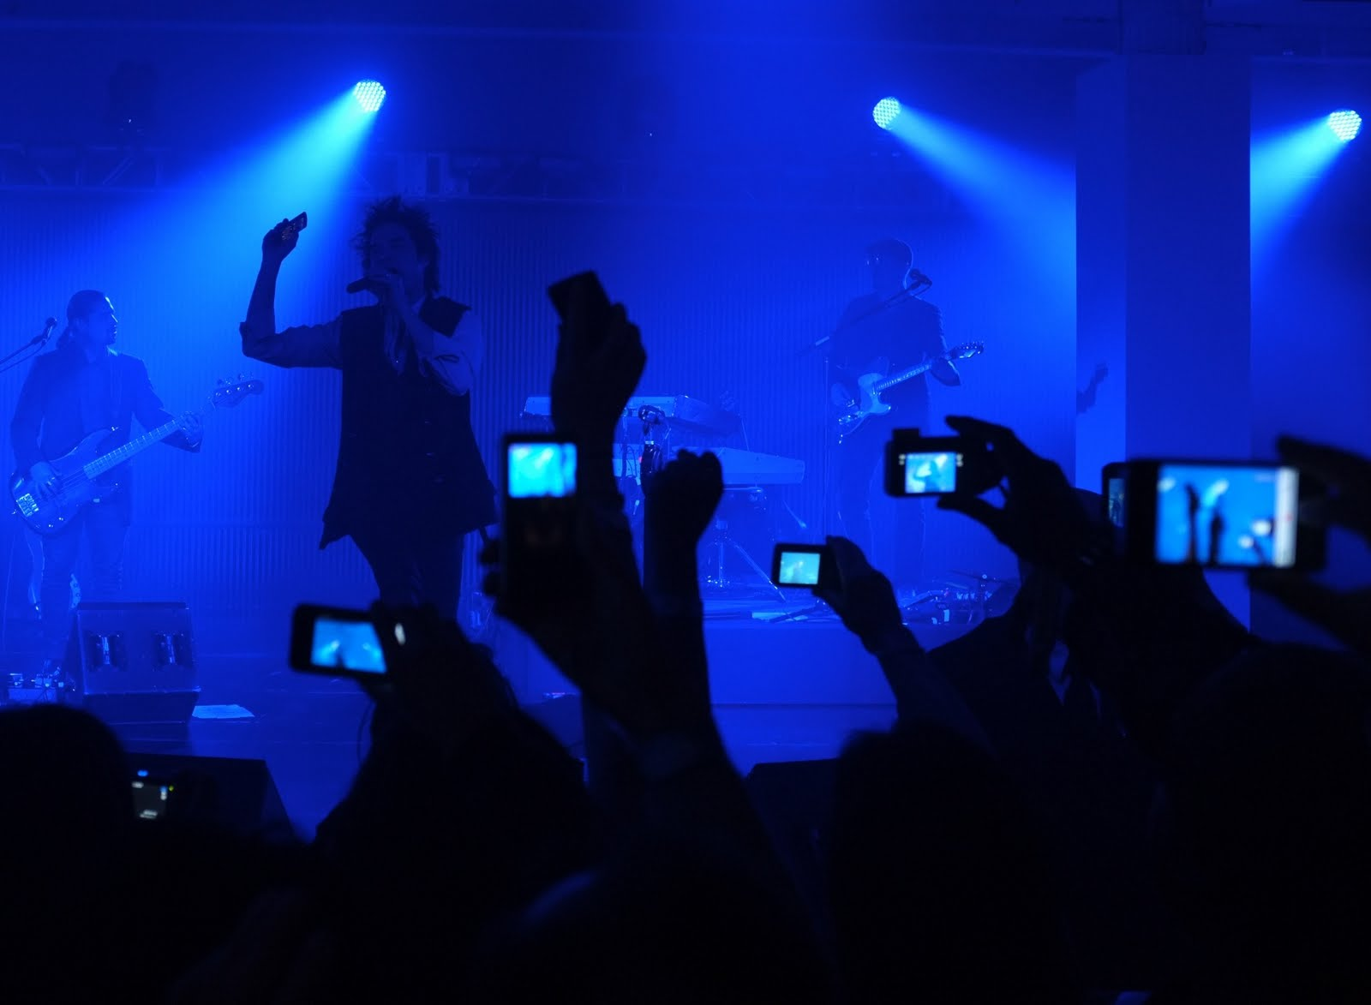

Take your pictures,
while others are doing the same!

Slide 6
Watch the event pictures
not just your own!!!

Slide 7
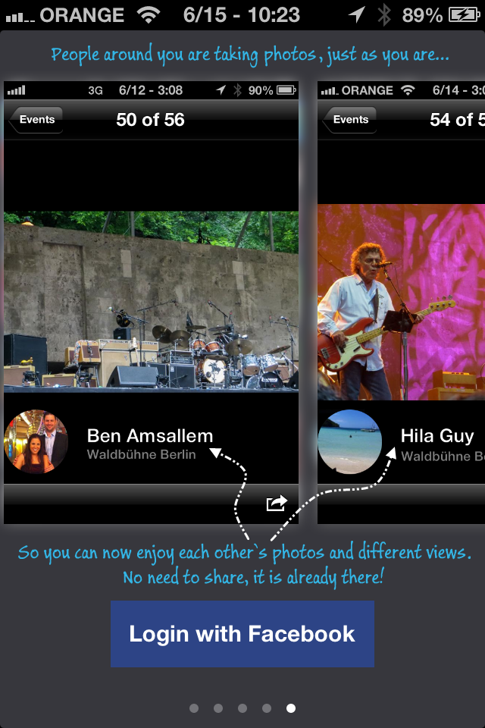



Explore
From every angle
Your photos & everybody else's
All the photos from the event are already there, in real time, available for everybody to enjoy.

