Slide 1
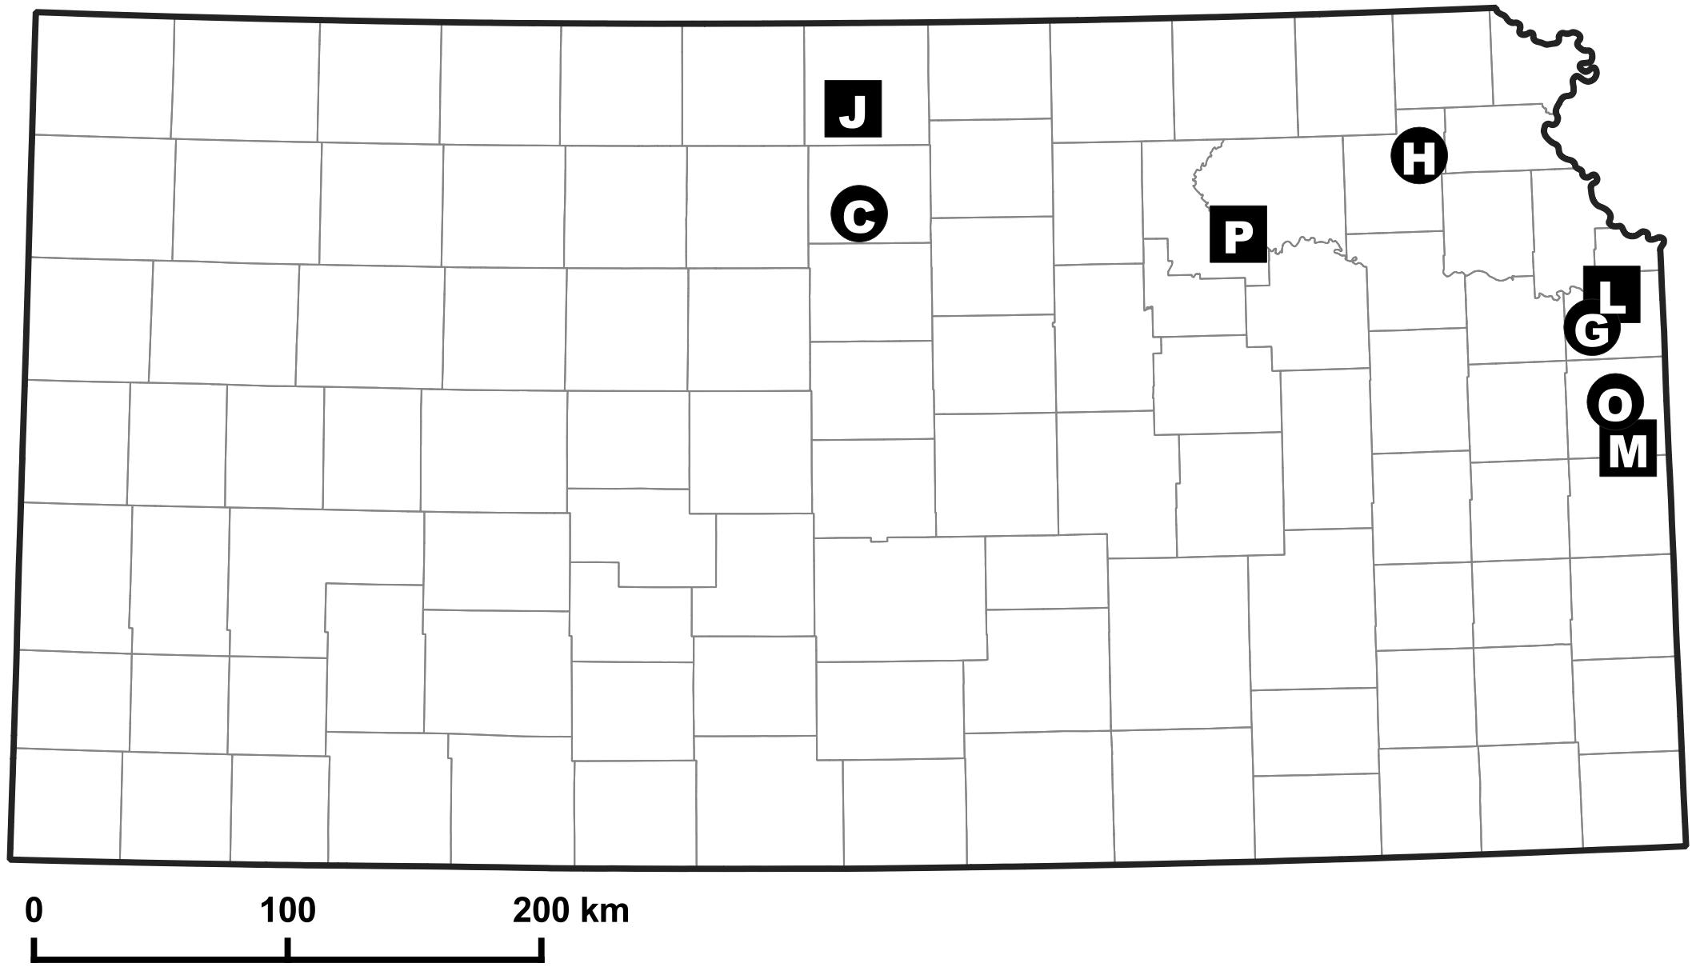
Impoundment | Label | Longitude | Latitude | Treatment | Size (ha)
Campbell | C | -98.259 | 39.324 | Control | 16.2
Gardner | G | -94.927 | 38.847 | Control | 48.6
Holton | H | -95.689 | 39.490 | Control | 31.6
Paola | O | -94.844 | 38.590 | Control | 80.9
Jewell | J | -98.279 | 39.699 | Regulation | 23.1
Lenexa | L | -94.840 | 38.965 | Regulation | 12.1
Miami | M | -94.791 | 38.421 | Regulation | 47.8
Pott #2 | P | -96.526 | 39.231 | Regulation | 30.4

