Slide 1
VMS, KALI, LINUX, ETC.
CIS4204: 0x080-VMsKaliLinuxEtc

Slide 2
In this Video You will Discover:
01
02
03
04
VMs
Kali
Linux
Etc.
Why a VM is used, and what we will use VMs for in this course.
What Kali is, and how we will use it in the course.
Why an understanding of the linux command line is beneficial.
How this all ties together for your class exercises.
Notes:
Off Screen

Slide 3
Virtual Machine (VM)
A Virtual Machine is an instance of an actual machine. Some real (host) machine is used to exhibit the same behavior as the (target) virtual machine.
The virtualization platform we will be using in this class is based around VMware’s ESXi bare-metal virtualization platform.
Students in the UF CISE department can get free access to VMware’s virtualization software (such as VMWare Workstation for Windows and VMWare Fusion for MacOS) from a supported download site. Account information forthcoming.
Notes:
On Screen

Slide 4
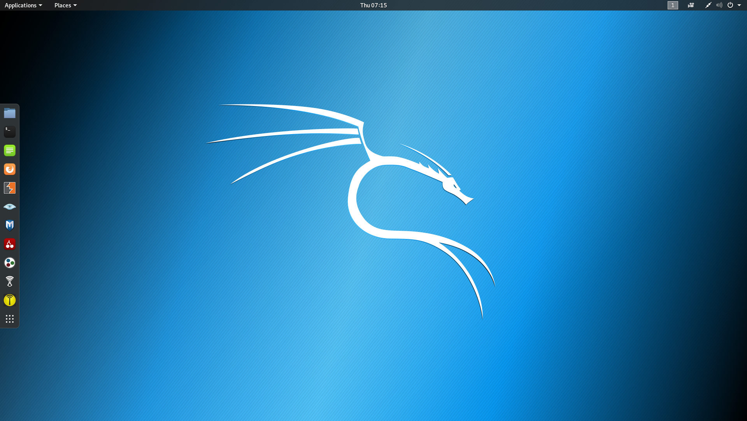
Kali Linux
Kali is a distribution of Linux prepared by Offensive Security.
A linux distro is a combination of a base operating system and a set of installed software applications and libraries.
Kali is based on the Debian version of Linux and contains a variety of software tools that have been designed and used for penetration testing.
Notes:
Off Screen

Slide 5
What’s a Kali VM and Why Would I Use One?
A Kali VM is a virtual machine that behaves as a Kali Linux machine operating under the control of your host system.
Penetration testers often use virtual machines for several reasons:
It may be necessary to use a variety of operating systems in a penetration test, but one doesn’t want to employ numerous physical machines.
A virtual machine can be used and modified and then easily returned to its original state through a snapshot, that is, an instantaneous record of the machine state.
If a virtual machine is compromised by an attacker, it is unlikely (but still possible) that your host machine can be compromised. Because penetration testers may use tools from dubious sources, it’s helpful to localize possible compromises to virtual machines (which can easily be rolled back to earlier snapshots).
Notes:
On Screen

Slide 6

Why Should I Care About Linux?
Kali is a linux distro, so you won’t use it very well if you don’t use linux well.
The linux command line is king. Facility with the linux command line leads to penetration testing wins. Wins lead to glory. Glory leads to….
Notes:
Off Screen

Slide 7


But What If I am Not a Linux Guru?
cat
cd
chmod
find
grep
less
ls
ps
pwd
scp
ssh
su
tail
whoami
Become one!
These commands are critical. Find out about them today and know them right away!
What do they do? Which are shell built-in commands?
If you are a complete linux newb, go to http://linuxcommand.org/ and follow the Learning the Shell tutorial.
This man is the Linux guru
(but maybe not polite).
For a learning linux ctf-ish game, visit: http://overthewire.org/wargames/bandit/
Notes:
Off Screen
[CLICK FOR PICTURE OF Torvalds]
Image source: http://images.bit-tech.net/news_images/2012/06/torvalds-slams-nvidia/article_img.jpg

Slide 8
What’s the Etc. Part?
The Etc. Part is how to log in to the UF Netlab NDG server so you can complete exercises for the class.
You connect to this server at https://ndg.cise.ufl.edu
You log in using credentials you will receive (or already have received from me) via email.
NDG has copious documentation about its Netlab-VE product. The student guide may be useful to you. I find this documentation tedious to read, so I will show you how to log in and start a lab exercise.
Notes:
On Screen

Slide 9

What About Logging In to Kali?
The default Kali user is kali with password kali (very original).
Don’t ever use the default password.
Always change the password whenever you are presented with a machine you are to use and someone else knows the password. Always! Always! (Except when you consciously decide not to.)
The username and password for the NDG Kali instances has been given to you in Exercise 0x010.
Notes:
Off Screen

Slide 10
What’s Up With This Plunder Server?
You are now the newest intern at pr0b3.com, one of the most respected penetration testing firms you’ve never heard of.
You will perform your penetration testing using a Netlab Kali instance.
Unfortunately, every time you start this Kali instance, it is started from a fixed snapshot. Any work you do is erased on logout. Thus, you need to store any information (like keys!!) you want to store somewhere else. For example, on a pr0b3.com server.
You can log in to plunder.pr0b3.com from your Netlab Kali instance.
Your log-in name on plunder is the same as your ndg login name. (It’s your gatorlink email address with underscores substituted for dots.) But what is your password on plunder?
Notes:
On Screen

Slide 11

Plunder Passwords
You can find your plunder password by logging in to plunder as user guest.
User guest is what is known as a “Joe” account. The password for guest is guest.
Once you’ve found your password, log in to plunder again and change your password!!!!!
This process can be brute forced, so someone can steal your account if you don’t change the password.
1
3
Once you’ve logged in as guest, you need to run the program
  decrypt_account_list.py
to find your password.
Important hint:
The passwords are encrypted using the exact same method I use to encrypt the keys. Thus, you can use decrypt_account_list.py as a model for a key decrypter.
2
Notes:
Off Screen

Slide 12

Closing Thoughts
Notes:
On Screen

Slide 13
You Have Reached the End Of This Presentation
References:
http://www.vmware.com
https://www.kali.org/
https://www.offensive-security.com/
http://linuxcommand.org/
http://overthewire.org/wargames/bandit/
http://images.bit-tech.net/news_images/2012/06/torvalds-slams-nvidia/article_img.jpg

