Slide 1
KEY FACTS ABOUT KEYS
CIS4204: Addendum0x000 -KeyEncryptionMethod

Slide 2


What Is It With These Keys?
The Keys are base64-encoded 16-byte sequences.
The 16-byte sequences form a long crypt-text that can be decrypted.
If you provide an incorrect string on the final exam, you lose 2 points. If you provide no string whatsoever, there is no change to your final grade.
With most of the exercises you complete, there will be keys that can be found. Sometimes in files, sometimes in packets, sometimes as a result of carrying out some activity.
If you are fortunate enough to find all the keys (or enough of them) you can decrypt the entire sequence to find a string of characters that will provide 4 points leeway* on the final exam.
* Leeway credit is credit that is added to your grade on an assignment, not exceeding full credit.
Notes:
Off Screen

Slide 3
What do Keys Look Like?
KEY010:VGhpcyBpc24ndCBhIGtleQ==
String KEY
followed by three digits
followed by a colon
followed by 22 character from the set A-Za-z0-9+/
followed by ==
This key is the base64 encoded string, “This isn’t a key.“
Base64 is a Multipurpose Internet Mail Encoding that was originally used to encode files, that is sequences of bytes (8 bits), using 6 bit characters so they could be reliably transmitted using available email implementations.

Slide 4

What is AES?
Advanced Encryption Standard
Based on cipher (Rijndael) developed by Vincent Rijmen and Joan Daemen.
Based on a substitution-permutation network.

Slide 5
My Choices
Key size:
I chose 16 bytes = 128 bits
Cipher mode:
I chose CBC
Initialization vector (IV):
Same size as key. I chose b'\n\xfdH\x92\x17\x05\xce\xe7\x84\xd0d\x06X#P+'
I encrypt/decrypt using the python3 AES class from the Crypto.Cipher module from pycryptodome.
To install this you need to pip3 install pycroptodome
Notes:
On Screen

Slide 6
What are these AES Modes?
Electronic Code Book (ECB)
ECB Sux, Look at Tux.
Cipher Block Chaining (CBC)
Better but not great.
GCM (Galois Counter Mode)
        Recommended for most applications, providing a balance of security and performance.
Notes:
On Screen

Slide 7
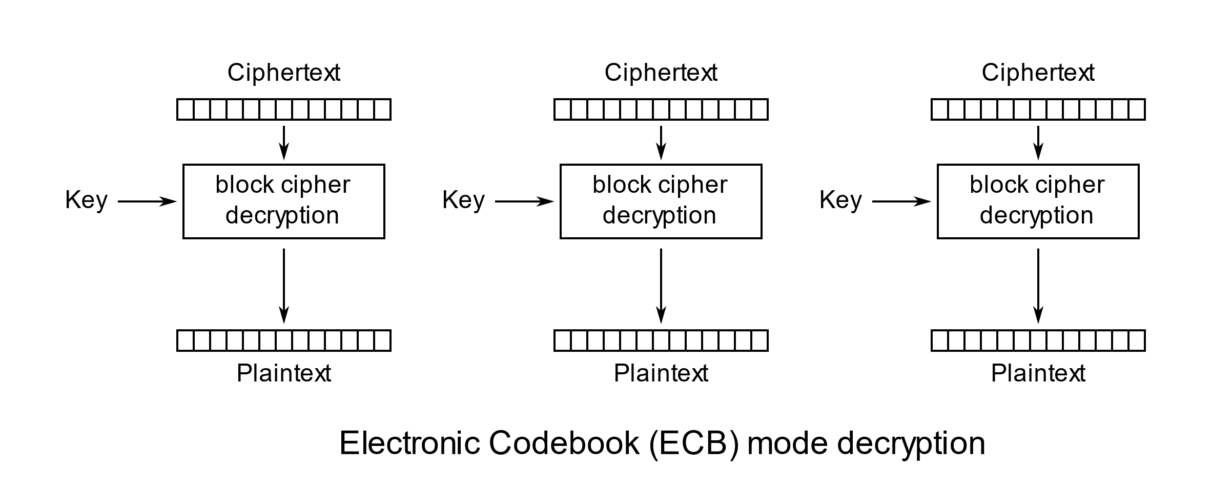
How Does ECB Mode Work?
In this mode, each block is independently encrypted/decrypted.
This means, that if you have the key, you can recover the plaintext of any block whose cipher text you possess.
Notes:
Off Screen
Image source: WhiteTimberwolf (SVG version) [Public domain] Retrieved from: https://upload.wikimedia.org/wikipedia/commons/e/e6/ECB_decryption.svg

Slide 8
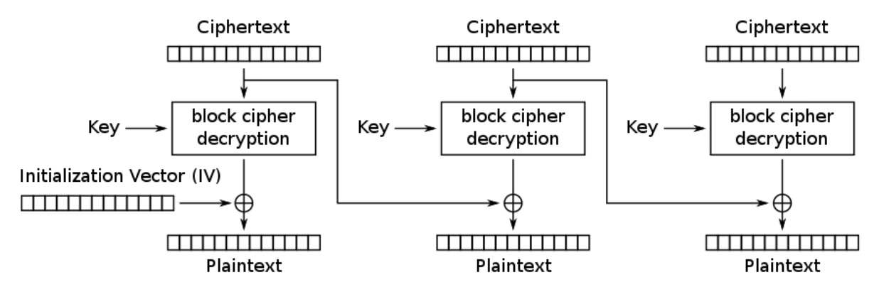
How Does CBC Mode Work?
In CBC mode an initialization vector is xor’d with the plaintext before encrypting.
After the first block, the preceding block’s cipher text is used as the iv for that block.
That means, if you lack a single block, you will not be able to recover either its plain text, nor the plain text of the following block.
Notes:
Off Screen

Slide 9
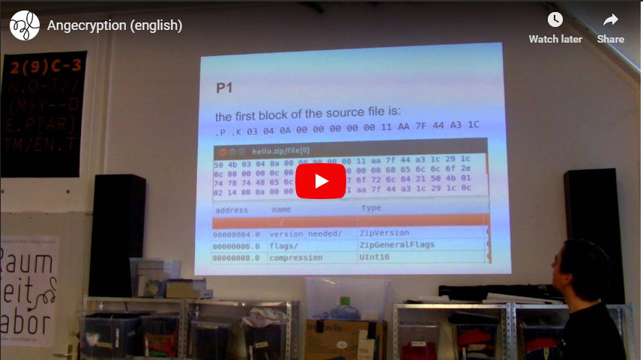

Angecryption
In addition to being the AES key, the encryption key is also the ciphertext associated with the initial key.
The message starts with the decrypted initial key.
The method of providing the key was suggested by Ange Albertini’s Angecryption method.
Important takeaway from Ange’s talk:
You only need to know enough to get the problem solved. Unfortunately, this is the world we live in today. There is too much information. Don’t try to understand everything, just the important things!
Watch: Ange Albertini talk about his crypto-binary magic trick to turn one valid file into another valid file using encryption on YouTube.
Notes:
On Screen

Slide 10
But Wait! I Need the Key and the IV
I never explicitly reveal the 16 byte Key. (This passphrase is also the base64decoded KEY000).
This presentation is important.
The key is here. You can find it in this presentation
To quote the Mandalorian, “This is the way.”
That’s just how we roll here.
As I mentioned before, the IV is
b'\n\xfdH\x92\x17\x05\xce\xe7\x84\xd0d\x06X#P+'
The rest is up to you
Notes:
On Screen

Slide 11
You Have Reached the End Of This Presentation
References:
https://en.wikipedia.org/wiki/Base64
https://zachgrace.com/posts/attacking-ecb/
https://en.wikipedia.org/wiki/Block_cipher_mode_of_operation
https://www.youtube.com/watch?v=wbHkVZfCNuE

