Slide 1
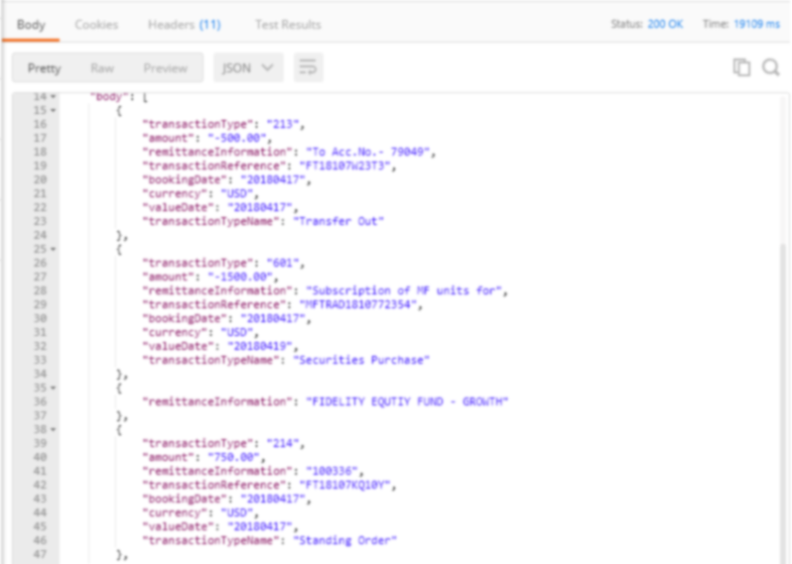
Welcome to the Temenos
Developer Portal
Learn how to build a product integration
Access your MarketPlace Developer Sandbox
Discover public Temenos APIs

