Slide 1

Security, Privacy and Anonymity
When a Little Information
Becomes a Dangerous Thing
Ben Dechrai ben@priva.si

Slide 2

How Do You
Ensure All Three?

Slide 3
Do Nothing
SECURITY
PRIVACY
ANONYMITY

Slide 4
Vote
SECURITY
PRIVACY
ANONYMITY

Slide 5
Carry an RFID chip
SECURITY
PRIVACY
ANONYMITY

Slide 6
Introduce Your Mum by her Full Name
SECURITY
PRIVACY
ANONYMITY

Slide 7
What About Online?

Slide 8
Load Web Page
SECURITY
PRIVACY
ANONYMITY

Slide 9
Load Web Page via Tor
SECURITY
PRIVACY
ANONYMITY

Slide 10
Log In
SECURITY
PRIVACY
ANONYMITY

Slide 11
Log In via Tor
SECURITY
PRIVACY
ANONYMITY

Slide 12
Log In with an
Anonymous Account
SECURITY
PRIVACY
ANONYMITY

Slide 13
Log In with an Anonymous
Account via Tor
SECURITY
PRIVACY
ANONYMITY

Slide 14
Log In to Site 2 via Tor after logging in to Facebook
SECURITY
PRIVACY
ANONYMITY

Slide 15
Log In to Site 2 via Tor when you're always logged in to Google
SECURITY
PRIVACY
ANONYMITY

Slide 16
Check In to 4 Square
SECURITY
PRIVACY
ANONYMITY

Slide 17
Check In to 4 Square over HTTP
SECURITY
PRIVACY
ANONYMITY

Slide 18
Connect to Open WIFI
SECURITY
PRIVACY
ANONYMITY

Slide 19
Log in to Webmail over HTTP on an Open WIFI
SECURITY
PRIVACY
ANONYMITY

Slide 20
Download email over IMAP on an Open WIFI
SECURITY
PRIVACY
ANONYMITY

Slide 21
Download email over IMAPS via WIFI using WPA2 auth
SECURITY
PRIVACY
ANONYMITY

Slide 22
Download email over IMAPS using Tor via WIFI using WPA2 auth
SECURITY
PRIVACY
ANONYMITY

Slide 23
Submitting a Contact Form over HTTP
SECURITY
PRIVACY
ANONYMITY

Slide 24
One Small Change
Can Have a Major Impact

Slide 25
Once Divulged
Data Cannot be Taken Back

Slide 26
Even A Little Information
Becomes a Dangerous Thing

Slide 27
Previous Actions and
Their Consequences

Slide 28
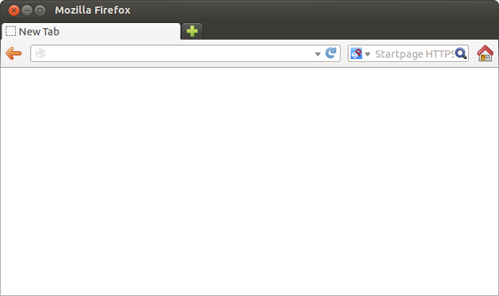
Scenario
https://securesite.com
Secure Site
Blah blah blah blah blah blah blah blah blah blah blah
blah blah blah blah blah blah.
Also, take a look at my friend's site about hedgehogs!
Notes:
G+, Twitter and Facebook images track your visit
Your ISP knows only the IP address of the request
Secure Site knows which city you're in

Slide 29
Scenario
http://hedgehogs.com
Hedgehogs
I've just added Google Analytics to this site. Can't believe it took me so long. The
insights I'm getting are just incredible. Who know so many people in Botswana
were interested in hedgehogs!
Notes:
Google Analytics tracks your visit plus Secure Site as referrer
Your ISP knows the full URL of the request
Hedgehog site knows which city you're in

Slide 30
Scenario
http://somethinginteresting.com
http://hedgehogs.com
Interesting things
Hedgehogs
Interesting? Tweet to your followers about it!
I've just added Google Analytics to this site. Can't believe it took me so long. The
insights I'm getting are just incredible. Who know so many people in Botswana
were interested in hedgehogs!
Notes:
Twitter image tracks your visit
Your ISP knows the full URL of the request
Interesting Things knows which city you're in

Slide 31
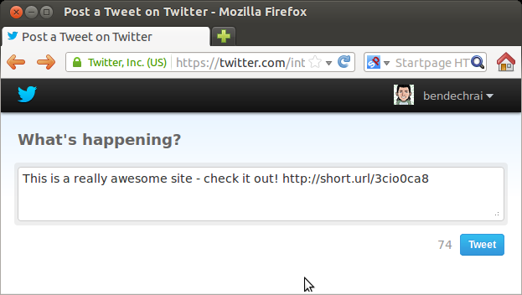
Scenario
http://somethinginteresting.com
http://hedgehogs.com
Interesting things
Hedgehogs
Interesting? Tweet to your followers about it!
I've just added Google Analytics to this site. Can't believe it took me so long. The
insights I'm getting are just incredible. Who know so many people in Botswana
were interested in hedgehogs!
Notes:
Twitter knows which city this was sent from, maybe your GPS coordinates, and that you were on Secute Site not long ago
Your ISP knows you visited twitter

Slide 32
Mitigation Options
Disable 3rd party tracking, by using plugins such as ghostery;
Stop your browser sending referrer URLs (this may break functionality of some sites);
Connect via VPN, secure proxy or Tor to mask your ISP assigned IP address and stop your ISP from logging your requests; and
Disable your browser's option to send geolocation information.

Slide 33
Scenario (continued)
Turn on your computer
Start Tor
Open https://twitter.com in a new tab
  Your ISP knows nothing
Log in to twitter with your anonymous account
  Twitter knows you logged in from your current IP
Send an anonymous tweet

Slide 34
Scenario (continued)
If the police want to find out who sent that tweet:
  ask Twitter for logon history for sender of the tweet;
  ask owners of IP addresses for details of logged on user, and browsing history around time of use of twitter site – find logs of requests to your bank; and
  ask the bank for details of person who logged on at that time.

Slide 35
Mitigation Options
Use a proxy for only anonymous stuff
  Maybe use a separate browser that proxies, while keeping your default browser, not proxied, for non-anonymous activities.
If leaking information is a major concern, consider using a separate machine or virtual machine for each use:
  One machine for net banking, insecure email, etc
  A VM that only connects via Tor for Anonimous communications
  A VM with a VPN connection to another country to avoid ISP logging and country censorship

Slide 36
What Can Developers Do?

Slide 37
Common Practice
Encrypt sensitive information
  One way encryption for passwords
  Reversible encryption for financial details
Don't send sensitive information in the clear
  Emails should never include passwords
Password protection
  Make sure users are authenticated
  Think twice before offering “remember me” or “autologin” features
  Auto-logout

Slide 38
Often Overlooked
Do you need all that information?
  Gender, location and age or date of birth are irrelevant to most applications
What do you log?
  Payments? Transaction IDs? Card numbers?
  Logins? With passwords?
  Decrypted messages?
Irreversible actions require reauthentication
  Changing email address? Ask for password.

Slide 39
Often Ignored
Access logs
  Do you need their IP address? Username?
Backups
  Do logs need to be backed up? If so, can they be further anonymised or aggregated?
  Do they need to be plain text? Can Backups be encrypted?
  Do they need to be easily accessible? Can you have a write only backup location?
Big changes? Tell the user
  Email address changed? Notify both!

Slide 40
Often Ignored
Have three levels of authentication:
  Guest
  Auto-logged in
  Recently authenticated
No Dot Track
  Fairly new, but do you honour it?

Slide 41
Often Ignored
Password resets
  Don't allow email addresses to be usernames
  Make resets based on username lookups
  Don't email usernames - only links to password reset page
  Compromised email accounts won't help log in to your system

Slide 42
Food For Thought
Detect Tor users
  Download list of Tor exit nodes. Perform even less logging for these users, who may be expressing an interest in being anonymous

Slide 43
Thanks!
Questions?
Ben Dechrai ben@priva.si

